Slide 1


SCIANTIX USER MEETING
SCIANTIX python shell for data assimilation
Giovanni Nicodemo
Lione, 16.05.2024

Slide 2
Agenda
Shell structure
Test case 1: Xe diffusion coefficient
Test case 2: MOX Melting temperature
Performance evaluation

Slide 3
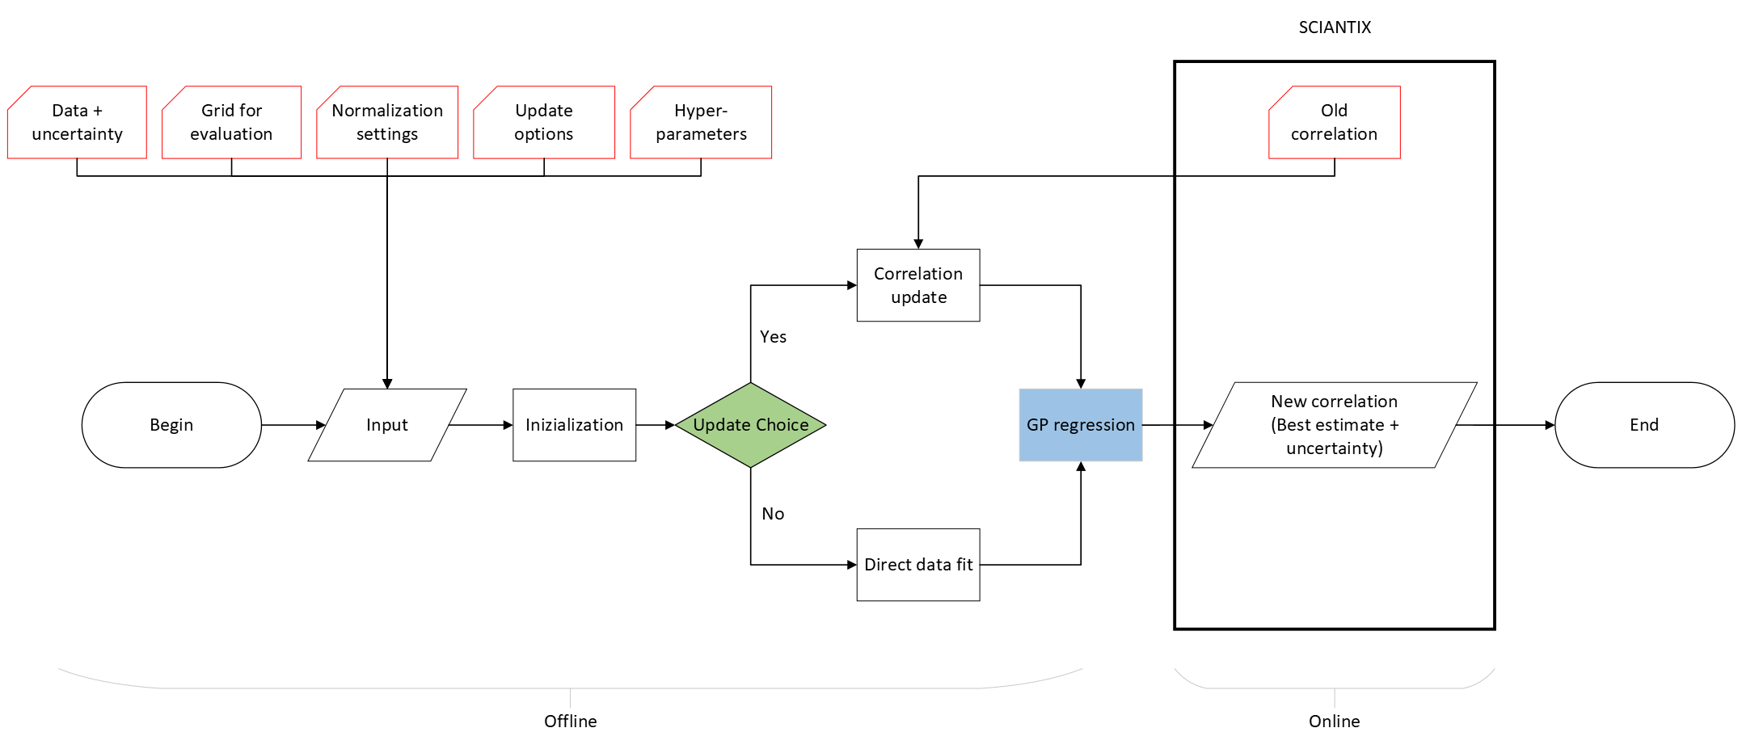
Python shell for data assimilation
Shell to apply machine learning techniques in fuel performance code environment (Pedregos 2011)
Specific tool for data assimilation purposes for nuclear data (Gaussian processes)

Slide 4
Gaussian processes
Definition: a gaussian process is a collection of random variables, any finite number of which have a joint Gaussian distribution (Rasmussen 2006)

Slide 5
Gaussian processes
Definition: a gaussian process is a collection of random variables, any finite number of which have a joint Gaussian distribution (Rasmussen 2006)
Intuitive approach

Slide 6

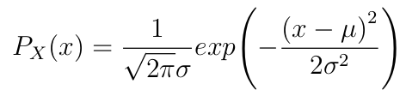
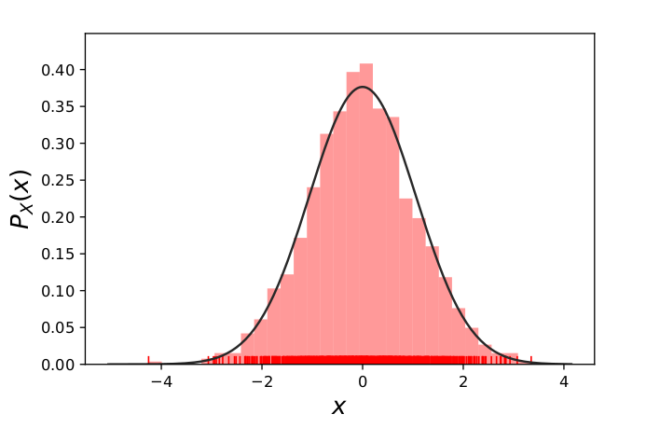
Gaussian processes
Gaussian distribution

Slide 7

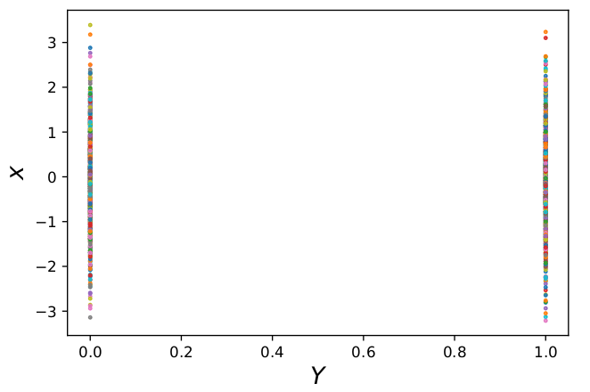
Gaussian processes
Gaussian distribution
Sampling from the distribution

Slide 8

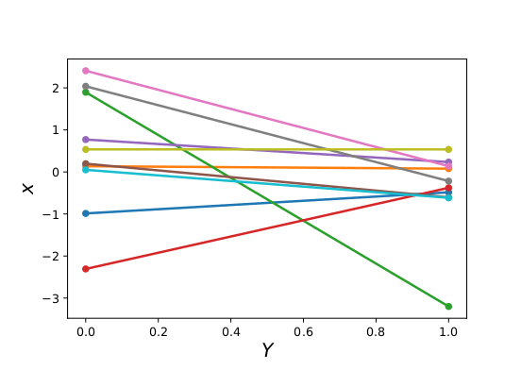
Gaussian processes
Connect sampled points

Slide 9
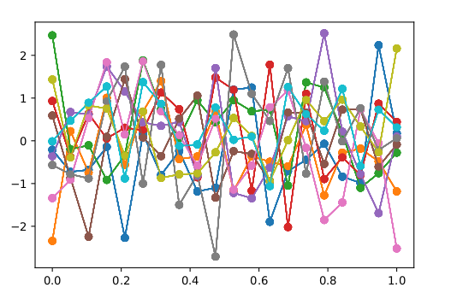
Gaussian processes
Connect sampled points (many times)

Slide 10


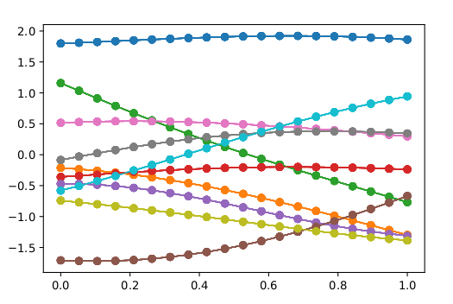
Gaussian processes
Connect sampled points
(many times)
Kernel introduction

Slide 11
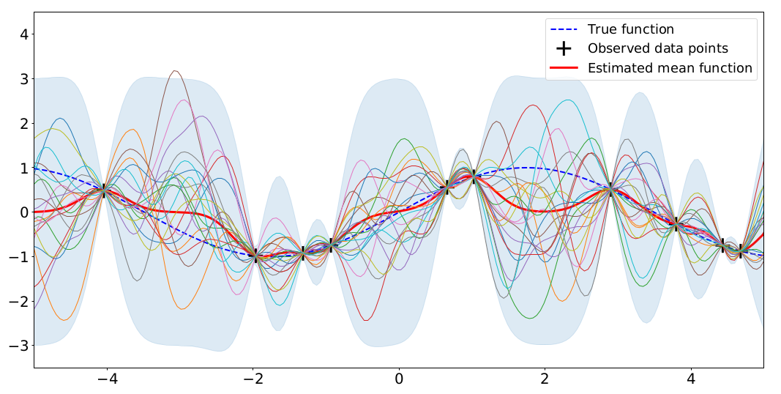
Gaussian processes
Definition: a Gaussian process is a collection of random variables, any finite number of which have a joint Gaussian distribution (Rasmussen 2006)
A Gaussian process is completely specified by its mean function (usually zero) and covariance function (kernel).

Slide 12
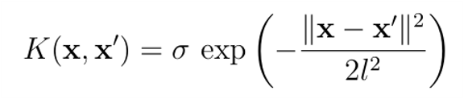
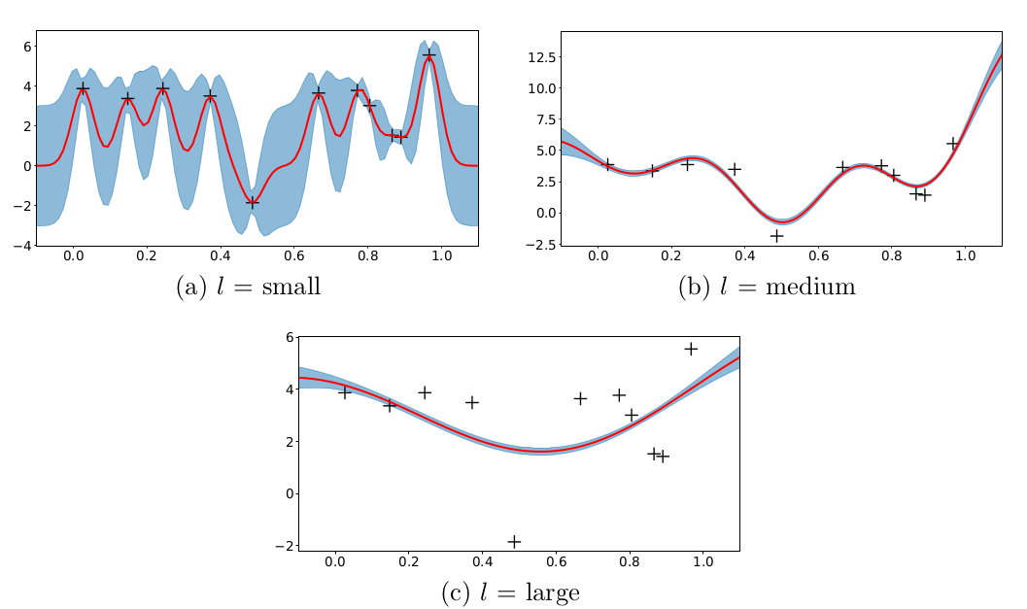
Gaussian processes : hyperparameters
σ_{F}: how much vertically the function can span
l : how quickly the correlation relationship between two points drops as their distance increases.

Slide 13
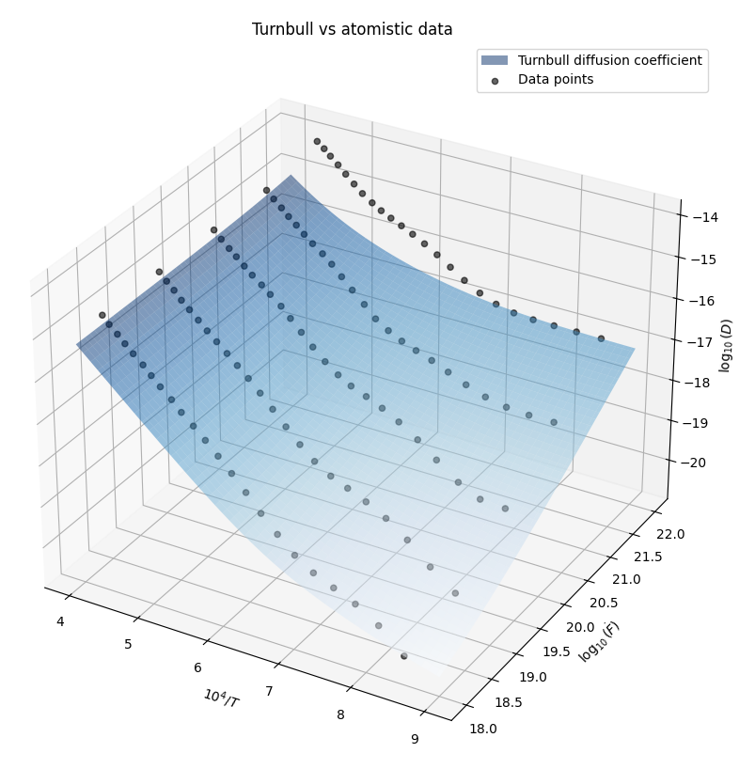
Test case 1: Xe diffusion coefficient
Fit of atomistic data (Matthews et al. 2020)
Turnbull correlation update (Turnbull 1989)

Slide 14
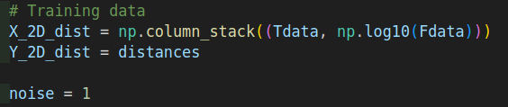



Test case 1: code structure
Data vector declaration
Grid definition
Kernel Setup
Posterior evaluation

Slide 15
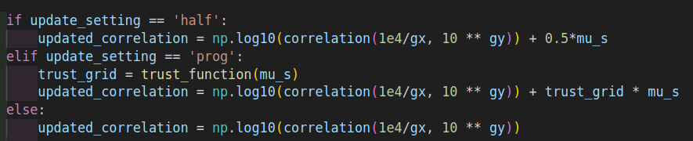
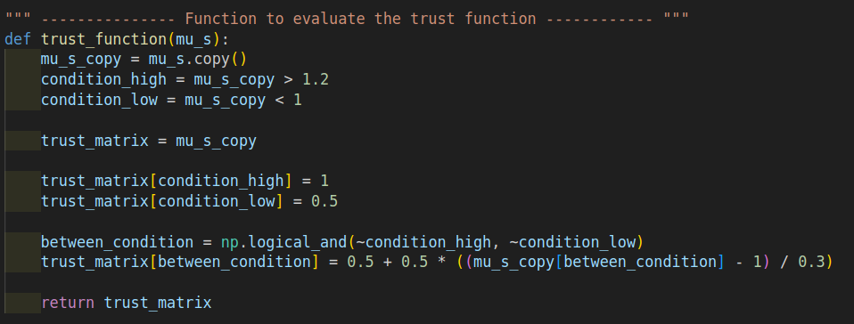
Test case 1: code structure
Update options
Trust grid

Slide 16
Test case 1: Xe diffusion coefficient
Multilinear interpolator in SCIANTIX
Baker regression tests
X₀
X
Y₀
X₀ Y₀
Y

Slide 17
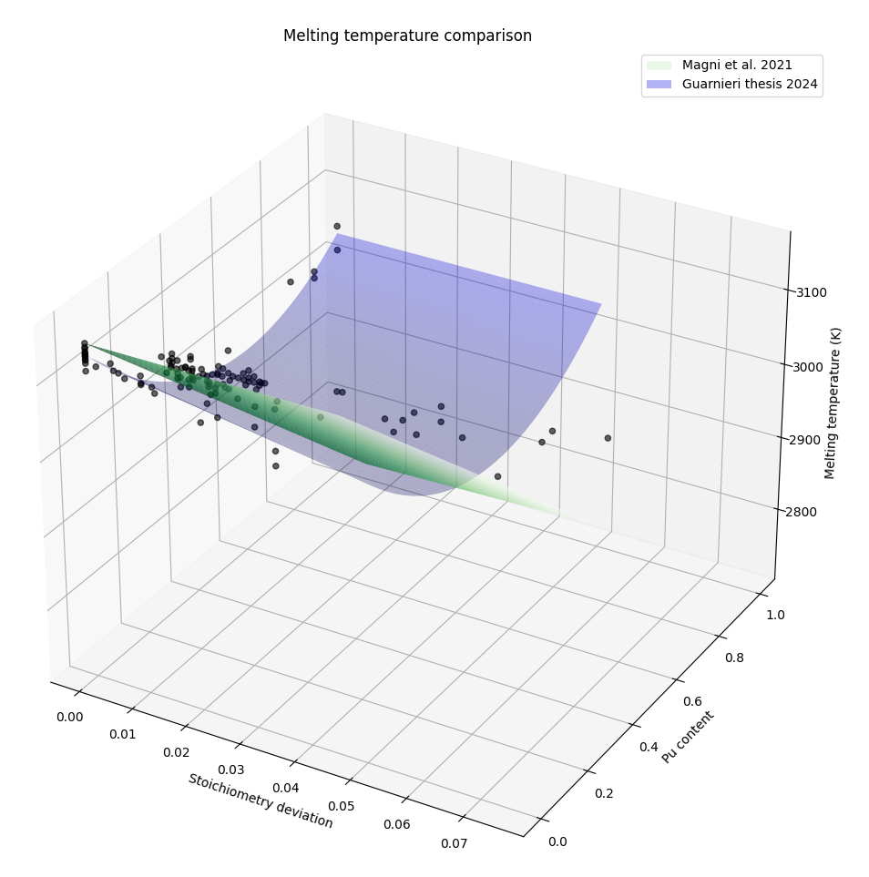
Test case 2: MOX melting temperature
Fit of melting temperature experimental data
Update of the Magni correlation (Magni et al. 2020)

Slide 18
Performance evaluation
Visualization
Cross-validation
Marginal Likelihood
Posterior predictive checks

Slide 19
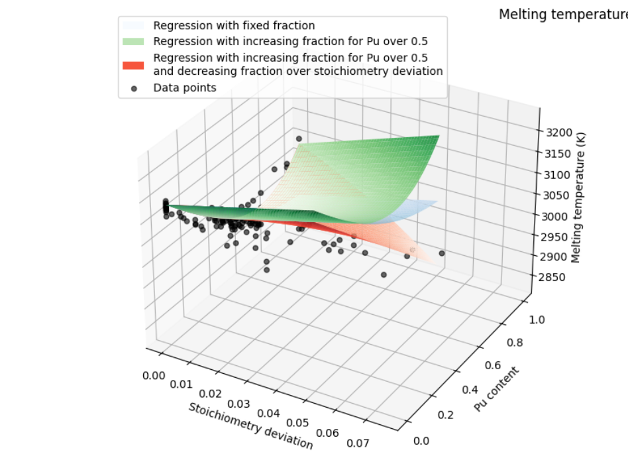
Performance evaluation
Visualization
Cross-validation
Marginal Likelihood
Posterior predictive checks

Slide 20
Performance evaluation
Visualization
Cross-validation
Marginal Likelihood
Posterior predictive checks
Dataset train/test split
Indicators: MSE - R²

Slide 21
Performance evaluation
Visualization
Cross-validation
Marginal Likelihood
Posterior predictive checks

Slide 22
Performance evaluation
Visualization
Cross-validation
Marginal Likelihood
Posterior predictive checks
local evaluation

Slide 23
Performance evaluation
Visualization
Cross-validation
Marginal Likelihood
Posterior predictive checks
Residual Analysis
Sensitivity Analysis

Slide 24
Why a python shell in SCIANTIX?
Agile handling of different machine learning methodologies to support the SCIANTIX development
Capability to add moduli to cope with specific problems (ANN, clustering algorithms... )
Enhance the data driven approach for the code development

Slide 25
In conclusion
SCIANTIX python shell for data assimilation
Shell structure
Test case 1: Xe diffusion coefficient
Test case 2: MOX Melting temperature
Performance evaluation
Code repository: https://github.com/sciantix/sciantix-official/tree/training Contact: giovanni.nicodemo@polimi.it

