Slide 1


Security Login Analytics Investigation
Technical Design Review
Detecting suspicious authentication behavior using behavioral analytics
Prepared by Stasy | 10 158 login events | 2024-01-01 to 2024-03-29

Slide 2

SECURITY LOGIN ANALYTICS
02
The review moves from business risk to operating model
- Business problem
- Assignment understanding
- Analytical strategy
- Decision log
- Data understanding
- Data quality
- Exploratory analysis
- Baseline and features
- Anomaly investigation
- Threat kill chain
- Statistical confidence
- Heuristics versus ML
- Explainability and cost
- SOC workflow
- Dashboard design
- Product perspective
- Product KPI case
- Production architecture
- Limitations
- Recommendations
The throughline is not 'find weird rows'; it is reduce security risk with evidence that a SOC can act on.
Senior Data Analyst Assignment
Notebook visuals only for analytical evidence

Slide 3
SECURITY LOGIN ANALYTICS
03
Login monitoring protects revenue, trust, and compliance
Primary objective
False-positive cost
False-negative cost
Reduce risk
Alert fatigue
Account takeover
Without flooding analysts
SOC capacity is finite
Fraud, privacy, trust loss
Threat
What login logs reveal
Business risk
Credential stuffing
Repeated failures, IP rotation
Compromised accounts
Password spraying
One IP across many users
Broad exposure
Automated bots
Machine-precise timing
Fraud and abuse
Insider or misuse
Off-hours or atypical access
Data loss and compliance
Senior Data Analyst Assignment
Notebook visuals only for analytical evidence

Slide 4
SECURITY LOGIN ANALYTICS
04
The assignment tests judgment, not just pandas syntax
Business thinking
>
Security thinking
>
Analytical thinking
>
Visualization
>
Communication
Decision making
>
Hypothesis generation
>
Prioritization
>
Production mindset
>
Defensible evidence
A senior answer explains why the method is appropriate, where it can be wrong, and how it would become a production control.
Senior Data Analyst Assignment
Notebook visuals only for analytical evidence

Slide 5
SECURITY LOGIN ANALYTICS
05
The analytical sequence is designed to avoid premature detection
Business question
>
Understand dataset
>
Assess quality
>
EDA
>
Baseline
Hypotheses
>
Features
>
Validate
>
Prioritize risk
>
Production design
Why this order matters
- EDA exposes the shape of normal activity before thresholds are chosen.
- Baselines prevent common events from being mislabeled as suspicious.
- Features translate raw rows into behavior that analysts can reason about.
Senior Data Analyst Assignment
Notebook visuals only for analytical evidence

Slide 6
SECURITY LOGIN ANALYTICS
06
The decision log explains why simpler choices won
Decision
Alternatives
Why rejected
Rule-based detection
Isolation Forest
No labels, lower explainability, harder SOC defense
Daily baseline
Weekly baseline
Dataset is too short for stable weekly seasonality
Failure rate
Raw failures
Normalizes activity across users and source volumes
IP velocity
Raw IP count
Makes source spread comparable across users
Behavioral features
Row-level flags
Security behavior emerges across event sequences
The strongest defense is not only what was chosen, but why tempting alternatives were not used first.
Senior Data Analyst Assignment
Notebook visuals only for analytical evidence

Slide 7
SECURITY LOGIN ANALYTICS
07
Baseline-first analysis keeps the investigation explainable
Question
Decision
Reasoning
Why EDA first?
Inspect normal behavior
Anomaly labels are meaningless without context.
Why not ML first?
Start with interpretable rules
No labels or ground truth exist in the assignment.
Why baseline before thresholds?
Estimate natural variance
Thresholds need a denominator and a normal range.
Why behavior over rows?
Engineer user/IP patterns
Attack behavior emerges across events, not one record.
The method is intentionally conservative: explainable evidence first, automation later.
Senior Data Analyst Assignment
Notebook visuals only for analytical evidence

Slide 8
SECURITY LOGIN ANALYTICS
08
The dataset is useful but missing key production signals
Records
Users
Fields
Failure rate
10 158
100
6 raw
6.2%
2024-01-01 to 2024-03-29
Known user identifiers
Time, user, IP, device, network, outcome
634 failed attempts
Available
Missing in production
Why it matters
Timestamp
Geo / ASN
Impossible travel and known bad infrastructure
User and IP
User agent / browser
Spoofing, bot signatures, device novelty
Device and network type
MFA status
Step-up failures and bypass attempts
Success flag
Session context
Post-login abuse and privilege changes
Senior Data Analyst Assignment
Notebook visuals only for analytical evidence

Slide 9
SECURITY LOGIN ANALYTICS
09
Data quality issues are small but operationally important
Issue
Count
Business impact
Action
Missing IP
3
Weakens IP-based detection
Investigate upstream source
Missing outcome
3
Affects failure metrics
Use conservative handling
Duplicates
88
Inflates alerts and velocity
Deduplicate before scoring
Invalid labels
2
Signals schema inconsistency
Normalize values at ingest
Even tiny integrity gaps matter because security alerts can become automated containment decisions.
Senior Data Analyst Assignment
Notebook visuals only for analytical evidence

Slide 10
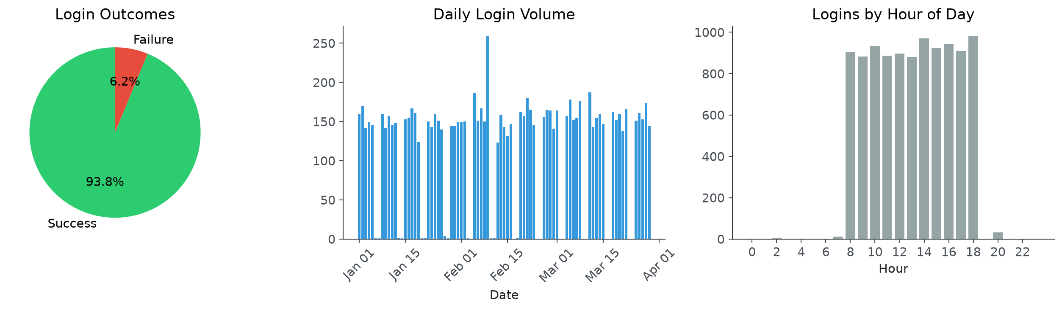
SECURITY LOGIN ANALYTICS
10
EDA shows stable volume with visible failure spikes
What would concern me
- Overall outcomes are mostly successful, but failure spikes are not evenly distributed.
- Daily traffic is stable enough to make Feb 9 stand out.
- Hourly activity gives a normal-use reference for off-hours investigation.
The EDA job is to define where normal behavior ends before calling something suspicious.
Senior Data Analyst Assignment
Notebook visuals only for analytical evidence

Slide 11
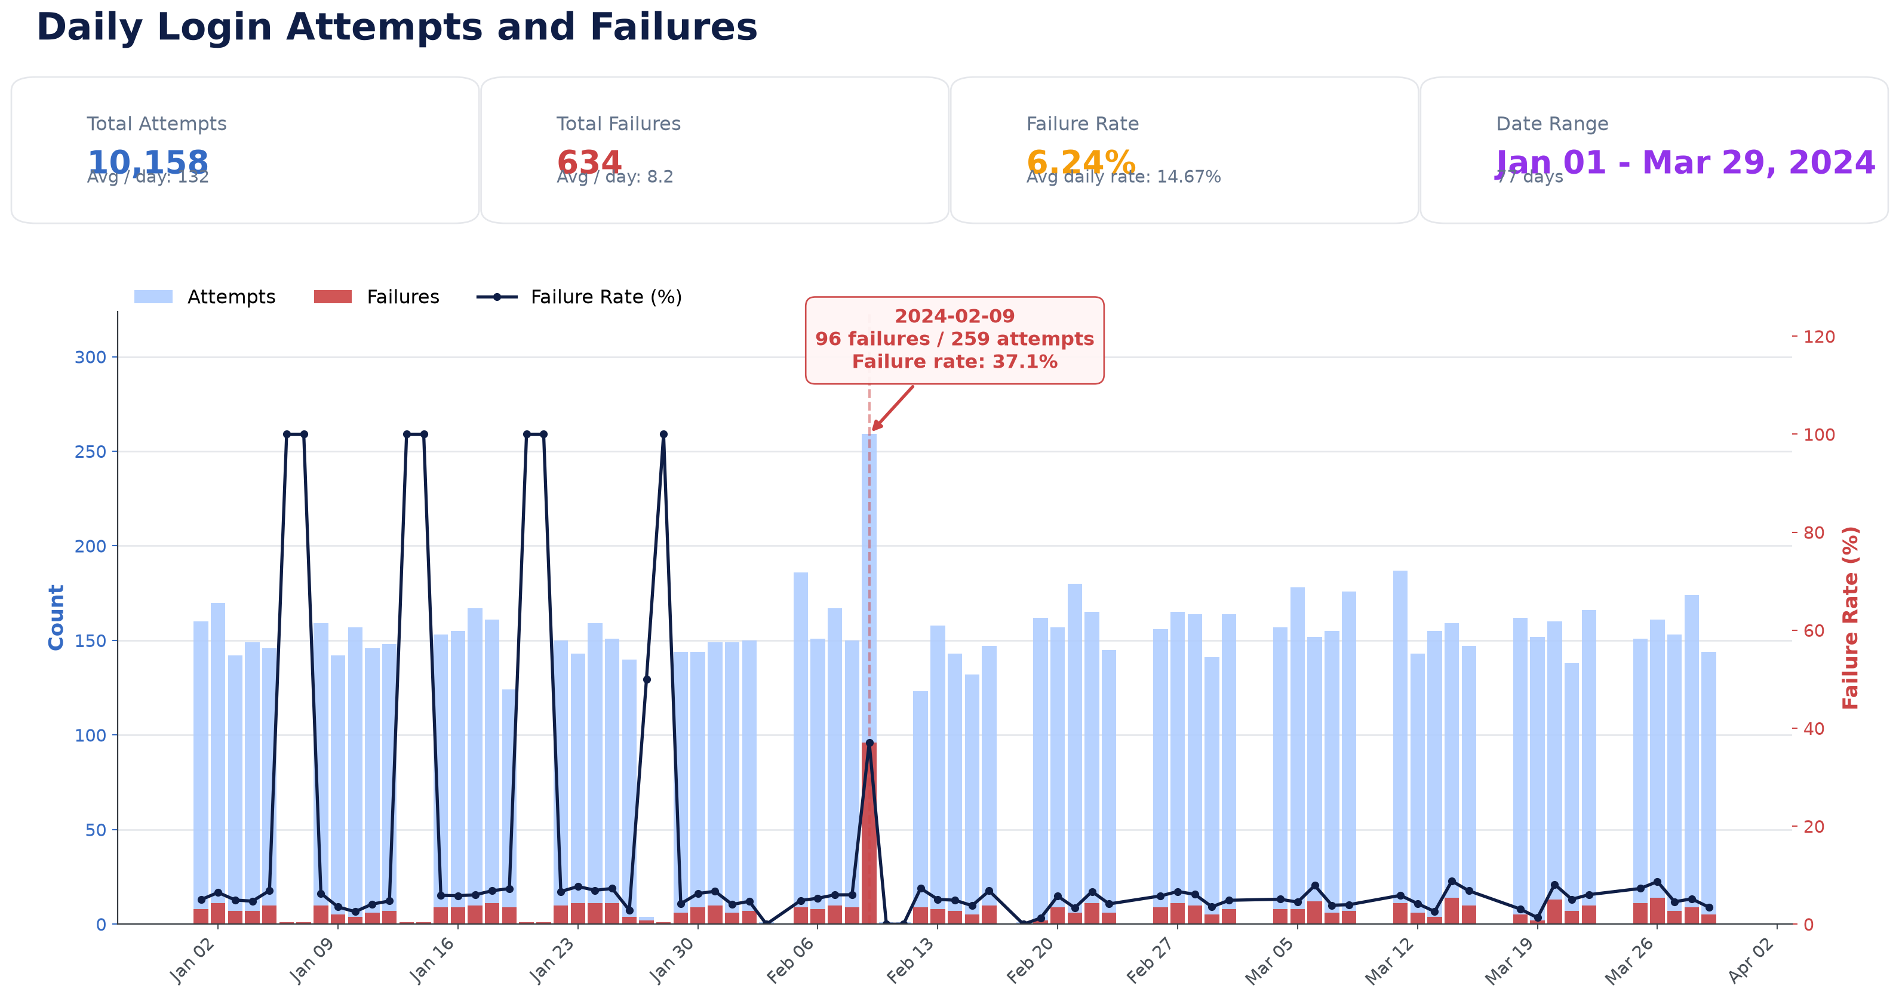
SECURITY LOGIN ANALYTICS
11
Feb 9 is the clearest dataset-level authentication anomaly
Feb 9 attempts
259
Normal days are much lower
Feb 9 failures
96
Concentrated failure spike
Failure rate
37.1%
Versus baseline near single digits
The spike creates the need to move from aggregate trend to user/IP-level investigation.
Senior Data Analyst Assignment
Notebook visuals only for analytical evidence

Slide 12
SECURITY LOGIN ANALYTICS
12
Raw login rows become useful only after behavior is engineered
Feature
Definition
Analyst question
Failure rate
Failures / attempts
Is the account being guessed?
IP velocity
Unique IPs / attempts
Is traffic rotating across infrastructure?
Unique IP count
Distinct sources per user
Is access distributed or shared?
Attempt velocity
Attempts per time window
Is activity humanly plausible?
Off-hours flag
Login outside normal window
Is timing unusual for this user?
Composite risk
Weighted rule score
Which cases should SOC review first?
Feature engineering is the bridge between a notebook and an explainable risk signal.
Senior Data Analyst Assignment
Notebook visuals only for analytical evidence

Slide 13
SECURITY LOGIN ANALYTICS
13
Failure rate separates user mistakes from attack pressure
Definition: failed logins divided by total attempts for the same entity.
Business meaning
Formula
Production version
Password guessing pressure
failures / attempts
Track by user, IP, subnet, device, and rolling time window.
Why it matters
Notebook feature logic
Operational hardening
High failure rate is evidence, not proof; lockouts, password resets, and outages can mimic it.
Senior Data Analyst Assignment
Notebook visuals only for analytical evidence

Slide 14
SECURITY LOGIN ANALYTICS
14
IP velocity reveals distributed access patterns
Definition: unique IP addresses divided by total attempts.
Business meaning
Formula
Production version
Infrastructure rotation
unique_ips / attempts
Compare against each user's historical baseline and ASN/geography.
Why it matters
Notebook feature logic
Operational hardening
This dataset has high IP spread broadly, so the threshold needs calibration by population and user segment.
Senior Data Analyst Assignment
Notebook visuals only for analytical evidence

Slide 15
SECURITY LOGIN ANALYTICS
15
Unique IP count identifies accounts with unusually wide source spread
Definition: count of distinct source IPs by user.
Business meaning
Formula
Production version
Account sharing or botnet activity
nunique(ip)
Normalize by active days, device consistency, ASN, and geography.
Why it matters
Notebook feature logic
Operational hardening
Travel and VPN usage can inflate the count without being malicious.
Senior Data Analyst Assignment
Notebook visuals only for analytical evidence

Slide 16
SECURITY LOGIN ANALYTICS
16
Attempt velocity catches bursts no human can generate
Definition: attempts per second, minute, or short time window.
Business meaning
Formula
Production version
Automation and brute force
count in time bucket
Use per-user, per-IP, and per-subnet rate limits with idempotent event IDs.
Why it matters
Notebook feature logic
Operational hardening
Clock precision and duplicate ingestion must be validated before containment.
Senior Data Analyst Assignment
Notebook visuals only for analytical evidence

Slide 17
SECURITY LOGIN ANALYTICS
17
Off-hours access is a weak signal until combined with novelty
Definition: login outside expected working window.
Business meaning
Formula
Production version
Timezone or compromise clue
hour < 6 or outside profile
Learn per-user temporal profiles and combine with new IP/device/MFA signals.
Why it matters
Notebook feature logic
Operational hardening
Remote teams, on-call work, and travel all create legitimate exceptions.
Senior Data Analyst Assignment
Notebook visuals only for analytical evidence

Slide 18
SECURITY LOGIN ANALYTICS
18
A daily baseline turns spikes into measurable deviations
Definition: normal daily attempts, failures, and failure rate.
Business meaning
Formula
Production version
System-level incident detection
daily metric vs baseline
Use rolling windows, seasonality, and deployment calendars.
Why it matters
Notebook feature logic
Operational hardening
A static baseline breaks when seasonality, growth, or campaigns change behavior.
Senior Data Analyst Assignment
Notebook visuals only for analytical evidence

Slide 19
SECURITY LOGIN ANALYTICS
19
Composite risk should prioritize review, not replace judgment
Definition: interpretable weighted combination of behavioral signals.
Business meaning
Formula
Production version
SOC queue ranking
rule score
Calibrate with analyst labels, alert outcomes, and false-positive monitoring.
Why it matters
Notebook feature logic
Operational hardening
Weights can encode bias and stale assumptions if feedback is not captured.
Senior Data Analyst Assignment
Notebook visuals only for analytical evidence

Slide 20
SECURITY LOGIN ANALYTICS
20
The anomalies map to a threat kill chain
Recon
>
Password spray
>
Credential stuffing
>
Successful login
>
Persistence
>
Privilege escalation
>
Data exfiltration
Stage
Observed anomaly
Why it matters
Password spray
20 users from one IP at one second
Single source testing many accounts
Credential stuffing
user_097 burst and user_003 probe
Automated guessing against known accounts
Successful login
13 successes in shared-IP event
Potential account compromise, not just attempts
Persistence / misuse
Off-hours access with high IP spread
Possible post-compromise access pattern
Mapping anomalies to attack stages shows what to contain first and what telemetry is missing next.
Senior Data Analyst Assignment
Notebook visuals only for analytical evidence

Slide 21
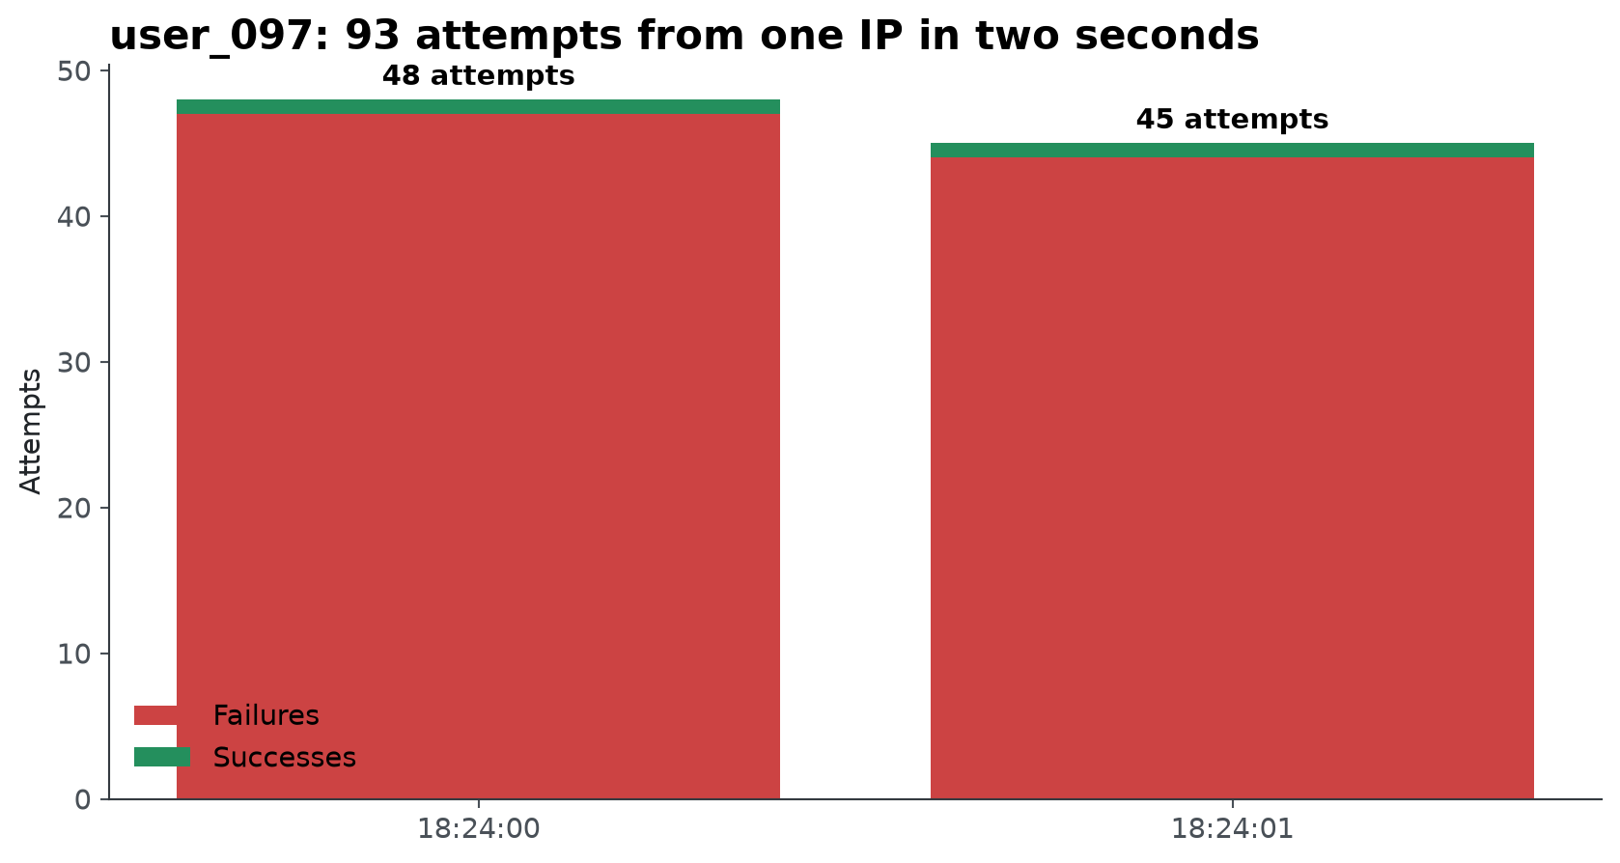
SECURITY LOGIN ANALYTICS
21
Anomaly 1: user_097 shows an automated brute-force burst
CONFIDENCE 95%
CRITICAL
Evidence
- 48 attempts at 2024-02-09 18:24:00 from 103.56.23.138.
- 97 failures across 194 logins for a 50.0% failure rate.
- The timing pattern is not physically plausible for a human user.
Alternative explanations
- Duplicated logs
- Replay artifact
Remaining uncertainty
- No event ID for dedupe
- No ASN or infrastructure metadata
Immediate response: force reset for user_097, block or rate-limit the source IP, and inspect nearby successful sessions.
Senior Data Analyst Assignment
Notebook visuals only for analytical evidence

Slide 22
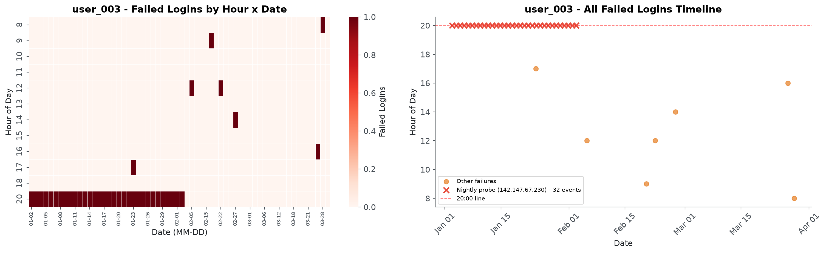
SECURITY LOGIN ANALYTICS
22
Anomaly 2: user_003 was probed on a machine schedule
CONFIDENCE 90%
CRITICAL
Evidence
- 33 attempts from 142.147.67.230 at exactly 20:00.
- 32 failures followed by 1 success.
- 93 unique IPs make account-level exposure unusually broad.
Alternative explanations
- Scheduled service account
- Synthetic test artifact
Remaining uncertainty
- No account owner context
- No geo, ASN, or user-agent data
Immediate response: block 142.147.67.230, rotate credentials, and check whether the final success changed account state.
Senior Data Analyst Assignment
Notebook visuals only for analytical evidence

Slide 23
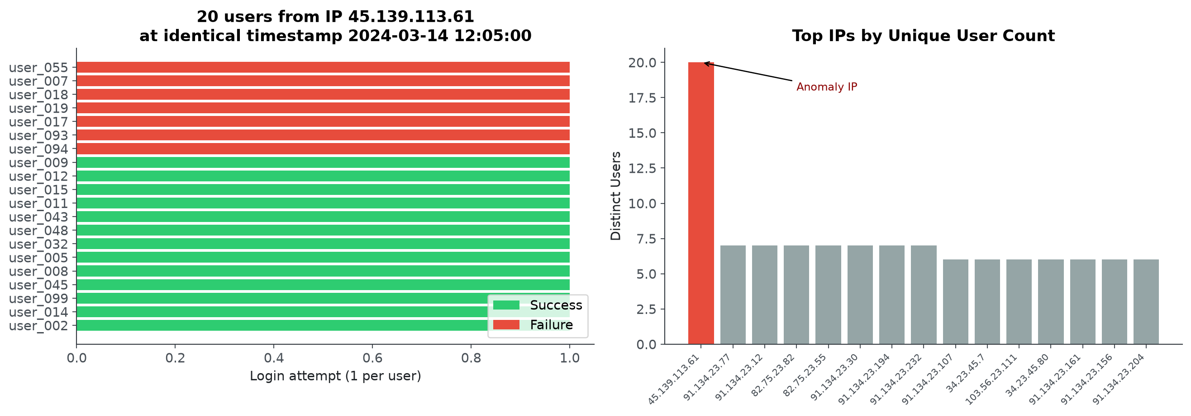
SECURITY LOGIN ANALYTICS
23
Anomaly 3: one IP touched 20 users at the exact same second
CONFIDENCE 92%
CRITICAL
Evidence
- 20 users from 45.139.113.61 at 2024-03-14 12:05:00.
- 7 failures and 13 successes in the same timestamp group.
- The pattern fits spray, replay, proxy, or controller behavior.
Alternative explanations
- Corporate NAT or VPN exit
- Load-test replay
Remaining uncertainty
- No ASN reputation
- No session IDs after login
Immediate response: block the IP, enumerate affected users, and review all successful sessions from that source.
Senior Data Analyst Assignment
Notebook visuals only for analytical evidence

Slide 24
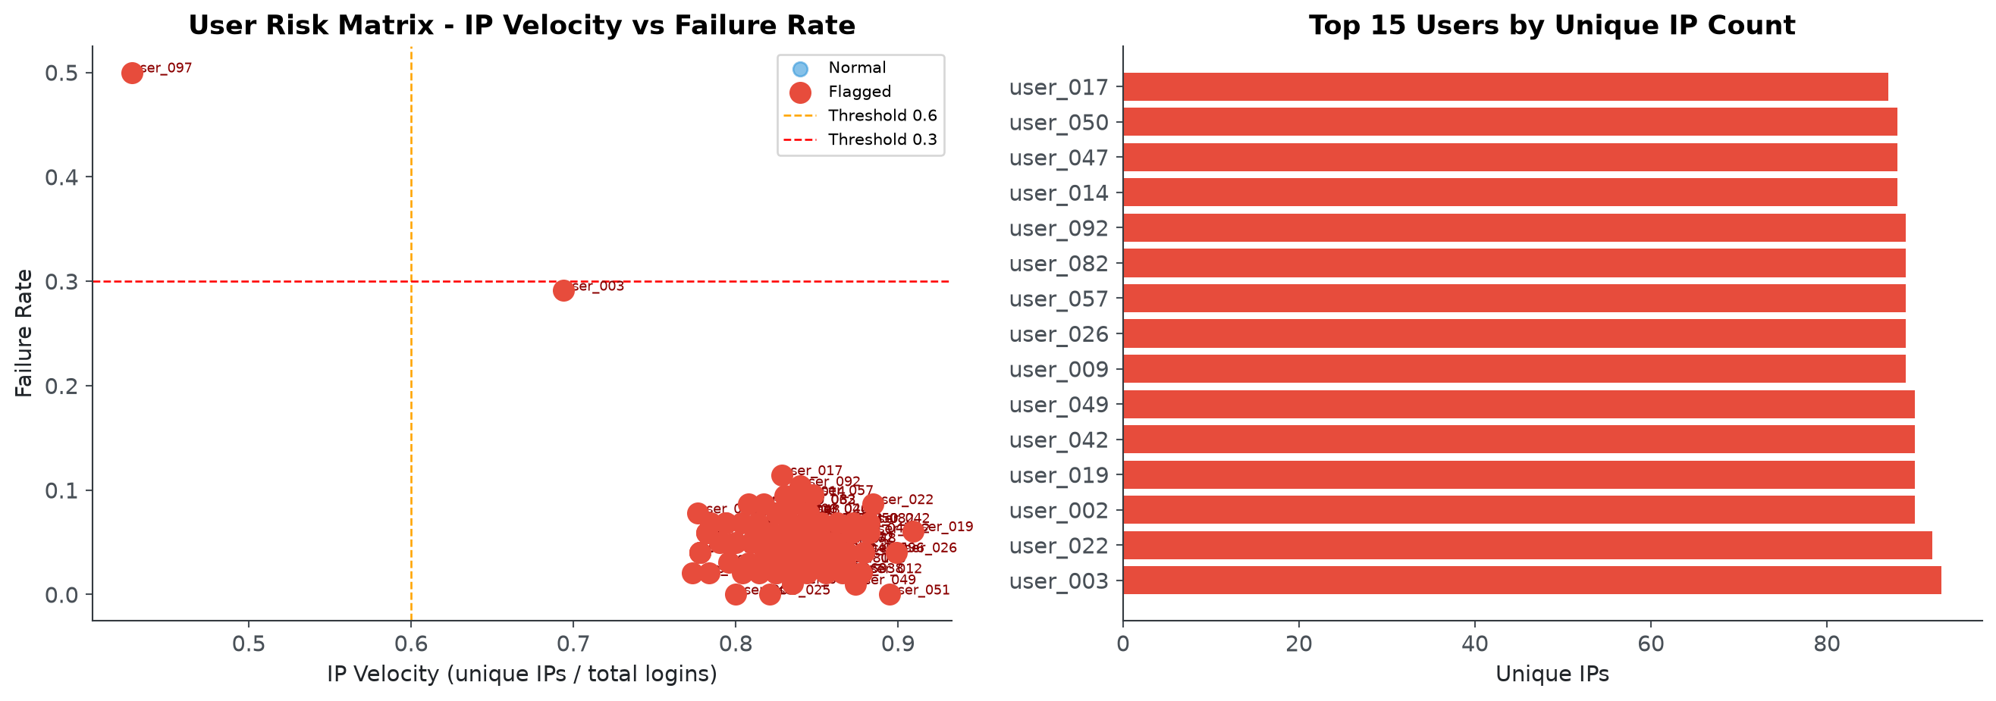
SECURITY LOGIN ANALYTICS
24
Anomaly 4: IP velocity is useful but the threshold needs calibration
CONFIDENCE 70%
HIGH
Evidence
- The notebook rule flags the population broadly, which is a signal that the threshold is too naive for this dataset.
- user_003 still stands out with 93 unique IPs across 134 sessions.
- The right production version compares users to their own historical baselines.
Alternative explanations
- VPN-heavy user population
- Synthetic IP distribution
Remaining uncertainty
- Threshold not calibrated
- No geo, ASN, or historical profile
Action: keep IP velocity as a feature, but calibrate it with geography, ASN, device stability, and analyst feedback.
Senior Data Analyst Assignment
Notebook visuals only for analytical evidence

Slide 25
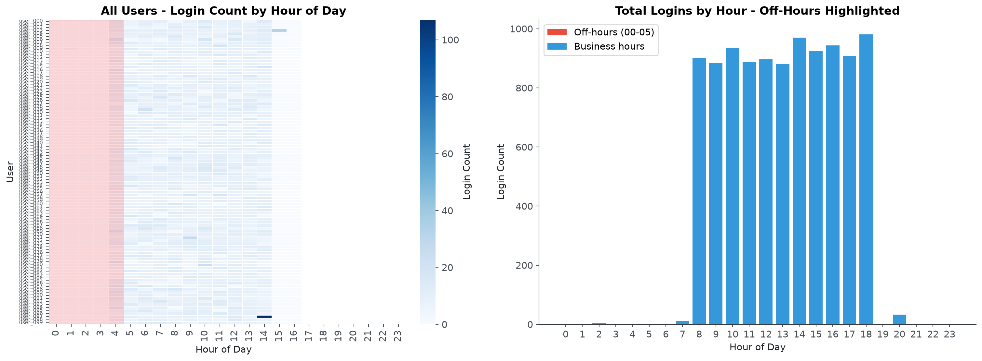
SECURITY LOGIN ANALYTICS
25
Anomaly 5: off-hours access becomes material when paired with other risk
CONFIDENCE 65%
MEDIUM
Evidence
- 5 total midnight-to-05:00 logins appear in the dataset.
- user_009 contributes 4 of them.
- user_009 also shows 89 unique IPs, making timing more concerning.
Alternative explanations
- Legitimate timezone
- On-call or travel access
Remaining uncertainty
- No user work schedule
- No timezone or geo data
Action: treat off-hours as a multiplier, not a standalone block condition; require novelty and user profile context.
Senior Data Analyst Assignment
Notebook visuals only for analytical evidence

Slide 26
SECURITY LOGIN ANALYTICS
26
The investigation should rank cases by evidence and actionability
Anomaly
Confidence
Entity
Reason
Brute-force burst
95%
user_097
48 attempts at one second; 50.0% failure rate
Nightly probe
90%
user_003
33 exact 20:00 attempts from one IP
Shared IP spray
92%
45.139.113.61
20 users at same timestamp; 7 failures
IP velocity
70%
100 users
Threshold flags broad behavior; needs calibration
Off-hours access
65%
user_009
4 midnight-to-05:00 logins plus high IP spread
The SOC queue should start with automated bursts and mass shared-IP events because they are high-confidence and easy to contain.
Senior Data Analyst Assignment
Notebook visuals only for analytical evidence

Slide 27
SECURITY LOGIN ANALYTICS
27
These findings are evidence, not courtroom proof
Risk to manage
How it appears here
Mitigation
False positives
VPNs, travel, failed password memory
Use combinations of signals and analyst review
False negatives
Low-and-slow attacks below thresholds
Monitor sequences and rolling baselines
Sampling bias
Only three months and no labels
Backtest on longer historical periods
Threshold bias
IP velocity flags too broadly
Calibrate per user segment and feedback
Missing context
No geo, ASN, MFA, user agent
Enrich events before automation
The correct claim is 'high-confidence suspicious behavior requiring investigation,' not confirmed malicious activity.
Senior Data Analyst Assignment
Notebook visuals only for analytical evidence

Slide 28
SECURITY LOGIN ANALYTICS
28
Heuristics are the right first model for this unlabeled dataset
Approach
Interpretability
Data need
Maintenance
Fit here
Heuristics
High
Low
Low
Best starting point
Isolation Forest
Medium
Medium
Medium
Possible after baselines
LOF / DBSCAN
Medium
Medium
Medium
Useful for clusters
Random Forest
Medium
High labels
Medium
Needs outcomes
Sequence models
Low
High
High
Future stage
Deep learning
Low
Very high
High
Not justified now
Explainability matters because security operations must defend every alert and containment action.
Senior Data Analyst Assignment
Notebook visuals only for analytical evidence

Slide 29
SECURITY LOGIN ANALYTICS
29
Explainability is what makes detection operational
Why it matters
Security impact
How heuristics help
Analyst trust
SOC teams need to understand why a case fired
Rules expose the exact signal
SOC acceptance
Opaque scores are harder to act on quickly
Evidence is readable in the queue
Legal defensibility
Containment decisions may need audit trails
Thresholds and data inputs are explicit
Threshold tuning
False positives must be reduced without hiding risk
Each rule can be adjusted separately
Incident learning
Close reasons should improve the detector
Feedback maps back to individual features
Heuristics are not less sophisticated here; they are the explainable control layer that earns permission to automate.
Senior Data Analyst Assignment
Notebook visuals only for analytical evidence

Slide 30
SECURITY LOGIN ANALYTICS
30
Operational cost favors heuristics before ML
Dimension
Heuristics
Machine learning
Latency
Milliseconds; simple rule evaluation
Higher and variable with feature joins and inference
Infrastructure
Minimal; stream rules and dashboards
Feature pipelines, model serving, registry, monitoring
Maintenance
Low to medium; tune thresholds
Retraining, drift detection, version governance
Explainability
High; direct evidence
Depends on model and explanation layer
Cost risk
Alert fatigue if rules are broad
Inference cost plus silent drift if not monitored
The right sequence is low-cost, interpretable protection first, then ML once labels and feedback justify the operating burden.
Senior Data Analyst Assignment
Notebook visuals only for analytical evidence

Slide 31
SECURITY LOGIN ANALYTICS
31
The analysis fits inside a SOC investigation loop
Alert
>
Investigation
>
Containment
>
Threat hunting
>
Root cause
>
Recovery
>
Lessons learned
Notebook output
SOC action
Operational artifact
Ranked anomalies
Open cases by severity
Alert queue
Evidence charts
Validate behavior
Case timeline
Recommended response
Contain affected accounts
SOAR playbook
Limitations
Avoid over-blocking
Analyst notes
Senior Data Analyst Assignment
Notebook visuals only for analytical evidence

Slide 32
SECURITY LOGIN ANALYTICS
32
Dashboard charts should answer decisions, not decorate the page
Widget
Question answered
Decision enabled
Failure rate
Is authentication degrading?
Investigate outage or attack
Unique IPs
Is access distributed?
Escalate stuffing investigation
New device/IP
Is account behavior novel?
Trigger step-up MFA
Hourly heatmap
Is timing abnormal?
Contextualize alert confidence
Top entities
Who needs review first?
Prioritize SOC queue
Every dashboard element should point to a user, threshold, refresh cadence, drilldown, and business action.
Senior Data Analyst Assignment
Notebook visuals only for analytical evidence

Slide 33
SECURITY LOGIN ANALYTICS
33
The assignment has two equal analytical products
Security analytics
Product analytics
Reduce attacks
>
Reduce false positives
>
Protect users
Increase acquisition
>
Maintain quality
>
Improve activation
>
Increase revenue
- Primary user: SOC analyst
- Decision: contain, investigate, or monitor
- Success metric: high-confidence risk reduction
- Primary user: product and growth leader
- Decision: scale, investigate, or fix tracking
- Success metric: durable high-quality growth
Both halves ask the same senior question: what decision changes when the metric moves?
Senior Data Analyst Assignment
Notebook visuals only for analytical evidence

Slide 34
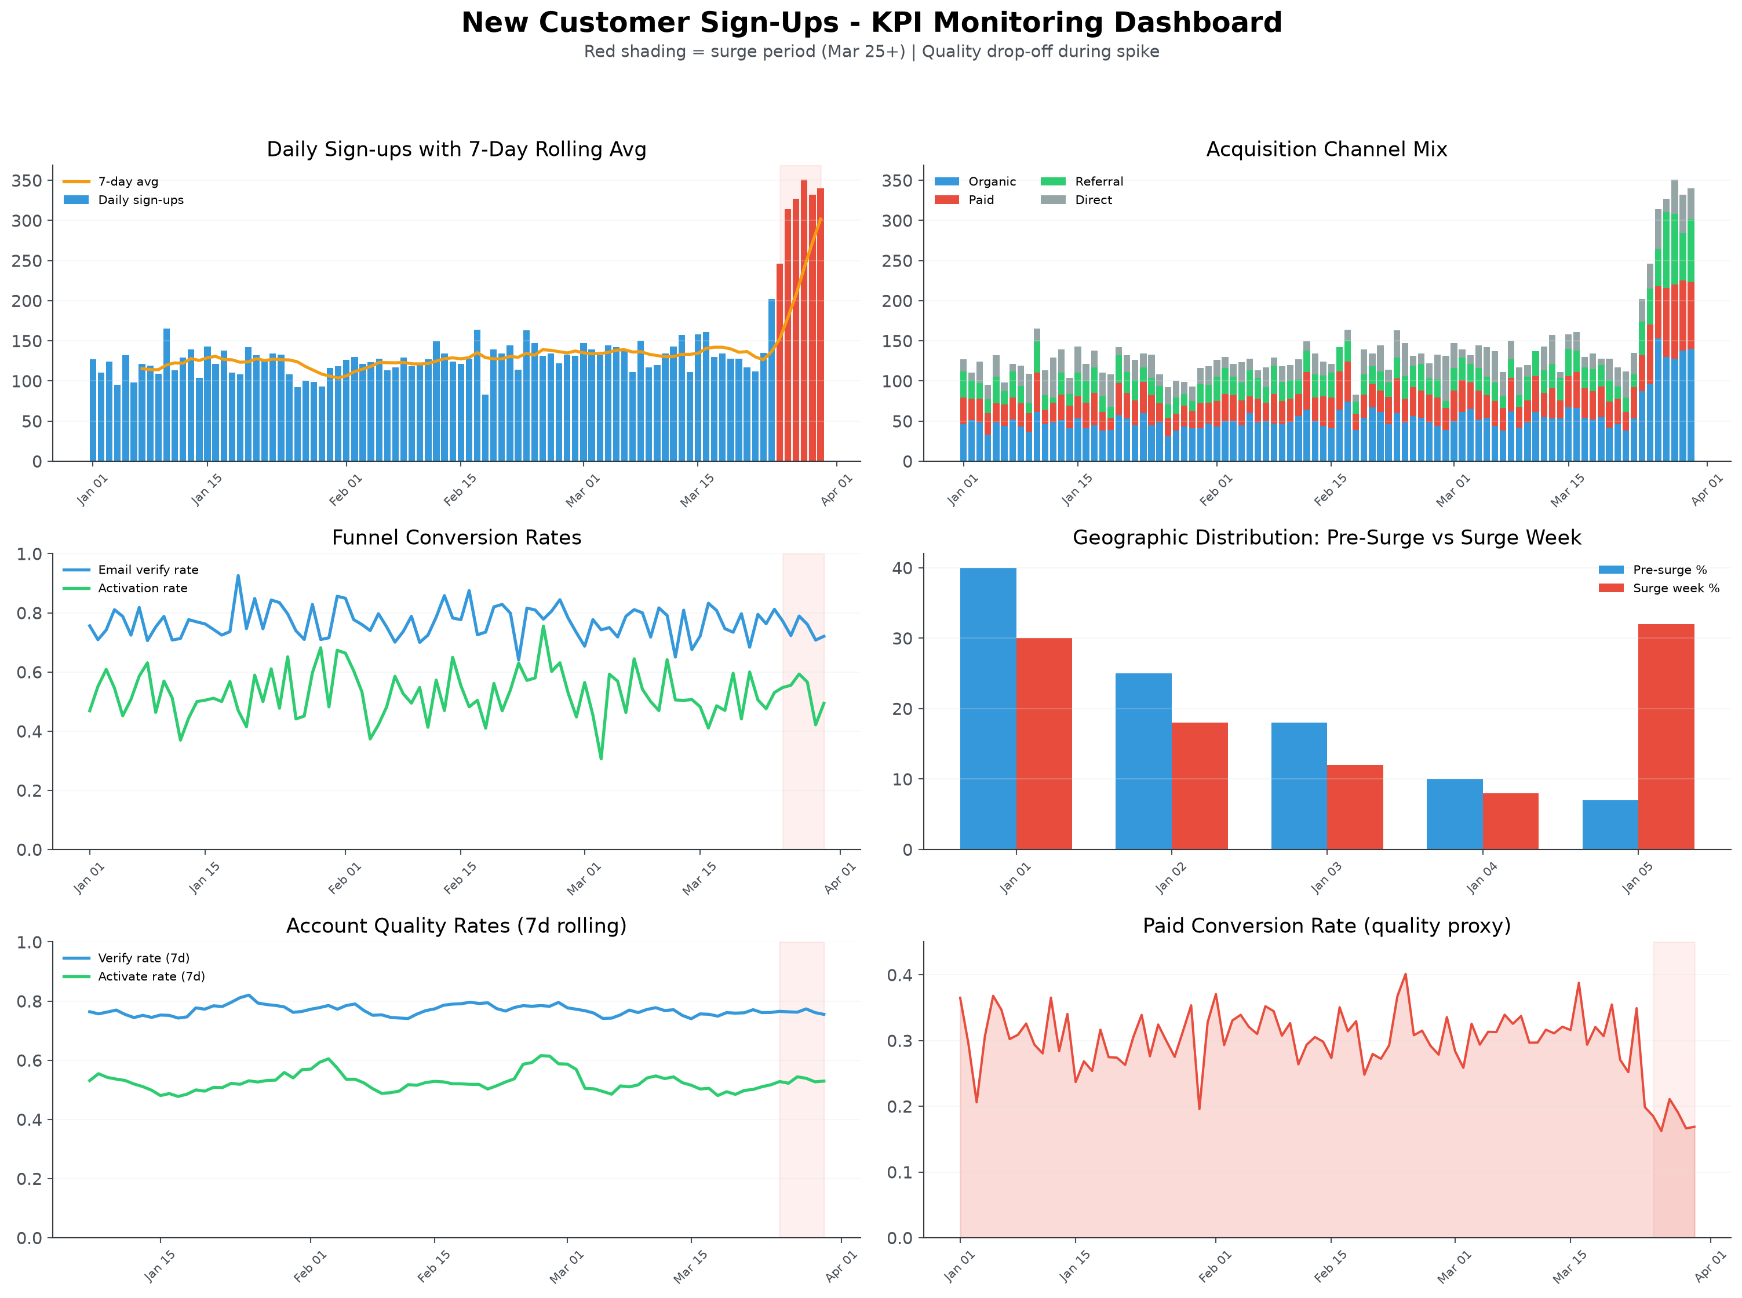
SECURITY LOGIN ANALYTICS
34
The KPI dashboard separates growth from account quality
Walkthrough logic
- Sign-up spikes are not automatically good news.
- Channel, geography, verification, activation, and paid conversion reveal quality.
- Surge-period shading helps separate timing from metric movement.
The same investigation mindset applies to product analytics: explain the movement before celebrating it.
Senior Data Analyst Assignment
Notebook visuals only for analytical evidence

Slide 35
SECURITY LOGIN ANALYTICS
35
A sign-up spike needs a hypothesis tree before a dashboard verdict
Marketing
>
Product launch
>
Bots
>
Referral
>
Seasonality
Pricing
>
Geo shift
>
Tracking bug
>
PR / news
Hypothesis
How to eliminate it
Metric to inspect
Marketing campaign
Match spend and campaign launch dates
Channel mix, CAC
Bot or spam
Check verification and activation quality
Verify rate, device/IP reuse
Tracking bug
Reconcile raw events with warehouse
Duplicate rate, schema change
Geo or referral shift
Segment by geography and source
Country, referrer, conversion
Senior Data Analyst Assignment
Notebook visuals only for analytical evidence

Slide 36
SECURITY LOGIN ANALYTICS
36
The KPI framework must measure both volume and quality
Metric
Purpose
Quality lens
Signups
Top-of-funnel volume
Unique accounts, dedupe
Verification
Identity and intent
Email/SMS completion rate
Activation
Product value reached
First meaningful action
Retention
Sustained usefulness
D1/D7/D30 cohorts
CAC / channel
Efficiency
Paid versus organic quality
Referral / geo
Source of movement
Fraud, localization, PR
Volume metrics need quality companions, or growth can mask abuse.
Senior Data Analyst Assignment
Notebook visuals only for analytical evidence

Slide 37
SECURITY LOGIN ANALYTICS
37
Production architecture turns notebook logic into governed detection
Applications
>
Kafka
>
Validation
>
Streaming ETL
>
Feature Store
>
Risk Scoring
Rules Engine
>
SIEM
>
SOAR
>
SOC
>
Feedback
>
Model Retraining
Design principles
- Validation prevents bad labels, missing IPs, and duplicate events from becoming false alerts.
- Feature Store keeps notebook, batch, and streaming definitions consistent.
- Rules Engine makes the first detection layer explainable before ML is added.
- SOC feedback feeds threshold tuning today and model retraining later.
Senior Data Analyst Assignment
Notebook visuals only for analytical evidence

Slide 38
SECURITY LOGIN ANALYTICS
38
Production monitoring must cover the detector, not just the data
Monitor
Failure mode
Action
Data quality
Missing IP, bad labels, duplicates
Block deployment or quarantine events
Latency
Alerts arrive too late
Scale streaming path
Schema drift
Fields change silently
Contract tests and alerts
Concept drift
Normal behavior changes
Recalibrate thresholds
Alert fatigue
Too many low-value alerts
Track precision and close reasons
Pipeline failures
Gaps in coverage
SLOs and replay capability
Senior Data Analyst Assignment
Notebook visuals only for analytical evidence

Slide 39
SECURITY LOGIN ANALYTICS
39
A one-month build should enrich context before adding complex ML
Behavioral profiles
>
Geo / ASN
>
Device fingerprint
>
Risk scoring
>
Streaming detection
Isolation Forest
>
Sequence analysis
>
Graph analytics
>
Analyst feedback
The highest-leverage improvement is enrichment plus calibrated behavioral profiles; advanced ML comes after labels and feedback exist.
Senior Data Analyst Assignment
Notebook visuals only for analytical evidence

Slide 40
SECURITY LOGIN ANALYTICS
40
The main limitations are context, labels, and production representativeness
Limitation
Impact
How to reduce it
No labels
Cannot estimate precision or recall
Use analyst feedback and confirmed incidents
No geo / ASN
IP velocity can be misleading
Enrich IPs and subnet reputation
No browser / UA
Device spoofing is invisible
Collect user-agent and fingerprint signals
Limited time span
Seasonality unknown
Backtest longer periods
Synthetic thresholds
Rules may over-alert
Calibrate per segment
Notebook analysis
Not a production control
Move to governed pipeline
Senior Data Analyst Assignment
Notebook visuals only for analytical evidence

Slide 41
SECURITY LOGIN ANALYTICS
41
The assignment demonstrates four senior analyst habits
Business
Technical
Security
Product
Frame risk
Engineer behavior
Think SOC
Measure quality
Not rows
Not raw fields
Not only charts
Not only volume
Lessons learned
- The same pattern applies across login security and product KPI investigation.
- A good answer makes assumptions visible and testable.
- The end product is a decision system, not a notebook screenshot.
Senior Data Analyst Assignment
Notebook visuals only for analytical evidence

Slide 42
SECURITY LOGIN ANALYTICS
42
Recommended actions move from containment to platform maturity
Horizon
Action
Owner
Immediate
Block confirmed malicious IPs; reset user_097 and user_003; rate-limit bursts
SOC / IAM
Immediate
Review successful sessions from shared IP 45.139.113.61
SOC
Short term
Add MFA, geo checks, ASN, user-agent, and session telemetry
Security engineering
Medium term
Create behavioral risk scoring and calibrated dashboards
Analytics / detection
Long term
Move to streaming detection with analyst feedback and model governance
Platform
Senior Data Analyst Assignment
Notebook visuals only for analytical evidence

Slide 43
SECURITY LOGIN ANALYTICS
43
At Palo Alto scale, this becomes an enterprise security analytics platform
Streaming
>
Feature store
>
Behavior profiles
>
Risk engine
SIEM
>
SOAR
>
Analyst feedback
>
Online learning
The assignment can evolve into a high-trust detection platform when feature definitions, feedback, and operations are treated as product surfaces.
Senior Data Analyst Assignment
Notebook visuals only for analytical evidence

Slide 44
SECURITY LOGIN ANALYTICS
44
The final story: explainable, defensible, extensible detection
This investigation demonstrates a repeatable analytical framework rather than a collection of isolated findings. I intentionally prioritized interpretable behavioral analytics over more complex machine-learning approaches because the dataset lacked labels and production context. The proposed features, investigation workflow, and dashboard are designed to support security analysts today while providing a clear path toward a production-grade detection platform through enrichment, feedback loops, and gradual automation.
The goal is not simply to detect suspicious events; it is to design an analytical process that is explainable, defensible, and extensible.
Senior Data Analyst Assignment
Notebook visuals only for analytical evidence

Slide 45
Appendix
Backup evidence, formulas, SQL equivalents, implementation notes, and interview defense material

Slide 46
SECURITY LOGIN ANALYTICS
46
A1. Dataset overview visual
Backup visual from the provided notebook/script
Defense points
- Shows success/failure mix, daily volume, and hourly distribution.
- Useful for proving the analysis starts with normal behavior.
- The chart is exploratory, not a detector.
Use this slide only when the interviewer wants the detail behind the main-story claim.
Senior Data Analyst Assignment
Notebook visuals only for analytical evidence

Slide 47
SECURITY LOGIN ANALYTICS
47
A2. Baseline daily attempts and failures
Backup visual from the provided notebook/script
Defense points
- The Feb 9 spike is the clearest aggregate anomaly.
- The daily baseline is stable enough to support investigation.
- Failure rate is more meaningful than raw failures alone.
Use this slide only when the interviewer wants the detail behind the main-story claim.
Senior Data Analyst Assignment
Notebook visuals only for analytical evidence

Slide 48
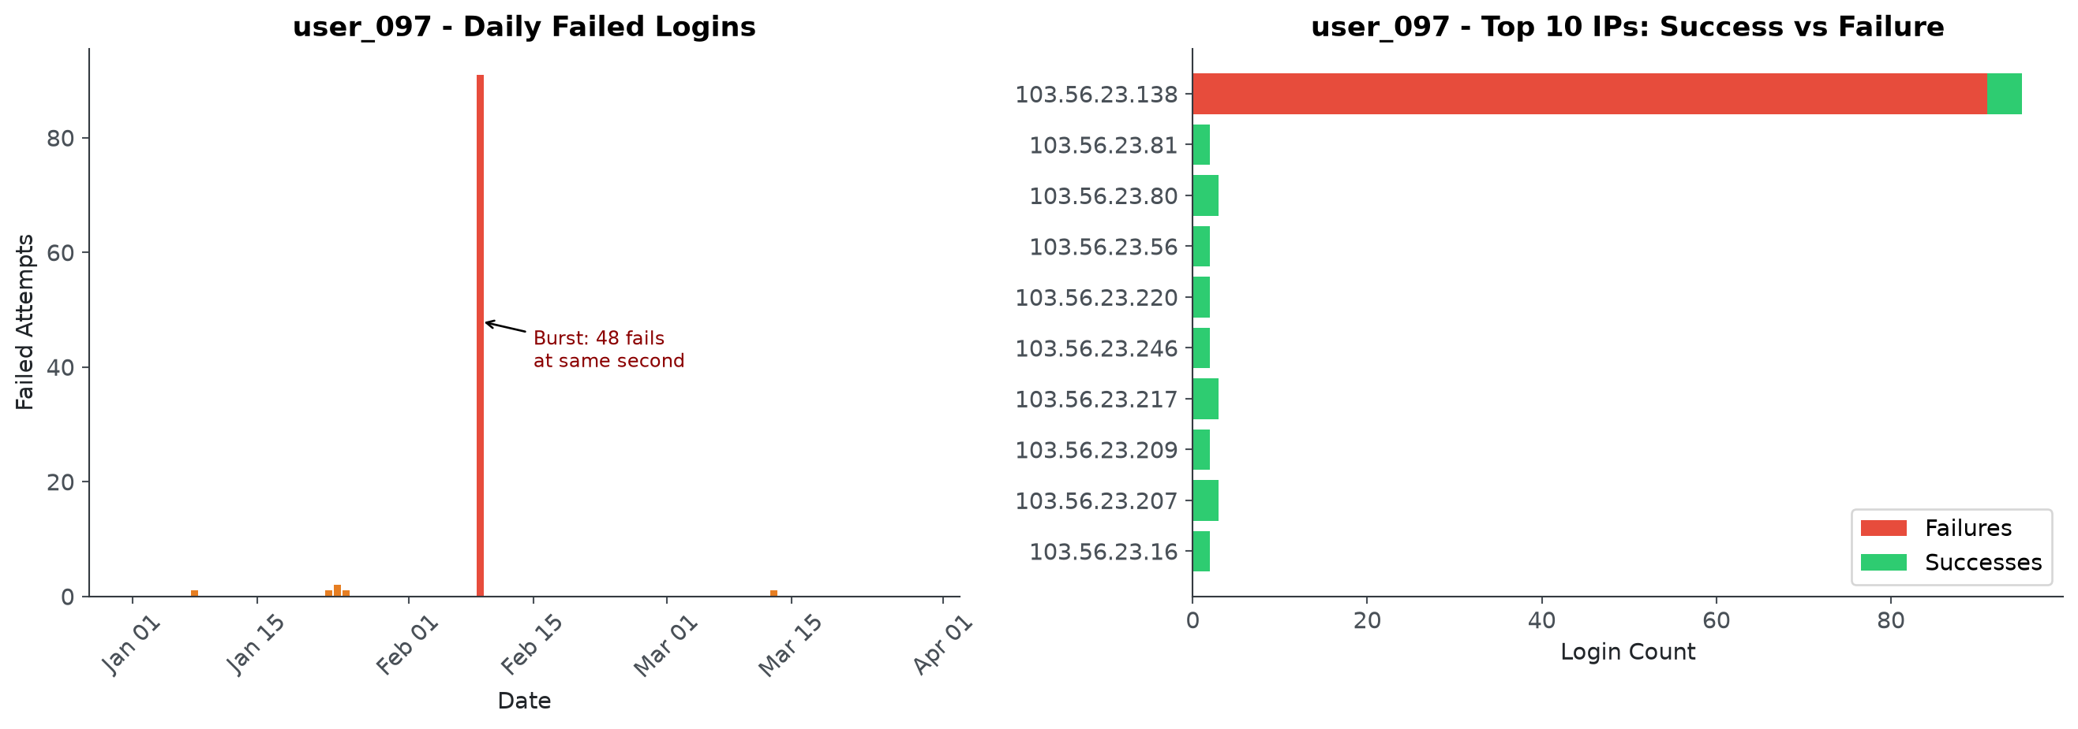
SECURITY LOGIN ANALYTICS
48
A3. user_097 brute-force evidence
Backup visual from the provided notebook/script
Defense points
- The same user and IP dominate the failure burst.
- Daily view shows concentration on Feb 9.
- IP breakdown supports targeted containment.
Use this slide only when the interviewer wants the detail behind the main-story claim.
Senior Data Analyst Assignment
Notebook visuals only for analytical evidence

Slide 49
SECURITY LOGIN ANALYTICS
49
A4. user_097 two-second burst
Backup visual from the provided notebook/script
Defense points
- The exact timestamp burst is machine-like.
- This is higher confidence than generic high failure rate.
- Duplicate ingestion should still be checked before automation.
Use this slide only when the interviewer wants the detail behind the main-story claim.
Senior Data Analyst Assignment
Notebook visuals only for analytical evidence

Slide 50
SECURITY LOGIN ANALYTICS
50
A5. user_003 nightly probe heatmap
Backup visual from the provided notebook/script
Defense points
- The 20:00 cadence is the key signal.
- A scheduled job explanation is more plausible than human behavior.
- Final success makes account review urgent.
Use this slide only when the interviewer wants the detail behind the main-story claim.
Senior Data Analyst Assignment
Notebook visuals only for analytical evidence

Slide 51
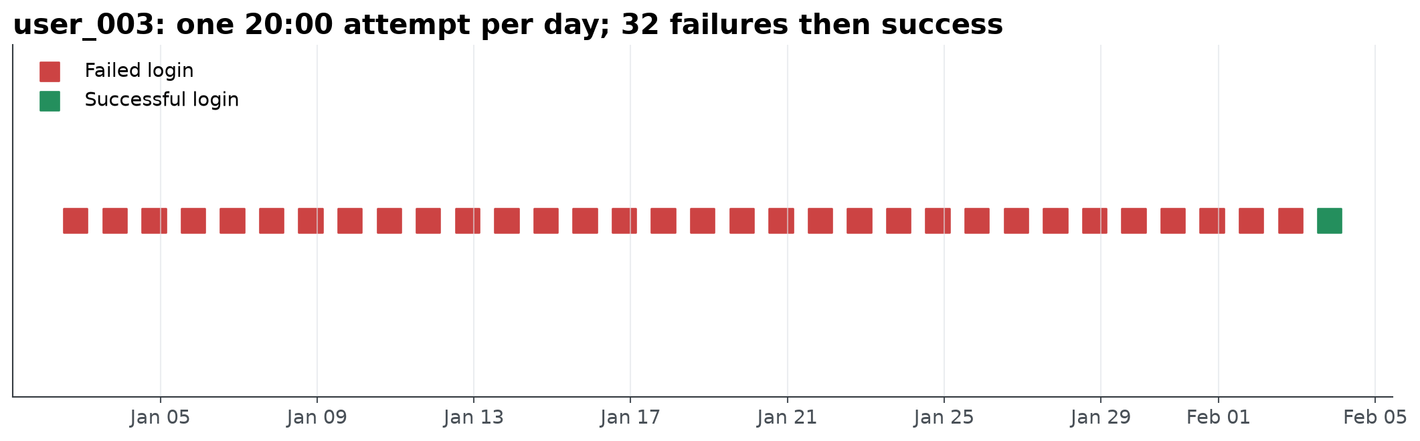
SECURITY LOGIN ANALYTICS
51
A6. user_003 low-and-slow timeline
Backup visual from the provided notebook/script
Defense points
- The pattern avoids high-velocity thresholds.
- Sequence logic is needed for low-and-slow attacks.
- A single success after repeated failures changes risk.
Use this slide only when the interviewer wants the detail behind the main-story claim.
Senior Data Analyst Assignment
Notebook visuals only for analytical evidence

Slide 52
SECURITY LOGIN ANALYTICS
52
A7. Shared IP multi-user event
Backup visual from the provided notebook/script
Defense points
- One IP touching many users at the same second is high-confidence.
- Successes and failures together suggest partial compromise or replay.
- This is a strong candidate for blocking and user enumeration.
Use this slide only when the interviewer wants the detail behind the main-story claim.
Senior Data Analyst Assignment
Notebook visuals only for analytical evidence

Slide 53
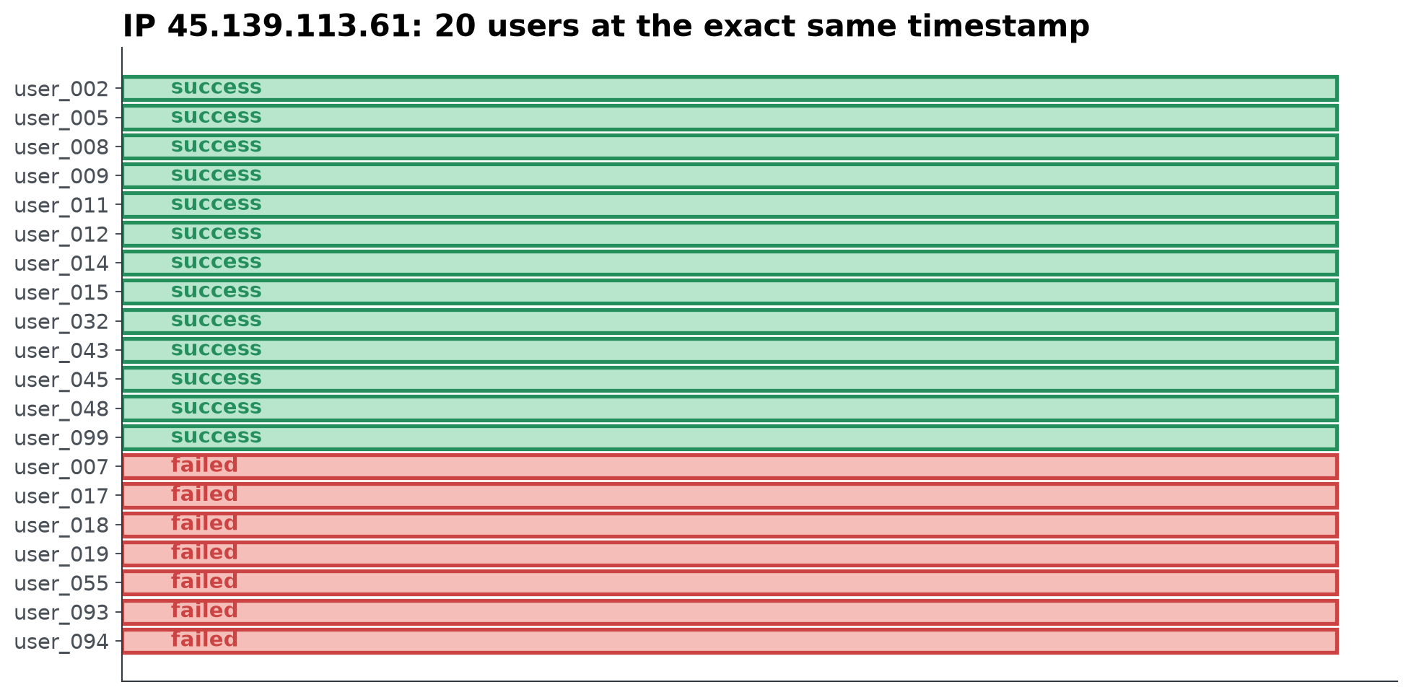
SECURITY LOGIN ANALYTICS
53
A8. Shared IP user outcome detail
Backup visual from the provided notebook/script
Defense points
- The visual identifies affected users.
- Green successes are investigation targets, not reassurance.
- Containment should review post-login activity.
Use this slide only when the interviewer wants the detail behind the main-story claim.
Senior Data Analyst Assignment
Notebook visuals only for analytical evidence

Slide 54
SECURITY LOGIN ANALYTICS
54
A9. IP velocity risk matrix
Backup visual from the provided notebook/script
Defense points
- The feature is useful, but the broad threshold over-flags.
- This is a threshold calibration lesson.
- Use historical baselines and enrichment in production.
Use this slide only when the interviewer wants the detail behind the main-story claim.
Senior Data Analyst Assignment
Notebook visuals only for analytical evidence

Slide 55
SECURITY LOGIN ANALYTICS
55
A10. Off-hours access visual
Backup visual from the provided notebook/script
Defense points
- Off-hours is weak alone but useful as a risk multiplier.
- user_009 is interesting because timing combines with high IP spread.
- Timezone context would reduce false positives.
Use this slide only when the interviewer wants the detail behind the main-story claim.
Senior Data Analyst Assignment
Notebook visuals only for analytical evidence

Slide 56
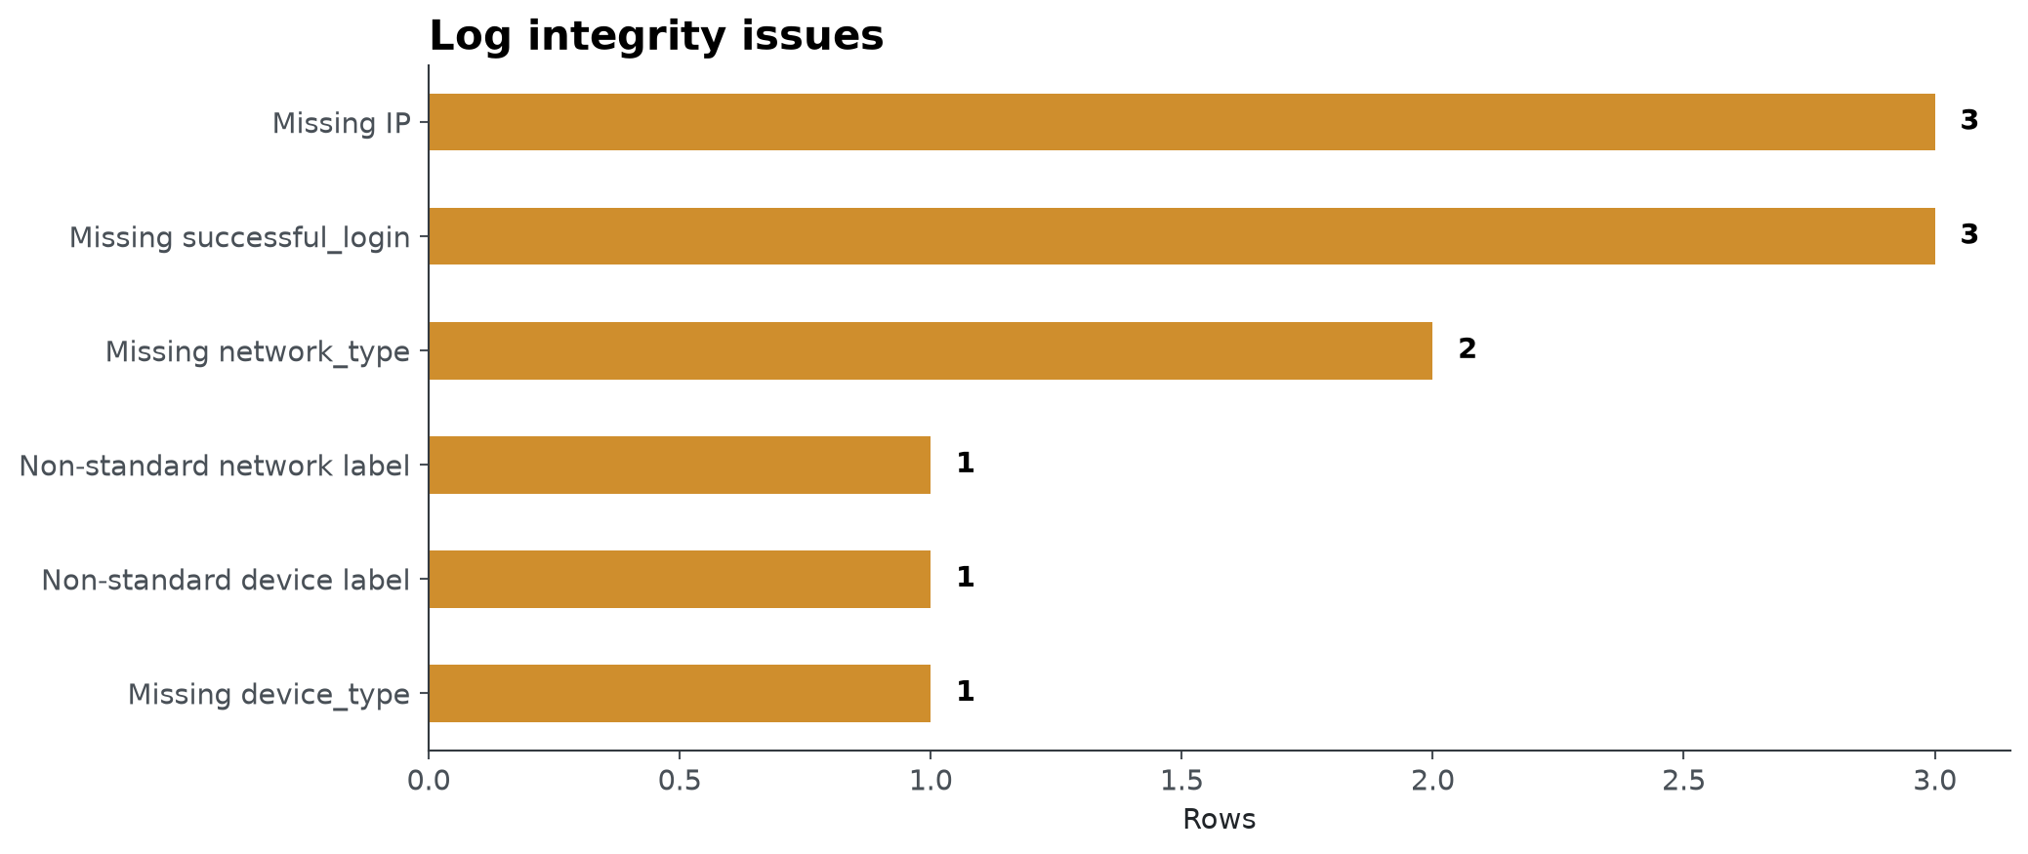
SECURITY LOGIN ANALYTICS
56
A11. Log integrity visual
Backup visual from the provided notebook/script
Defense points
- Quality issues are small in count but large in security impact.
- Missing IP breaks source-based rules.
- Schema validation belongs in production monitoring.
Use this slide only when the interviewer wants the detail behind the main-story claim.
Senior Data Analyst Assignment
Notebook visuals only for analytical evidence

Slide 57
SECURITY LOGIN ANALYTICS
57
A12. Product KPI dashboard visual
Backup visual from the provided notebook/script
Defense points
- The dashboard asks whether a signup spike is healthy.
- Quality metrics prevent over-celebrating volume.
- The same investigative pattern applies to product analytics.
Use this slide only when the interviewer wants the detail behind the main-story claim.
Senior Data Analyst Assignment
Notebook visuals only for analytical evidence

Slide 58
SECURITY LOGIN ANALYTICS
58
A13. Feature defense: Failure rate
Definition, rationale, and production hardening
Feature
Notebook formula
Signal
Production note
Failure rate
failures / attempts
Password guessing
Tune by user and IP window
False-positive check
Review alternatives
Avoid over-blocking
Require analyst feedback
Senior Data Analyst Assignment
Notebook visuals only for analytical evidence

Slide 59
SECURITY LOGIN ANALYTICS
59
A14. Feature defense: IP velocity
Definition, rationale, and production hardening
Feature
Notebook formula
Signal
Production note
IP velocity
unique IPs / attempts
Proxy or botnet rotation
Normalize by history and ASN
False-positive check
Review alternatives
Avoid over-blocking
Require analyst feedback
Senior Data Analyst Assignment
Notebook visuals only for analytical evidence

Slide 60
SECURITY LOGIN ANALYTICS
60
A15. Feature defense: Unique IP count
Definition, rationale, and production hardening
Feature
Notebook formula
Signal
Production note
Unique IP count
nunique(ip)
Wide source spread
Normalize by active days
False-positive check
Review alternatives
Avoid over-blocking
Require analyst feedback
Senior Data Analyst Assignment
Notebook visuals only for analytical evidence

Slide 61
SECURITY LOGIN ANALYTICS
61
A16. Feature defense: Attempt velocity
Definition, rationale, and production hardening
Feature
Notebook formula
Signal
Production note
Attempt velocity
count / time bucket
Automation burst
Deduplicate event IDs first
False-positive check
Review alternatives
Avoid over-blocking
Require analyst feedback
Senior Data Analyst Assignment
Notebook visuals only for analytical evidence

Slide 62
SECURITY LOGIN ANALYTICS
62
A17. Feature defense: Off-hours
Definition, rationale, and production hardening
Feature
Notebook formula
Signal
Production note
Off-hours
hour outside profile
Timezone or compromise clue
Combine with novelty
False-positive check
Review alternatives
Avoid over-blocking
Require analyst feedback
Senior Data Analyst Assignment
Notebook visuals only for analytical evidence

Slide 63
SECURITY LOGIN ANALYTICS
63
A18. Feature defense: Daily baseline
Definition, rationale, and production hardening
Feature
Notebook formula
Signal
Production note
Daily baseline
rolling daily metrics
System-level anomaly
Seasonality-aware windows
False-positive check
Review alternatives
Avoid over-blocking
Require analyst feedback
Senior Data Analyst Assignment
Notebook visuals only for analytical evidence

Slide 64
SECURITY LOGIN ANALYTICS
64
A19. Feature defense: Composite risk
Definition, rationale, and production hardening
Feature
Notebook formula
Signal
Production note
Composite risk
weighted features
SOC prioritization
Calibrate with feedback
False-positive check
Review alternatives
Avoid over-blocking
Require analyst feedback
Senior Data Analyst Assignment
Notebook visuals only for analytical evidence

Slide 65
SECURITY LOGIN ANALYTICS
65
A20. Threshold rationale
Risk controls and caveats
- Start with interpretable thresholds because the dataset has no labels.
- Validate thresholds against known baselines before alerting.
- Treat broad flags as evidence that calibration is needed.
- Thresholds should rank review priority before they automate containment.
Thresholds should rank review priority before they automate containment.
Senior Data Analyst Assignment
Notebook visuals only for analytical evidence

Slide 66
SECURITY LOGIN ANALYTICS
66
A21. Assumptions to disclose
Risk controls and caveats
- The notebook treats missing successful_login as failure after initial inspection.
- Dates are interpreted in the source timestamp timezone because no user timezone exists.
- IP velocity is considered suspicious only when paired with other context.
- No malicious label is assumed without SOC confirmation.
No malicious label is assumed without SOC confirmation.
Senior Data Analyst Assignment
Notebook visuals only for analytical evidence

Slide 67
SECURITY LOGIN ANALYTICS
67
A22. Alternative explanations
Risk controls and caveats
- VPN use can create many IPs.
- Travel and on-call work can create off-hours logins.
- Application outage can create repeated failures.
- Duplicate ingestion can mimic impossible velocity.
Duplicate ingestion can mimic impossible velocity.
Senior Data Analyst Assignment
Notebook visuals only for analytical evidence

Slide 68
SECURITY LOGIN ANALYTICS
68
A23. Additional data needed
Risk controls and caveats
- Geo, city, and ASN for impossible travel and risky infrastructure.
- User-agent and browser fingerprint for spoofing and automation.
- MFA status and failure reason for attack-stage diagnosis.
- Session duration and post-login actions for account takeover confirmation.
Session duration and post-login actions for account takeover confirmation.
Senior Data Analyst Assignment
Notebook visuals only for analytical evidence

Slide 69
SECURITY LOGIN ANALYTICS
69
A24. Patterns to monitor next
Risk controls and caveats
- Password spray by subnet or ASN.
- Dormant account sudden activity.
- New device plus new IP plus off-hours.
- Successful login followed by sensitive account changes.
Successful login followed by sensitive account changes.
Senior Data Analyst Assignment
Notebook visuals only for analytical evidence

Slide 70
SECURITY LOGIN ANALYTICS
70
A25. SQL: daily login baseline
SQL equivalent for defending pandas transformations
SELECT
CAST(datetime AS DATE) AS login_date,
COUNT(*) AS attempts,
SUM(CASE WHEN successful_login = 0 THEN 1 ELSE 0 END) AS failures,
AVG(CASE WHEN successful_login = 0 THEN 1.0 ELSE 0.0 END) AS failure_rate
FROM login_events
GROUP BY CAST(datetime AS DATE)
ORDER BY login_date;
This is the SQL counterpart to the notebook's daily baseline table.
Senior Data Analyst Assignment
Notebook visuals only for analytical evidence

Slide 71
SECURITY LOGIN ANALYTICS
71
A26. SQL: user-level risk features
SQL equivalent for defending pandas transformations
SELECT
user,
COUNT(*) AS total_attempts,
COUNT(DISTINCT ip) AS unique_ips,
SUM(CASE WHEN successful_login = 0 THEN 1 ELSE 0 END) AS failures,
1.0 * SUM(CASE WHEN successful_login = 0 THEN 1 ELSE 0 END) / COUNT(*) AS fail_rate,
1.0 * COUNT(DISTINCT ip) / COUNT(*) AS ip_velocity
FROM login_events
GROUP BY user;
This makes the notebook feature engineering auditable in a warehouse.
Senior Data Analyst Assignment
Notebook visuals only for analytical evidence

Slide 72
SECURITY LOGIN ANALYTICS
72
A27. SQL: per-second burst detection
SQL equivalent for defending pandas transformations
SELECT
user,
ip,
datetime,
COUNT(*) AS attempts,
SUM(CASE WHEN successful_login = 0 THEN 1 ELSE 0 END) AS failures
FROM login_events
GROUP BY user, ip, datetime
HAVING COUNT(*) >= 10
ORDER BY attempts DESC;
Use this to catch humanly impossible bursts like user_097.
Senior Data Analyst Assignment
Notebook visuals only for analytical evidence

Slide 73
SECURITY LOGIN ANALYTICS
73
A28. SQL: shared-IP spray detection
SQL equivalent for defending pandas transformations
SELECT
ip,
datetime,
COUNT(*) AS attempts,
COUNT(DISTINCT user) AS distinct_users,
SUM(CASE WHEN successful_login = 0 THEN 1 ELSE 0 END) AS failures
FROM login_events
GROUP BY ip, datetime
HAVING COUNT(DISTINCT user) >= 10
ORDER BY distinct_users DESC;
This captures one IP touching many users in the same instant.
Senior Data Analyst Assignment
Notebook visuals only for analytical evidence

Slide 74
SECURITY LOGIN ANALYTICS
74
A29. SQL: off-hours candidates
SQL equivalent for defending pandas transformations
SELECT
user,
COUNT(*) AS offhour_logins,
COUNT(DISTINCT ip) AS unique_ips
FROM login_events
WHERE EXTRACT(HOUR FROM datetime) BETWEEN 0 AND 5
GROUP BY user
ORDER BY offhour_logins DESC, unique_ips DESC;
Off-hours should be combined with novelty and account history.
Senior Data Analyst Assignment
Notebook visuals only for analytical evidence

Slide 75
SECURITY LOGIN ANALYTICS
75
A30. SQL: data quality checks
SQL equivalent for defending pandas transformations
SELECT 'missing_ip' AS check_name, COUNT(*) AS rows FROM login_events WHERE ip IS NULL
UNION ALL
SELECT 'missing_device_type', COUNT(*) FROM login_events WHERE device_type IS NULL
UNION ALL
SELECT 'missing_network_type', COUNT(*) FROM login_events WHERE network_type IS NULL
UNION ALL
SELECT 'missing_successful_login', COUNT(*) FROM login_events WHERE successful_login IS NULL;
Production alerting needs quality checks before scoring.
Senior Data Analyst Assignment
Notebook visuals only for analytical evidence

Slide 76
SECURITY LOGIN ANALYTICS
76
A31. Stream processing implementation
Implementation detail
- Parse login events with schema validation.
- Compute rolling counts by user, IP, ASN, subnet, and device.
- Emit both raw signals and composite risk score.
- Store all feature versions for auditability.
Store all feature versions for auditability.
Senior Data Analyst Assignment
Notebook visuals only for analytical evidence

Slide 77
SECURITY LOGIN ANALYTICS
77
A32. Feature store design
Implementation detail
- Offline and online features must share definitions.
- Keys should include user, IP, subnet, device, and time window.
- Backfills should be reproducible from immutable event logs.
- Feature freshness must be monitored.
Feature freshness must be monitored.
Senior Data Analyst Assignment
Notebook visuals only for analytical evidence

Slide 78
SECURITY LOGIN ANALYTICS
78
A33. SOAR playbook design
Implementation detail
- Critical burst: block IP and force reset.
- Shared IP success: open case and inspect session activity.
- Low-and-slow probe: step-up MFA and watchlist.
- Broad IP velocity: enrich before containment.
Broad IP velocity: enrich before containment.
Senior Data Analyst Assignment
Notebook visuals only for analytical evidence

Slide 79
SECURITY LOGIN ANALYTICS
79
A34. Analyst feedback loop
Implementation detail
- Every alert needs close reason and true/false-positive label.
- Thresholds should be reviewed weekly during ramp.
- Precision by rule is more important than total alert count.
- Feedback creates the training data for future ML.
Feedback creates the training data for future ML.
Senior Data Analyst Assignment
Notebook visuals only for analytical evidence

Slide 80
SECURITY LOGIN ANALYTICS
80
A35. Interview Q&A: analytics choices
Backup talking points
- Q: Why not start with ML? A: no labels and explainability matters.
- Q: Why is baseline important? A: anomalies require a normal reference.
- Q: What would you do differently with more data? A: calibrate thresholds by user history.
Q: What would you do differently with more data? A: calibrate thresholds by user history.
Senior Data Analyst Assignment
Notebook visuals only for analytical evidence

Slide 81
SECURITY LOGIN ANALYTICS
81
A36. Interview Q&A: security judgment
Backup talking points
- Q: Is this proof of attack? A: no, it is high-confidence evidence.
- Q: What would you contain first? A: bursts and shared-IP simultaneous events.
- Q: What reduces false positives? A: enrichment, combinations of signals, analyst review.
Q: What reduces false positives? A: enrichment, combinations of signals, analyst review.
Senior Data Analyst Assignment
Notebook visuals only for analytical evidence

Slide 82
SECURITY LOGIN ANALYTICS
82
A37. Interview Q&A: product KPI case
Backup talking points
- Q: Is a signup spike good? A: only if quality metrics hold.
- Q: Which segments first? A: channel, geo, device, verification, activation.
- Q: How find a tracking bug? A: reconcile raw events, dedupe, and schema changes.
Q: How find a tracking bug? A: reconcile raw events, dedupe, and schema changes.
Senior Data Analyst Assignment
Notebook visuals only for analytical evidence

Slide 83
SECURITY LOGIN ANALYTICS
83
A38. Interview Q&A: production readiness
Backup talking points
- Q: What breaks in production? A: latency, schema drift, data gaps, alert fatigue.
- Q: How monitor the detector? A: precision, false positives, freshness, drift.
- Q: What is the first platform investment? A: enrichment and a governed feature store.
Q: What is the first platform investment? A: enrichment and a governed feature store.
Senior Data Analyst Assignment
Notebook visuals only for analytical evidence

Slide 84
SECURITY LOGIN ANALYTICS
84
A39. Interview Q&A: limitations
Backup talking points
- Q: Biggest limitation? A: no ground truth labels.
- Q: Weakest feature? A: off-hours alone, because context matters.
- Q: How defend thresholds? A: present them as triage heuristics, not final rules.
Q: How defend thresholds? A: present them as triage heuristics, not final rules.
Senior Data Analyst Assignment
Notebook visuals only for analytical evidence

Slide 85
SECURITY LOGIN ANALYTICS
85
A40. Source and asset provenance
Backup talking points
- Analytical charts: generated from the provided notebook/script and login workbook.
- Assignment brief: provided Word document in Downloads.
- Palo Alto Networks logo: Wikimedia Commons PNG preview of the 2020 SVG logo.
- Non-analytical hero/topology visuals: generated with image generation for this deck.
Non-analytical hero/topology visuals: generated with image generation for this deck.
Senior Data Analyst Assignment
Notebook visuals only for analytical evidence

