Slide 1


Security Login Analytics Investigation
Short Technical Review
All key decisions, anomaly evidence, product analytics, and production design in one compact deck.
Prepared by Stasy | 10 158 login events | 2024-01-01 to 2024-03-29

Slide 2

SHORT REVIEW
02
Executive summary
The investigation identifies repeatable suspicious behaviors and a path to operationalize them.
Events analyzed
Dataset window
Overall failure rate
Sharpest spike
10 158
89 days
6.2%
Feb 9
100 users
2024-01-01 to 2024-03-29
634 failures
37.1% failure rate
Priority finding
Confidence
Why it matters
Brute-force burst
95%
Machine-speed timing on user_097
Shared-IP spray
92%
20 users from one IP at one timestamp
Nightly probe
90%
Repeated exact 20:00 failures before success
IP velocity
70%
Strong signal, but threshold needs calibration
The strongest answer is a repeatable framework, not a collection of isolated suspicious rows.
Senior Data Analyst Assignment
Analytical visuals are notebook-generated

Slide 3
SHORT REVIEW
03
Assignment scope balances security and product analytics
The work treats attack reduction and business growth as equal analytical responsibilities.
Security analytics
>
Reduce attacks
Product analytics
>
Increase acquisition
Reduce false positives
>
Protect users
Maintain quality
>
Improve activation
Question
Security answer
Product answer
What changed?
Failure spikes and suspicious sources
Signup volume and channel mix
Is it good?
Only if false positives are controlled
Only if activation and quality hold
What action follows?
Triage, enrich, contain, learn
Segment, verify, improve conversion
Senior Data Analyst Assignment
Analytical visuals are notebook-generated

Slide 4
SHORT REVIEW
04
Analytical strategy and decision log
The approach favors explainable behavioral analytics before machine learning.
Decision
Alternatives
Why rejected
Rule-based detection
Isolation Forest
No labels and lower SOC explainability
Daily baseline
Weekly baseline
Dataset too short for stable weekly seasonality
Failure rate
Raw failures
Normalizes activity across users and sources
IP velocity
Raw IP count
Makes source spread comparable across users
Composite score
Single flag
Combines timing, outcome, source, and novelty
Heuristics are appropriate first because the dataset has no labels, limited context, and requires defensible explanations.
Senior Data Analyst Assignment
Analytical visuals are notebook-generated

Slide 5
SHORT REVIEW
05
Dataset and data quality
Small integrity issues can materially distort security scoring when alerts become automated.
Login records
Duplicates
Missing IP
Missing outcome
10 158
88
3
3
Raw authentication events
Deduplicate before scoring
Weakens source analytics
Affects failure metrics
Issue
Count
Business impact
Action
Missing IP
3
Weakens IP-based detection
Investigate upstream
Missing outcome
3
Affects failure metrics
Conservative handling
Duplicates
88
Inflates alerts
Deduplicate before scoring
Invalid labels
2
Schema inconsistency
Normalize values
Senior Data Analyst Assignment
Analytical visuals are notebook-generated

Slide 6
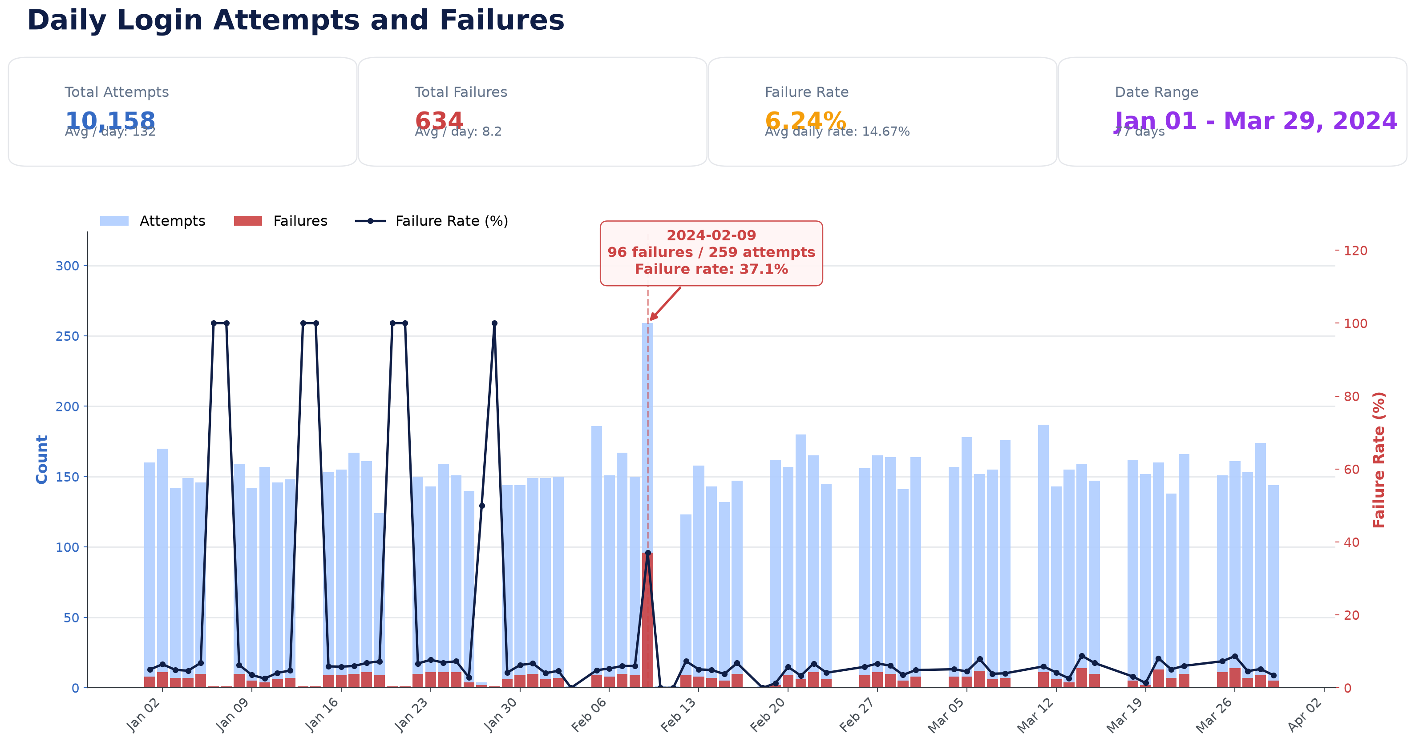
SHORT REVIEW
06
Baseline and Feb 9 spike
Aggregate trends identify when to drill into user and IP behavior.
Feb 9 attempts
259
Dataset-level spike
Feb 9 failures
96
Concentrated failures
Failure rate
37.1%
Far above baseline
Feb 9 is not the conclusion; it is the signpost that points to concentrated attacks.
Senior Data Analyst Assignment
Analytical visuals are notebook-generated

Slide 7
SHORT REVIEW
07
Behavioral features used for scoring
Raw events are converted into comparable user, IP, and timing signals.
Feature
What it captures
Why it is better than raw rows
Failure rate
Failures / attempts
Normalizes activity volume
IP velocity
Distinct IPs / attempts
Detects rotating sources
Attempt velocity
Events in tight windows
Finds automation
Shared-IP spread
Users per IP per timestamp
Finds spraying
Off-hours access
00:00 to 05:00 logins
Adds context when paired with novelty
Each feature is interpretable enough for an analyst to validate without trusting a black box.
Senior Data Analyst Assignment
Analytical visuals are notebook-generated

Slide 8
SHORT REVIEW
08
Threat kill chain mapping
Each anomaly is mapped to where it likely appears in an attack path.
Recon
>
Password spray
>
Credential stuffing
>
Successful login
Persistence
>
Privilege escalation
>
Data exfiltration
Anomaly
Kill-chain fit
Analyst action
user_097 burst
Credential stuffing / automation
Block IP, force reset, inspect sessions
user_003 nightly probe
Recon to successful login
Step-up MFA and review post-login activity
Shared-IP spray
Password spray
Open case, enrich IP, look for broad exposure
High IP velocity
Recon / distributed attack
Calibrate with geo, ASN, and device novelty
Senior Data Analyst Assignment
Analytical visuals are notebook-generated

Slide 9
SHORT REVIEW
09
Anomaly confidence at a glance
The confidence score summarizes evidence strength, alternatives, and remaining uncertainty.
Case
Confidence
Evidence
Remaining uncertainty
user_097 burst
95%
48 attempts at one second; same IP; repeated failures
Could include replayed logs
Shared-IP spray
92%
20 users, one IP, same timestamp, mixed outcomes
Need IP reputation and ASN
user_003 probe
90%
33 exact 20:00 attempts; 32 failures then success
Need user schedule context
IP velocity
70%
Many users have broad IP spread
Threshold needs calibration
Off-hours
65%
5 midnight logins; user_009 has 4
Work schedule may explain it
Confidence is not certainty; it is a transparent way to prioritize triage.
Senior Data Analyst Assignment
Analytical visuals are notebook-generated

Slide 10
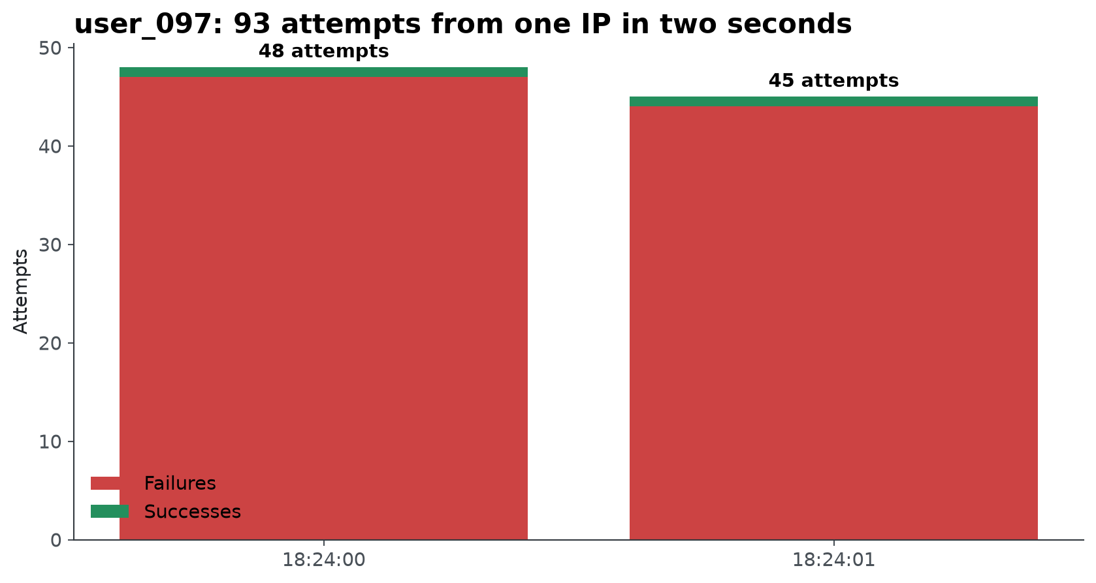
SHORT REVIEW
10
Anomaly 1: user_097 brute-force burst
Confidence: 95% - impossible timing is the strongest signal.
Evidence
- 48 attempts at 2024-02-09 18:24:00
- Same IP: 103.56.23.138
- 97 failures and 50.0% failure rate
Alternatives
- Duplicate ingestion
- Replay artifacts
- Synthetic load test
Contain first, then verify with session history, source reputation, and upstream log quality.
Senior Data Analyst Assignment
Analytical visuals are notebook-generated

Slide 11
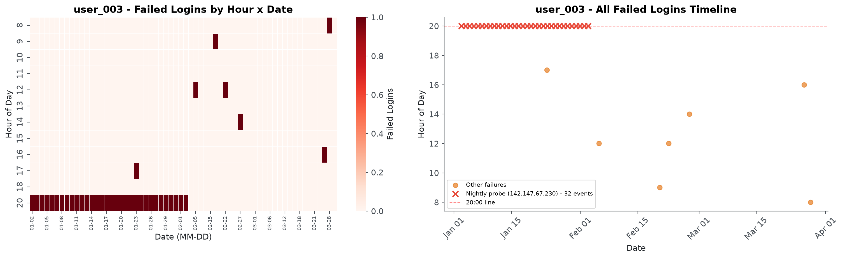
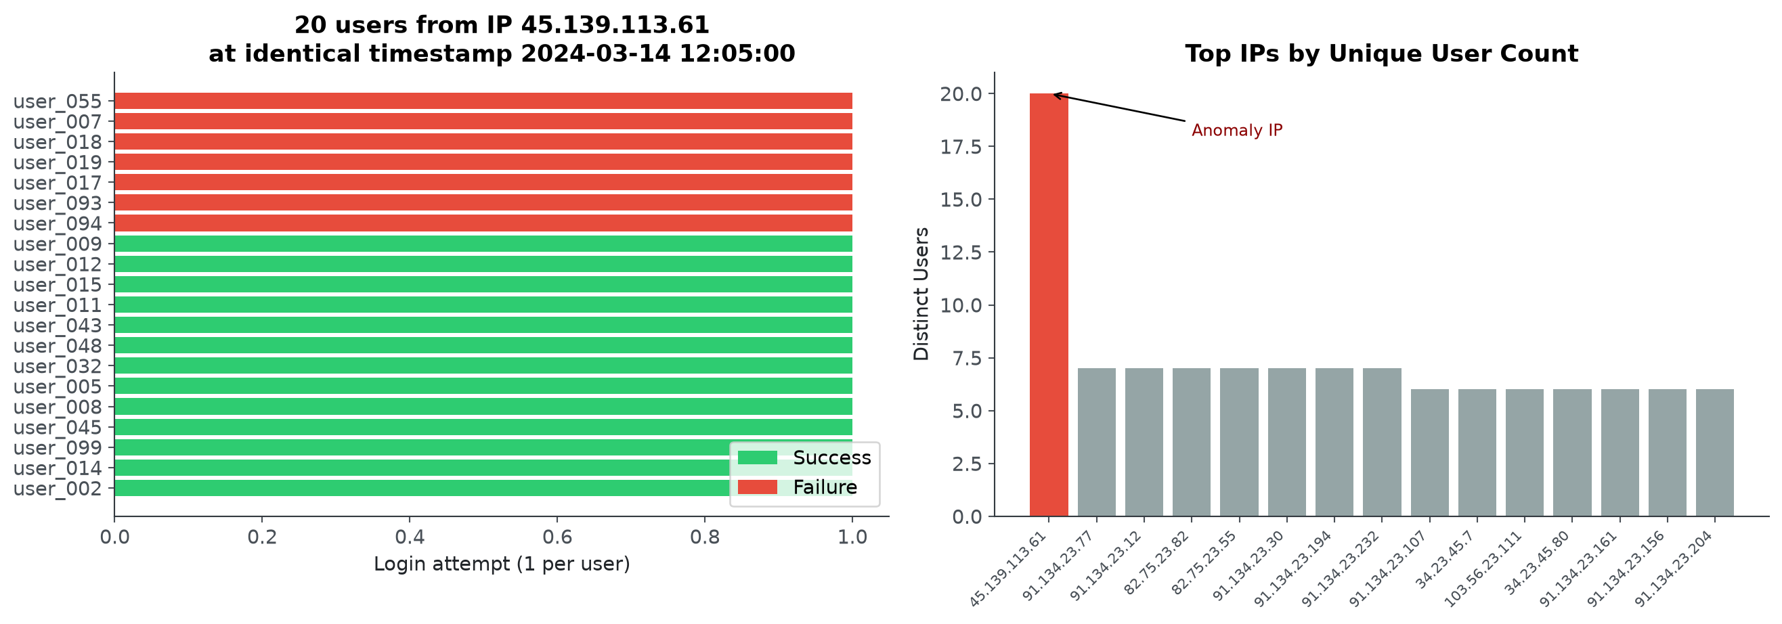
SHORT REVIEW
11
Anomalies 2 and 3: probe plus shared-IP spray
Both patterns indicate coordinated source behavior rather than normal user mistakes.
Case
Confidence
Evidence
Action
user_003
90%
33 exact 20:00 probes; 32 failures; 1 success
Step-up MFA
45.139.113.61
92%
20 users at one timestamp; 13 successes
Open case and enrich IP
Senior Data Analyst Assignment
Analytical visuals are notebook-generated

Slide 12
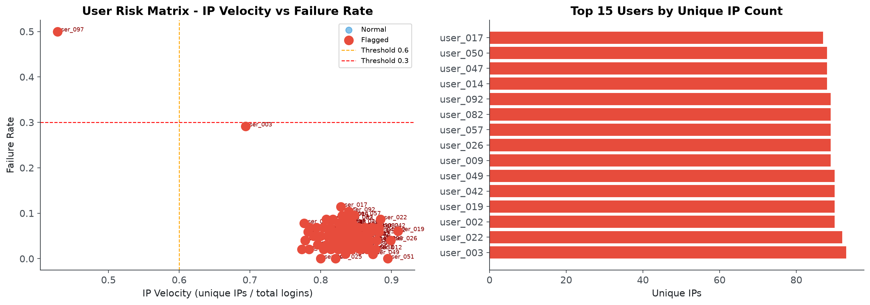
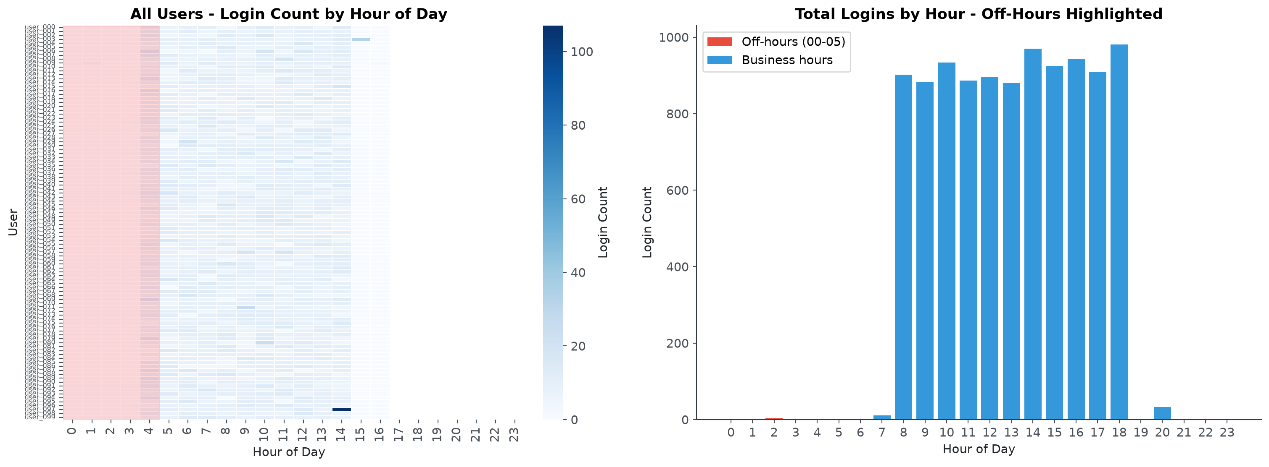
SHORT REVIEW
12
Anomalies 4 and 5: calibration-sensitive signals
IP velocity and off-hours access are useful, but should not fire alone.
Signal
Confidence
Interpretation
Production hardening
High IP velocity
70%
Potential proxy/VPN/bot source rotation
Add geo, ASN, device and user history
Off-hours access
65%
Suspicious only with novelty or sensitive actions
Use work schedules and role context
Senior Data Analyst Assignment
Analytical visuals are notebook-generated

Slide 13
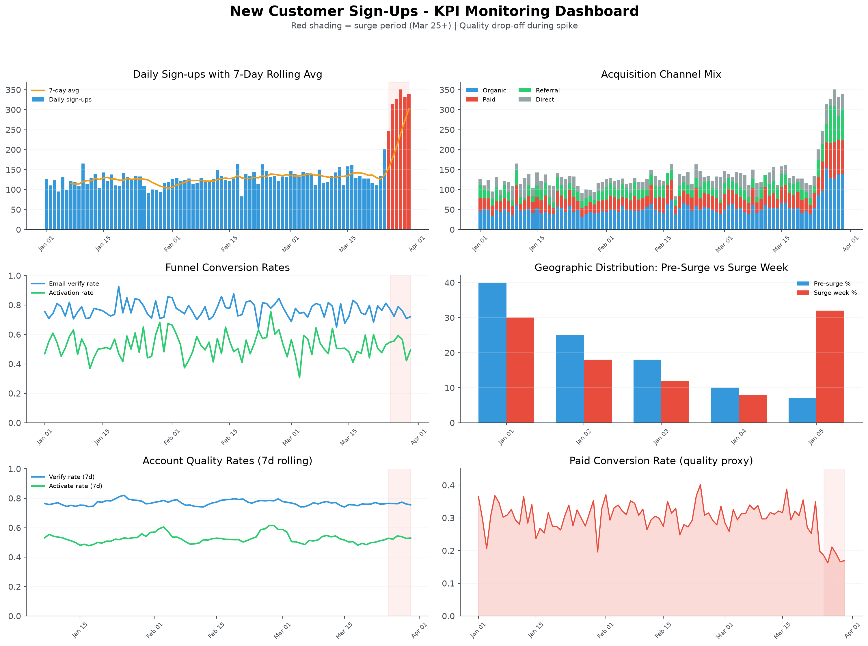
PRODUCT ANALYTICS
13
Product KPI case: signup spike needs quality checks
A growth spike is valuable only if acquisition quality and downstream activation hold.
Dashboard questions
- Which channel, country, and device changed?
- Did verification, activation, and payment quality hold?
- Was the spike real traffic, bot abuse, or instrumentation drift?
- What revenue or retention signal followed the spike?
Core KPIs
- Signups
- Activation
- Verified users
- Fraud rate
- Revenue impact
Senior Data Analyst Assignment
Analytical visuals are notebook-generated

Slide 14
SHORT REVIEW
14
Why explainability and cost matter
Security teams need alerts they can trust, defend, tune, and afford to run.
Dimension
Heuristics first
Machine learning later
SOC trust
Clear evidence per alert
Needs model explanation layer
Legal defensibility
Rule and threshold are inspectable
Requires governance and documentation
Tuning
Fast threshold changes
Needs retraining and drift monitoring
Latency
Milliseconds
Higher inference and feature costs
Maintenance
Low to moderate
Model monitoring, retraining, feature parity
The right path is not anti-ML; it is staged automation after evidence, labels, and feedback exist.
Senior Data Analyst Assignment
Analytical visuals are notebook-generated

Slide 15
PRODUCTION DESIGN
15
Production architecture expands the notebook into a detection platform
The same features become streaming signals, alert rules, and feedback data.
Applications
>
Kafka
>
Validation
>
Streaming ETL
Feature Store
>
Risk Scoring
>
Rules Engine
>
SIEM
SOAR
>
SOC
>
Feedback
>
Model Retraining
Analyst feedback closes the loop: it improves thresholds now and creates labels for future ML.
Senior Data Analyst Assignment
Analytical visuals are notebook-generated

Slide 16
SHORT REVIEW
16
Recommendations and conclusion
The final recommendation is a repeatable, defensible analytics framework.
Time horizon
Action
Owner value
Now
Deduplicate, normalize labels, triage top anomalies
Cleaner alerts and faster response
Next
Add geo, ASN, user agent, MFA, session context
Fewer false positives
Next
Build SOC dashboard with confidence and evidence
Analyst trust and auditability
Later
Use feedback labels for ML and drift monitoring
Gradual automation
Close
This investigation demonstrates a repeatable analytical framework rather than a collection of isolated findings. I prioritized interpretable behavioral analytics because the dataset lacked labels and production context. The proposed features, workflow, dashboard, and architecture support analysts today while creating a path toward a production-grade detection platform.
Senior Data Analyst Assignment
Analytical visuals are notebook-generated

