Slide 1

D. Y. Patil College of Engineering and Technology, Kolhapur
Department of Computer Science and Engineering
Academic Year: 2026-27
B.Tech (Bachelor of Technology) Project 2026-27: Synopsis Presentation
“Multi-Agent RAG (Retrieval-Augmented Generation) System for DPDP (Digital Personal Data Protection) Act Compliance Assessment and Citizen Rights Awareness”
Group Number: G45
Sr. | Students Name | Juno ID (Identifier) | Div. (Division) | Roll No.
1 | Raj Ashok Nikam | EN23225464 | D | 6
2 | Aditya Sachin Patil | EN23238761 | D | 7
3 | Varad Rahul Mhetar | EN23176065 | D | 8
4 | Shubham Sanjaykumar Rajurkar | EN23149824 | D | 9
5 | Shubhdeep Sunil Jasuja | EN23222171 | D | 10
Guide Name: Mrs. D. R. Patil
D. Y. Patil College of Engineering and Technology (DYPCET), Kolhapur | Computer Science and Engineering (CSE) Dept.
1

Slide 2
Project Synopsis Outline
1
Introduction
5
Proposed Work
Background, importance, relevance & purpose of the study
System architecture, modules, mechanisms & approach
2
Literature Survey & Need of Work
6
Requirements
Justification for the project with relevant references
Hardware, software, tools/platforms & cost
3
Problem Statement
7
Project Plan
Clear explanation of the issue, its context and aims
Month-wise plan of execution
4
Objectives
8
References
Major & sub-objectives, divided into modules
IEEE (Institute of Electrical and Electronics Engineers)-format papers and web resources
2

Slide 3
1. Introduction
Section 1 of 8
Background
India's DPDP (Digital Personal Data Protection) Act, 2023 and DPDP Rules, 2025 make every organisation that handles personal data a Data Fiduciary with legal duties, and give every citizen (Data Principal) enforceable rights.
Importance & Relevance
Duties and penalties of up to ₹250 crore apply from 13 May 2027, yet privacy policies are rarely checked against the Act, and LLMs (Large Language Models) often cite legal sections that do not exist.
Applicability & Purpose
DPDP Compass audits a privacy policy against 14 DPDP obligations with exact citations, drafts compliant policies, and explains citizens' rights in plain English, Hindi and Marathi — one engine for businesses and citizens.
3

Slide 4
2. Literature Survey and Need of Work
Section 2 of 8
Literature Survey
Sr. | Title | Author/Year | Summary | Limitation
1 | PAKTON: Multi-Agent Framework for QA (Question Answering) in Long Legal Agreements | P. Roy et al., 2025 | Coordinated agents answer questions over long contracts | QA only; no compliance checking or risk
2 | RAGulating Compliance: Multi-Agent KG (Knowledge Graph) for Regulatory QA | B. Agarwal et al., 2025 | Extracts triplets from regulations for precise retrieval | Regulation side only; no real policies
3 | LegalGraphRAG: Multi-Agent Graph RAG (Retrieval-Augmented Generation) | 2026 | Organises facts, rules and principles for legal reasoning | Needs a hand-built ontology
4 | LLM (Large Language Model) Agents in Law: Taxonomy & Challenges | 2026 | Survey of LLM-based legal agent systems | No validated system for India's DPDP Act
5 | Helping Johnny Make Sense of Privacy Policies with LLMs | 2026 | Plain-language explanations of privacy policies | Consumer-only; no business audit
6 | Large Legal Fictions: Legal Hallucinations in LLMs | M. Dahl et al., 2024 | LLMs invent laws, cases and citations | Diagnoses the problem; offers no remedy
4

Slide 5
2. Literature Survey and Need of Work
Section 2 of 8
Need of the Work
No DPDP tool: no existing system or benchmark is built on India's DPDP (Digital Personal Data Protection) Act.
Hallucinated law: LLMs (Large Language Models) invent sections, so every citation must be verified, not generated.
Split tools: business compliance checkers and citizen-rights explainers are built and evaluated separately.
Our difference: clause-aware retrieval, citations attached by the system, output guardrails, and one rule book that both audits policies and drafts new ones that pass their own audit.
Outcome: one engine serves organisations (Data Fiduciaries) and citizens (Data Principals).
4

Slide 6
3. Problem Statement
Section 3 of 8
To enable organisations to assess their privacy policies for compliance with the DPDP (Digital Personal Data Protection) Act, 2023, while helping citizens understand their rights and whether those policies uphold them — through a unified AI (Artificial Intelligence)-powered multi-agent RAG (Retrieval-Augmented Generation) system that accurately evaluates policies against DPDP obligations and presents the findings in an accessible manner.
5

Slide 7
4. Objectives
Section 4 of 8
Primary Objectives
Sub-Objectives (Module-wise)
1
Build a multi-agent RAG (Retrieval-Augmented Generation) engine for DPDP Act and Rules 2025 obligations
M1 Knowledge Base: parse the Gazette PDF (Portable Document Format) into clause chunks and 3 layers
M2 Multi-Agent Engine: hybrid retrieval and 6 LangGraph agents with guardrails
M3 Business Compliance: 14-obligation audit, redlines, rule-book policy generator
M4 Citizen Rights: grounded Q&A (Question and Answer), app policy check, request letters
M5 Platform & Evaluation: accounts, exports, 116 automated tests, benchmarks
2
Business module: cited audit report, ranked gaps, fixes and a compliant policy generator
3
Citizen module: plain-language rights answers in English, Hindi and Marathi
4
Evaluate against single-prompt LLM (Large Language Model) and keyword baselines
6

Slide 8
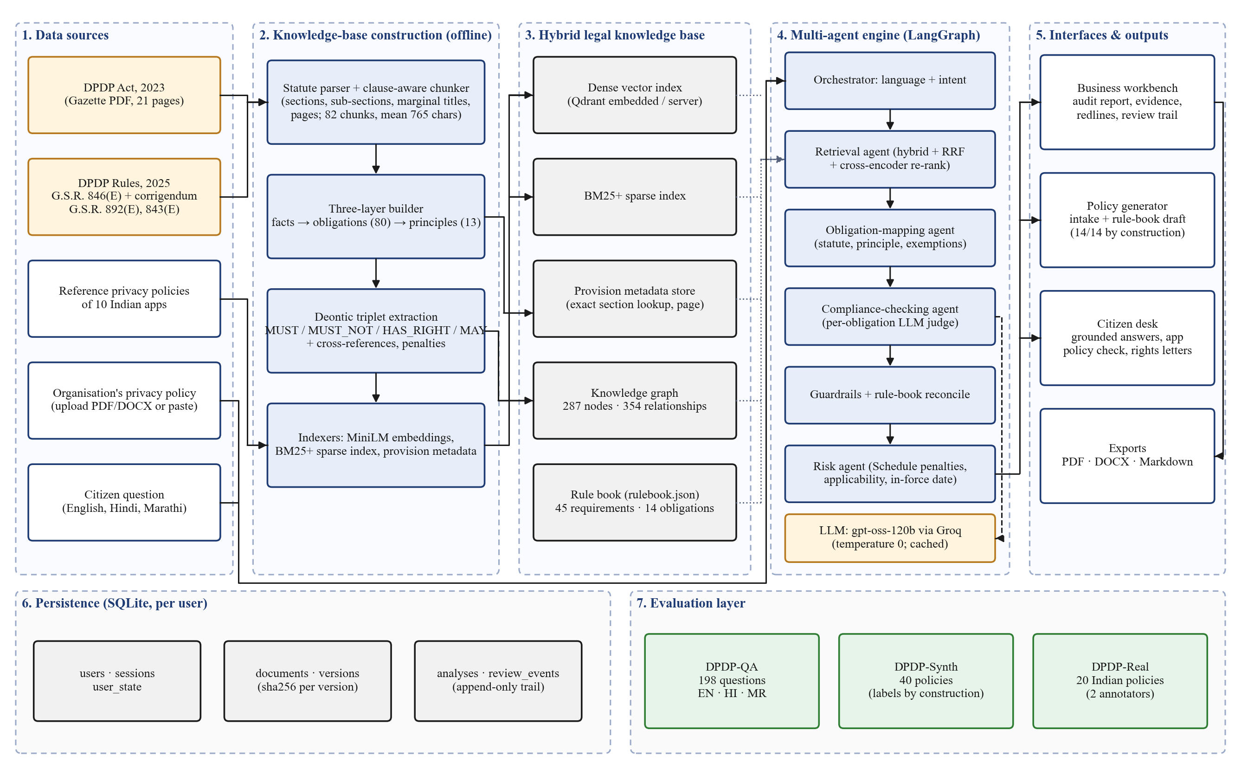
5. Proposed Work
Section 5 of 8
System Architecture
7

Slide 9
5. Proposed Work
Section 5 of 8
Mechanism & Approach
Project Modules
Clause-aware chunking of the Gazette text
Hybrid retrieval: dense + BM25+ (Best Matching 25 Plus) + exact section lookup
RRF (Reciprocal Rank Fusion) + cross-encoder re-ranking
Per-obligation LLM (Large Language Model) judge
Guardrails verify every quote and citation
Rule book: 45 checks; risk from penalties
M1 Legal Knowledge Base
M2 Multi-Agent Engine
M3 Business Compliance (audit, redline, generator)
M4 Citizen Rights (Q&A: Question and Answer)
M5 Platform & Evaluation
7

Slide 10
6. Requirements
Section 6 of 8
Hardware Requirements
Software Requirements
Intel i5 or equivalent CPU (Central Processing Unit)
8 GB (Gigabyte) RAM (Random Access Memory), 16 GB ideal
256 GB SSD (Solid State Drive); stable internet
Windows 10/11 or Linux
Python 3.13, Node.js 20+
VS (Visual Studio) Code, Git & GitHub, Docker Compose
Devices / Tools / Platforms
Cost of Implementation
React + TypeScript UI (User Interface)
FastAPI + LangGraph API (Application Programming Interface)
Qdrant + SQLite (Structured Query Language) databases
Groq gpt-oss-120b LLM (Large Language Model)
Open-source tools and libraries: ₹0
Self-hosted Qdrant and SQLite: ₹0
LLM API usage (development & evaluation): ₹3,000–5,000 (estimate)
8

Slide 11
7. Project Plan
Section 7 of 8
July
August
September
October
November
Literature survey
Gazette + policy data
Parser and clause-aware chunker
Hybrid retrieval
Obligation mapping agent
DPDP-QA (Question Answering) test set
Compliance agent, guardrails, risk
Business & Citizen UI (User Interface)
Accounts, versioned documents
Rule book + policy generator
Evaluation and 116 tests
Development complete
External examiner review
Research paper publication
Final report and demo
9

Slide 12
8. References
Section 8 of 8
Journal / Conference Papers (IEEE: Institute of Electrical and Electronics Engineers format)
Web Resources (with access dates)
[1] P. Roy et al., “PAKTON: A multi-agent framework for question answering in long legal agreements,” Proc. EMNLP (Empirical Methods in NLP), 2025.
[2] B. Agarwal et al., “RAGulating compliance: A multi-agent knowledge graph for regulatory QA (Question Answering),” arXiv:2508.09893, 2025.
[3] P. Lewis et al., “Retrieval-augmented generation for knowledge-intensive NLP (Natural Language Processing) tasks,” NeurIPS (Neural Information Processing Systems), 2020.
[4] M. Dahl et al., “Large legal fictions: Profiling legal hallucinations in LLMs,” J. Legal Analysis, vol. 16, 2024.
[5] “Helping Johnny make sense of privacy policies with LLMs,” arXiv:2501.16033, 2026.
MeitY (Ministry of Electronics and Information Technology), DPDP Act, 2023, https://www.meity.gov.in, Accessed on: 4 August 2026
MeitY, DPDP Rules, 2025 — G.S.R. (General Statutory Rules) 846(E), Accessed on: 4 August 2026
LangGraph Documentation, https://langchain-ai.github.io/langgraph/, Accessed on: 25 July 2026
RAGAS (Retrieval Augmented Generation Assessment) Docs, https://docs.ragas.io/, Accessed on: 4 August 2026
10

