Slide 1
ARTIFICIAL INTELLIGENCE REPORT
AI IN BIOTECHNOLOGY

Slide 2
Introduction
Biotechnology is technology that utilizes biological systems, living organisms or parts of this to develop or create different products.
Today, the five branches into which modern biotechnology is divided — human, environmental, industrial, animal and plant — help us fight hunger and disease, produce more safely, cleanly and efficiently, reduce our ecological footprint and save energy

Slide 3
Types of AI in biotechnoligy
AI in Agricultural biotechnology
AI in Medical biotechnology
AI in Animal biotechnology
AI in Industrial biotechnology
AI in Bioinformatics
AI in forest biotechnology

Slide 4
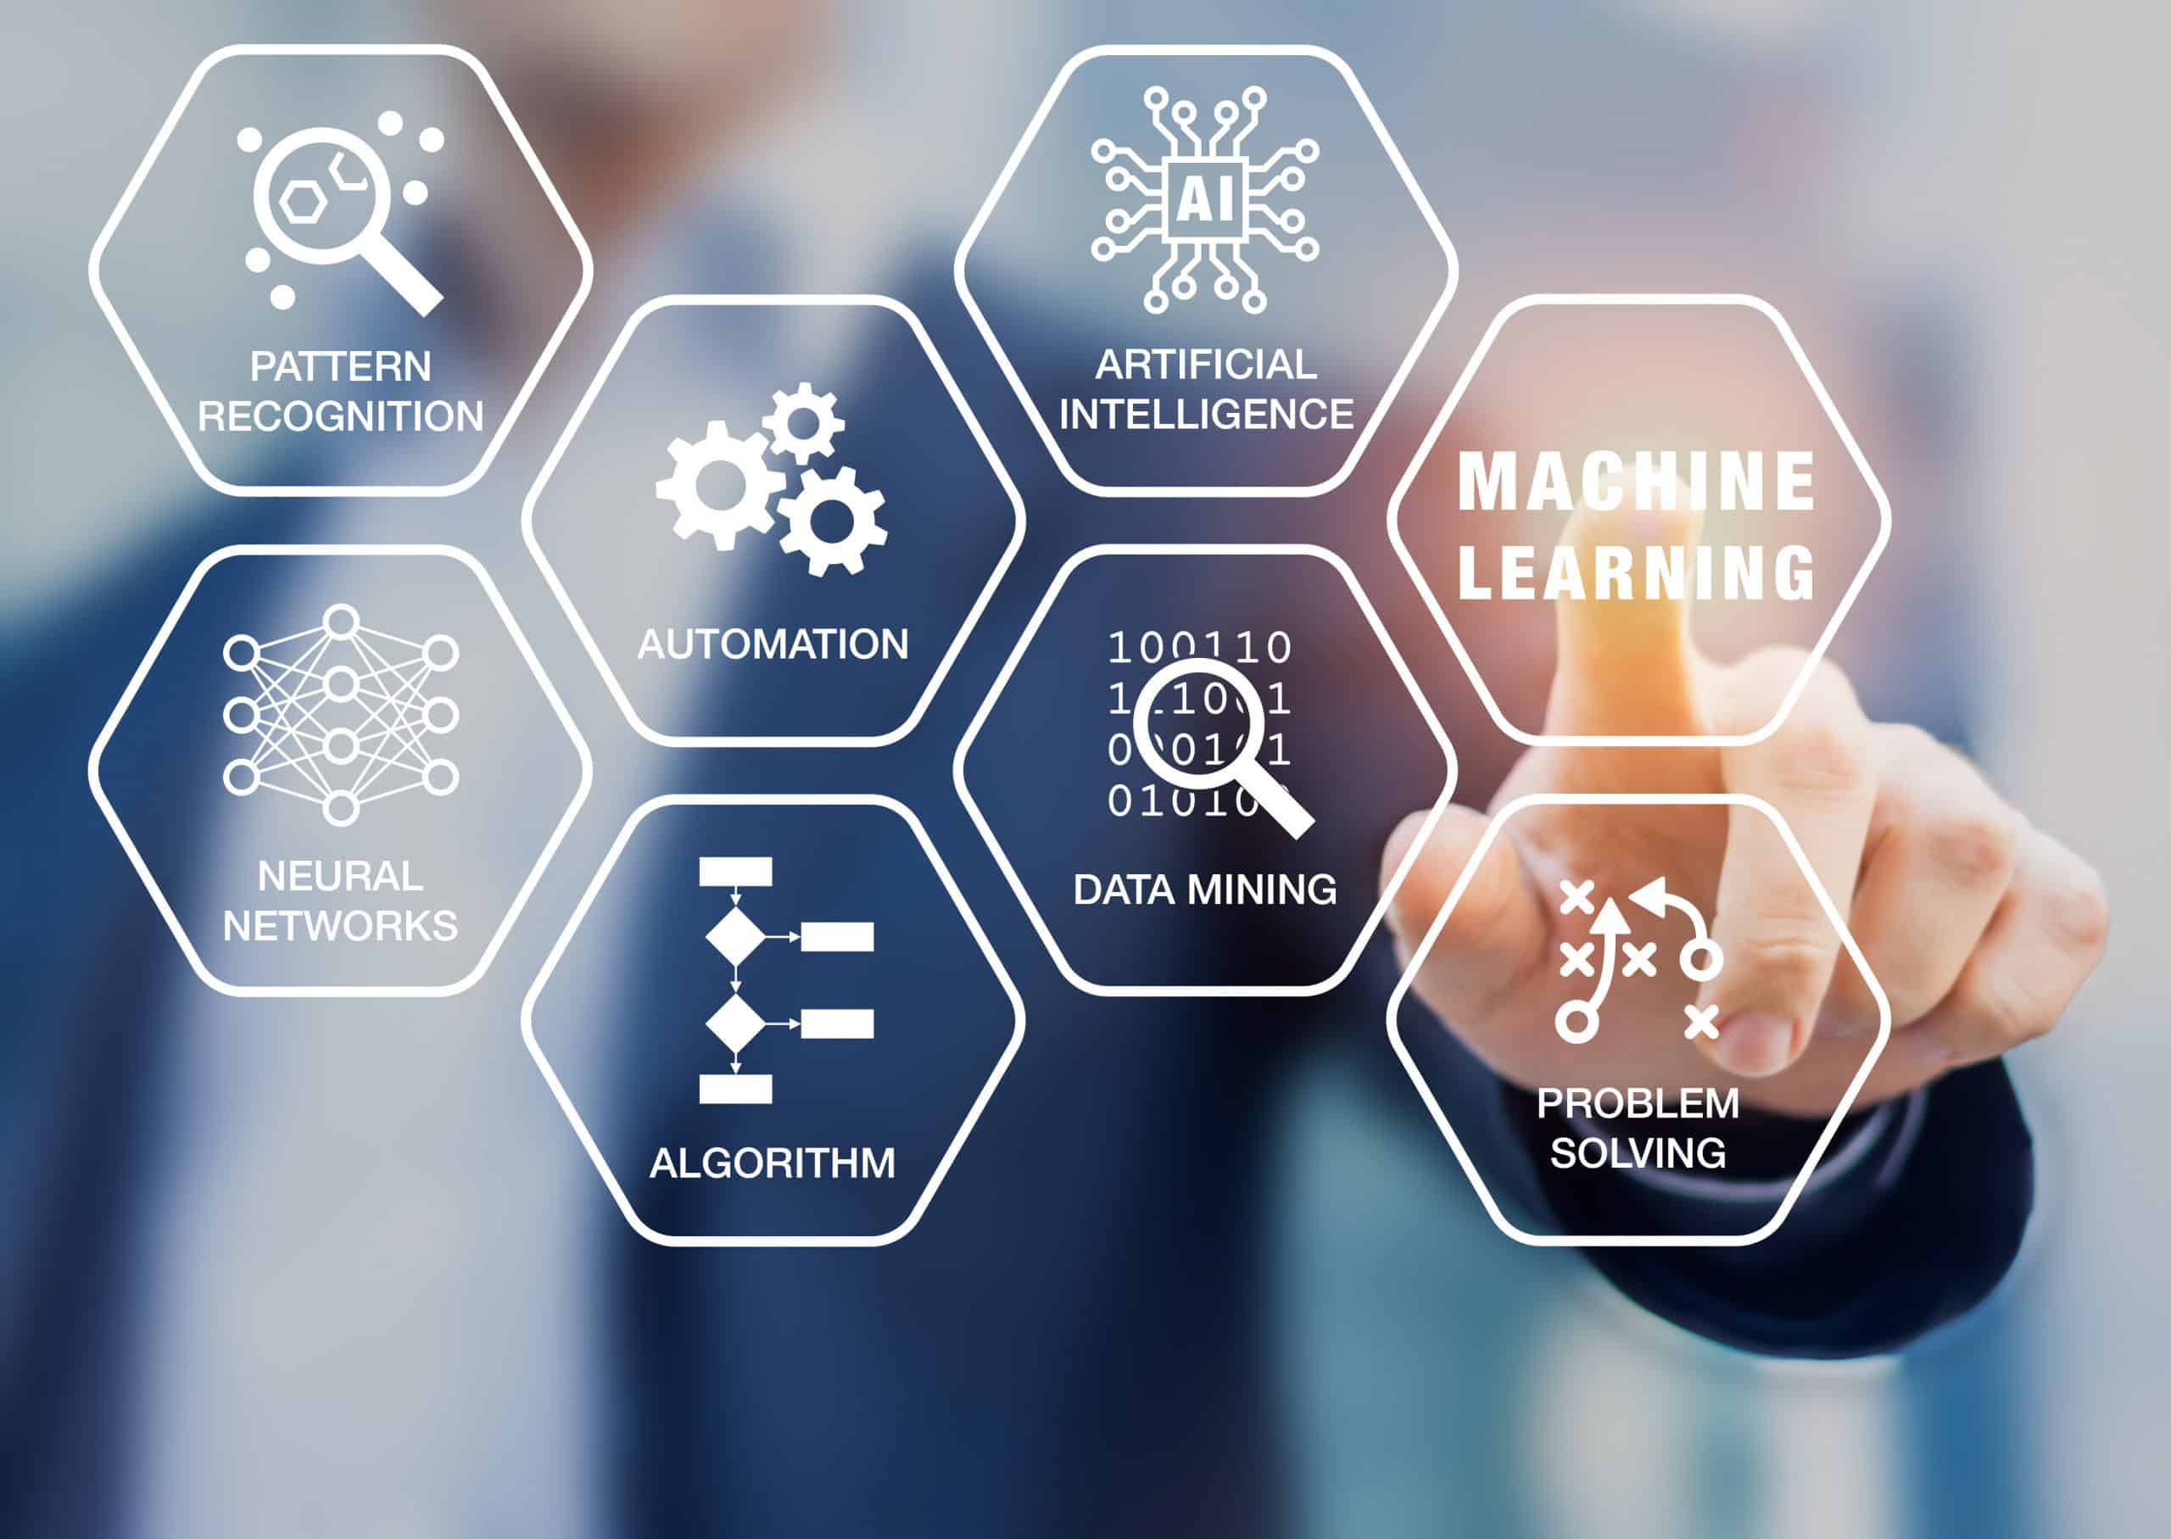

Slide 5
AI in Agricultural biotechnology
Agricultural biotechnology develops genetically modified plants to increase crop yields or introduce new characteristics to the existing plants. It involves conventional plant breeding, tissue culture, micro propagation, molecular breeding, and genetic engineering of plants.
Biotechnology firms are now leveraging Artificial Intelligence and Machine Learning techniques to develop and program autonomous robots that handle important agricultural tasks like harvesting crops at a much faster pace than humans. Computer Vision and Deep Learning algorithms are leveraged to process and analyze the data captured by drones. This helps in monitoring crop and soil health. Machine Learning algorithms help in tracking and predicting various environmental changes like the weather changes that impact the crop yield.

Slide 6
AI in Medical biotechnology
Medical biotechnology uses living cells for the betterment of human health by producing drugs and antibiotics. It also involves the study of DNA and genetically manipulates the cells to increase the production of important and beneficial characteristics.
Artificial Intelligence and Machine Learning are extensively used in drug discovery. Machine Learning helps in discovering small molecules that could give therapeutic benefits dependent on known target structures. Machine Learning is widely used in diagnosing diseases as it uses the true result to improve the diagnostic tests i.e., the more diagnostic tests that are run, the more accurate results can be achieved. AI is also helping in reducing the radiation therapy planning process resulting in saving time and improving patient care.

Slide 7
AI in Animal biotechnology
This branch applies molecular biology techniques to genetically engineer /modify the animals to improve their sustainability for pharmaceutical, industrial, or agricultural purposes.
The breeding of animals is one area where Artificial Intelligence and machine learning models provide valuable insights. Selective breeding is a very common practice where animals with the most desirable characteristics are bred with each other so that their offspring will also result in the same traits. This practice is implemented on the molecular level too where genetic characteristics among the animals are selected and such animals are bred. Machine learning is being used to interpret large genomic data sets and annotate a wide variety of genomic sequence elements.

Slide 8
AI in Industrial biotechnology
Industrial biotechnology is all about biopolymers substitutes, the invention in various areas like vehicle parts, fuels, fibers, new chemicals, and the production process.
Internet of Things (IoT), Machine Learning, and Artificial Intelligence analyze the machines, predict outages, optimize equipment, etc to provide efficient production and better product quality. Computer-aided designs and Artificial Intelligence are coming up with the desired molecule design. Robotics and Machine Learning cultivate the strains and test to what extent the desired molecule was reached.

Slide 9
AI in Bioinformatics
Bioinformatics helps the acquisition, storage, processing, distribution, analysis, and interpretation of biochemical and biological information with the help of mathematical, computer science, and biology tools to understand the biological significance of a variety of data. This information is organized in large data pools.
This information needs to be harnessed to gain tremendous insights. Artificial Intelligence and Machine Learning are leveraged in DNA sequencing from the huge data crunch involved, classification of protein along with protein’s catalytic role and biological function, analysis of gene expressions, genome annotation where a certain level of automation is required to identify the locations of genes, computer-aided drug design, etc.

Slide 10
AI in forest biotechnology
Wood is an increasingly important resource for humanity and natural forests are of enormous ecological value. However, these slow-growing forests are unable to meet current demand, resulting in loss and degradation of forest resources. This is where forest biotechnology, especially genetic engineering, can help. This is very important because plantation forests, for example, are urgently needed to sustainably meet global demand for wood . There are many potential applications for AI, including:
Predictive modelling: AI can be used to analyze data from satellite imagery, drone imagery, and other sources to predict the growth and yield of different species of trees in different locations. This can help to optimize the planting and management of forests for maximum productivity .
Disease and pest management: AI can be used to analyze data on the presence and spread of diseases and pests in forests, as well as to predict their likely impact on the health and productivity of trees. This can help to identify areas that are at risk and to implement preventative measures to protect forests.
Environmental monitoring: AI can be used to analyze data from sensors and other sources to monitor the health of forests and identify potential environmental impacts, e.g., wildfire . This can help to identify areas that are at risk and to implement measures to protect forests, also.
Resource management: AI can be used to optimize the use of resources, such as water and nutrients, in forests to maximize productivity and minimize waste.
Inventory management: AI can be used to optimize the management of forests for different purposes, such as timber production, conservation, and recreation. This can involve the use of AI to analyze data on the location, age, and species of trees, as well as the availability of resources and the demand for different products and services.

Slide 11
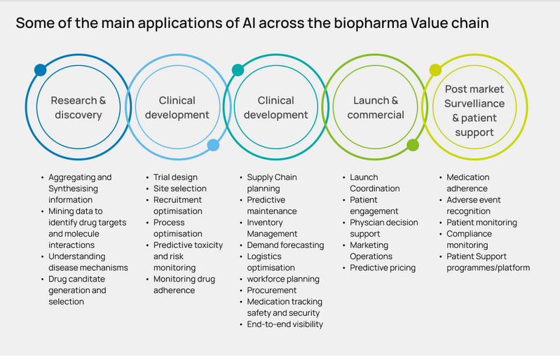

Slide 12
Future directions:
Artificial intelligence (AI) is playing an increasingly important role in biotechnology, with the potential to revolutionize the field in the coming years. Here are some of the future directions in AI in biotechnology:
Drug discovery: AI algorithms can analyze large amounts of data to identify new drug targets, design new molecules, and predict their efficacy and safety. This can help accelerate the drug discovery process and reduce the costs and risks of developing new drugs.
Precision medicine: AI can help personalize treatment plans for individual patients by analyzing their genetic and clinical data. This can improve the efficacy of treatments and reduce the risk of adverse events.
Bio processing: AI can optimize bio processing operations by analyzing data from sensors, monitoring equipment, and other sources. This can help improve product quality, reduce waste, and increase efficiency.
Bioinformatics: AI can help analyze large-scale genomic, proteomic, and metabolomic data to identify patterns and relationships that are difficult for humans to detect. This can lead to new insights into the underlying biology of diseases and help identify new targets for drug development.
Synthetic biology: AI can help design and engineer synthetic biological systems with specific functions, such as producing bio fuels, pharmaceuticals, or industrial chemicals. This can help improve the efficiency and sustainability of industrial processes.

Slide 13
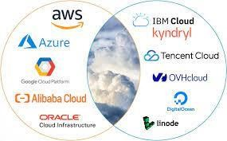
Some of the companys that uses AI

Slide 14
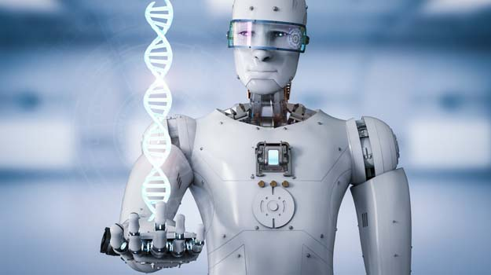
AI ethics, fairness and trust
Can we trust an AI in crucial fields such as biotechnology ?

Slide 15
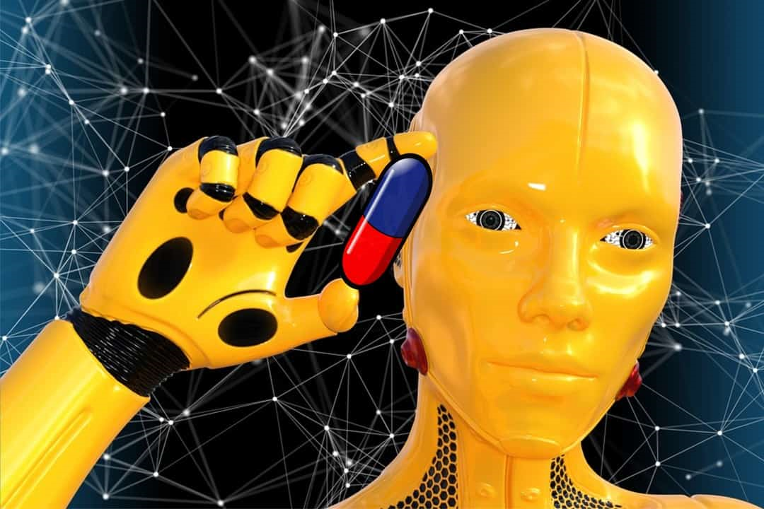
AI ethics, fairness and trust In Biotechnology
Finally, there is no question that AI ethics, fairness and trust are very important research topics in the application of AI for biotechnology. Some examples of (open) research questions include:
How can we ensure that AI systems are designed and used in ways that are ethically and socially responsible, and that respect fundamental human rights and values?
How can we ensure that AI systems are fair, and do not perpetuate or amplify existing biases or discrimination?
How can we ensure that AI systems are transparent and explainable, so that they can be trusted by users and stakeholders?
How can we ensure that AI systems are secure, and do not expose individuals or organizations to risks or harms?
How can we ensure that the development and deployment of AI systems is inclusive and involves diverse perspectives and voices?

Slide 16
CODE DEMONSTRATION
One important aspect of drug discovery is molecular structure prediction. This involves predicting the activity of molecules based on their chemical structure. Here is a sample code snippet in C++ that uses the RDKit library to predict the solubility of a molecule

Slide 17
#include <iostream>
#include <string>
#include <vector>
#include <GraphMol/SmilesParse/SmilesParse.h>
#include <GraphMol/Descriptors/MolDescriptors.h>
using namespace std;
using namespace RDKit;
// Define a function to calculate solubility
double calculate_solubility(const string& smiles) {
unique_ptr<ROMol> molecule(SmilesToMol(smiles));
double solubility = calc_MolLogP(*molecule);
return solubility;
}
// Main function to predict solubility of a molecule
int main() {
string smiles = "CC(=O)OC1=CC=CC=C1C(=O)O";
double solubility = calculate_solubility(smiles);
cout << "The predicted solubility of the molecule is: " << solubility << endl;
return 0;
}
The predicted solubility of the molecule is: -0.1929

Slide 18
CONCLUSION
AI is increasingly used in Biotechnology, although to a lesser degree than technology overall. – In 2020, about 17.5 percent of all public patent applications included AI, while about 3.5 percent of Biotech applications did. • Biotechnology AI patenting is diffusing across technologies, owners, and inventor-patentees. – In 2020, 17.5 percent of biotech patent technology sub-classes contained AI. – About 10 percent of Biotech patent owners-at-grant and about 5 percent of Biotech inventor-patentees patented in AI in 2020. • Allowance rates for AI in Biotechnology have trended similarly to all AI applications in recent years, and AI Biotech allowance rates are slightly lower than non-AI Biotech allowance rates.

Slide 19


