Slide 1
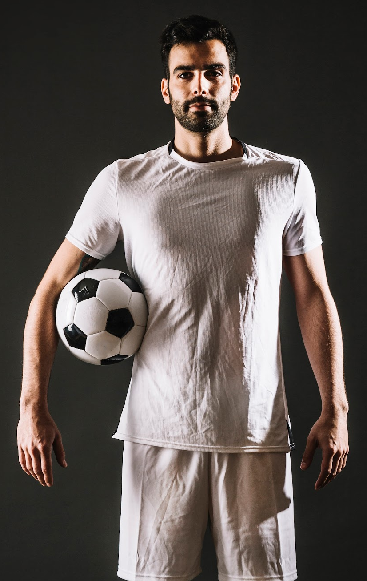
MY BEST POSITION
Where Do I Fit On The Pitch??
2023

Slide 2

INTRODUCTION
Football is a popular sport worldwide, and identifying the best position for each player is crucial for a team's success.
With the help of machine learning, we can create a model that predicts a player's best position based on their skills and physical attributes.

Slide 3
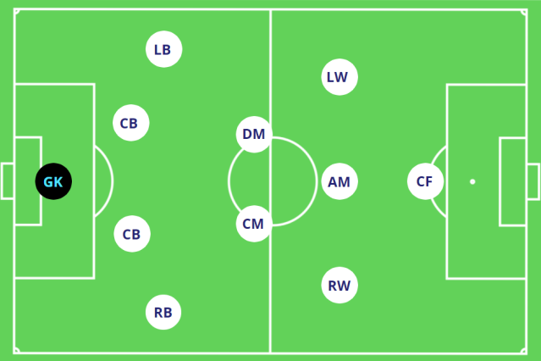
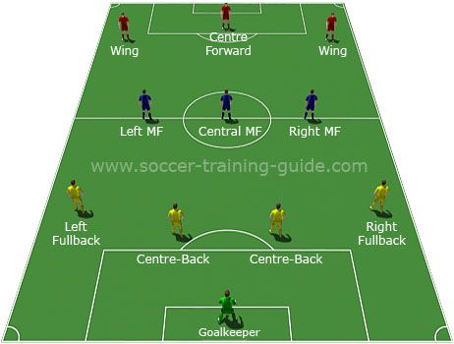
PROBLEM
The problem we are trying to solve is to help football coaches and scouts identify the best position for a player based on their skills and physical attributes.
This will help teams build a balanced and effective squad, leading to better performance on the field.

Slide 4
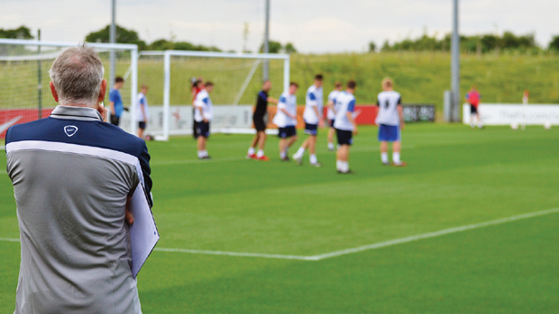
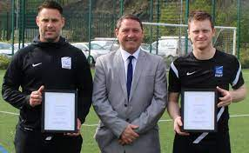
TARGET USERS
Our targeted users are football coaches and scouts who need to make informed decisions on player positions.
This model can also be used by players to identify areas they need to improve in order to play in their desired position.

Slide 5
FEATURES AND ALGORITHMS
We used 6 features: pace, shooting, passing, dribbling, defending and physicality
To build our model, we used the k-nearest neighbors algorithm and performed hyperparameter tuning with randomized search cross-validation.

Slide 6
ROOM FOR IMPROVEMENT
One limitation of our model is that it only uses a limited number of features to predict a player's best position. Incorporating more features could improve the accuracy of our predictions.
Additionally, using a different algorithm or fine-tuning our current algorithm further could lead to better results.

Slide 7
SUMMARY
In summary, our project used machine learning to build a model that predicts a football player's best position based on their skills and physical attributes.
The model has potential to be useful for football coaches and scouts in making informed decisions on player positions.

