Slide 1

Python Session - 2
Anirudha Anil Gaikwad
gaikwad.anirudha@gmail.com

Slide 2
What you learn
Install Python
Run Python
Python Keyword
Python Identifiers
Python Variables
Python Literals
Python Comments

Slide 3
Install Python
Download the latest version of Python from URL : https://www.python.org/
Run the installer file and follow the steps to install Python.
During the install process, check Add Python to environment variables. This will add Python to environment variables and you are able to run Python from any drive of the computer.
By default Python installed on following path in Windows
C:\Users\user\AppData\Local\Programs\Python\Python37
Removing the MAX_PATH Limitation :
Windows historically has limited path lengths to 260 characters. This meant that paths longer than this would not resolve and errors would result.
In the latest versions of Windows, this limitation can be expanded to approximately 32,000 characters. Your administrator will need to activate the “Enable Win32 long paths” group policy, or set the registry value HKEY_LOCAL_MACHINE\SYSTEM\CurrentControlSet\Control\FileSystem@LongPathsEnabled to 1.

Slide 4
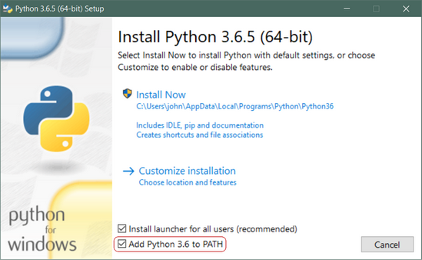

Slide 5
Run Python
Run Python in Immediate mode
Typing python in the command line will invoke the interpreter in immediate mode. We can directly type in Python code and press enter to get the output.

Slide 6
Run Python
Run Python in the Integrated Development Environment (IDE)
We can use any text editing software to write a Python script file.
We just need to save it with the .py extension. But using an IDE can make coding more easier. IDE is a piece of software that provides useful features like code hinting, syntax highlighting and checking, file explorers etc. to the programmer for application development.
when you install Python, an IDE named IDLE is also installed. You can use it to run Python on your computer. It's a decent IDE for beginners.

Slide 7
Run Python
When you open IDLE, an interactive Python Shell is opened.

Slide 8
Run Python
Now you can create a new file and save it with .py extension. For example, filename.py
Write Python code in the file, save it. To run the file go to Run > Run Module or simply click F5.

Slide 9
Python Keyword
Keywords are the reserved words in Python.
We cannot use a keyword as a variable name, function name or any other identifier. They are used to define the syntax and structure of the Python language.In Python, keywords are case sensitive.There are 35 keywords in Python 3.7.3

Slide 10
Python Identifiers
Identifiers refer to the names of variable,class ,object ,functions , lists etc. created by the programmer
An identifier is a long sequence of letters(a-z & A-Z) and numbers(0-9).
No special character except underscore ( _ ) can be used as an identifier.
Keyword should not be used as an identifier name.
Python is case sensitive. So using case is significant.
First character of an identifier can be letter, underscore ( _ ) but not digit.

Slide 11
Python Literals
String literals:
x='abc' OR y=”1234”
Numeric literals:
I=105 #Integer Literals
a = 0b1010 #Binary Literals
b = 100 #Decimal Literal
c = 0o310 #Octal Literal
d = 0x12c #Hexadecimal Literal
float_1 = 10.5 #Float Literal
float_2 = 1.5e2 #Float Literal
x = 3.14j #Complex Literal
Boolean literals: True or False
Special literals : None(None is used to specify to that field that is not created. It is also used for end of lists in Python)

Slide 12
Python Variables
Variable is a name of the memory location where data is stored.
It is helpful to think of variables as a container that holds data which can be changed later throughout programming.
Assigning values to Variable: x=30
Multiple Assignment: x=y=z=30 0r x,y,z=15,100,150

Slide 13
Python Comments
Single lined comment:
# This is single line comment
Multi lined Comment :
''''' This
Is
Multipline
comment'''

Slide 14
THANKS

