Slide 1

Python Session - 6
Anirudha Anil Gaikwad
gaikwad.anirudha@gmail.com

Slide 2
What you learn
Python Errors and Built-in Exceptions
Python Exception Handling - Try,Except and Finally
Python OOP
Python Operator Overloading
Constructor
Method Overloading and Method Overriding

Slide 3
Python Errors
When writing a program encounter errors.
Error caused by not following the proper structure (syntax) of the language is called syntax error or parsing error.
x=10
if x>5
print(x)
We can notice here that a colon is missing in the if statement.
Errors can also occur at runtime and these are called exceptions.
for example, when a file we try to open does not exist (FileNotFoundError), dividing a number by zero (ZeroDivisionError), module we try to import is not found (ImportError) etc.
Whenever these type of runtime error occur, Python creates an exception object. If not handled properly, it prints a traceback to that error along with some details about why that error occurred.

Slide 4
Built-in Exceptions

Slide 5
Built-in Exceptions

Slide 6
Built-in Exceptions

Slide 7
Python Exceptions
An exception can be defined as an abnormal condition in a program resulting in the disruption in the flow of the program.
Python provides us with the way to handle the Exception so that the other part of the code can be executed without any disruption. However, if we do not handle the exception, the interpreter doesn't execute all the code that exists after the that.
The Exception Handling in Python is one of the powerful mechanism to handle the runtime errors so that normal flow of the application can be maintained.

Slide 8
Python Exception Handling
In Python, exceptions can be handled using a try statement.
A critical operation which can raise exception is placed inside the try clause and the code that handles exception is written in except clause.
# import module sys to get the type of exception
import sys
randomList = ['a', 0, 2]
for entry in randomList:
try:
print("The entry is", entry)
r = 1/int(entry)
break
except:
print("Oops!",sys.exc_info()[0],"occured.")
print("Next entry.")
print()
print("The reciprocal of",entry,"is",r)

Slide 9
Catching Specific Exceptions
try:
# do something
pass
except ValueError:
# handle ValueError exception
pass
except (TypeError, ZeroDivisionError):
# handle multiple exceptions
# TypeError and ZeroDivisionError
pass
except:
# handle all other exceptions
pass

Slide 10
Raising Exceptions
exceptions are raised when corresponding errors occur at run time, but we can forcefully raise it using the keyword raise.
try:
age = int(input("Enter the age?"))
if age<18:
raise ValueError;
else:
print("the age is valid")
except ValueError:
print("The age is not valid")

Slide 11
try...finally
We can use the finally block with the try block in which, we can pace the important code which must be executed before the try statement throws an exception.
try:
fileptr = open("file.txt","r")
try:
fileptr.write("Hi I am good")
finally:
fileptr.close()
print("file closed")
except:
print("Error")

Slide 12
Custom Exceptions
sometimes you may need to create custom exceptions that serves your purpose.
In Python, users can define such exceptions by creating a new class. This exception class has to be derived, either directly or indirectly, from Exception class. Most of the built-in exceptions are also derived form this class.
class ErrorInCode(Exception):
def __init__(self, data):
self.data = data
def __str__(self):
return repr(self.data)
try:
raise ErrorInCode(2000)
except ErrorInCode as ae:
print("Received error:", ae.data)

Slide 13
Python OOP
Python is a multi-paradigm programming language. Meaning, it supports different programming approach.
One of the popular approach to solve a programming problem is by creating objects. This is known as Object-Oriented Programming (OOP).
Class
Object
Method
Inheritance .
Encapsulation
Polymorphism
Data Abstraction

Slide 14
Python OOP - Class and Object
A class is a blueprint for the object.
class ClassName:
<statement-1>
.
.
<statement-N>
The object is an entity that has state and behavior. It may be any real-world object like tree,fruit etc.
Everything in Python is an object, and almost everything has attributes and methods. All functions have a built-in attribute
objName = ClassConstructor()

Slide 15
Python OOP - Method and Inheritance
Methods are functions defined inside the body of a class. They are used to define the behaviors of an object.
def MethodName(Argument1,Argument2):
Inheritance provides code reusability to the program because we can use an existing class to create a new class instead of creating it from scratch. In inheritance, the child class acquires the properties and can access all the data members and functions defined in the parent class. A child class can also provide its specific implementation to the functions of the parent class.
class derived-class(base class1):

Slide 16
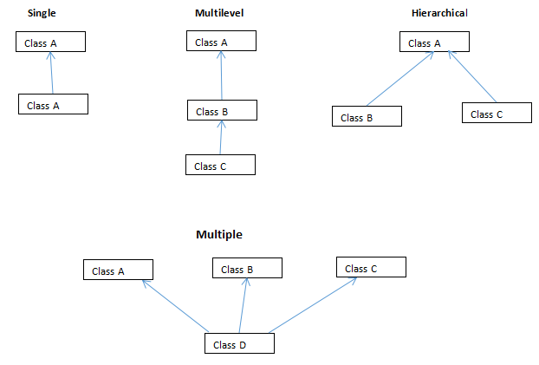
Python OOP - Inheritance Types

Slide 17
Python OOP - Encapsulation
Using OOP in Python, we can restrict access to methods and variables. This prevent data from direct modification which is called encapsulation
Python OOP - Polymorphism
Polymorphism is an ability (in OOP) to use common interface for multiple form (data types).

Slide 18
Python OOP - Data Abstraction
we can also perform data hiding by adding the double underscore (___) as a prefix to the attribute which is to be hidden. After this, the attribute will not be visible outside of the class through the object.

Slide 19
Operator Overloading in Python
Python operators work for built-in classes. But same operator behaves differently with different types. For example, the + operator will, perform arithmetic addition on two numbers, merge two lists and concatenate two strings.
Oerator Overloading allows same operator to have different meaning according to the context is called operator overloading

Slide 20
Python Constructor
A constructor is a special type of method (function) which is used to initialize the instance members of the class.
There are two types of Constructors.
1) Parameterized Constructor
2) Non-parameterized Constructor
Constructor definition is executed when we create the object of this class.
In python, the method __init__ simulates the constructor of the class. This method is called when the class is instantiated.

Slide 21
THANKS

