Slide 1
Change Detection – What does it do?
<h1>Counter = {{counter}}</h1>
Binding Expressions
@if(counter % 2 === 0) {
<h2>Even</h2>
}
Compare current and the previous value of the binding expressions
If changed, update the proper place in the DOM

Slide 2
Change Detection – When does it happen?
Depends on the change detection strategy
On Push
Angular inputs changes
Angular events triggered
When triggered using ChangeDetectorRef
A few more selected triggers
Default
Seems like all the time…
But how?

Slide 3
Thread and Tasks – Simplified
function
Thread
Tasks Queue
function
function
setTimeout ( )
setInterval ( )
addEventHandler ( )
XHR.send ( )
Script file loaded ( )
Promise.then ( )
Promise.catch ( )
queueMicrotask ( )
function
function
function
function
function
function
function
function
function

Slide 4
Zone - Simplified
Pre
function
Post
Thread
Tasks Queue
Pre
function
Post
Pre
function
Post
setTimeout ( )
setInterval ( )
addEventHandler ( )
XHR.send ( )
Script file loaded ( )
Promise.then ( )
Promise.catch ( )
queueMicrotask ( )
function
function
Pre
Post
function
function
function
function
function
function
function

Slide 5
Writeable Signals
42
Creating a signal
Reading the value
Binding to the value
Modifying the value
readonly firstSignal = signal(42);
let val = this.firstSignal();
<h1>
First Signal: {{firstSignal()}}
</h1>
this.firstSignal.set(10);
this.firstSignal.update(value => value + 1);

Slide 6
Computed Signals
10
X => X *2
20
Creating a computed signal
Reading the value
Binding to the value
Modifying the value
readonly derived = computed(() => firstSignal() * 2);
let val = this.derived(); // same as writeable
<h1>
Derived Signal: {{derived()}} // same as writeable
</h1>

Slide 7


Computed signals
It’s ok to
Use more than one signal
Use writeable or computed signals
Use constants and immutable non-signal data
But don’t
Use asynchronous code
Use changeable data that is not signal
Cause side effects
Modify or create other signals
computed(() => x() * y())
computed(() => x() * derived())
computed(() => x() * Math.PI)
computed(async () => x() * await calc())
computed(() => x() * Date.now())
computed(() => x() * j++)
computed(() => {
x.update(v => v + 1);
return x() * 10;
})

Slide 8
Effects
Effects are functions that:
Rely on signals
Are executed when the signals change
Auto-magically subscribe and unsubscribe to the signals
effect(() => {
console.log('The first signal value is:', this.firstSignal());
console.log('The second signal value is:', this.secondSignal());
});

Slide 9
Effects
It’s ok to
Use more than one signal
Use async code
Cause side effects
But don’t
Modify any signals
effect(() => console.log(x() * y()))
effect(async () => await service.set(x()))
effect(() => storage.save(x()))
effect(() => x.set(10))

Slide 10
Reactive Context
Locations in you code where angular follows calling signals
Inside the body of computed
Inside the body of effect
readonly derived = computed(() => firstSignal() * 2);
effect(() => {
console.log('The first signal value is:', this.firstSignal());
console.log('The second signal value is:', this.secondSignal());
});

Slide 11
When in reactive context…
It’s ok to
Read from signals
But don’t
Modify signal
Create a new signal
Create an effect
const x = mySignal()
computed(() => {
x.update(v => v + 1);
return x() * 10;
})
computed(() => {
const total = x() + y();
return {sum: signal(total)}
})
effect(() => {
if (sum() > 10) {
effect(() => console.log(y())
}
})

Slide 12
Signals and Immutability
readonly names = signal(['Alice', 'Bob', 'Charlie']);
addName() {
this.names().push('David');
}
addName() {
this.names.update(list => [...list, 'David']);
}

Slide 13
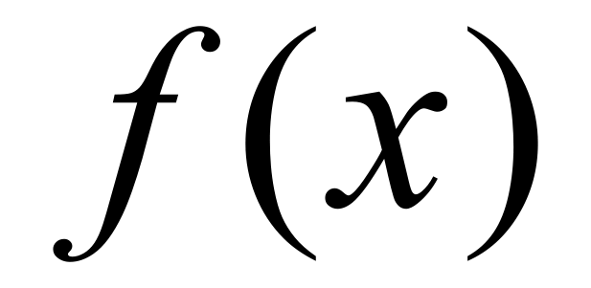
Signals === Functional!

Slide 14
Functional Guards
ng old
export class AuthGuard implements CanActivate {
constructor(private readonly auth: AuthService) {}
canActivate() {
return this.auth.isLoggedIn();
}
}
ng new
export const authGuard: CanActivateFn =
() => inject(AuthService).isLoggedIn();

Slide 15
The new Angular API
Based on Functions instead of decorators
Based on Signals
ng old
export class BeforeComponent {
constructor(@Inject(SOME_NUMBER) private num: number) {} @Input({required: true}) title!: string;
}
ng new
export class AfterComponent {
readonly num = inject(SOME_NUMBER);
readonly title = input.required<string>(); }

Slide 16
Why functions?
Avoid unnecessary classes just for dependency Injection
Less decorators
Less lifecycle hooks
Cleaner, more direct code

