Slide 1


SMART INDIA HACKATHON 2024
Problem Statement ID:- SIH1659
Problem Statement Title:- Data download Duplication Alert System (DDAS)
Theme:- Miscellaneous
PS Category:- Software
Team ID:-
Team Name:- Team Acutis

Slide 2
Data download Duplication
Alert System (DDAS)
Acutis
Proposed Solution
To create an browser extension and backend server that establish a centralized database that stores metadata for all downloaded datasets across the organization.
TThe database will have fields such as file names, sizes, timestamps, unique identifiers (hashes), and download locations
Whenever the user asks to downloadac a file, it is checked by system against the database in order to discover possible duplicates and warn about them..
For the situations when downloaded files and existing file have different name and size but same data, they are converted into hashes which helps compare them with existing ones in order to avoid false alerts and prevent missing duplicate contents.
How it addresses the problem
An extension for the browsers will automatically detect downloads.
Unique identifier is assigned to each files.
The system will then check its footprint against the database of existing fingerprints. If it finds a duplicate, it confirms.
Next, the system cross checks this “footprint” with the centralized database to see if there is a match with any other files within the network or system.
The alert will provide existing file download timestamp, location, filename etc
It notifies the user who tries to download it
For the future preference,all detected duplicates and alerts are logged for auditing and reporting purposes
Browser Extension<-----Metadata----->Centralized database ———> Alerts the user if matched
Downloads -----hashes----> Centralized database ———> Alerts the user if matched
Innovation and uniqueness of the solution
The solution facilitates user with automatic alerting system for any duplicate files in the system or the network.It also provides an secure encryption system for the metadatas to avoid any data leaks.User Authentication & Access Control is monitored and maintained.

Slide 3
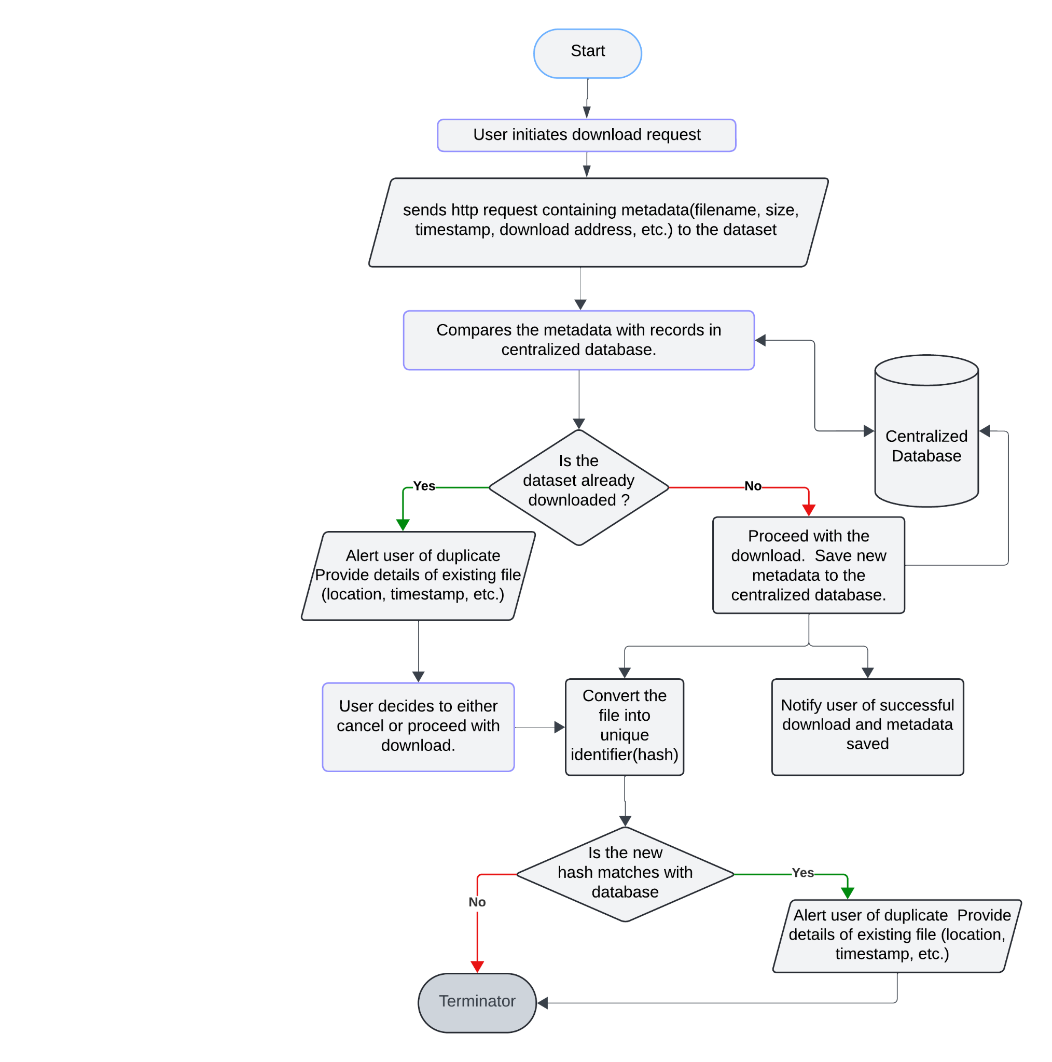
TECHNICAL APPROACH
Acutis
Flow chart for Implementation
Technologies used
MYSQL(Database)
High level Language(JAVA, Python)
JavaScript
Browser Extension

Slide 4
FEASIBILITY AND VIABILITY
Acutis
Feasibility Analysis
The centralized Meta-database is technically and economically feasible with optimized architecture and accurate duplicate detection through hashing
Initially the setup can be complex but its highly user friendly as the whole system is automatic.
Cost-benefit analysis shows long-term savings in storage and data management outweigh initial investment.
Challenges and Risks
Data privacy, security, maintaining data consistency, optimizing system performance and overcoming the user resistance
Incorrect duplicate detections, wrong alerts, poor system performance can cause minimize system’s effectiveness.
Maintaining data consistency across multiple sources and Compatibility issues with existing systems and databases.
Strategies for Overcoming Challenges
To tackle data privacy local database is implemented instead of a web database.
Limit the database access to avoid privilege escalation
To handle Incorrect duplicate detection and wrong alerts two factor detection is used.
Conduct regular system audits and performance optimizations. Implementing local or intranet database instead of web database can also be a solution

Slide 5
IMPACT AND BENEFITS
Acutis
Potential impact on the target audience
Benefits of the solution
1. Improves Productivity
Reduced Redundant Efforts: Users will no longer waste time downloading and managing duplicate files. This allows them to focus on more important work, thereby increasing overall productivity of the organization.
2. User Satisfaction
Improved Experience: By making data management simpler and more efficient, the system enhances the overall user experience, who rely on quick access to accurate data.
3.Improves Data Integrity
Accurate and Consistent Data: User benefits from having a single, authoritative version of datasets, reducing the risk of discrepancies and ensuring that all users are working with accurate data.
4. Cost Savings
Operational Cost Reduction: By avoiding duplicate downloads, the system reduces the consumption of bandwidth and storage resources, leading to significant cost savings.
1. Social Benefits
Increased Accessibility: The reduction of redundant data simplifies data management processes, making data more accessible to users who may not have advanced technical skills.
2. Economic Benefits
Cost Savings: The reduction in bandwidth usage, storage requirements, and IT maintenance leads to significant cost savings for organizations. These savings can be reinvested in other areas, such as innovation or employee development.
Resource Optimization: Efficient use of resources (like storage and bandwidth) decreases the need for frequent upgrades to infrastructure, which can be costly.
3. Environmental Benefits
Reduced Energy Consumption: The reduction in unnecessary data transfers minimizes the energy used in network operations. It is necessary as data transmission over the internet requires significant energy for network infrastructure.
Efficient Data Storage: By preventing duplicate data downloads, Data download Duplication Alert System(DDAS) increases efficiency in Data storage
.

Slide 6
RESEARCH AND REFERENCES
Acutis
Extension Ideas:
https://developer.chrome.com/docs/extensions
DataBase Implementation:
https://www.w3schools.com/sql/default.asp
https://dev.mysql.com/doc/
Java Documentation:
https://docs.oracle.com/en/java/

