Slide 1

FORECASTING ROAD SAFETY: A PREDICTIVE MODEL FOR ACCIDENT SEVERITY

Slide 2






WHY?
National Highway Traffic Safety Administration reported 42,795 dead in motor vehicle accidents in 2023.
1.19 million people die each year from road crashes (World Health Organization).
Road traffic injuries are the top causes of death for people ages 5–29.
Road traffic crashes cost most countries 3% of their gross domestic product.
More than half of all road traffic deaths are among vulnerable road users, including pedestrians, cyclists and motorcyclists.
Notes:
DEFINING THE PROBLEM
In 2023 the National Highway Traffic Safety Administration released their latest projections for traffic fatalities: 42,795 people died in a motor vehicle crash.
Approximately 1.19 million people die each year as a result of road traffic crashes.
Road traffic injuries are the leading cause of death for children and young adults aged 5–29 years.
Road traffic crashes cost most countries 3% of their gross domestic product.
More than half of all road traffic deaths are among vulnerable road users, including pedestrians, cyclists and motorcyclists.

Slide 3
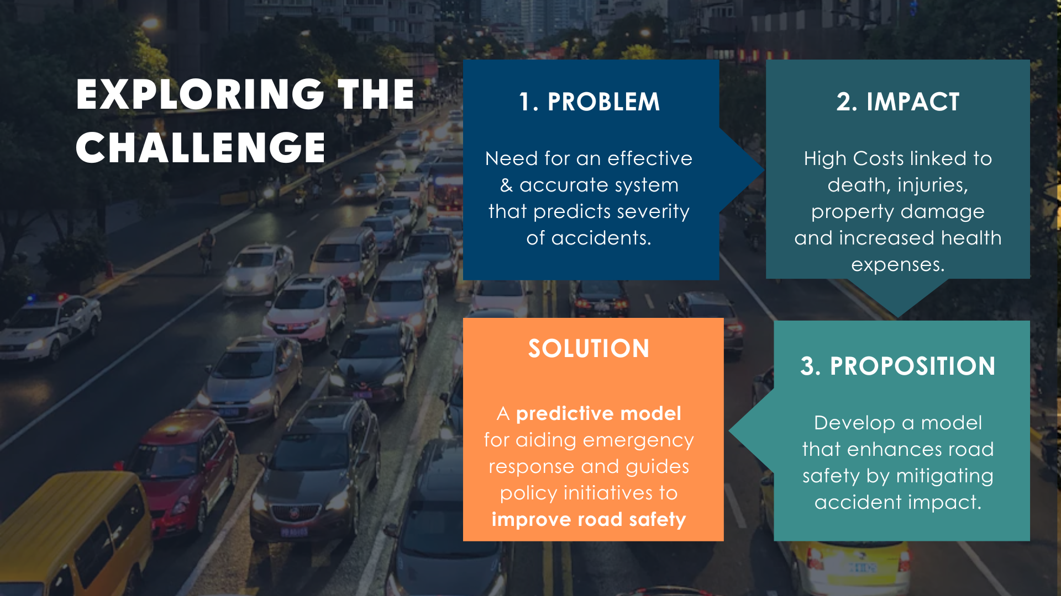
Notes:
BUSINESS PROBLEM
The business problem addressed in this project is the need for an effective & accurate system to forecast road safety by predicting the severity of accidents.
Road accidents result in significant human and economic cost, including loss of life, injuries, property damage and increased health expenses.
Therefore, developing a model for accident severity can contribute to proactive measure for preventing or mitigating the impact of accidents, ultimately enhancing road safety.
The primary goal is to create a predictive model that not only aids in emergency response but also supports the development of policies and initiatives aimed at enhancing road safety.

Slide 4
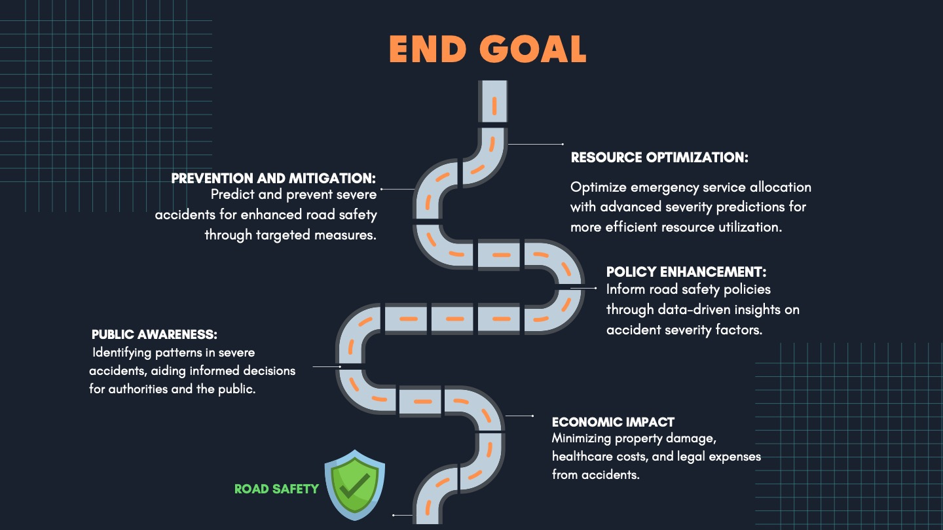
Notes:
In 2023 the National Highway Traffic Safety Administration released their latest projections for traffic fatalities: 42,795 people died in a motor vehicle crash.
Approximately 1.19 million people die each year as a result of road traffic crashes.
Road traffic injuries are the leading cause of death for children and young adults aged 5–29 years.
Road traffic crashes cost most countries 3% of their gross domestic product.
More than half of all road traffic deaths are among vulnerable road users, including pedestrians, cyclists and motorcyclists.

Slide 5
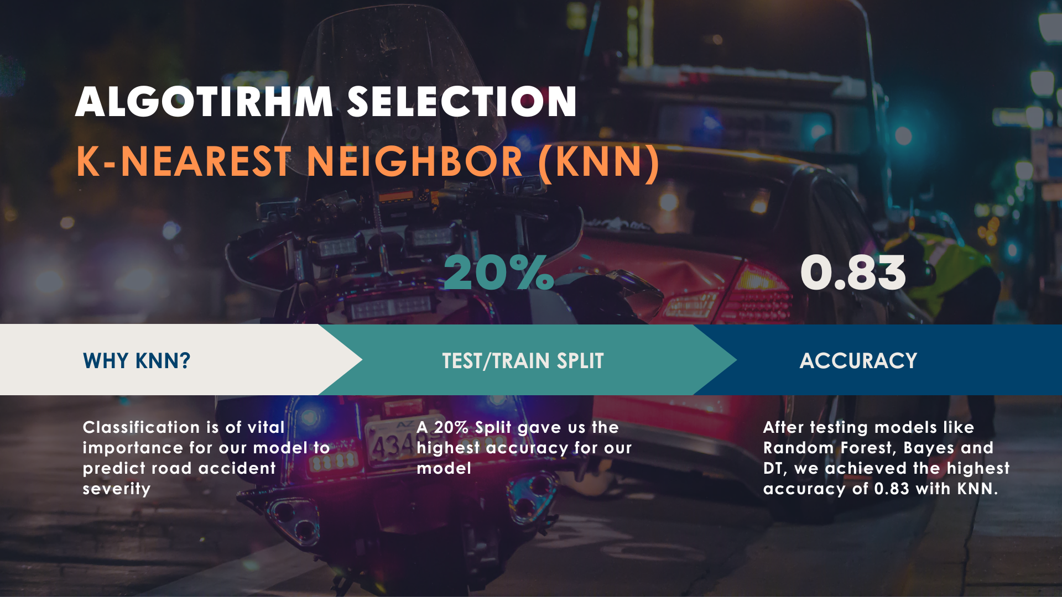

Slide 6

Dataset Description
Collected from
Addis Ababa Sub-city police departments for master's research work
Source
Records of road traffic accidents between 2017-2020
Final Dataset
32 features
12316 instances of accidents

Slide 7
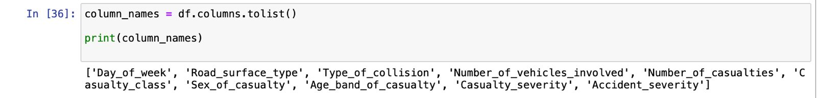
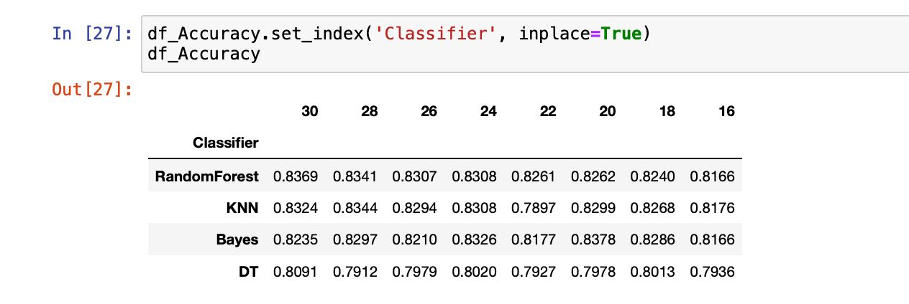
Variables Description
Input variable
32 Variables (30 categorical variables – 2 numerical variables )
Selected Variable
Output Variable
8 categorical variables

Slide 8
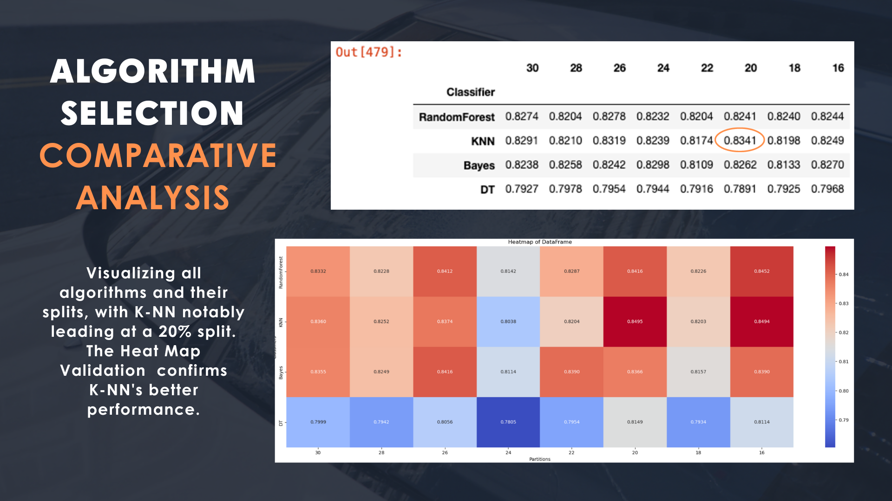
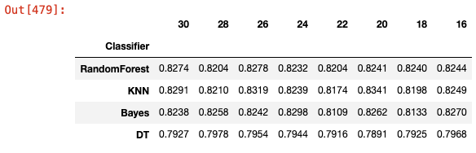
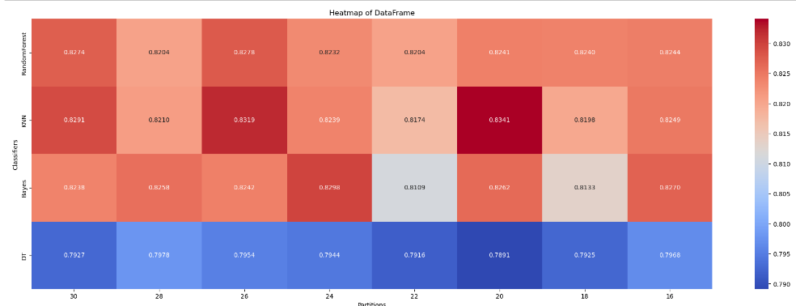
K Nearest Neighbor (K-NN)
The first image shows a comparison of all the algorithms with their respective splits.
K-NN has the highest value at 20% split.
The second image depicts a heat map confirming the same.

Slide 9
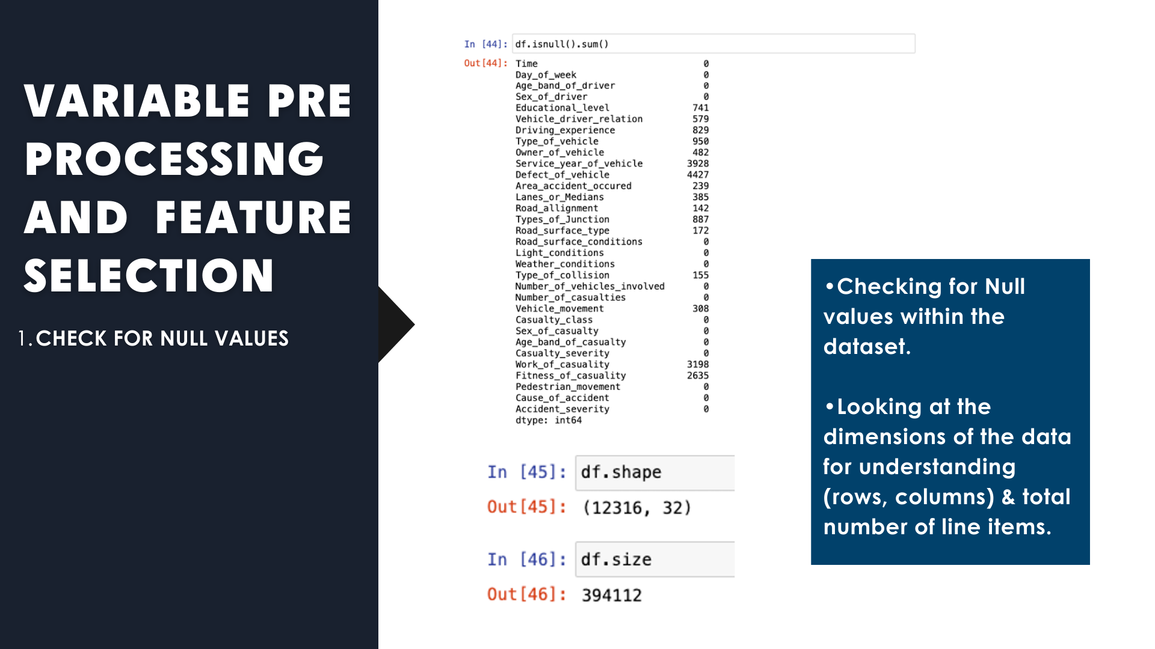

Slide 10
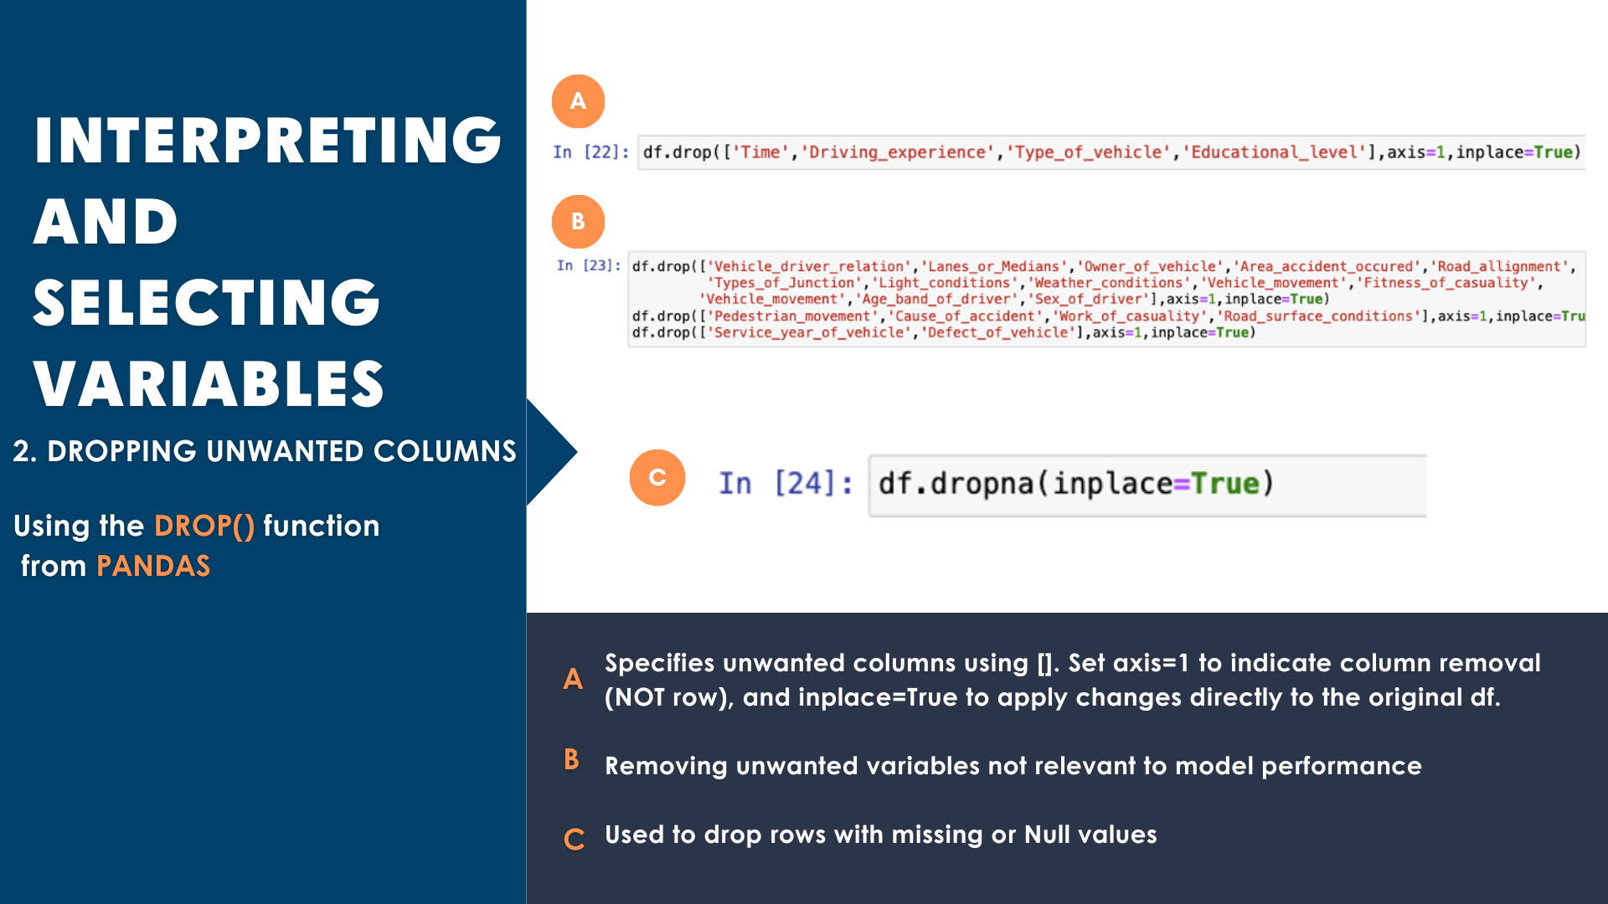
Variable Selection & Interpretability
The drop() function from Pandas is used to drop certain features that don’t add value to the model.
The first line drops the specified columns from the data frame df. The columns listed within the square brackets are removed. The axis=1 parameter indicates that you are dropping columns (as opposed to rows), and in place=True means the changes are applied directly to the original data frame.
The second line drops another set of columns from the data frame df.
The third line drops yet another set of columns.
The df.dropna(inplace=True) line is used to drop rows with missing or Null values

Slide 11
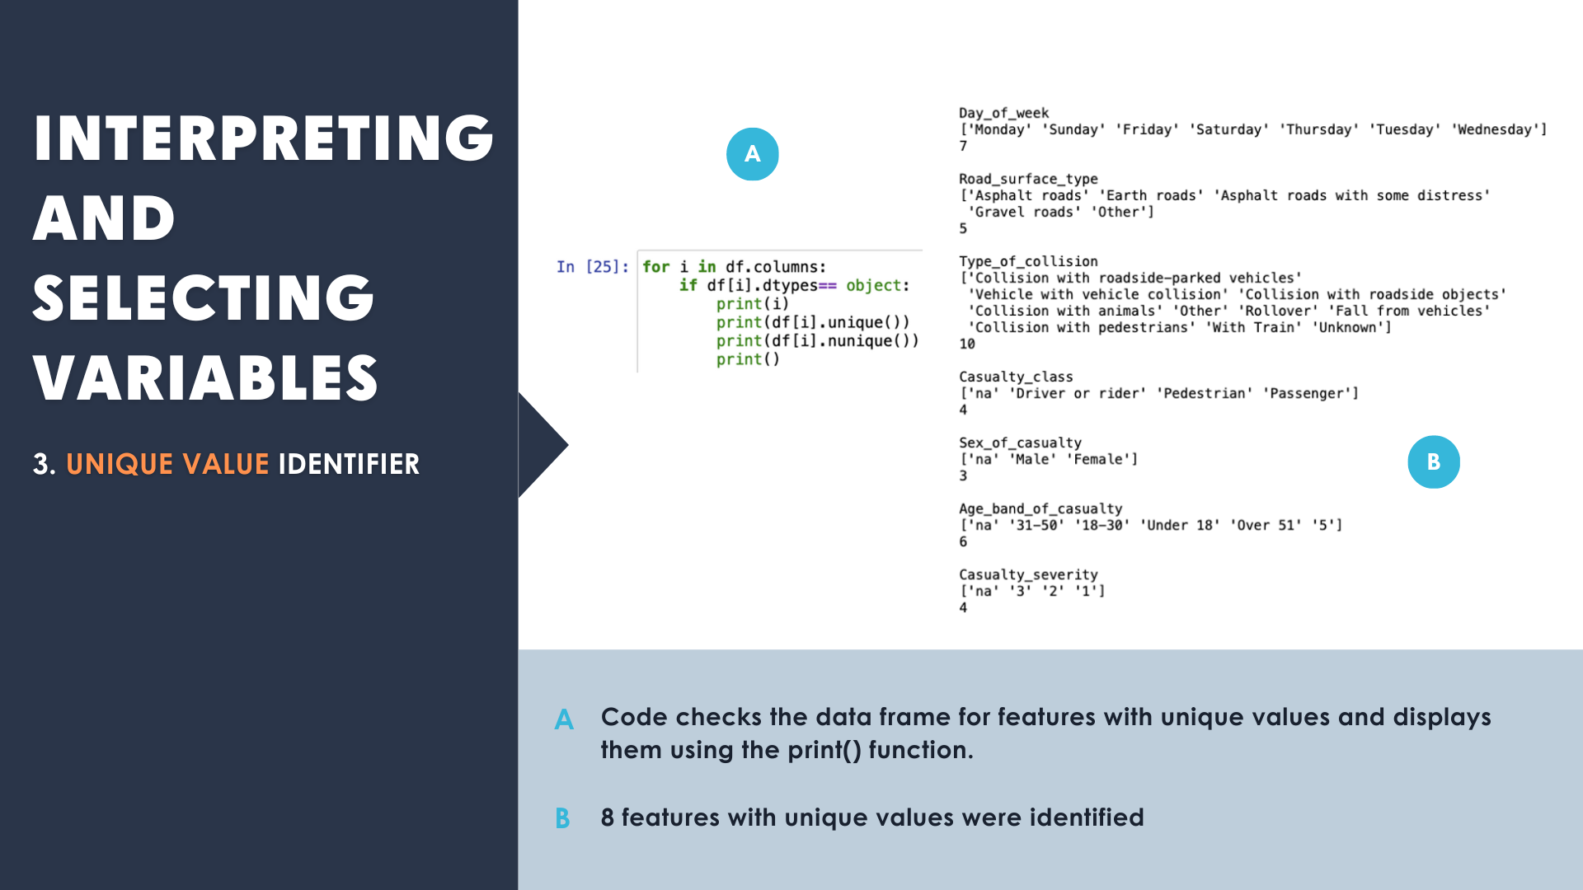
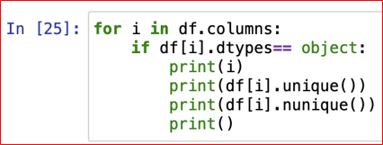
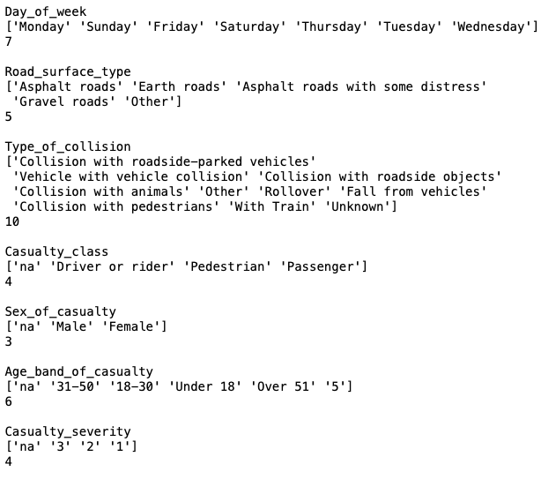
Variable Selection & Interpretability Cont.
The code checks the data frame for features with unique values.
The values are then displayed using the print() function.
From the output we know that there are 8 features with unique values.

Slide 12
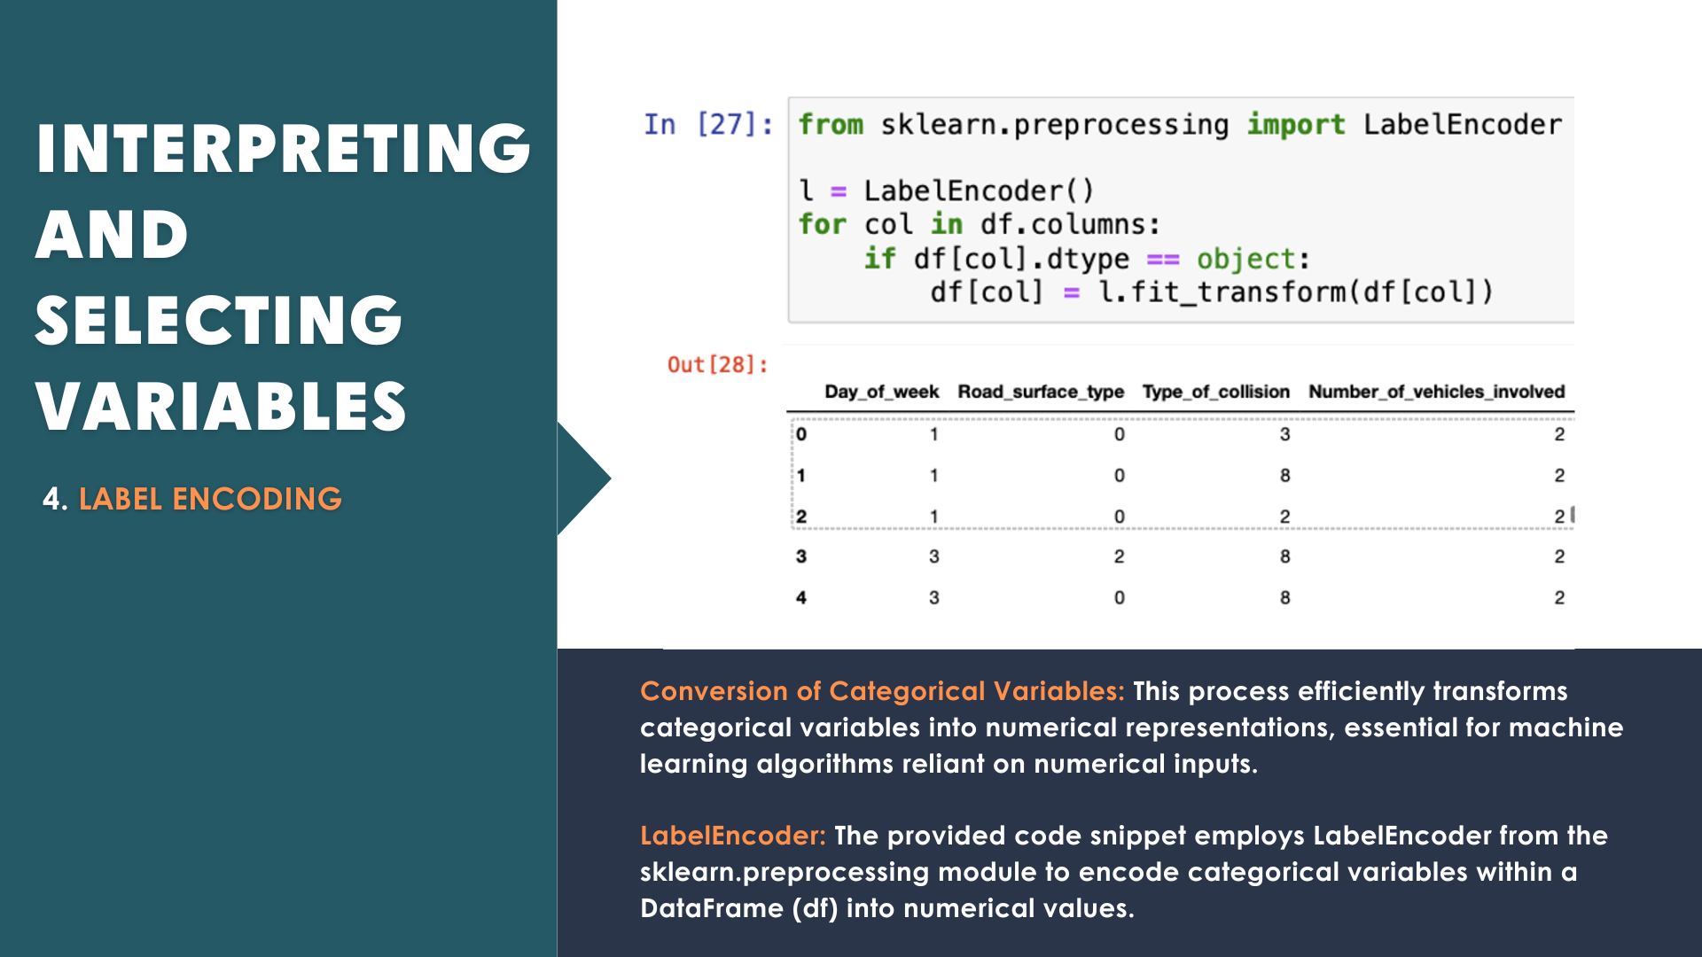
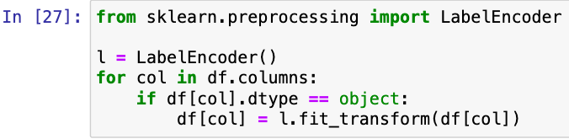
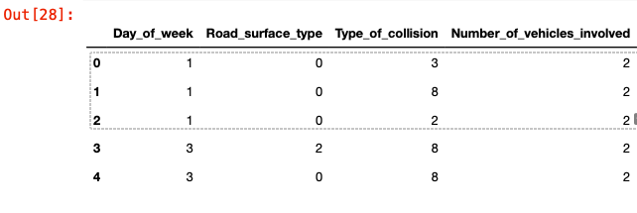
Label Encoding
This process effectively converts categorical variables into numerical representations, which can be useful for machine learning algorithms that require numerical inputs.
This code snippet is using LabelEncoder from the sklearn.preprocessing module to encode categorical variables in a data frame (df) into numerical values.

Slide 13
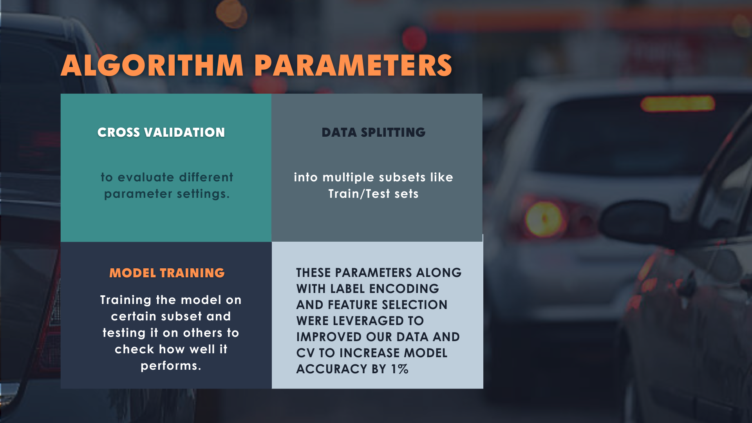
Algorithm Parameters
Used techniques like cross validation to evaluate different parameter settings.
This involved splitting our data into multiple subsets.
Training the model on certain subset and testing it on others to check how well it performs.
We identified that these parameters can be leveraged to improve our data and model accuracy.

Slide 14
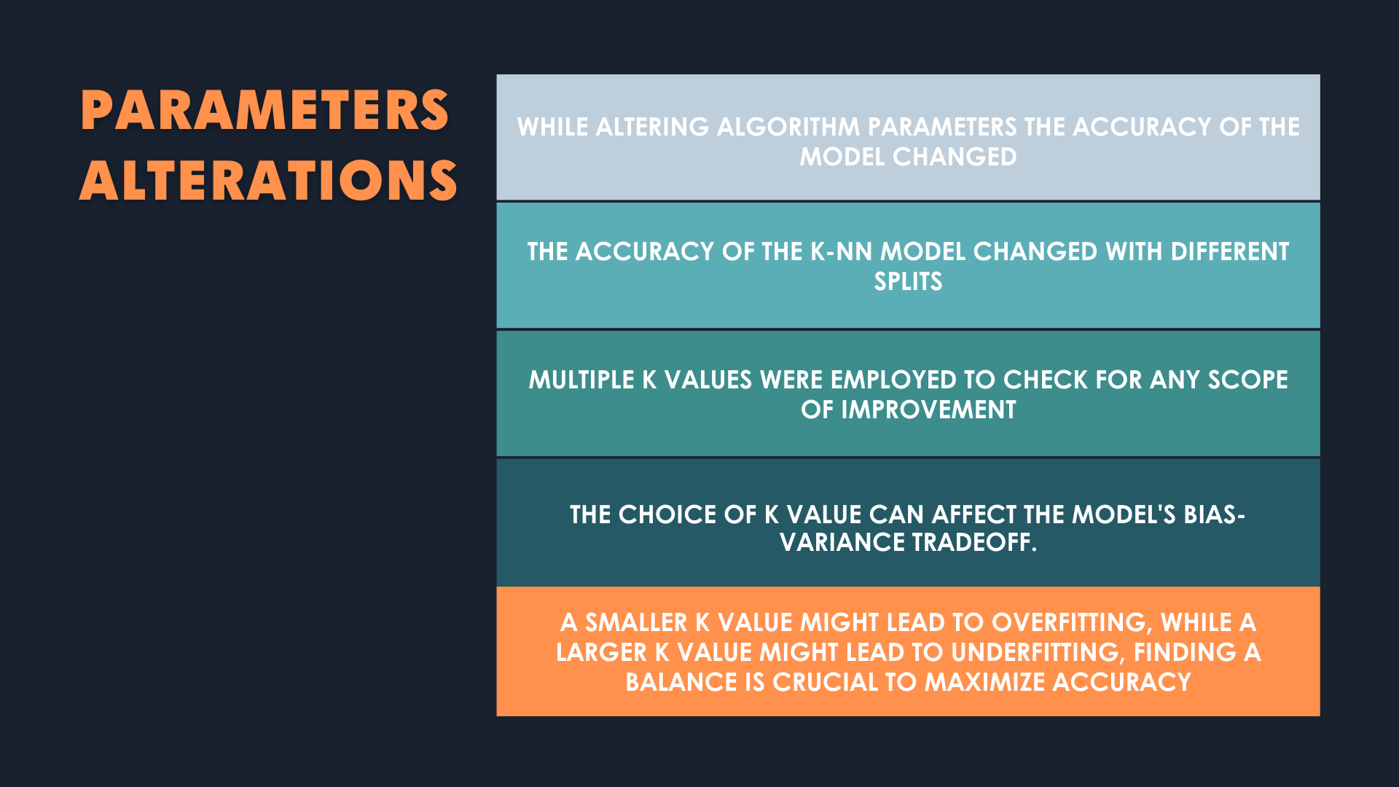
Algorithm Parameter Alterations
While altering algorithm parameters the accuracy of the model changed.
The accuracy of the K-NN model changed with different splits.
Multiple K values were employed to check for any scope of improvement.
The choice of K value can affect the model's bias-variance tradeoff.
A smaller K value might lead to overfitting, while a larger K value might lead to underfitting.
Finding the right balance is crucial for maximizing accuracy.

Slide 15
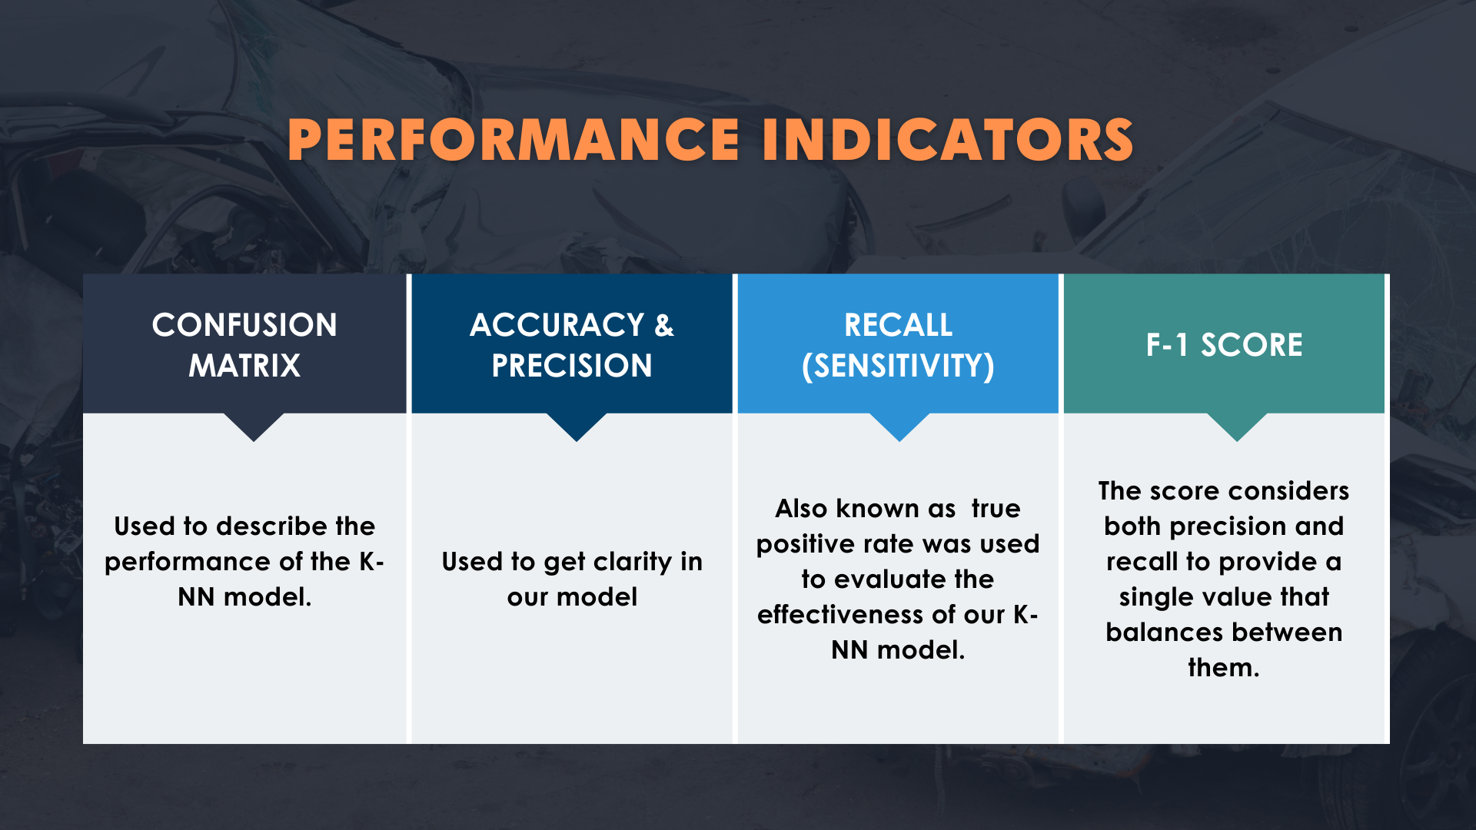
Performance Indicators
Multiple performance indicators were used to check the model.
Confusion-Matrix was used to describe the performance of the K-NN model.
Accuracy and Precision were looked at for model clarity.
Recall also known as sensitivity or true positive rate was a performance metric used to evaluate the effectiveness of our K-NN model.
F1-Score, it considers both precision and recall to provide a single value that balances between them.

Slide 16

Conclusion
Our model exhibits promising capabilities in forecasting the severity of road accidents, offering valuable insights for preemptive measures and resource allocation.
With an impressive accuracy rate of 83%, our model presents a valuable asset for governmental organizations tasked with safeguarding road safety. Its precision ensures informed decision-making and efficient allocation of resources.
Through rigorous testing and comparison, our project yielded multiple models, each tailored for optimal performance. Among these models, the K-Nearest Neighbors (K-NN) approach emerged as the most effective, affirming its potential for real-world application.

Slide 17

This Photo by Unknown author is licensed under CC BY-SA.

