Slide 1
Investment Analytics FDI`s

Slide 2
Objective :-
Investing in crucial contributions in nation building via FDI`s routes being put away around GDP parameter. Predicting contribution to consumption patterns and cooling factors in nation building in the initial phase of the design to find out optimal solutions amongst different sectors are quite important, as well as in the operating phase after several turbulence trends in world economies make graphical pattern at microscopic levels inviting several insights of FDI`s moods . In this project, different models were applied for forecasting significant loads of a sectors which based on a dataset for GDP`s performance.

Slide 3
ARCHITECTURE
Start
Start
Data From Client
Insert In DB
Get From DB
Pre-Processing
Filtering
Patter n Evaluation
Insight Building
Parameter Checking
Feature Scaling
Labelling
Graphical Models
Interpretation Setup
Grouping Trends
Pivotal Sidelining
END
Forecasting
Report Generation

Slide 4
Data Insertion in Database: Using Tableau
Sheets Creation : Sheet name “FDI" is created in the key space having name “FDI in India” for inserting the files. If the sheets are already present then new files are inserted in the same table.
Insertion of files in the table : All the graphical sheets `are inserted in the concern areas. If any sheets has invalid data format in any of the columns, the file is not loaded in the table

Slide 5
Understanding data interpretation Format :
In data interpretation lots of step’s are included, but in that we use some of them. The reason behind that we avoid any ` irrelevant value or categorical column.
Column Name : In that case we just name the column name as their original name such as
Rows Name : In that case we just name the column name as their original name such as
Columns | Financial Years | FYS
Rows | FDI`s | Sum

Slide 6
Model Building :-
Normalization : In these case we normalize all feature value except the target value. So that all the feature value come in one range Move Sheets to visualisation purpose
Preprocessing: Unpivoting data from converting wide format to long format
Splitting Data : In these case we split up the data into train and test to get graphical patterns
Cleaning Model : In these case we use ` specific options as per our problem statement.
`

Slide 7
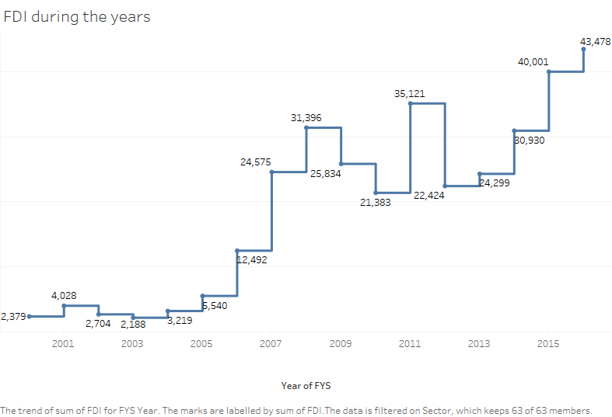

Slide 8
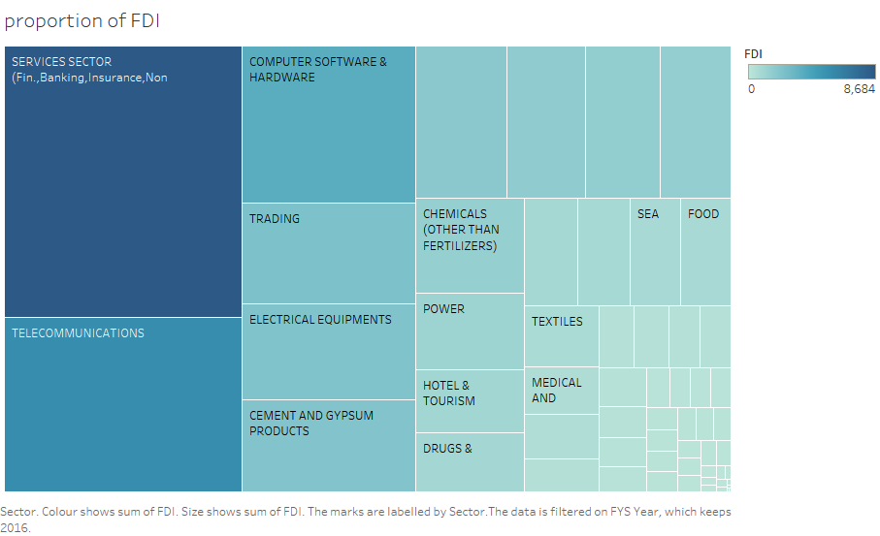

Slide 9
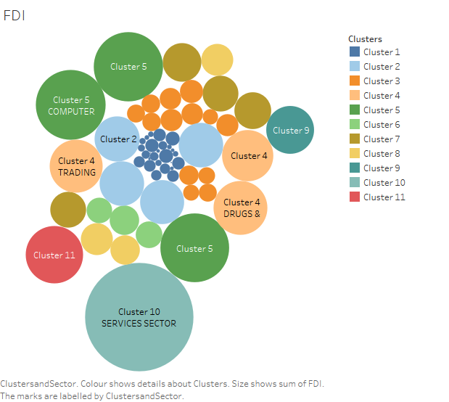

Slide 10
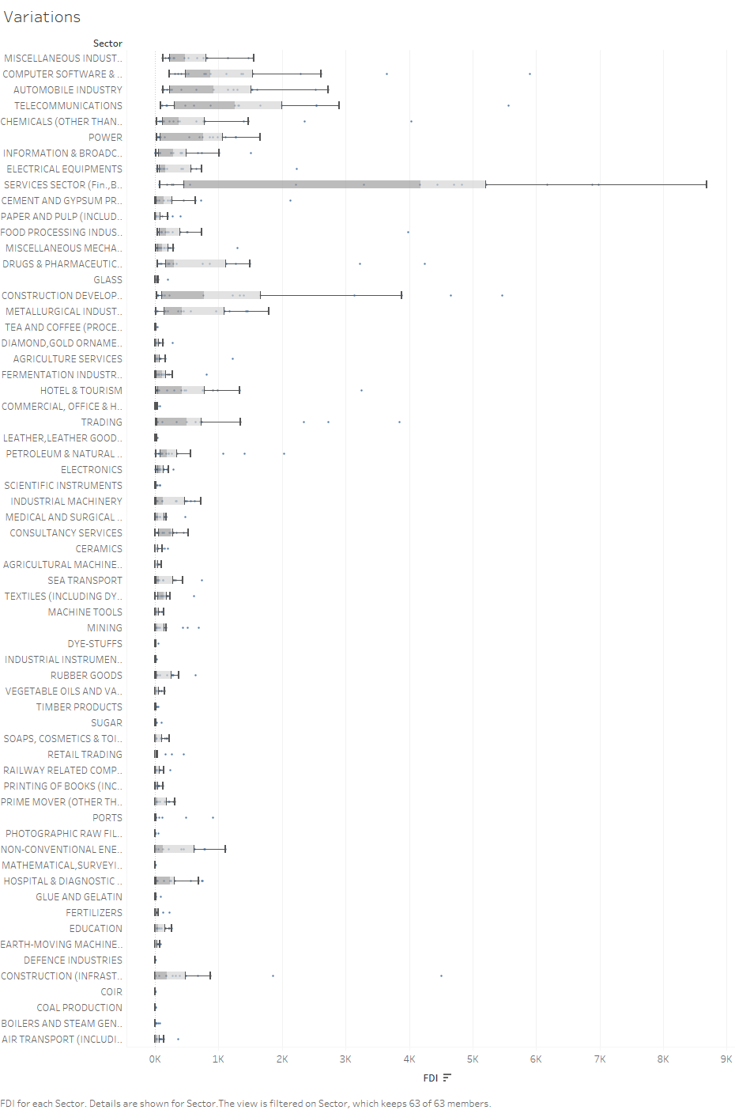
Variation In Contribution

Slide 11
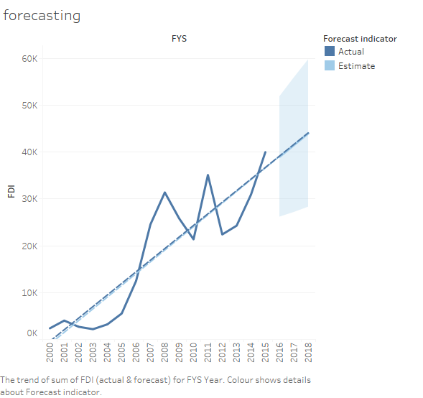
Trending Recognition

Slide 12
THANK YOU

