Slide 1
International Debt Analytics BI

Slide 2
Objective :-
International Debt, a value, borrowed by a government, corporation or private household from another country's government or private lenders. Foreign debt also includes obligations to international organizations such as the World Bank Asian Development Bank (ADB), and the International Monetary Fund (IMF). Total foreign debt can be a combination of short-term and long-term liabilities.
Foreign debt, also known as external debt, has been rising steadily in recent decades, with unwelcome side-effects in some borrowing countries. These include slower economic growth, particularly in low-income countries, as well as crippling debt crises, financial market turmoil and even secondary effects such as a rise in human-rights abuses.
The World Bank, in conjunction with the IMF and the Bank for International Settlements (BIS), gathers short-term foreign debt data from the Quarterly External Debt Statistics (QEDS) database. Long-term external debt data compilation is also collectively accomplished by the World Bank, individual countries that carry foreign debt, and multilateral banks and official lending agencies in major creditor countries.

Slide 3
ARCHITECTURE
Start
Start
Data From Client
Insert In DB
Get From DB
Pre-Processing
Filtering
Patter n Evaluation
Insight Building
Parameter Checking
Feature Scaling
Labelling
Graphical Models
Interpretation Setup
Grouping Trends
Pivotal Sidelining
END
Query Modeling
Report Generation

Slide 4
Data Insertion in Database: Using Jupyter
Sheets Creation : Sheet name “Country Name" is created in the key space having name “Series name” as well as “Series Code”for inserting the files. If the sheets are already present then new files are inserted in the same table.
Insertion of files in the table : All the graphical sheets `are inserted in the concern areas. If any sheets has invalid data format in any of the columns, the file is not loaded in the table

Slide 5
Understanding data interpretation Format :
In data interpretation lots of step’s are included, but in that we use some of them. The reason behind that we avoid any ` irrelevant value or categorical column.
Column Name : In that case we just name the column name as their original name such as
Rows Name : In that case we just name the column name as their original name such as
Columns | Countries Name | Counter Part Area | Debts
Rows | Series Names | Series Code | Values

Slide 6
Model Building :-
Normalization : In these case we normalize all feature value except the target value. So that all the feature value come in one range Move Sheets to visualisation purpose
Preprocessing: Unpivoting data from converting wide format to long format
Splitting Data : In these case we split up the data into train and test to get graphical patterns
Cleaning Model : In these case we use ` specific options as per our problem statement.
`

Slide 7
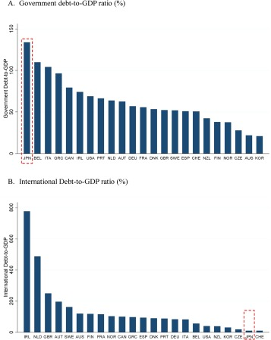

Slide 8
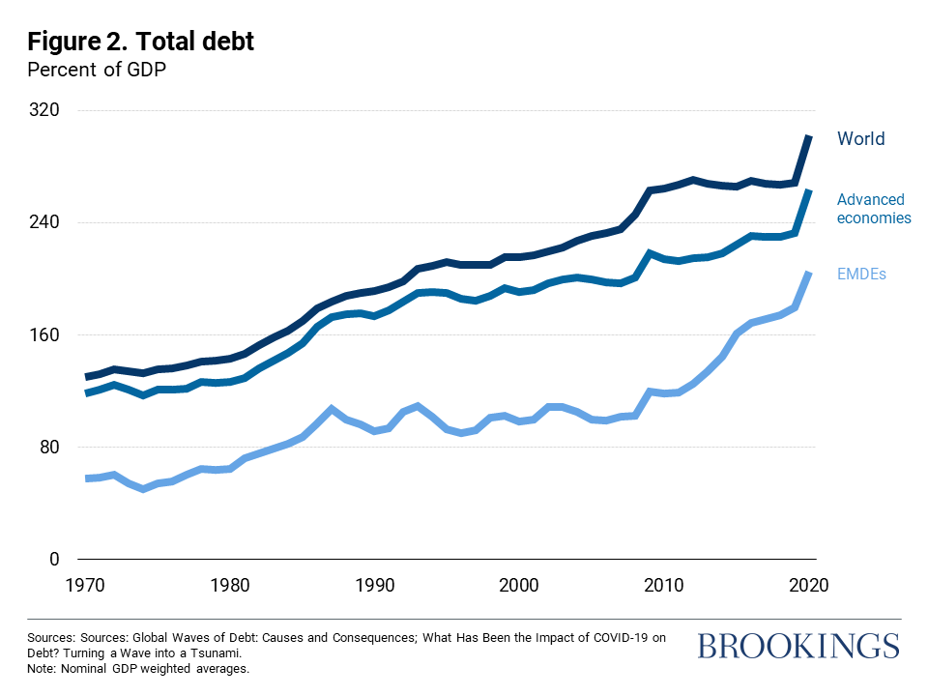

Slide 9
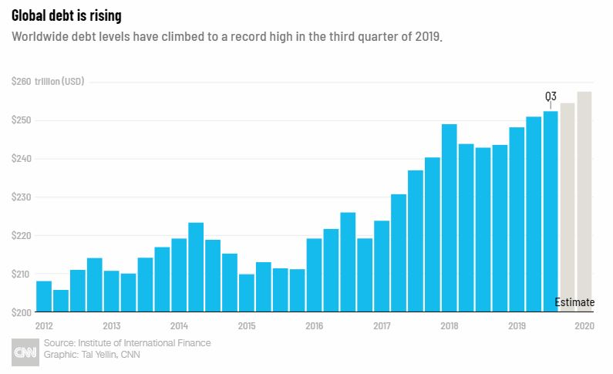

Slide 10
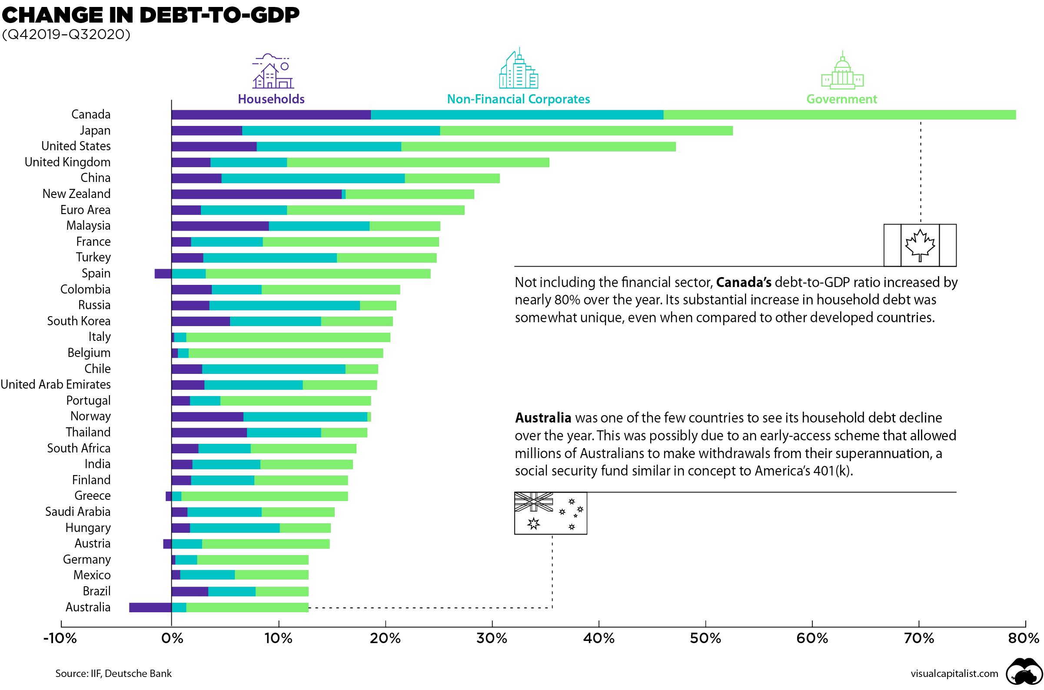
Debts Variation In Contribution

Slide 11
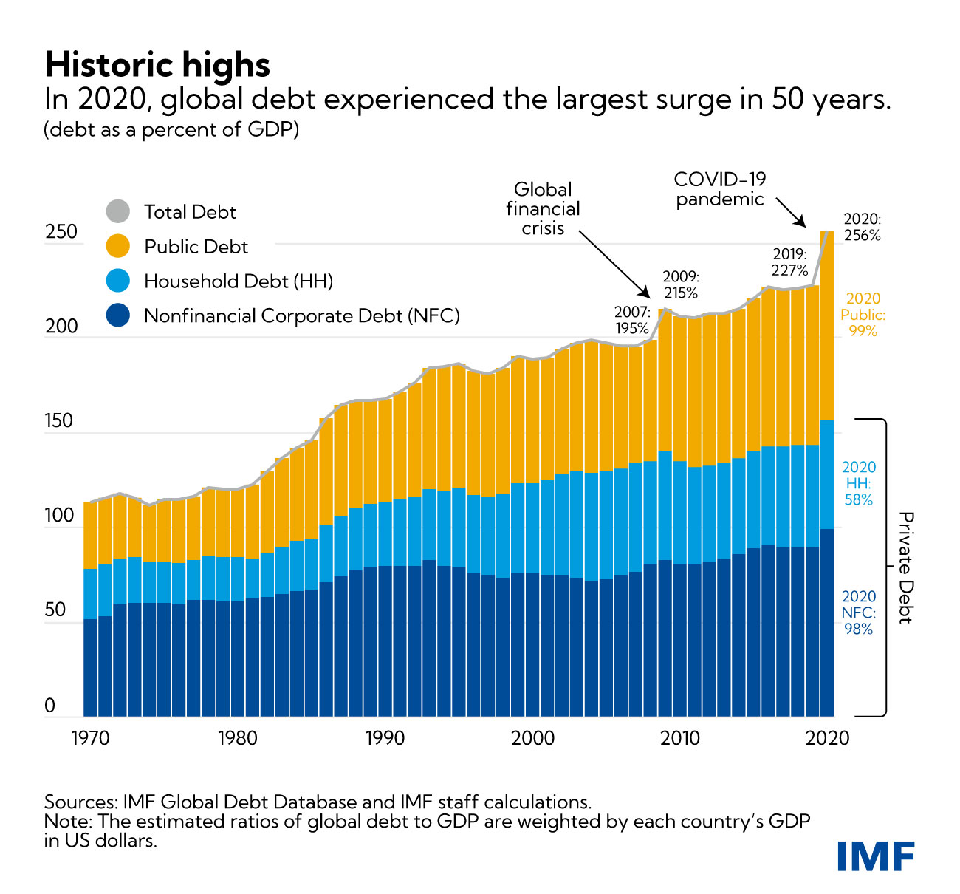
Trending Debts Recognition

Slide 12
THANK YOU

