Slide 1
BLOGGING USING DJANGO

Slide 2
Objective :-
Blogging refers to writing, photography, and other media that's self-published online. Blogging started as an opportunity for individuals to write diary-style entries, but it has since been incorporated into websites for many businesses. The hallmarks of blogging include frequent updates, informal language, and opportunities for readers to engage and start a conversation.
Here's an overview of what a blog is, why it's popular, and tips for starting your own blog.
What defines Blogging?
The word blog is actually a shortened form of its original name, "weblog." These weblogs allowed early internet users to "log" the details of their day in diary-style entries. Blogs often allow readers to comment, so as they became more common, communities sprung up around popular blogs

Slide 3
ARCHITECTURE
Start
Start
Data From Client
Insert In DB
Get From DB
Pre-Processing
Filtering
Patter n Evaluation
Insight Building
Parameter Checking
Feature Scaling
Labelling
Graphical Models
Interpretation Setup
Grouping Trends
Pivotal Sidelining
END
Query Modeling
Report Generation

Slide 4
Data Insertion in Database: Using Jupyter
Sheets Creation : Sheet name “Blogs Name" is created in the key space having name “Series name” as well as “series”for inserting the files. If the sheets are already present then new files are inserted in the same table.
Insertion of files in the table : All the graphical sheets `are inserted in the concern areas. If any sheets has invalid data format in any of the columns, the file is not loaded in the table

Slide 5
Understanding data interpretation Format :
In data interpretation lots of step’s are included, but in that we use some of them. The reason behind that we avoid any ` irrelevant value or categorical column.
Column Name : In that case we just name the column name as their original name such as
Rows Name : In that case we just name the column name as their original name such as
Columns | Blogs Name | Counter Part Area | Details
Rows | Series Names | series | Values

Slide 6
Blogging Building :-
Normalization : In these case we normalize all feature value except the target value. So that all the feature value come in one range Move Sheets to visualisation purpose
Preprocessing: Unpivoting data from converting wide format to long format
Splitting Data : In these case we split up the data into train and test to get graphical patterns
Cleaning Model : In these case we use ` specific options as per our problem statement.
`

Slide 7


Slide 8
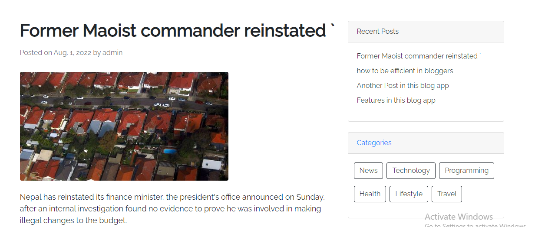

Slide 9
The majority of your SEO efforts will be to create engaging content for real people. Whether that’s through text, videos, or images, your job as a
blogger is to spark a relationship with your readers.
And, what better way is there than through relatable and informative conversation?
We can get started by downloading a plugin

Slide 10

Blogging Variation

Slide 11

Blogging Recognition

Slide 12
THANK YOU

