Slide 1
Movielens Ratings

Slide 2
Objective :-
The movielens scala solution system is machine learning model which helps to find out the co-relation between the input variable and output variable of model building. Each row of dataset represents feedback trend parameter. So our task is to predict the output on the basis of given input variable
The effect of input variables on output variables, namely feedback and ratings of sampling is investigated using a statistical machine learning framework. We have to use a number of classical and non-parametric statistical analytic tools to carefully analyze the strength of each input variable's correlation with each of the output variables in order to discover the most strongly associated input variables. We need to estimate parameters; we can compare a traditional linear regression approach to a sophisticated state-of-the-art nonlinear non- parametric method, etc.

Slide 3
EE ARCHITECTURE
Start
Start
Data From Client
Insert In DB
Get From DB
Pre-Processing
Hyper-Parameter
Prediction
Model Building
PCA
Feature Scaling
Model Testing
Model Dump
Cloud Setup
Application Start
Data From User
END
Prediction
Data Validation

Slide 4
Data Insertion in Database:
Table creation : Table name datasets attributes is created in the key space for inserting the files. If the table is already present then new files are inserted in the same table.
Insertion of files in the table : All the files in the are inserted in the above-created table. If any file has invalid data type in any of the columns, the file is not loaded in the table

Slide 5
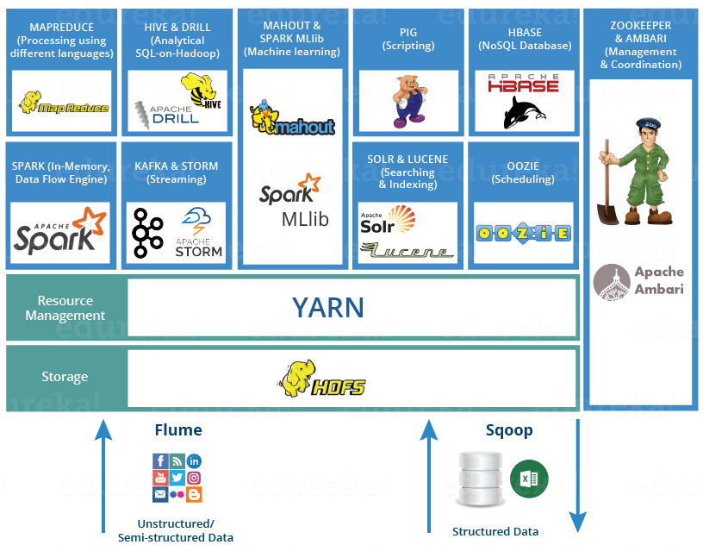

Slide 6
Model Building :-
Normalization : We normalize all features value except the target value. So that all the feature value come in one range. In that case we use MinMax Scalar in which value vary between 0 to 1.
PCA : Principal component analysis (PCA) is a technique for reducing the dimensionality of such datasets, increasing interpretability but at the same time minimizing information loss. It does so by creating new uncorrelated variables that successively maximize variance.
Splitting Data : In these case we split up the data into train and test sets
Build Model : In these case we use two model as per our problem statement.

Slide 7
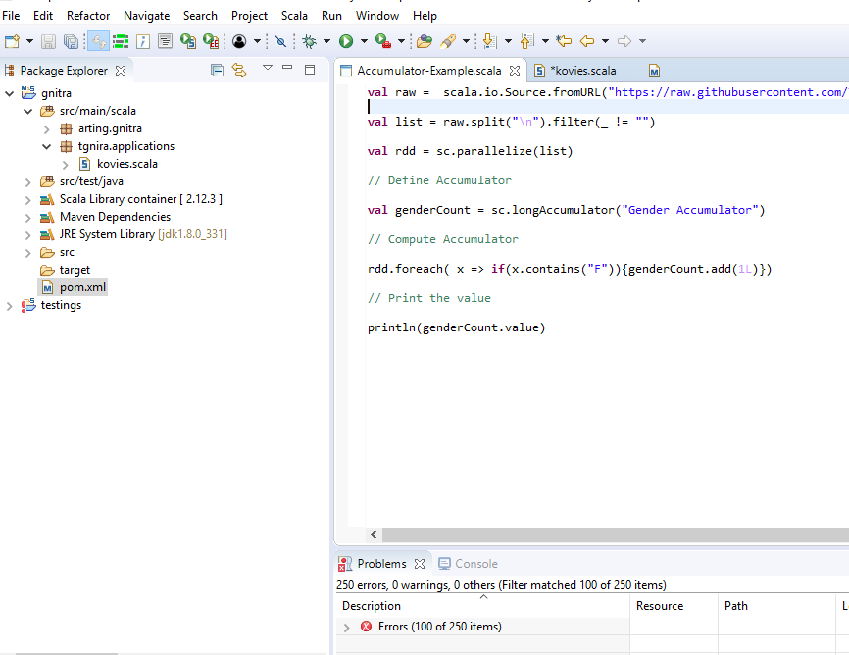

Slide 8
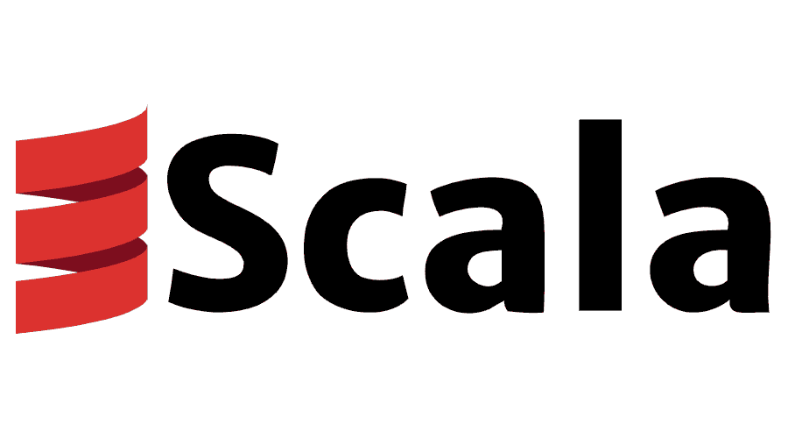
Model Dump: The Higher accuracy model is dump in pickle file ).
Cloud Setup:- In that we upload code on GitHub for deployment purpose. The HTML content to create the front page & backend we will be using the flask python framework.
User Interface

Slide 9
Q & A
Q1) What’s the source of data?
The data for training is provided by the client .
Q 2) What was the type of data?
The data type is numerical in nature.
Q 3) What’s the complete flow you followed in this Project?
Refer slide 4th for better Understanding
Q 4) How logs are managed?
We are using different logs as per the steps that we follow in, Data Insertion, Model Training log , prediction log etc.

Slide 10
Q 6) What techniques were you using for data pre-processing?
We don’t use many technique because there is no need of that except the Normalization
Q 7) How training was done or what models were used?
1] Before diving the data in training and testing set we performed scaling operation on the training and testing set.
2] Algorithms like Linear Regression & RF were used to find out the accuracy.
Q 8) What are stage for deployment?
1] The 1st stage is to create your app.py file so that we can see our model.
2] The 2nd stage is to update your project on GitHub.
3] The 3rd stage in which you can deploy your model on any server such as GCP, AWS, Azure

Slide 11
THANK YOU

