Slide 1
Biogas
By Utkarsh, Sarad and Anunaya
(Group 9)

Slide 2
Topics
Introduction
Ethanol
Biodiesel
Biogas
Biogas plant
Advantages

Slide 3
Introduction
Biofuel is a fuel that is produced in a short time span from biomass.
Since such feedstock material can be replenished readily, biofuel is considered to be a source of renewable energy, unlike fossil fuels.
Feedstock materials for conventional biofuels include food crops such as palm, rapeseed, soy, beets and cereals (corn, wheat, etc).
The liquid biofuel in greatest production is ethanol (ethyl alcohol), which is made by fermenting starch or sugar.

Slide 4

Common Biofuels
Some commonly produced biofuels are:
Biogas
Biodiesel
Ethanol

Slide 5
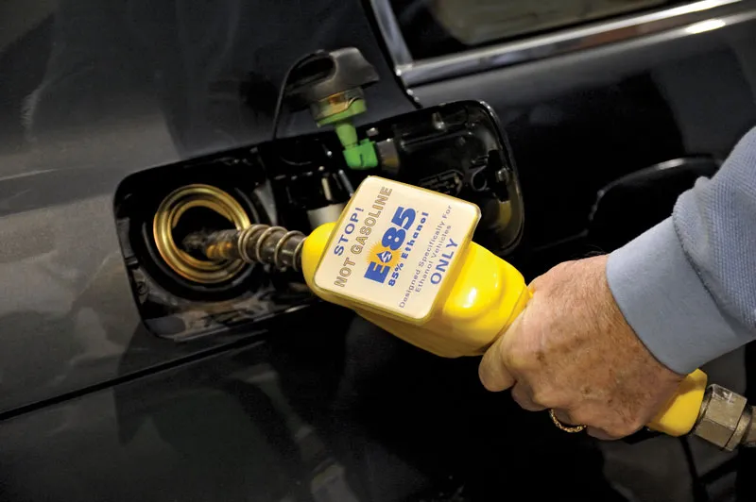
Ethanol
Ethanol biofuel is made from starch, generally corn, by breaking down the starch into sugar and then fermenting it into a liquid.
Ethanol is typically mixed with petrol/gasoline to produce a blend of E10 ,E15 ,E20 or higher ethanol concentration.
This blend is generally preferred in engines as a anti-knocking agent and increase the performance.

Slide 6
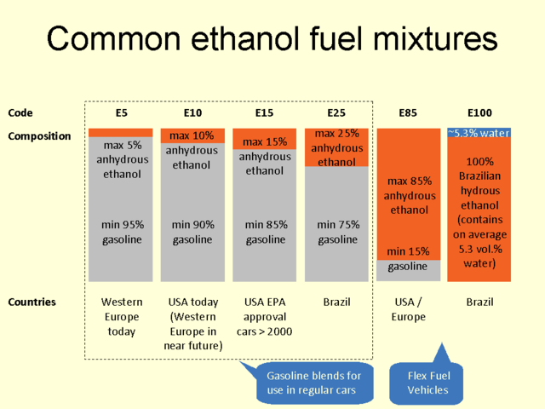

Slide 7
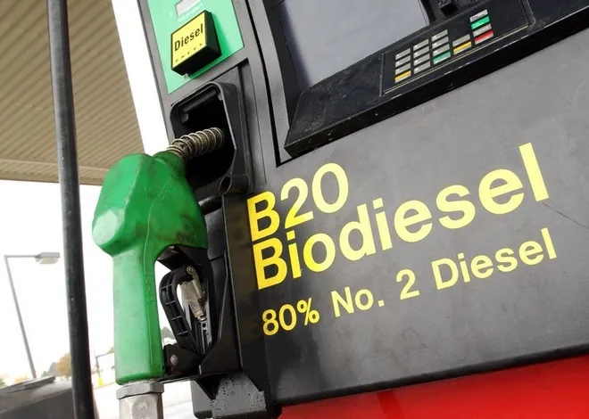
Biodiesel
The second most common liquid biofuel is biodiesel, which is made primarily from oily plants such as rapeseed(mustard family), oil palm, sunflower and soybean.
Biodiesel is used in diesel engines and usually blended with petroleum diesel fuel in various percentages.
Blends of 20% biodiesel and lower can be used in diesel equipment with no, or only minor modifications.

Slide 8
Biogas
Biogas refers to a mixture of different types of gases produced by anaerobic microbes.
Anaerobic Bacteria: Anaerobic bacteria are the microorganisms which do not require oxygen to function.
Anaerobic bacteria may be of three types:
Obligate anaerobes: They can only survive in oxygen deficient environments and die in presence of oxygen.
Aerotolerant anaerobes: They can grow while in presence of oxygen.
Facultative anaerobes: They can grow without oxygen but use oxygen when present.

Slide 9
Biogas(Contd)
Methanogens are a group of bacteria which produce methane through the degradation of organic matter. 90% of the atmospheric methane is produced by methanogens.
Methanogens produce methane by the reduction of carbon dioxide into methane gas.
Thus, the composition of biogas is roughly 70% methane gas and 30 - 40% CO2 gas with traces of hydrogen sulfide, ammonia and water vapour .

Slide 10
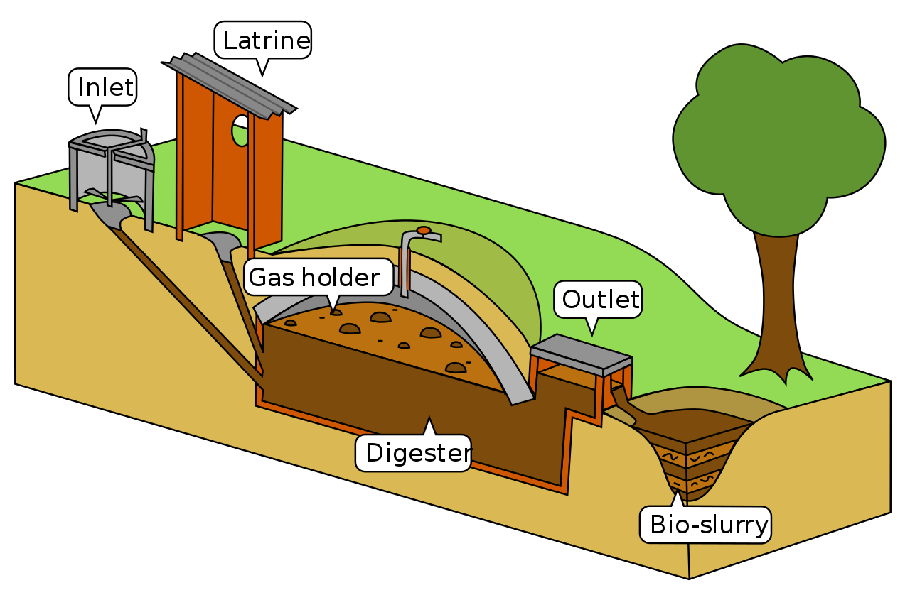
Biogas Plant
A biogas plant is a facility for the production of biogas from biomass.
It consists of an isolated chamber called digester containing the biomass to be degraded and a gas valve for the collection of the produced gases.

Slide 11
Components of Biogas Plant
Inlet tank: The inlet tank is a space to insert the raw materials to be fed into the digestion tank.
Digestion tank: The digestion tank has a dome-like ceiling with an outlet valve on top for the collection of produced gases. Since biogas is lighter than air, it floats to the top.
Outlet tank: The outlet tank is connected to the digester and is used to take the byproducts out. The byproducts can be used as compost.

Slide 12
Working mechanism of biogas plant
The biomass are mixed in an equal amount with water to produce a slurry. The slurry is put into the inlet tank.
The digester is filled through the inlet tank and partially filled. Once adequate slurry is added, the digester is sealed for two months. The temperature in the digester is kept at 60-70° C.
Anaerobic bacteria present in the slurry digest the biomass and produce CO2, methane and other gases in the presence of water.
The produced gases are collected in the dome. Due to the pressure of the gases, the slurry is forced out into the outlet tank. The spent slurry is used as manure for plants
The gas collected in the dome can be used for different purposes.

Slide 13
Advantages of Biogas
Provides a non-polluting and renewable source of energy.
Produces organic manure as a side product rich in N, P and K that can be used as a fertilizer.
Anaerobic digestion inactivates pathogens and parasites, and is quite effective in reducing the incidence of water borne diseases.
Landfill gas collection systems are increasingly being implemented to prevent explosions from methane accumulation inside the landfill.
Prevents the loss of methane, a greenhouse gas, into the atmosphere.
It helps divert food waste from landfills, positively impacting the environment and economics.

Slide 14
Advantages of biogas(contd)
Building biogas systems can create short-term construction jobs and permanent jobs.
Biogas can create new revenue streams for farmers and rural communities.
Some biogas systems are carbon negative, so replacing some fossil gas with biogas can help combat climate change.
Research shows that biogas energy production can be economically viable, with a payback period of 1.17–1.01 years for different sized plants.

Slide 15
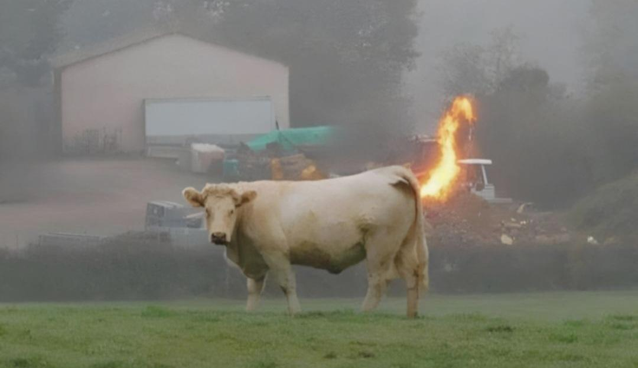
Thankyou!

