Slide 1
AI- BASED FAKE NEWS DETECTOR
CAPSTONE PROJECT
Presented By:
Student Name- Aabid Nabi Tantry
College Name- NIT Srinagar
Department- Computer Science & Engineering

Slide 2
OUTLINE
Problem Statement (Should not include solution)
Proposed System/Solution
System Development Approach (Technology Used)
Algorithm & Deployment
Result
Conclusion
Future Scope
References

Slide 3
Problem Statement
.
Background
The rapid growth of social media platforms has significantly increased the spread of misinformation. Studies indicate that a majority of adults consume news primarily through online platforms, where verification mechanisms are weak.
Core Issues
Fake news propagates significantly faster than verified information
Manual fact checking is time consuming and requires domain expertise
Students and researchers struggle to validate information authenticity
Misinformation influences public opinion, academic research, and decision making
Impact
Spread of false narratives
Poor quality academic references
Manipulation of public perception
Reduced trust in digital media

Slide 4

Proposed Solution
AI Powered Fake News Detection System
The proposed system is an AI based automated Fake News Detection platform that classifies news articles as Real or Fake using supervised machine learning techniques.
Key Features
Real time news verification through text input
High accuracy classification model trained on more than 44,000 articles
Clean and responsive web interface
Dark and light mode support
History tracking for recent predictions
Social sharing functionality for transparency
The system transforms raw textual input into structured numerical representations and applies a trained classification model to predict authenticity.

Slide 5
System DEVELOPMENT Approach
End to End Pipeline
User Input The user submits a news article through the web interface.
Text Preprocessing • Lowercase normalization • Removal of punctuation and special characters • Stop word removal • Removal of URLs and HTML tags
Feature Extraction • TF IDF vectorization • Extraction of top 10,000 textual features • Inclusion of unigrams, bigrams, and trigrams
Model Prediction • Logistic Regression classifier • Probability based classification
Result Display • Real or Fake prediction • Confidence percentage
Technologies Used
Programming Language • Python
Machine Learning and NLP Libraries • Scikit learn • NLTK
Web Framework • Flask
Frontend • HTML5 • CSS3 • Bootstrap 5 • JavaScript
Deployment Platform • Render Cloud
Version Control
• Git and GitHub

Slide 6
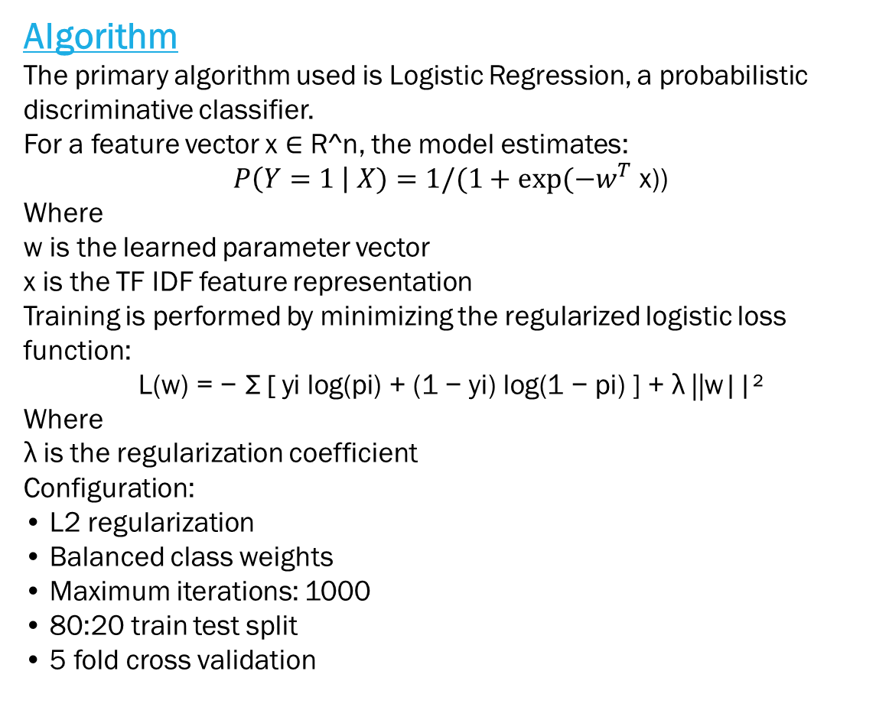
Algorithm & Deployment
Algorithm
The primary algorithm used is Logistic Regression, a probabilistic discriminative classifier.
For a feature vector x ∈ R^n, the model estimates:
$P\left(Y=1 \right| X)=1/(1+exp⁡(−w^{T}$ x))
Where w is the learned parameter vector x is the TF IDF feature representation
Training is performed by minimizing the regularized logistic loss function:
$$\text{L}\text{(}\text{w}\text{) = − }\text{Σ}\text{ [ }\text{yi} \text{log}\text{(}\text{pi}\text{) + (1 − }\text{yi}\text{) }\text{log}\text{(1 − }\text{pi}\text{) ] + }\text{λ}\text{ ||}\text{w}\text{||²}$$
Where λ is the regularization coefficient
Configuration: • L2 regularization • Balanced class weights • Maximum iterations: 1000 • 80:20 train test split • 5 fold cross validation
Deployment
Code pushed to GitHub repository
Repository linked to Render platform
Build command executed:
pip install -r requirements.txt
Application started using:
gunicorn app:app
Public URL generated for global access
https://fake-news-detector-ai-0izj.onrender.com/
The system supports auto scaling and automatic wake on request.

Slide 7


Result
Dataset Statistics: Total Articles: 44,898 Real: 22,458 Fake: 22,440
Performance Metrics:
Accuracy: 98.5 percent Precision: 0.98 Recall: 0.98 F1 Score: 0.98 ROC AUC: 0.99
3. Confusion Matrix Summary:
True Fake: 4392 False Negative: 86 False Positive: 52 True Real: 4470
Average inference time per article is less than 2 seconds.
The classifier demonstrates high discriminative capability and strong generalization on test data.

Slide 8

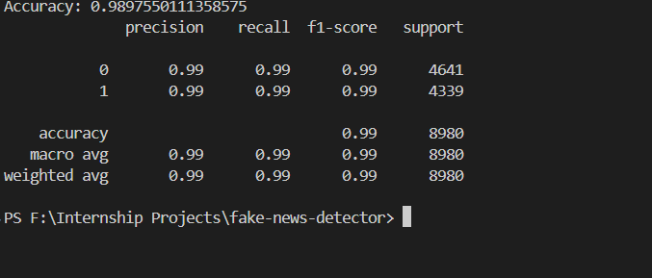
RESULT SNAPSHOTS

Slide 9
Conclusion
The project successfully demonstrates that classical machine learning methods combined with robust text preprocessing can achieve high accuracy in fake news classification tasks.
Key achievements:
High accuracy and balanced performance
Low latency prediction
Scalable web based implementation
Successful cloud deployment
The system provides a practical tool for assisting users in identifying potentially misleading content.

Slide 10
Future scope
Integration of Transformer based architectures such as BERT for improved contextual understanding
Multilingual support for regional language news detection
Development of browser extension for real time verification
Public REST API for third party integration
Mobile application development
Future work will focus on improving robustness against adversarial text manipulation and concept drift.

Slide 11
References
Datasets • Fake and Real News Dataset, Kaggle
https://www.kaggle.com/datasets/clmentbisaillon/fake-and-real-news-dataset
2. Libraries • Scikit learn Documentation • Flask Documentation • NLTK Documentation
3. Research Papers • Fake News Detection Using Machine Learning, IEEE 2021 • Survey on Fake News Detection Techniques, Springer 2022 • Combating Fake News, ACM Computing Surveys 2023

Slide 12
Github link
Github Link: https://github.com/Aabidnabi/fake-news-detector-ai
Deployment Link: https://fake-news-detector-ai-0izj.onrender.com/

Slide 13
THANK YOU

