Slide 1
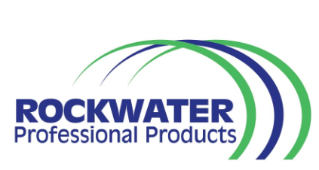
ROCKWATER CHEMICAL AND FOOD SAFETY BROCHURE

Slide 2
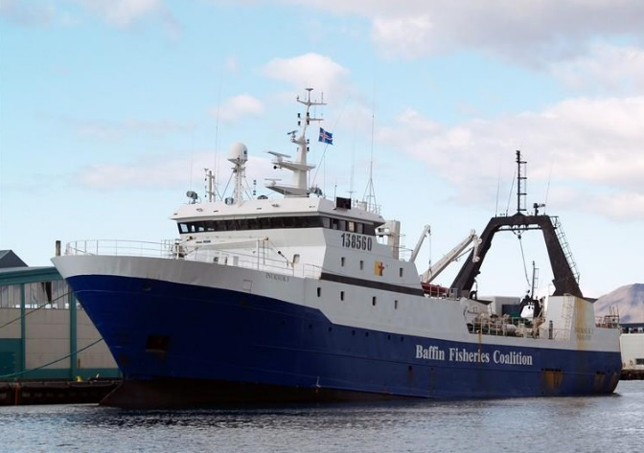
Food Sanitation Program
Dispensing Equipment
CFIA Approved Cleaning Chemicals
Technical Services
Food Safety Items

Slide 3
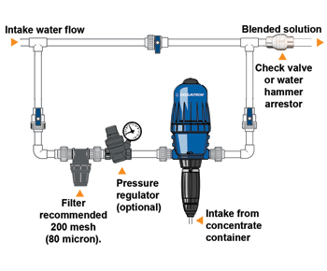
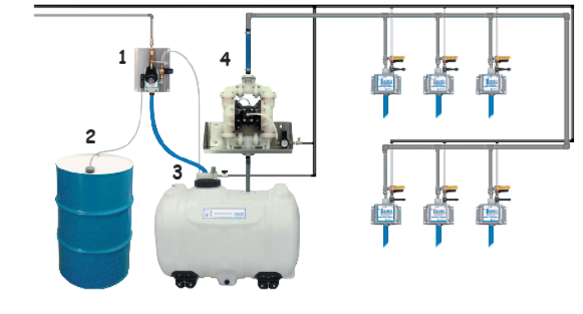
Dispensing Equipment

Slide 4
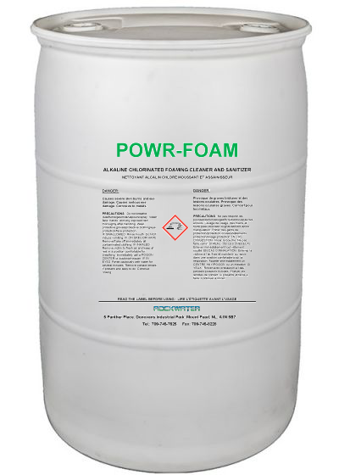
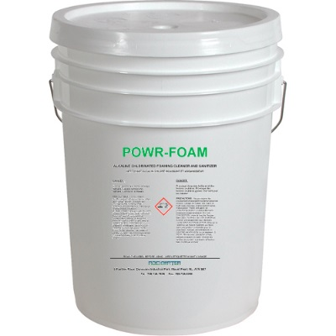
CFIA Approved Chemicals
POWR-FOAM
Type | High-Foaming Chlorinated Alkaline Cleaner
Area of Use | General Plant Cleaning (Daily)
Dispensing | Wall-mount and/or Pump-up

Slide 5

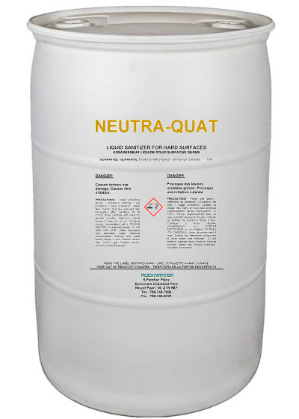
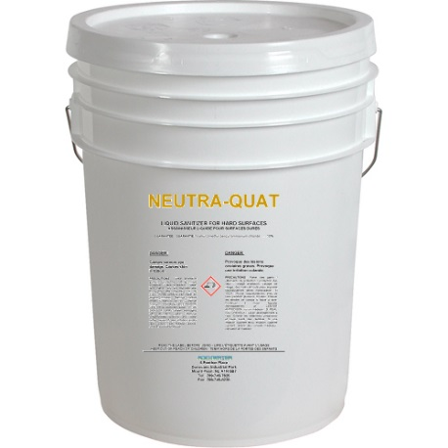
NEUTRA-QUAT
Type | Quaternary Ammonium Based Neutral pH Sanitizer
Area of Use | Sanitization of Plant (Daily)/Foot Dips
Extra Features | Virucide – Bactericide – Fungicide – Algicide –
Dispensing | Wall-mount proportioners

Slide 6
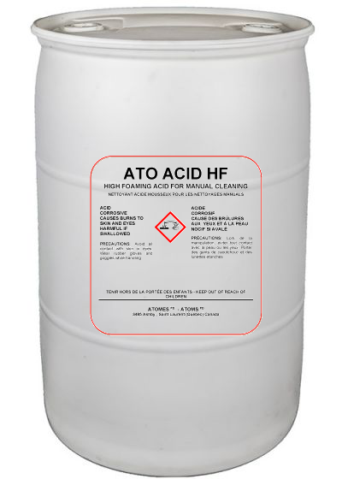
ATO ACID HF
Type | Phosphoric Acid Based Foaming Cleaner
Area of Use | General Plant Acid Cleaning (Weekly)
Extra Features | Foaming Cleaner = More Contact Time
Dispensing | Wall-mount Foamer

Slide 7
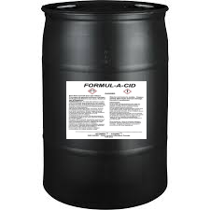
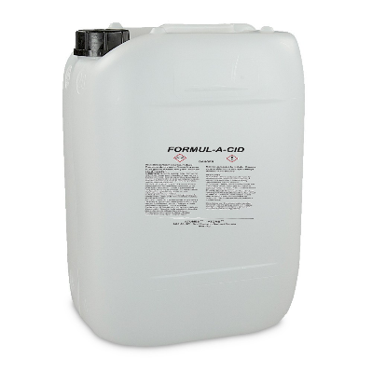
FORMUL-A-CID
Type | Phosphoric & Nitric Acid Blend
Area of Use | Cooker cleaning Acid boil-off
Extra Features | Non-foaming Descaler
Dispensing | Wall-mount proportioners / Manual dilution

Slide 8
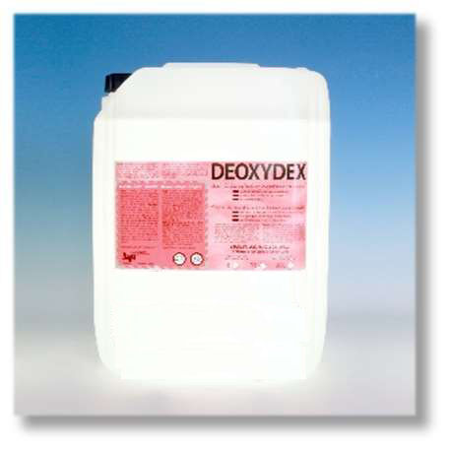
DEOXYDEX
Type | Acid Cleaner/Restorer
Area of Use | Treatment of exterior surfaces
Extra Features | Surface enhancer Brightener Descaler
Dispensing | Manual dilution

Slide 9
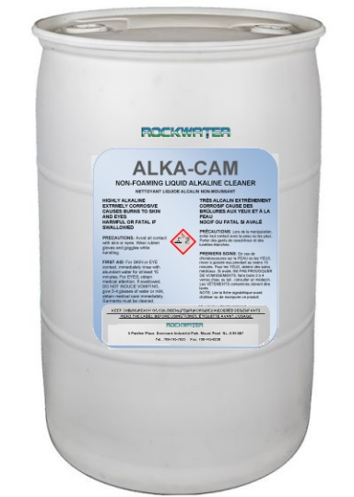
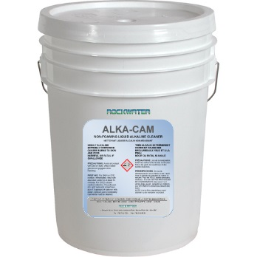
ALKA-CAM
Type | Alkaline Cleaner
Area of Use | General Plant Cleaning (Weekly)
Extra Features | Concentrated Highly alkaline Non-foaming
Dispensing | Manual/CIP/ Proportioners

Slide 10
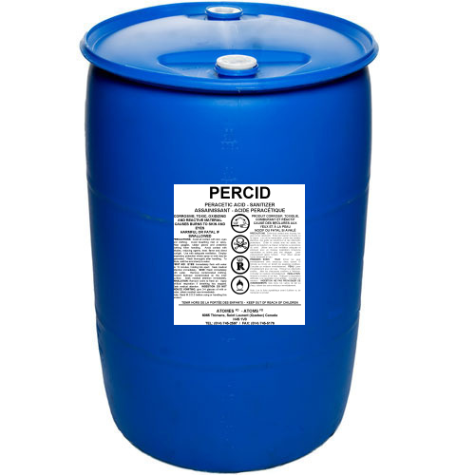
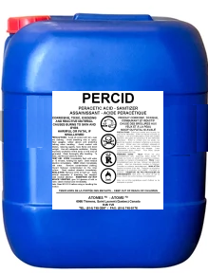
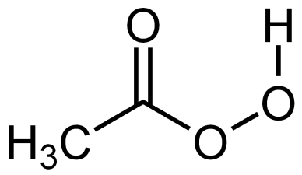
Percid
Type | Peroxyacetic Acid Disinfectant/Sanitizer
Area of Use | Spike Sanitization of Plant (Weekly)
Extra Features | Broad Spectrum
Dispensing | Wall-mount proportioners/Foggers

Slide 11
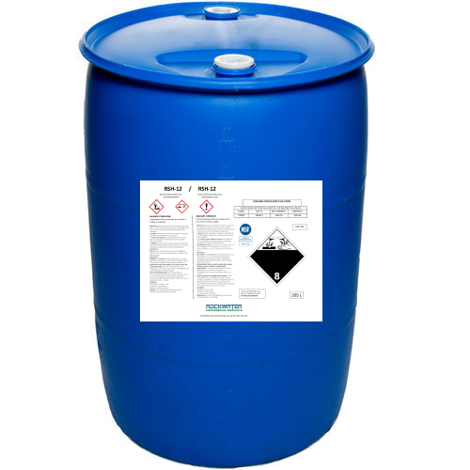
RSH-12
Type | 12% Liquid Chlorine Sanitizer
Area of Use | Belt Whitening Water Chlorination
Extra Features | Drain cleaning, water chlorination, heavy protein removal
Dispensing | Chlorinator pump

Slide 12
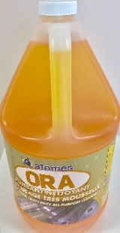
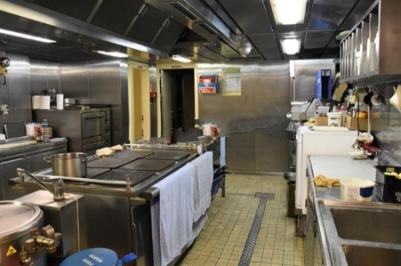

ORA
Type | Solvent based Foaming Degreaser
Area of Use | Normal/heavy duty cleaning
Extra Features | CFIA Approved Lower concentrations for general cleaning of lunch rooms, kitchens, bathrooms, etc.
Dispensing | Manual

Slide 13
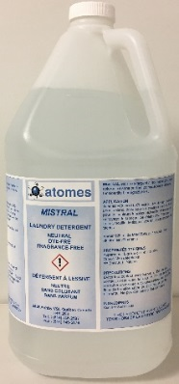
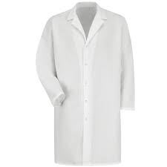
Mistral
Type | Dye & Fragrance Free Detergent
Area of Use | Laundry
Extra Features | CFIA Approved Hot or cold water Combination of biodegradable cleaners, grease cutters, and water softeners
Dispensing | Ounce pump

Slide 14
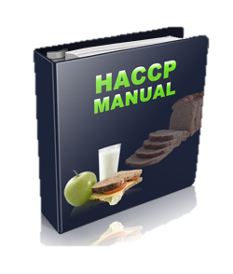
Technical Services
SOP/SSOP Development, Implementation & Training
Food Safety Training
WHMIS Training
On-site Visits
Chemical Checks
Clean-up Monitoring/Inspecting
HACCP/QMP Consultation

Slide 15
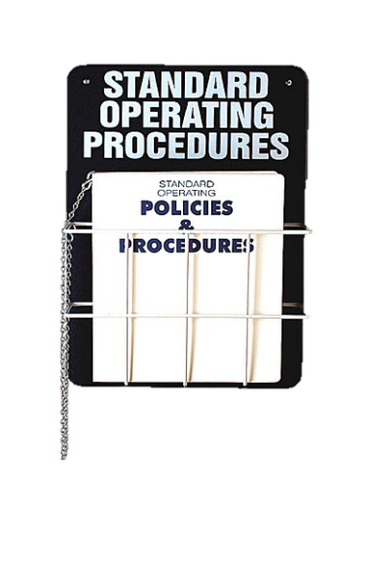
SOP/SSOP Development/Training
After developing the SOP/SSOP manual, we will provide training to each member of the clean-up crew on areas/equipment which they are responsible for.
Yearly training update/new employee training provided as part of Sanitation Program

Slide 16
SOP/SSOP Training Continued…
Manual will be developed for every area and piece of equipment
Chemical concentrations, safety equipment, dismantling instructions, and any special considerations for clean up will be outlined on each SOP/SSOP

Slide 17
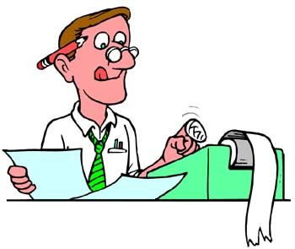

Sanitation/Food Safety Support
Provide insight and technical support on any food safety/sanitation issues that may arise. Some examples of this service include
Action plans for high bacteria count/spikes
Proper procedures for cleaning/sanitizing new equipment
Input on issues, questions, and concerns raised by customers and auditors.

Slide 18
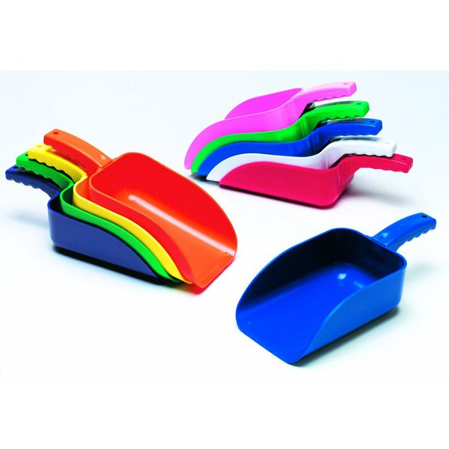
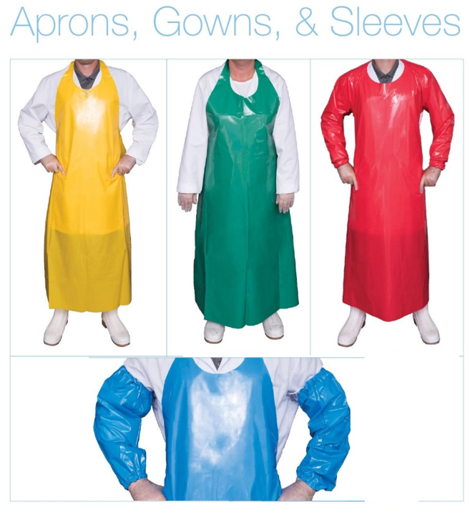
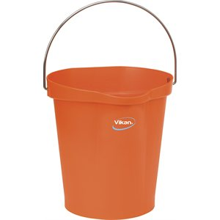
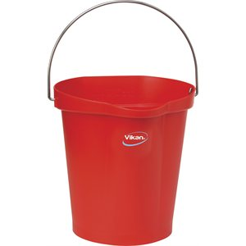


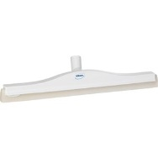
Food Safety Items

Slide 19
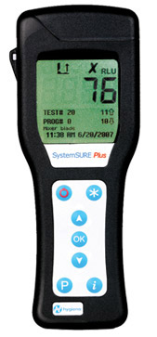
Hygiene Monitoring Systems
System Sure Plus
Measures ATP
ATP=Food Soil Residue
More ATP = More potential bacteria
Bacteria=Re-clean
Allows for Quick action re-cleaning
Reduce chances of contamination

Slide 20
Hygiene Monitoring Systems Continued…
Pro-Clean
Semi-quantitative test for protein soils only
Swab and read a color change
Faster Color change = MORE protein
No devices necessary
Listeria swabs also available!

