Slide 1
Kantipur Engineering College
CABLE FAULT DETECTION SYSTEM USING TIME DOMAIN REFLECTOMETRY
PROJECT PROGRESS REPORT ON
Presented By:
Aabiskar Subedi [KAN079BEI001]
Chofung Jabegu Limbu [KAN079BEI007]
Prasun Khatiwada [KAN079BEI014]
Jan,2026

Slide 2
INTRODUCTION
  Coaxial cables provide safe, reliable power and communication.
  Fault detection is challenging due to their buried, inaccessible nature
  Traditional methods involve costly, time-consuming manual digging.
  Urban growth and outages amplify the need for efficient solutions.
  Time Domain Reflectometry (TDR) locates faults via pulse reflection.

Slide 3
PROBLEM STATEMENT
  - Underground faults are difficult to locate visually
  - Current methods are slow and excavation-based
  - Manual detection increases labor and downtime
  444444
  - Fault delays raise repair cost and outages
  - A faster, cheaper, smarter solution is needed.

Slide 4
OBJECTIVE
The objective of the study is:
  Develop a low-cost system for detecting underground cable faults.
  TDR-based prototype to detect open/short faults.
  Compute fault distance from time delay and show on local display

Slide 5
APPLICATION
    - Accurate fault localization using TDR
    - Identifies short and open circuit faults
    - Enables faster detection and repair
    - Quick fault localization and reduces downtime
    - Remote diagnostics via wireless data access

Slide 6
Features
    - Pulse generation using NE555 (monostable)
    - Reflection detection + amplification using LM358
    - Distance calculation using TDR equation (v≈2×10⁸ m/s in RG-58)
    - Local output on OLED/LCD
Notes:
1.7.2013
NEXT SLIDE
SK ko
‹#›

Slide 7
FEASIBILITY
Technical Feasibility
  Uses widely available components (555, LM358, NodeMCU)
  Operates at low voltage—safe and reliable
  The circuit is currently in the design and simulation stage using Proteus

Slide 8

FEASIBILITY CONTD..
Economic Feasibility
  Uses low-cost, easily available hardware modules for system design
  Total project cost estimated at approximately Rs. 41800 only
  Budget-friendly solution suitable for educational and practical implementation

Slide 9
LITRATURE REVIEW:WORK RELATED
Auther | Work element | Description
Ramharack & Bahadoorsingh (2023) | Step-pulse TDR + Wavelet Transform | Enabled accurate fault location without needing detailed cable specifications.
Klaus Giese (2016) | Signal degradation in TDR systems | Studied how attenuation and dispersion affect reflected signal accuracy
Barry M. Novac (2011) | Transmissionimpedence line analysis | Emphasized role of impedance profile in clean pulse propagation and fault resolution.

Slide 10
LITERATURE REVIEW:THEORY RELATED
Theory Element | Description
TDR Operating Principle | TDR sends a high-frequency pulse through a cable; impedance mismatches cause signal reflections used to detect and locate faults.
Electromagnetic Pulse Propagation | Pulses travel as TEM waves; dielectric changes from insulation failure or moisture affect speed, helping identify fault locations.
Impedance Discontinuities | Faults like breaks or corrosion create sudden impedance shifts, reflecting the pulse back toward the source—used to detect open/short faults.
Distance Calculation | Distance = (v × Δt)/2 where v ≈ 2×10⁸ m/s for RG-58

Slide 11
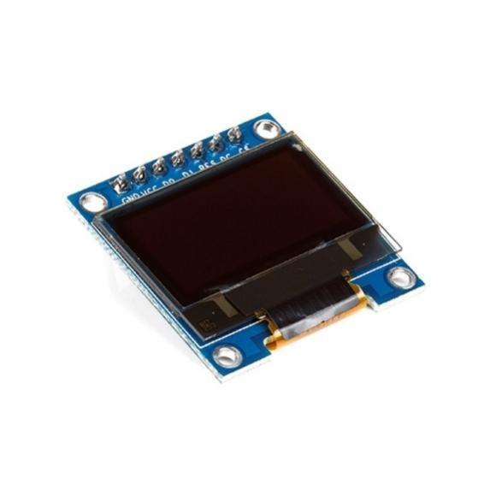
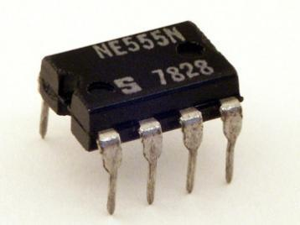
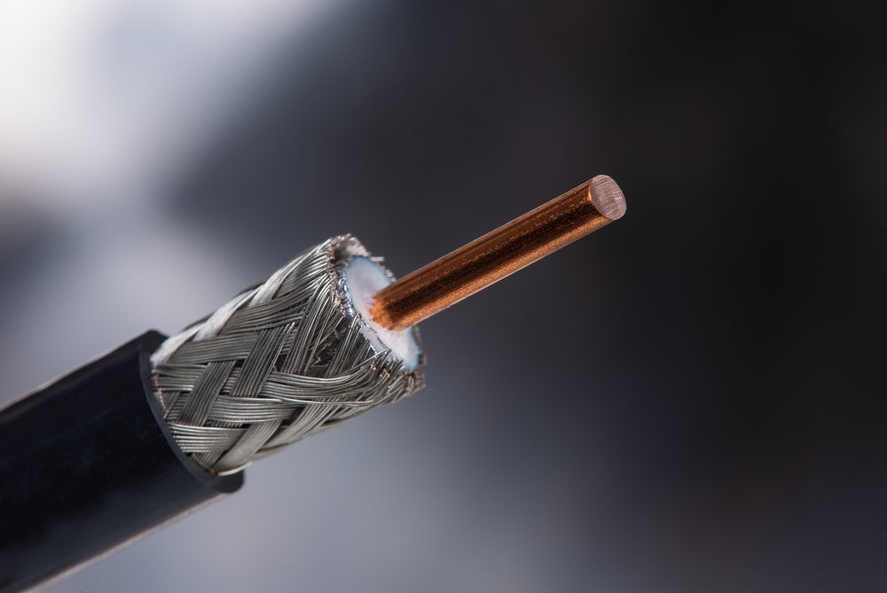
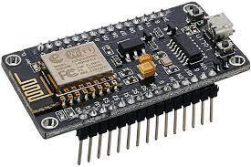
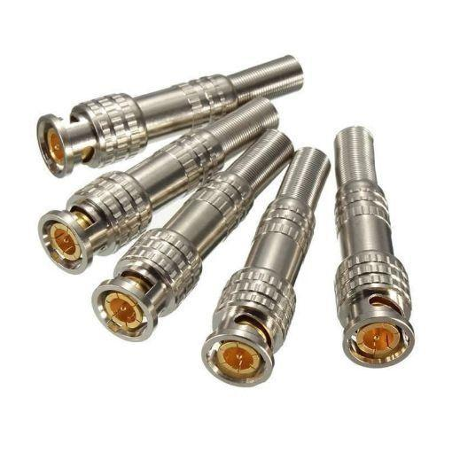
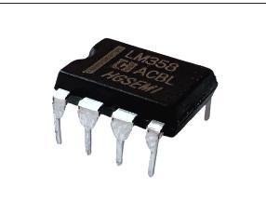
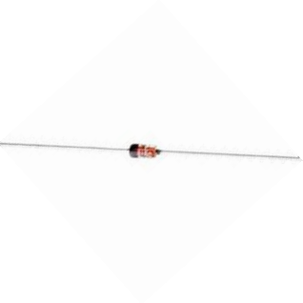
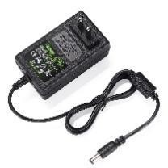
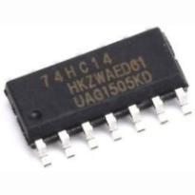
HARDWARE
REQUIRED
OLED DISPLAY
NE555 Timer IC
coaxial cable
NodeMCU (ESP8266)
1N4148 Switching Diode
LM358 Amplifier Operational
BNC Connector
Schmitt trigger
Picture Courtesy : mouser.co.id
Power Supply
Notes:
1.7.2013
Ultra - HC-SR04
SERVO F- SG 90
Torque- 1.8kg
SERVO B- MG996R
Torque- 9.4kg
‹#›

Slide 12
SOFTWARE REQUIRED
Arduino IDE
Used to program the NodeMCU (ESP8266). It uploads code, manages libraries, and interfaces the hardware for signal processing and IoT communication.
Proteus
Simulation software used to test and visualize circuit behavior before actual implementation. It helps verify design logic and component interaction.

Slide 13
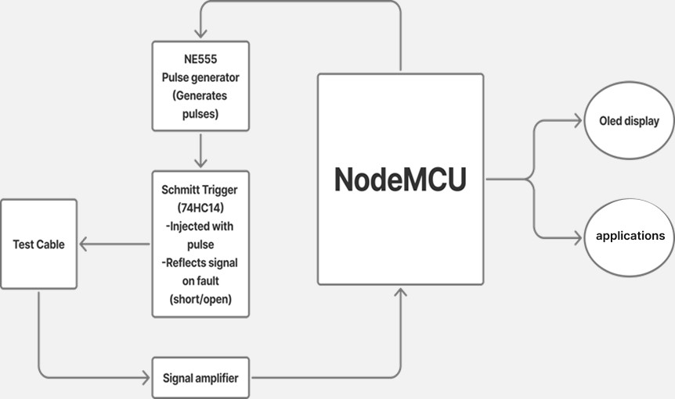
WORKING MECHANISHM
System Block Diagram

Slide 14
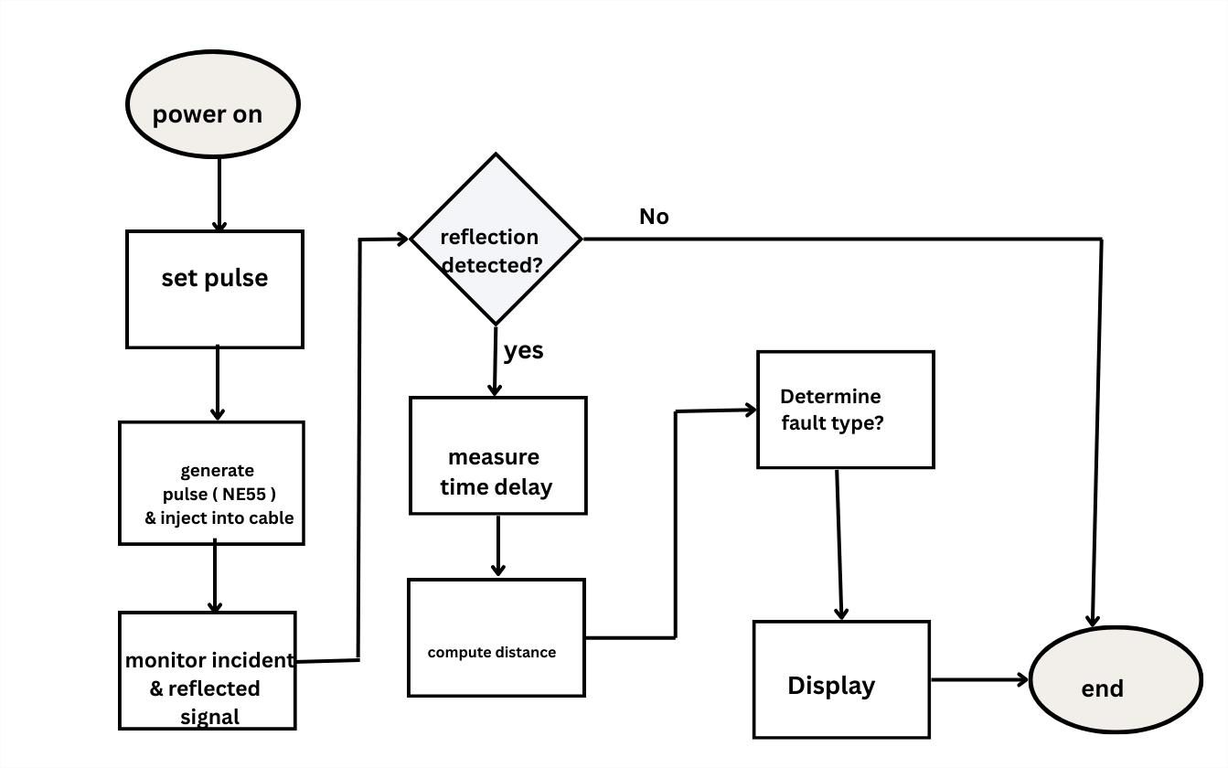
WORKING MECHANISHM
Figure : Flowchart

Slide 15
EXPECTED OUTCOME
  Detect open/short and estimate distance
  Reduce manual digging effort
  Low-cost alternative for learning/demo
  Ready base for future enhancements.

Slide 16
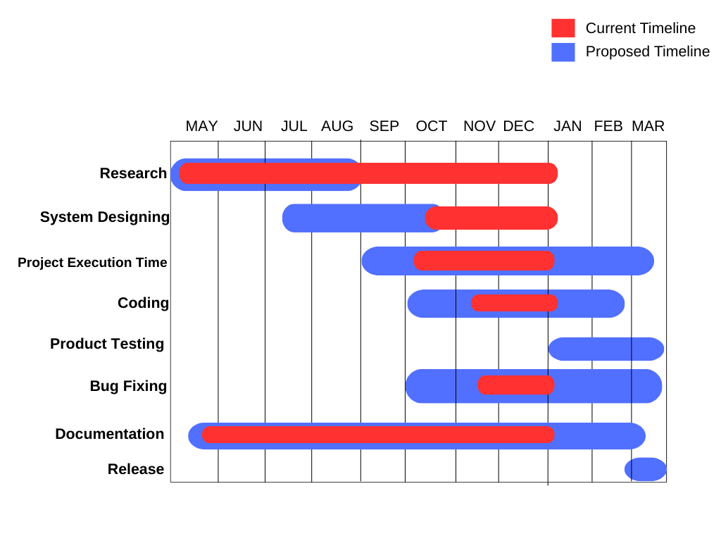
GANTT CHART

Slide 17
WORK COMPLETED
- Literature review on Time Domain Reflectometry (TDR) principles and fault behavior
- Finalized system architecture and functional block diagram
- Selection of major components (NE555, LM358, NodeMCU, Schmitt trigger, BNC)
-Initial circuit modeling and simulation setup in Proteus (in progress)

Slide 18
REFERENCES
- B. Gustavsen et al., "High-frequency modeling of underground power cables and the use of TDR for fault location," IEEE Transactions on Power Delivery, vol. 25, no. 3, pp. 1153–1161, Jul. 2010.
- R. Patel and M. Shah, "IoT-Based Underground Cable Fault Detection Using
NodeMCU," International Journal of Research in Engineering, Science and
Management, vol. 4, no. 6, pp. 45–48, Jun. 2021.
- R. Sharma et al., "Advanced Underground Cable Fault Detection Using TDR and Machine Learning," IEEE Sensors Letters, vol. 6, no. 5, pp. 1–4, May 2022.
- S. Ramharack and S. Bahadoorsingh, "Wavelet Transform Techniques for StepPulse TDR in Cable Fault Detection," Electric Power Systems Research, vol. 215, 2023, Art. no. 108986.

Slide 19

Kantipur Engineering College
THANK YOU

