Slide 1
CSE 428
Milestone-2
Aabrar Islam - 20101361
Ayen Aziza Haque - 20301487
Simin Waliza - 20101401
Zahin Shabab - 20101165
Shahriar Azad Frahim- 20101223

Slide 2
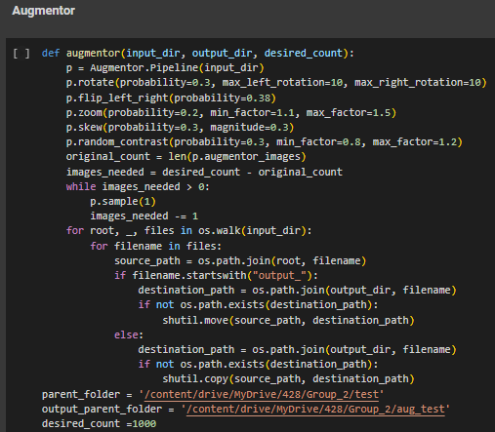
Augmentation
Types of Augmentations used:
Rotation(left and right)
Flipping(left and right)
Zooming(in and out)
Changing contrast
Skewing

Slide 3
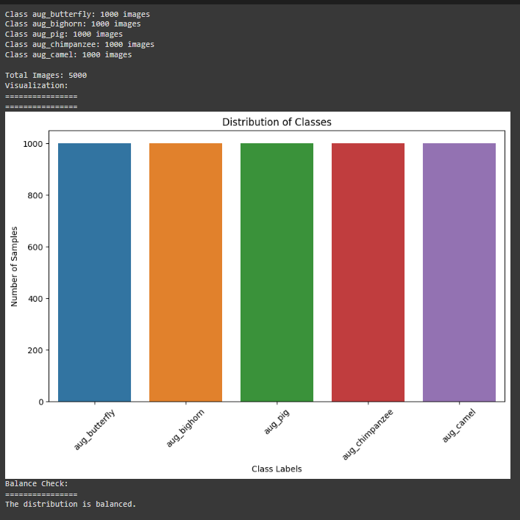
Augmented Train Dataset
5 classes
Train(5000)
Bighorn=1000
Butterfly=1000
Camel=1000
Chimpanzee=1000
Pig=1000

Slide 4
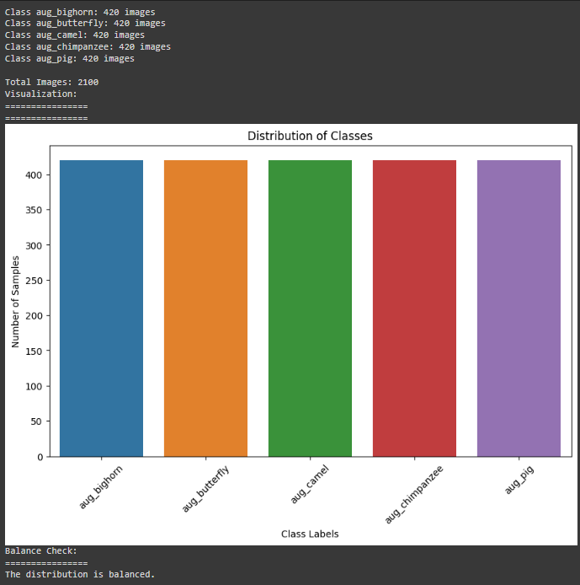
Augmented Test Dataset
5 classes
Test(2100)
Bighorn=420
Butterfly=420
Camel=420
Chimpanzee=420
Pig=420

Slide 5
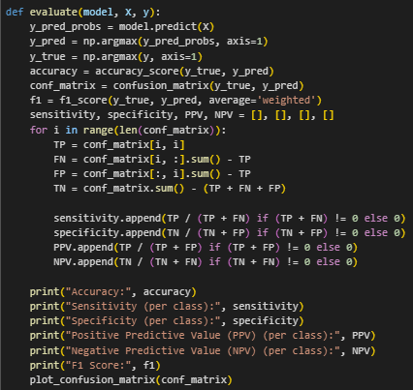
Performance Metric Formulae
Sensitivity: True Positive / (True Positive + False Negative)
Specificity : True Negative / (True Negative + False Positive)
Positive Predictive Value(PPV): True Positive / (True Positive + False Positive)
Negative Predictive Value(NPV): True Negative / (True Negative + False Negative)
F Score:(2*Precision*Recall) / (Precision + Recall)

Slide 6
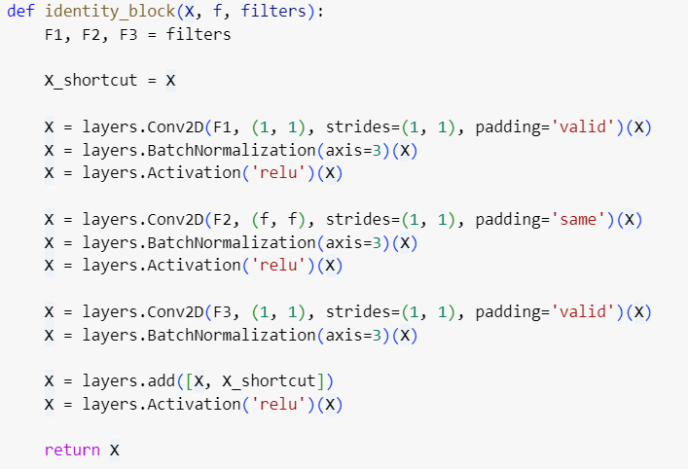
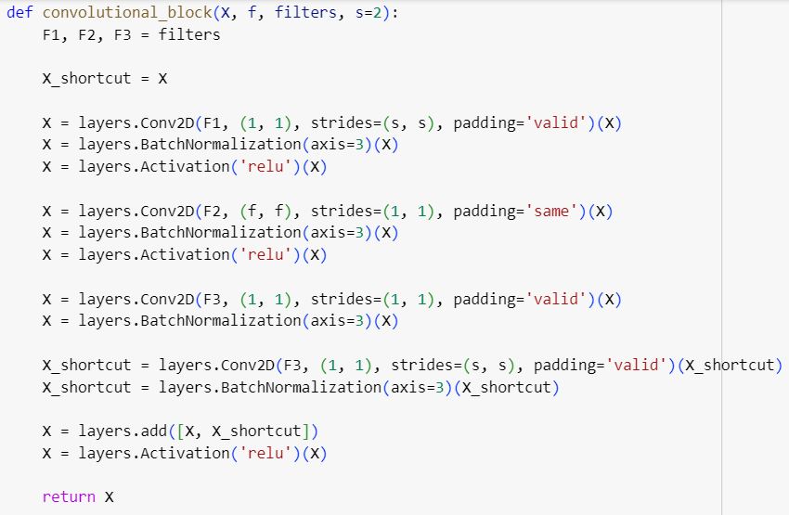
Resnet50

Slide 7
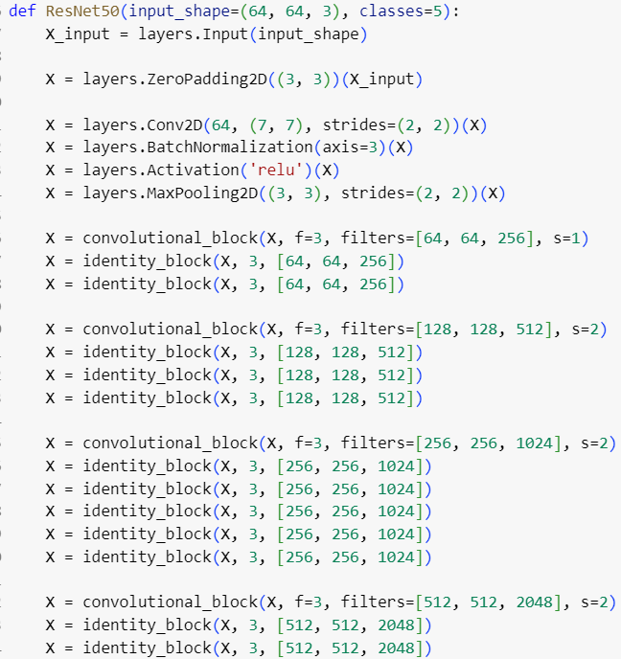
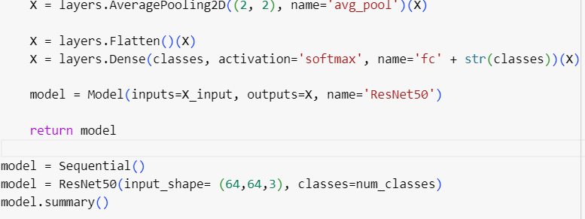

Slide 8
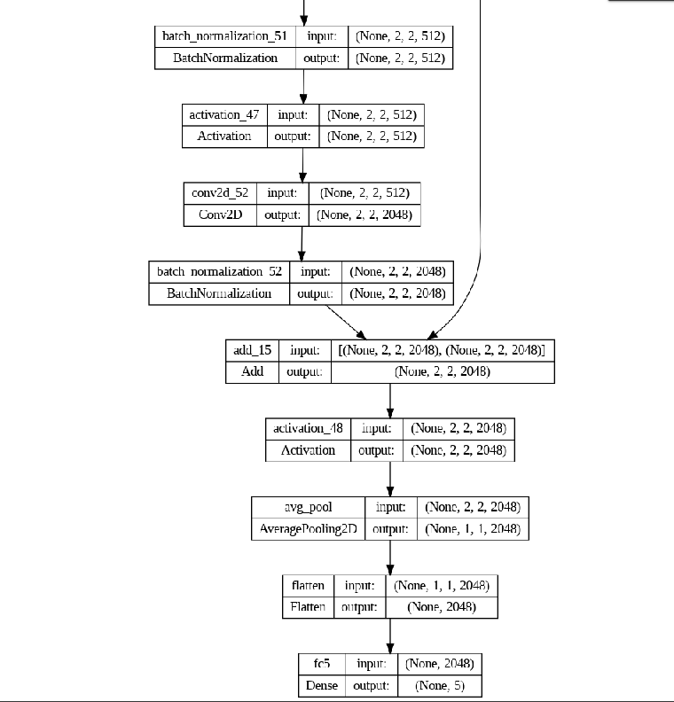
Structure of Resnet-50

Slide 9
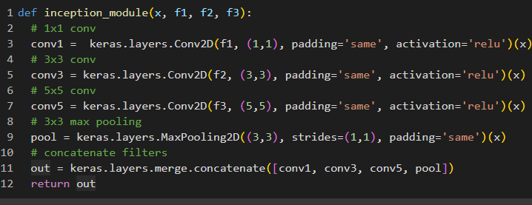
Inception Net

Slide 10
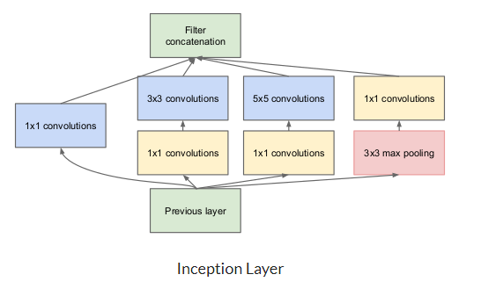
Structure of Inception Net

Slide 11
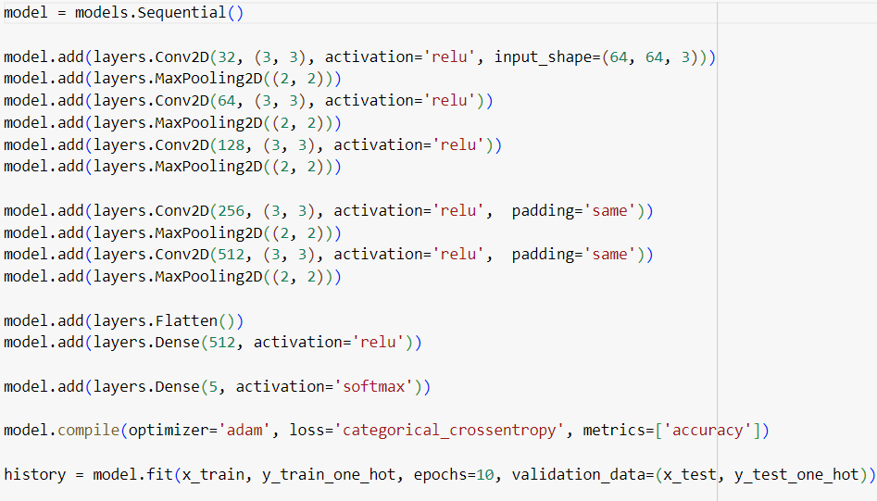
Custom CNN

Slide 12
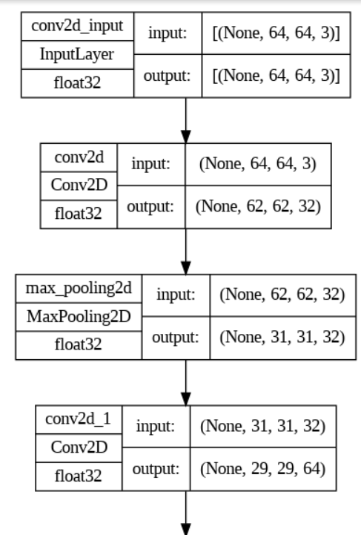
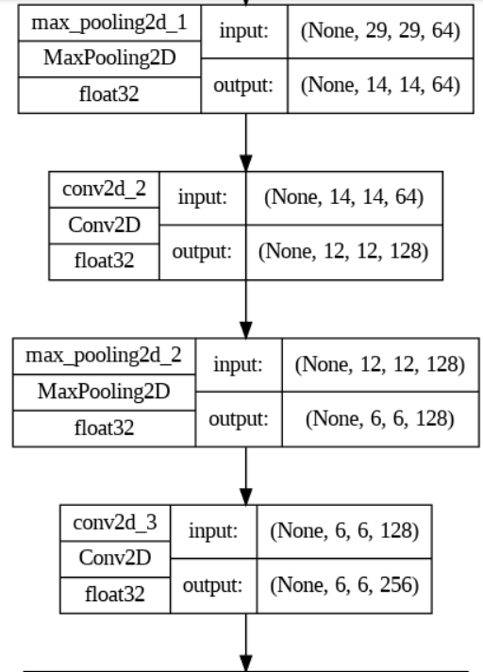
Structure of Custom CNN

Slide 13
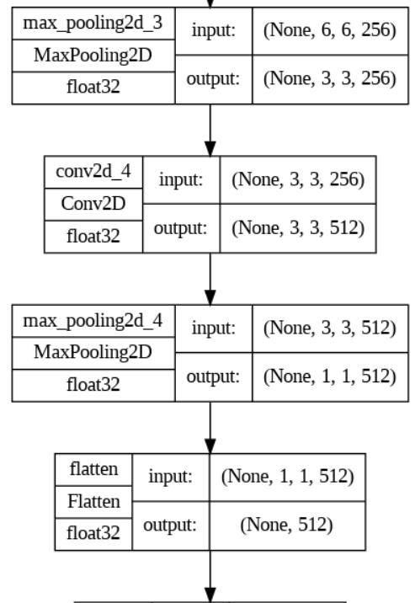
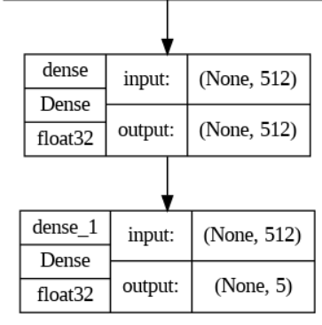

Slide 14
Better Model
The Resnet-50 model is the better model compared to the Inception Net model in this case.
Resnet-50 accuracy 87.74% and Inception Net accuracy 67%.
Easier to train due to less complex architecture.
Consistency and more deeper layers.

Slide 15
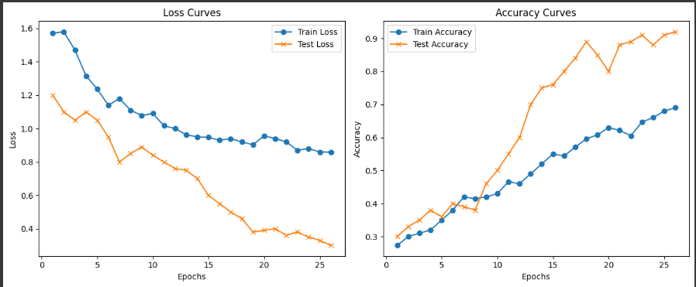
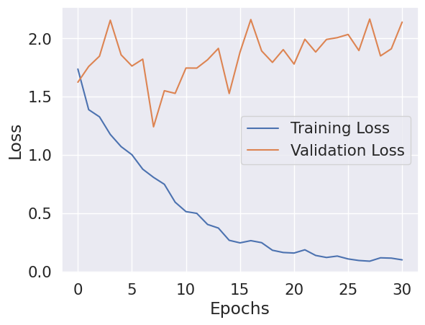
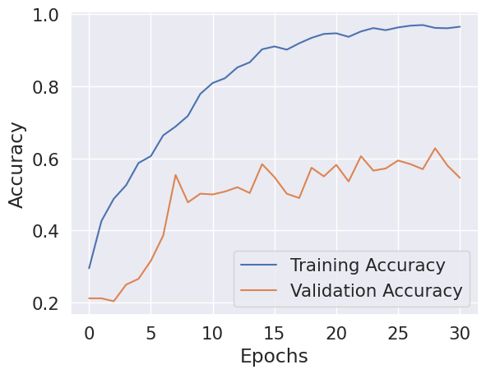
Train and Test Curve
Inception Model
Resnet-50 Model

Slide 16
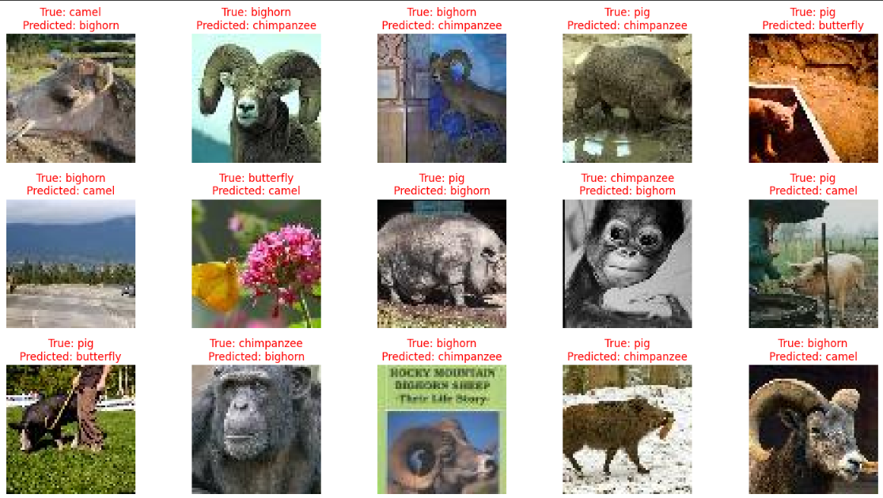
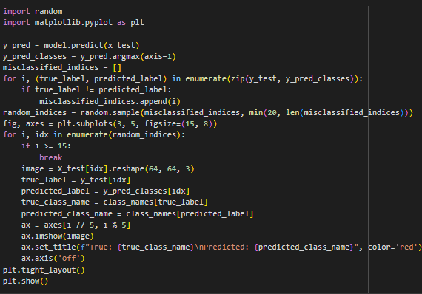
Misclassified Test Images

Slide 17
Updated
Milestone-1
Aabrar Islam - 20101361
Ayen Aziza Haque - 20301487
Simin Waliza - 20101401
Zahin Shabab - 20101165
Shahriar Azad Frahim- 20101223

Slide 18
Dataset
Size of the dataset is 2414
Test set = 250
Train set = 2164
Separate batch for test set
Separate batch for train set
Validation part has to be done manually

Slide 19

Classes in the dataset
5 classes for both test and train sets are:
Bighorn
Butterfly
Camel
Chimpanzee
Pig.

Slide 20
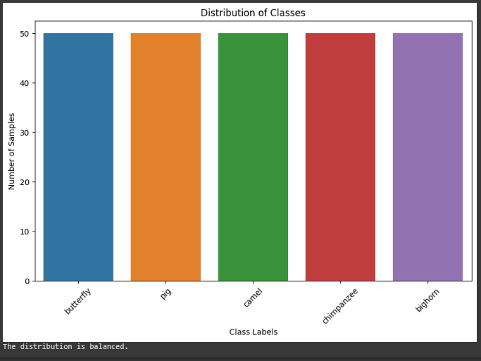
Distribution
5 classes
Test(250)
Bighorn=50
Butterfly=50
Camel=50
Chimpanzee=50
Pig=50

Slide 21
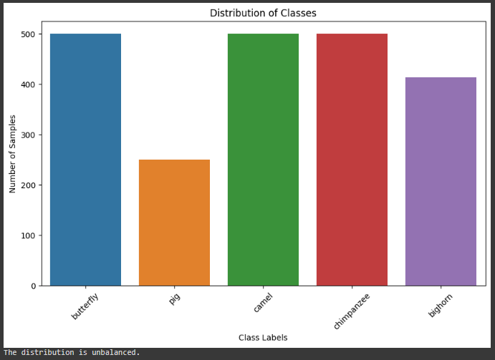
Distribution
5 classes
Train(2164)
Bighorn=414
Butterfly=500
Camel=500
Chimpanzee=500
Pig=250

Slide 22
Issues when dataset is unbalanced
Biased Models: Model may become biased toward the majority class, as it has more examples to learn from. This can result in poor performance on the minority class.
Poor Generalization: Unbalanced datasets can lead to poor generalization to new, unseen data, especially for the minority class. The model may simply predict the majority class most of the time, as it's more likely to be correct according to the training data distribution.
Misleading Evaluation Metrics: Common evaluation metrics like accuracy can be misleading when dealing with unbalanced datasets. A model that predicts the majority class all the time might have a high accuracy, but it's not useful if the minority class is of interest.

Slide 23
Tackling Unbalanced Dataset
Resampling:
Oversampling: By producing duplicate or fake samples, increase the number of examples in the minority class.
Undersampling: Reduce the number of instances in the majority class by deleting samples at random.
Data Augmentation: For image or text data, you can create new training examples by applying transformations or adding noise to existing samples. This can help balance the dataset.
Synthetic Data Generation: Use techniques like Synthetic Minority Over-sampling Technique (SMOTE) to generate synthetic examples for the minority class, based on the existing minority samples.

Slide 24
Cost-sensitive Learning: Assign different misclassification costs to different classes, emphasizing the importance of correctly classifying the minority class.
Algorithm Selection: Select techniques that are less sensitive to class imbalances, such as gradient boosting or support vector machines, which may be adjusted to place greater weight on minority class data.
Change the Decision Threshold: Adjust the categorization threshold to strike a balance between recall and precision based on your particular scenario. If the cost of false positives and false negatives differs, this can be especially helpful.
Collect More Data: In some cases, collecting more data for the minority class can be a solution if it's feasible.

Slide 25
Technique used to tackle unbalanced dataset
We chose the algorithm selection method to avoid or tackle the unbalanced dataset. Tree based algorithms are also performed in these scenarios and can also be boosted for unbalanced dataset
Algorithm Selection: Select techniques that are less sensitive to class imbalances, such as gradient boosting or support vector machines, which may be adjusted to place greater weight on minority class data.

Slide 26
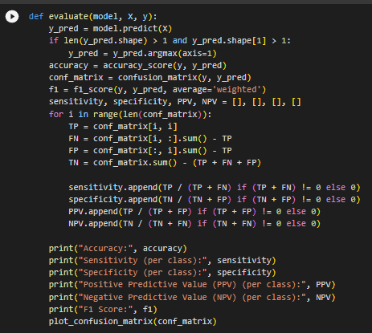
Evaluation function

Slide 27
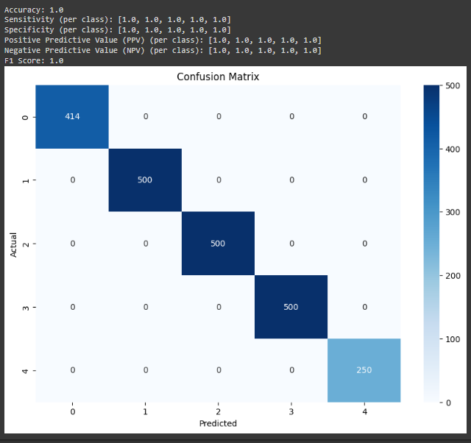
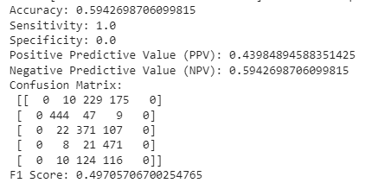
Logistic Regression(Train)

Slide 28
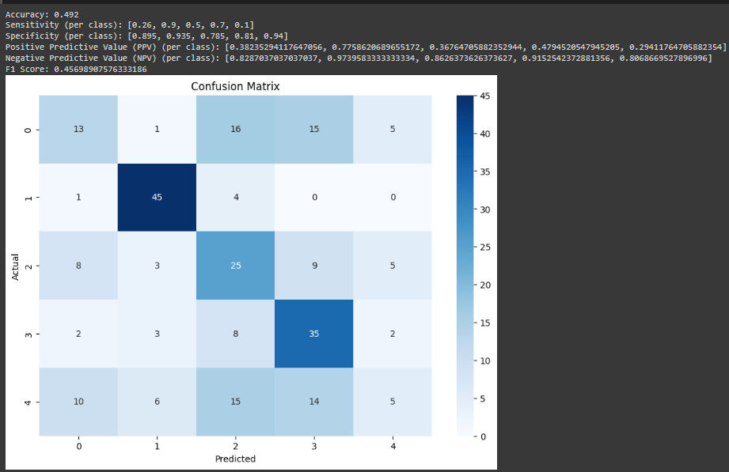
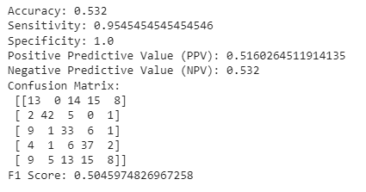
Logistic Regression(Test)

Slide 29
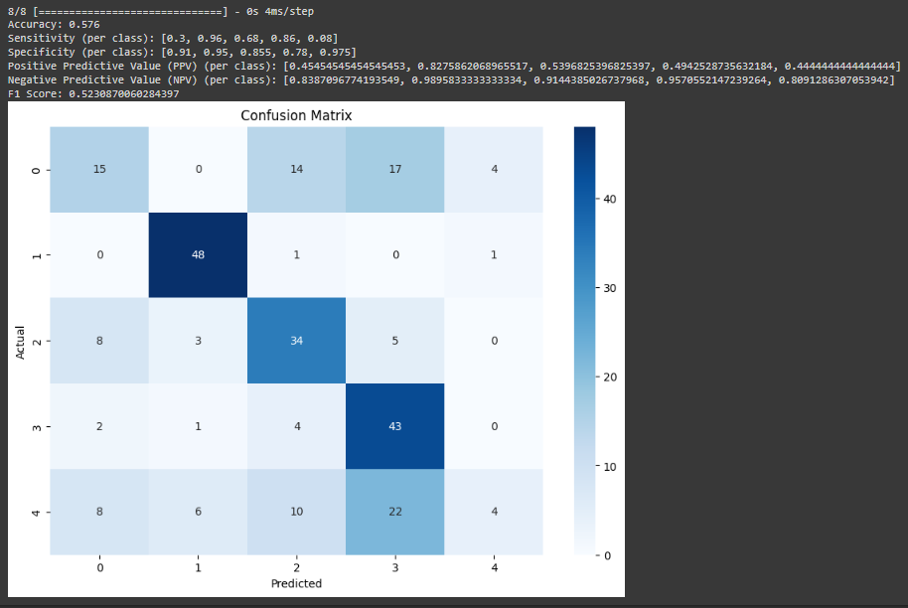
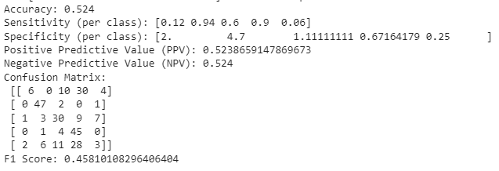
Neural Network

Slide 30
Comparison between logistic regression and neural network
Neural network is better than logistic regression in this case.

