Slide 1
Final Project – Web Application
Jeremy PEILLERON
Maxime PERRIN
Cloud computing
ESILV A4 – CCC 2

Slide 2




Course presentation
Introduction
Demonstration
Explaination
Tasks repartition

Slide 3
Introduction – Context
Cloud Computing final project
Web Application from another ESILV course
3 containers:
Frontend
Backend
Database

Slide 4
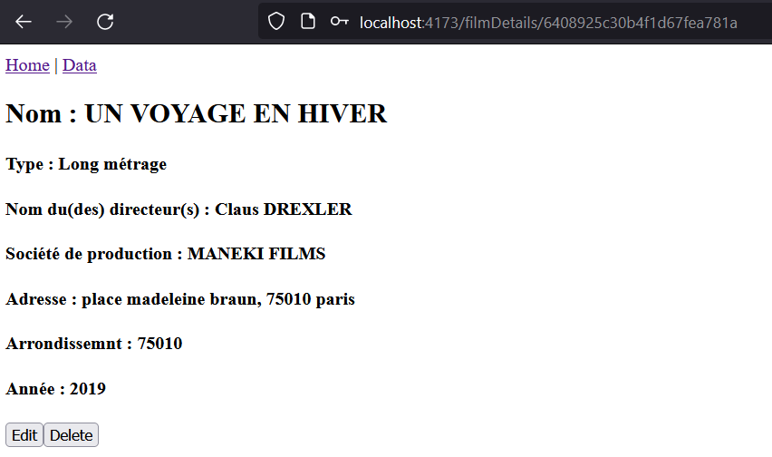
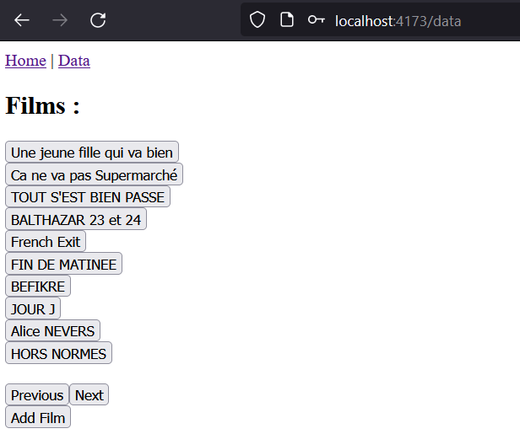
Demo

Slide 5
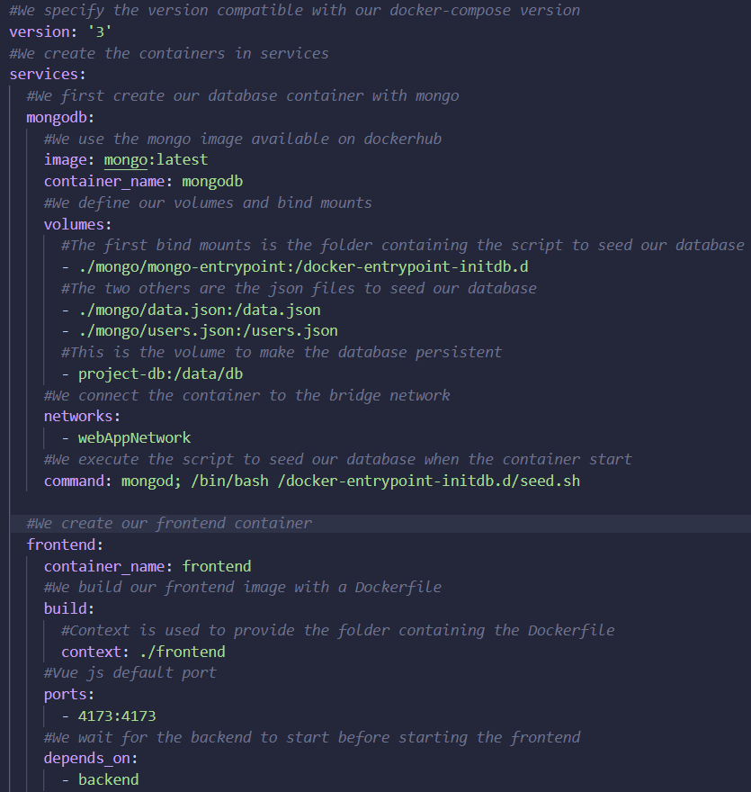
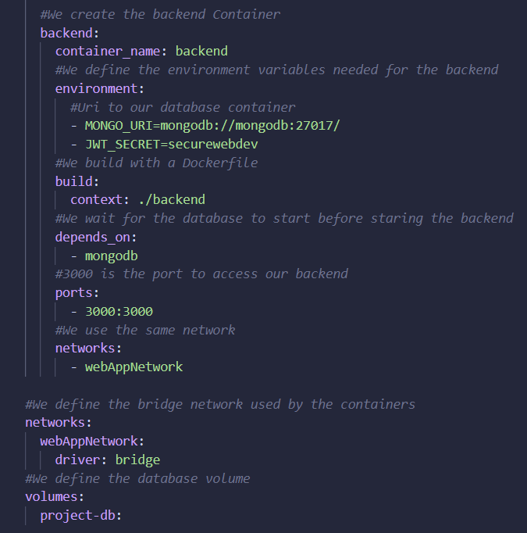
Explaination

Slide 6





Tasks
Jeremy
Maxime
Database
Backend
Frontend

Slide 7
External links
GitHub repository:
https://github.com/Aabzyx/Cloud-Computing_Projet-Final
DockerHub frontend image:
https://hub.docker.com/repository/docker/aabzyx/cloud-computing-final-project-frontend/general
Students email adresses:
maxime.perrin2@edu.devinci.fr
jeremy.peilleron@edu.devinci.fr

