Slide 1
Internship Report

Slide 2
Introduction :
Where I did my internship :
The Ecole Normale Supérieure Tétouan Martil is a renowned educational institution in Tétouan, Morocco, known for its teacher training programs. With a focus on academic excellence and innovative teaching methods, the school prepares future educators with the necessary knowledge and practical skills for successful careers in education. The institution's committed faculty, interactive teaching approaches, and emphasis on practical training contribute to a dynamic learning environment. Through cultural exchange and community engagement, the Ecole Normale Supérieure Tétouan Martil fosters the holistic development of its students. It is an ideal choice for individuals aspiring to become competent and compassionate teachers.

Slide 3
Requirements :
Project objectives :
Create a functional library management website.
Create two types of user, an administrator/librarian and a student.
A small-to-medium-sized page
Functionality requirements:
(On the student side)
The ability for the student to create an account in order to use the site, and to log out if they wish.
The possibility for the student to reserve/borrow a book from a virtual library of books.
Students can manage their own borrowed books (return them, see book details, return deadline).

Slide 4
(On the administrator's side)
The ability to manage library books (delete, add).
Be able to manage student reservation requests (be able to refuse or accept the student's reservation request).
View books currently reserved and confirm the return of the book by the student, as well as view books reserved on the same day and books returned on the same day.
Be able to Add additional administration accounts from any administration account.
Manage students accounts created on the site (be able to delete accounts).
Be able to Log out if you wish.

Slide 5
Design and user experience:
User-friendly interface with Eye-pleasing colors.
Technology requirements :
Intern's preferred technologies.
Schedule:
All April.

Slide 6
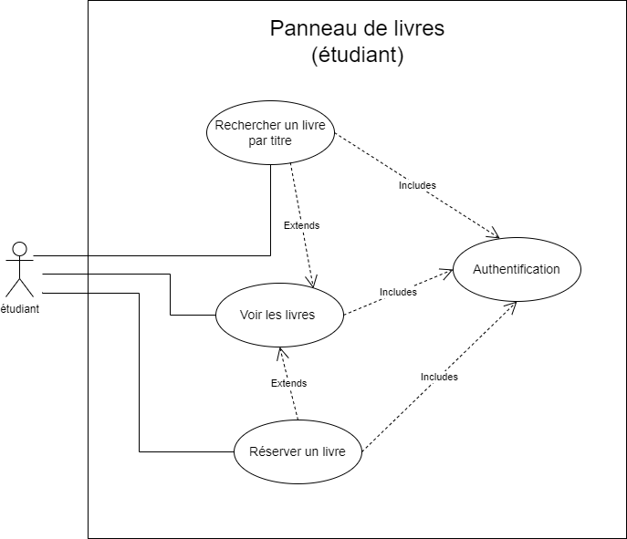
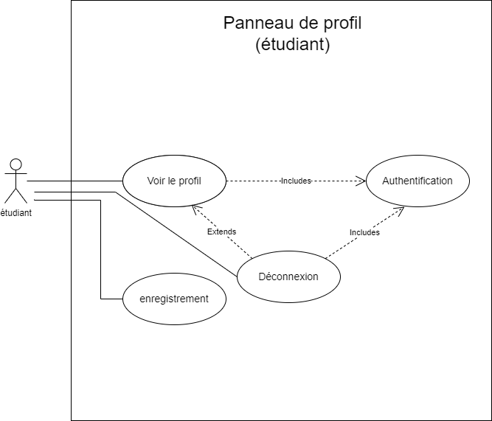
UML Diagrams :
Use case diagrams :
Students perspective UML’s :

Slide 7
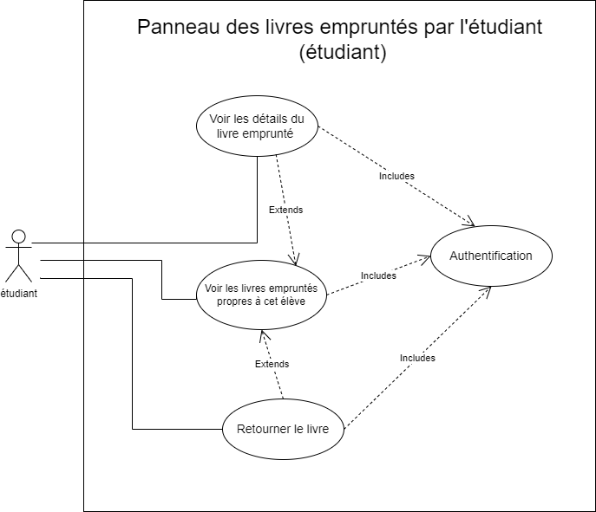

Slide 8
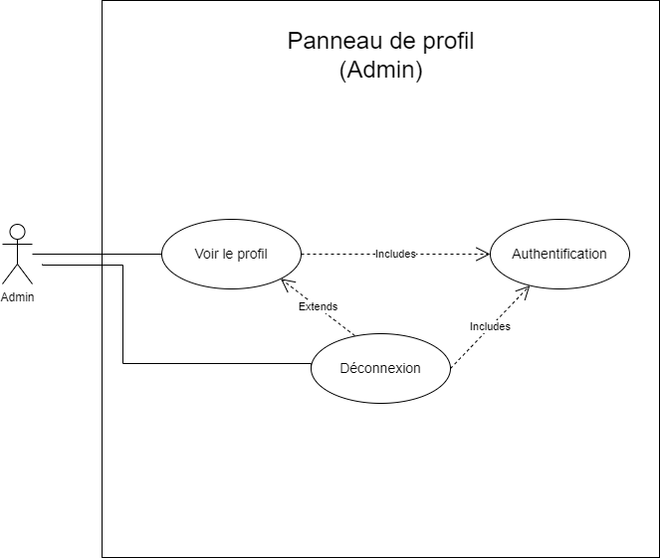
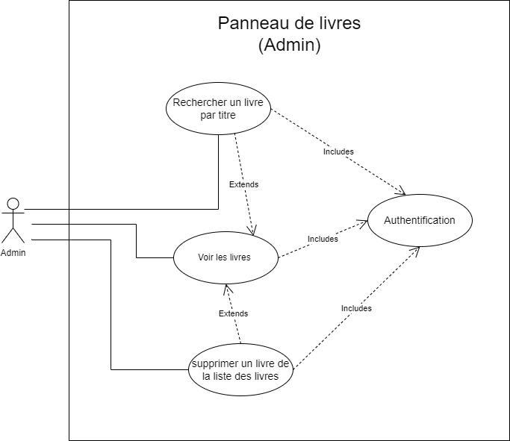
(Admins perspective UML’s)

Slide 9
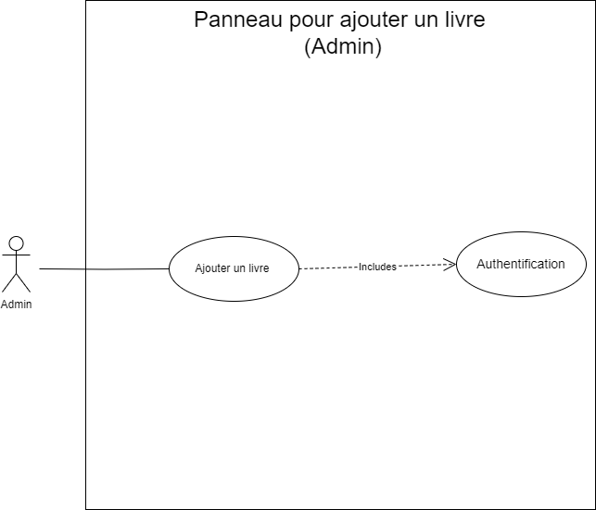
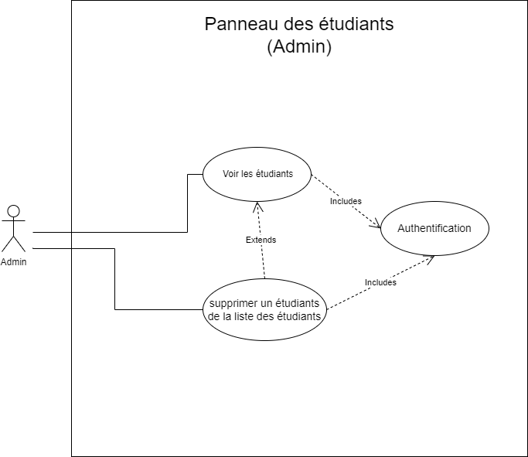

Slide 10
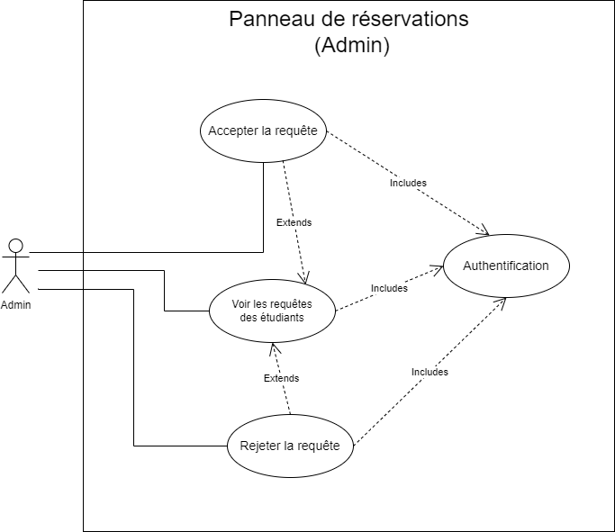
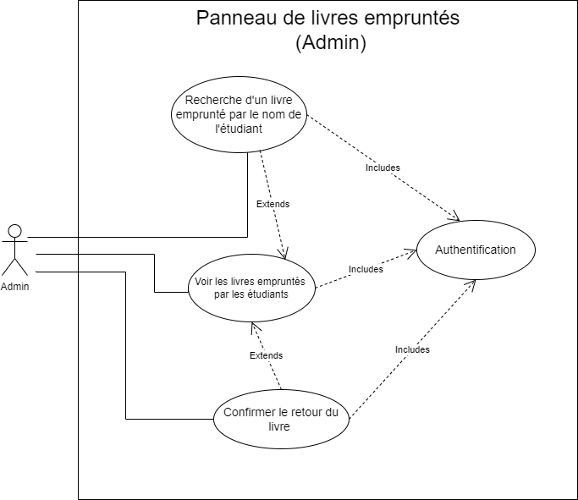

Slide 11
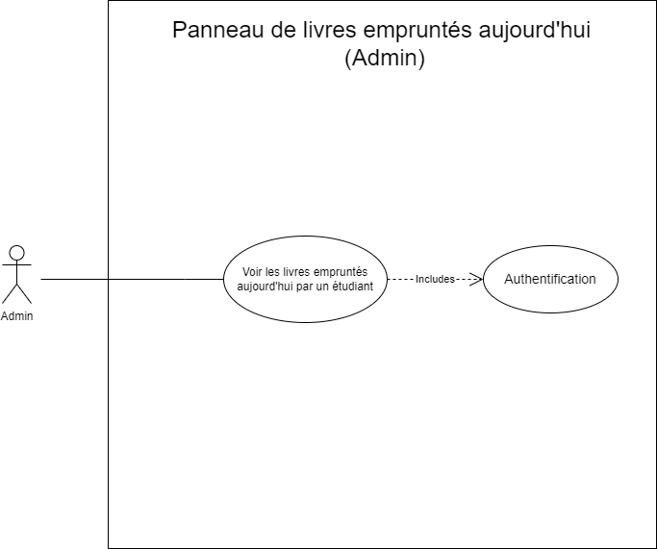


Slide 12
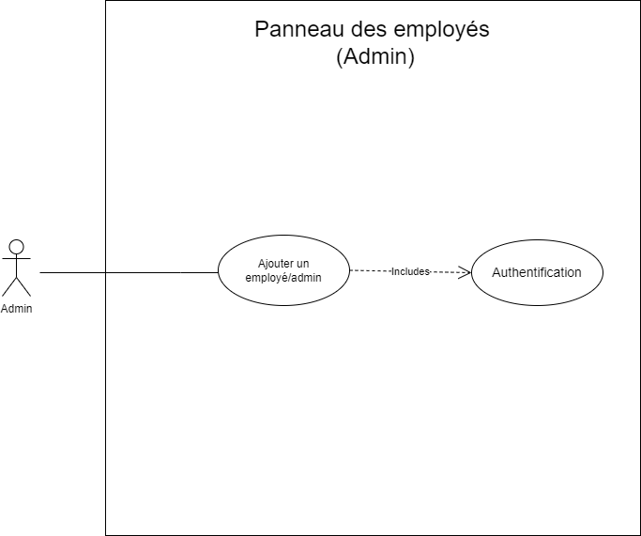

Slide 13
Class diagrams :

Slide 14
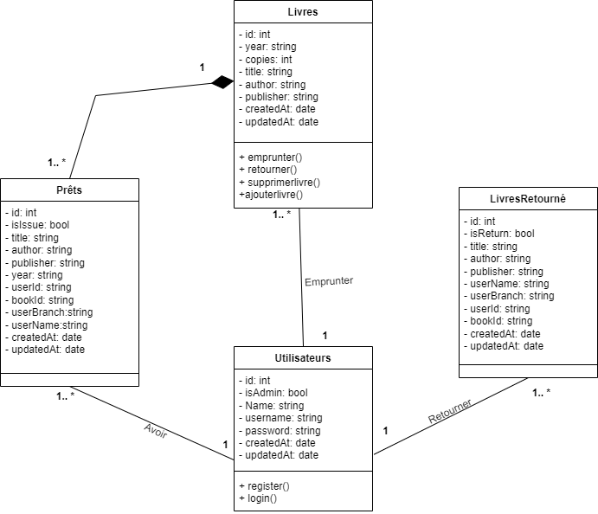

Slide 15
Used technologies and benchmarking :
Used technologies :
React :
React is a popular JavaScript library for building user interfaces. It allows developers to create reusable UI components and efficiently update them when the data changes. React follows a component-based architecture, making it easier to manage complex UIs and build interactive web applications. It is widely used for creating single-page applications, mobile apps, and responsive user interfaces.
MongoDB :
MongoDB is a NoSQL database that provides a flexible, scalable, and high-performance solution for managing large volumes of structured and unstructured data. It is a document-oriented database, which means it stores data in JSON-like documents. MongoDB offers features like flexible data models, automatic scaling, high availability, and rich query capabilities. It is widely used in modern web applications, particularly in scenarios where flexibility and scalability are crucial.

Slide 16
Node.js :
Node.js is a JavaScript runtime built on Chrome's V8 engine. It allows developers to run JavaScript on the server-side, enabling them to build scalable and high-performance web applications. Node.js uses an event-driven, non-blocking I/O model, making it efficient for handling concurrent requests. It has a rich ecosystem of modules and packages, making it easy to build web servers, RESTful APIs, real-time applications, and more. Node.js is highly popular for its ability to build fast and efficient server-side applications using JavaScript.

Slide 17
Benchmarking :
React:
Pros :
Efficient virtual DOM rendering for fast and responsive user interfaces.
Component-based architecture promotes reusability and modularity.
Large and active community with extensive documentation and libraries.
Supports code splitting and lazy loading for improved performance and scalability.
Cons :
Steep learning curve for beginners due to the introduction of JSX and component-based development.
Requires additional tools and libraries for state management and routing.
Can be resource-intensive for complex applications with frequent UI updates.

Slide 18
MongoDB :
Pros :
High performance and scalability, designed for handling large volumes of data.
Flexible document-oriented data model for agile and evolving applications.
Distributed architecture with sharding and replica sets for improved performance and fault tolerance.
Rich query capabilities and support for indexing.
Cons :
Lack of ACID (Atomicity, Consistency, Isolation, Durability) transactions, which might be important for certain use cases.
Not suitable for highly structured and relational data.
Limited support for complex joins and aggregations.

Slide 19
Node.js :
Pros :
Excellent performance and scalability due to the V8 engine and event-driven, non-blocking I/O model.
Well-suited for real-time applications and handling multiple concurrent connections.
JavaScript as the primary language allows for full-stack development and code sharing.
Vast ecosystem of libraries and modules available through npm.
Cons :
Single-threaded nature can lead to performance bottlenecks for CPU-intensive tasks.
Requires careful handling of asynchronous code and potential callback hell.
Not suitable for applications requiring heavy multi-threading or parallel processing.

Slide 20
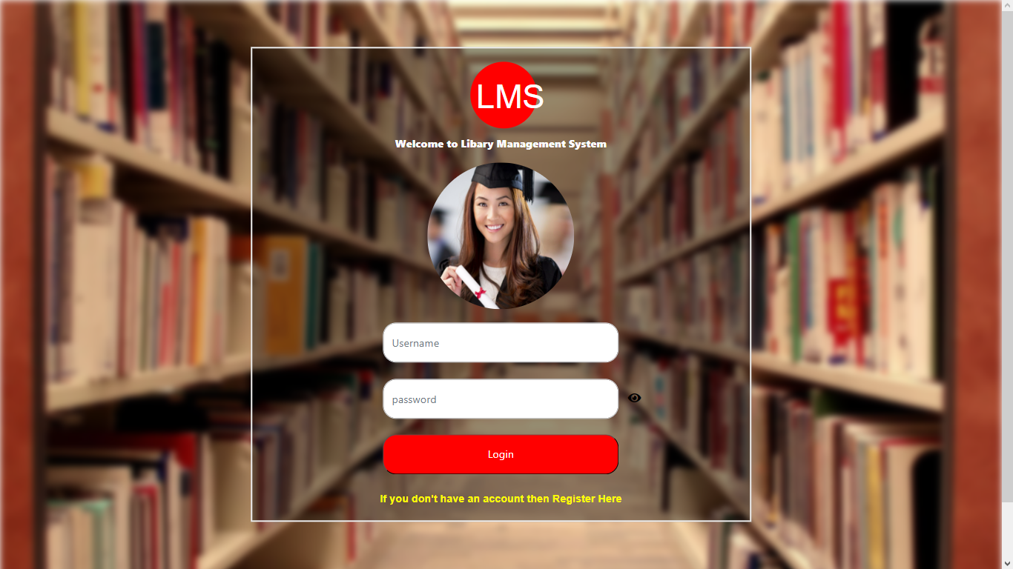
User's manual :
Intructions for use :
(Students side)
When students enter the site for the first time, they are in the authentication window and, if they don't have an account, they can create one in the registration window, in the yellow link.

Slide 21
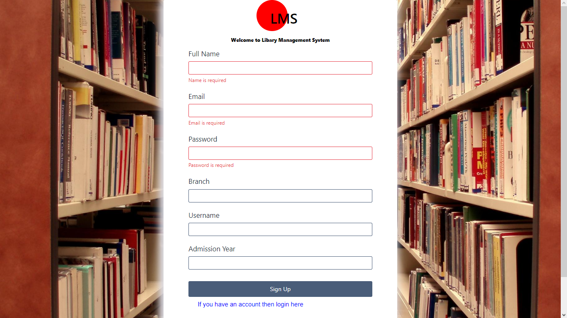
Once the student has created an account and completed authentication, he or she is redirected to the student account home page.

Slide 22
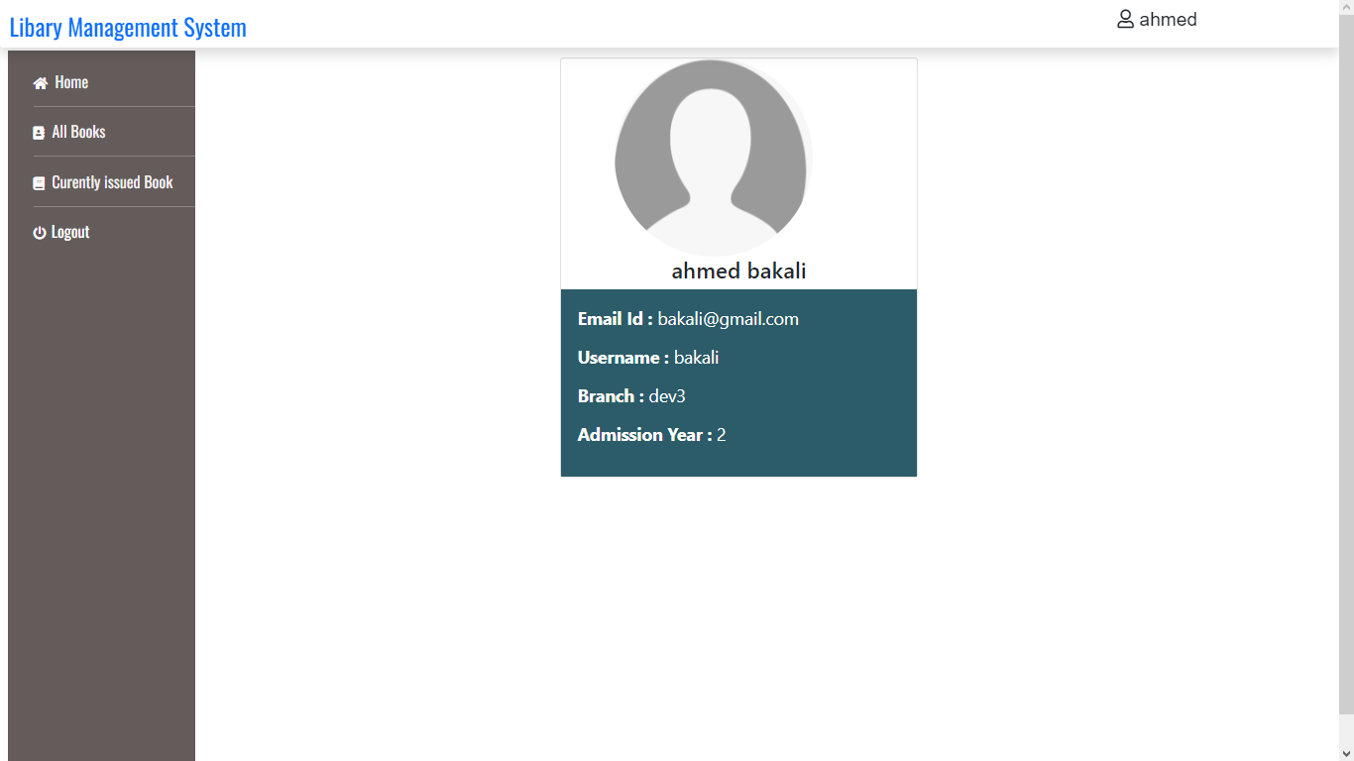
The student then has two windows in addition to the logout window: the window where he can borrow/reserve the book he wants, and the window for managing the books currently borrowed for him. In addition, the student cannot borrow the same book twice.

Slide 23
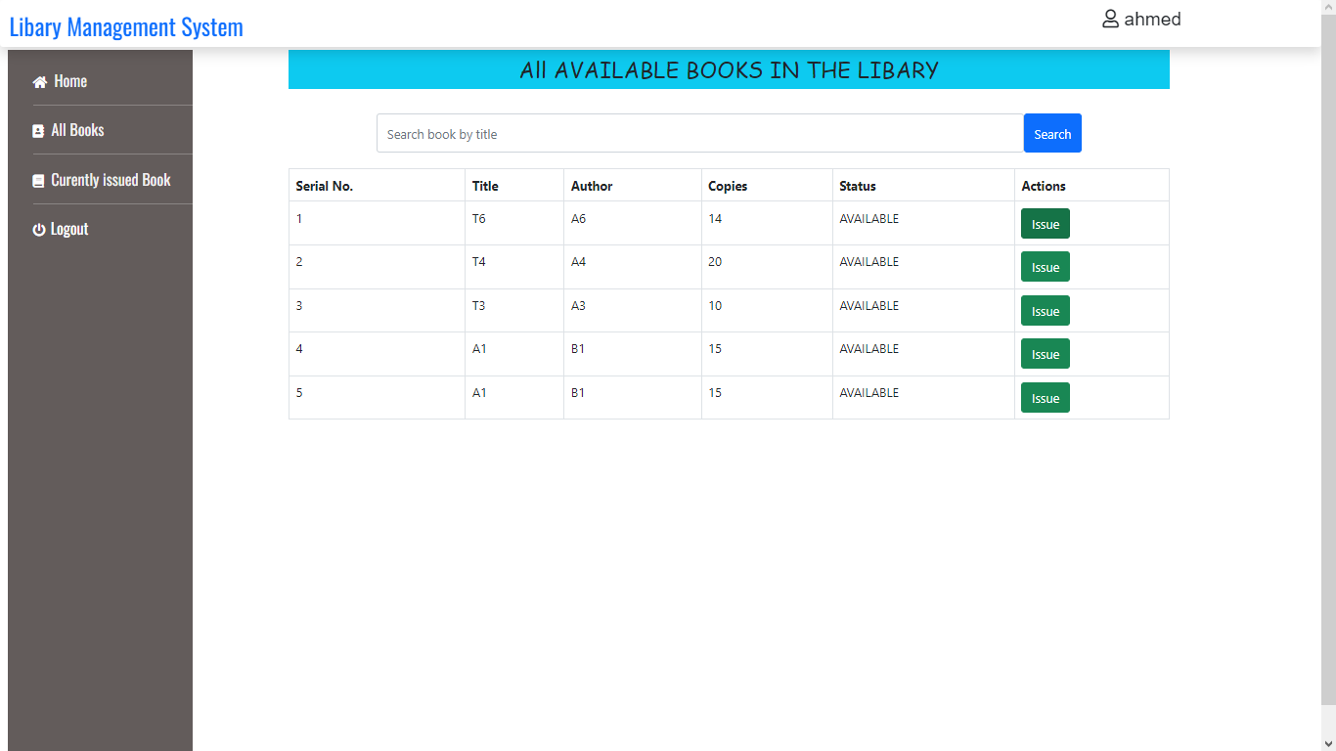

Slide 24
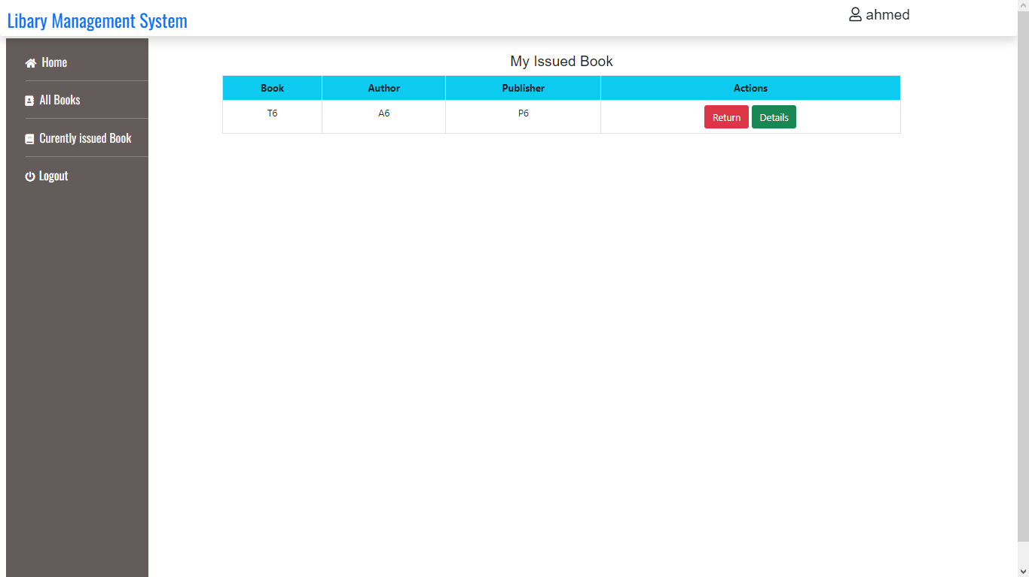

Slide 25
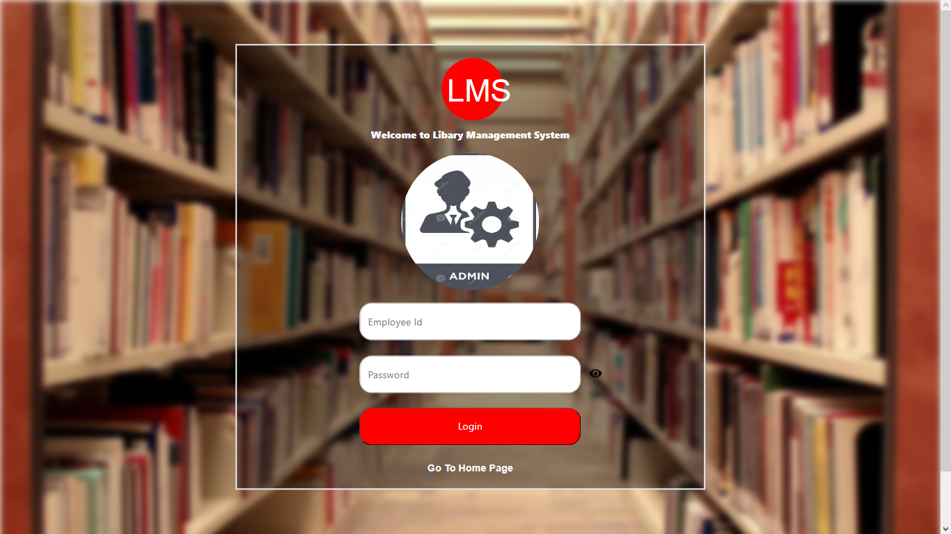
(Admins side)
On the administration side, as for students, we have our own panel for administrator authentication.
And once in the administrator account, we have the account information window.

Slide 26
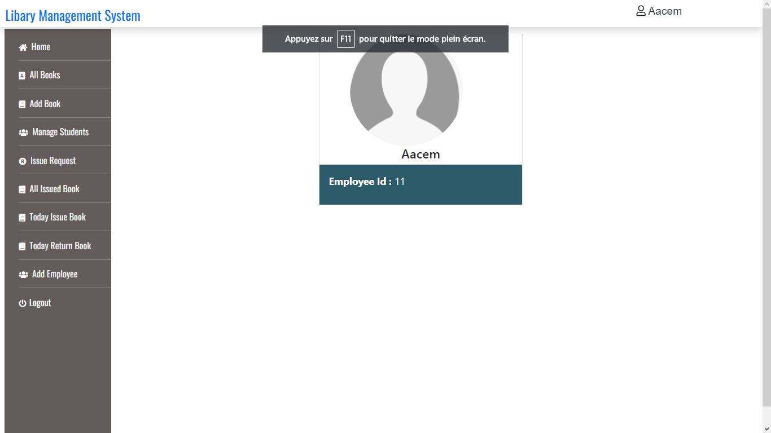
Now let's take a look at some of the vital functions the administrator can perform. One of these is to delete any desired book from the library's books window, as well as to add a book to the virtual library at any time. In addition, he can manage students as well as student requests to borrow a book.

Slide 27
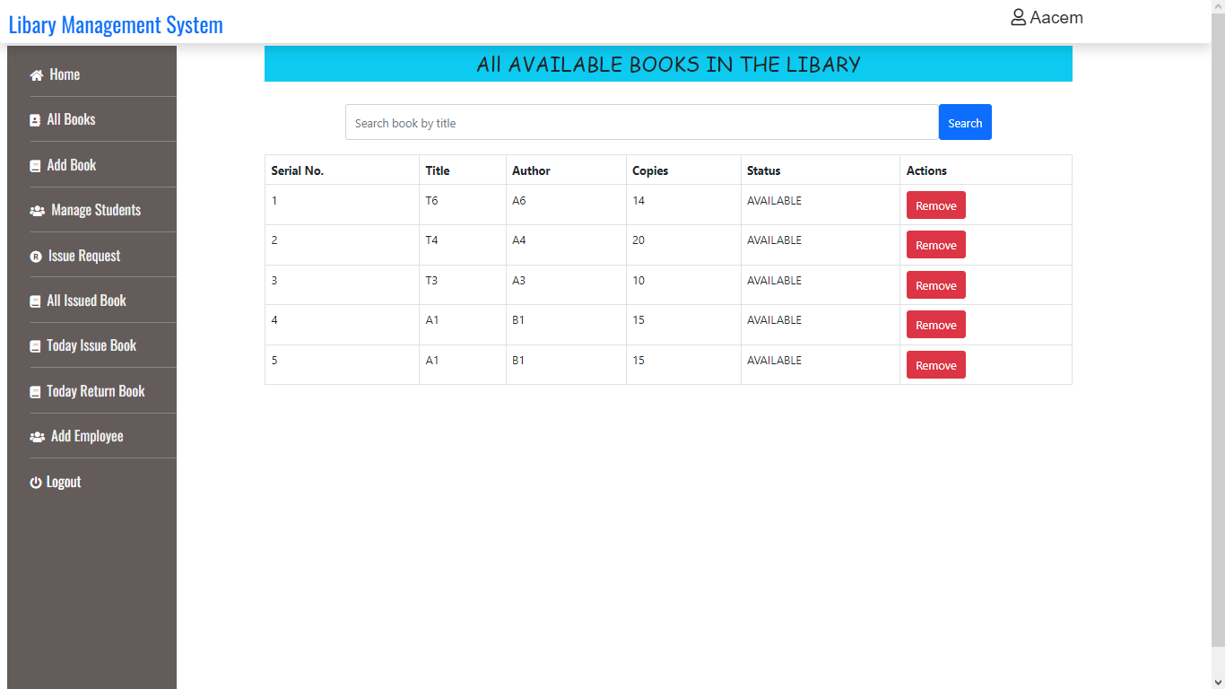

Slide 28
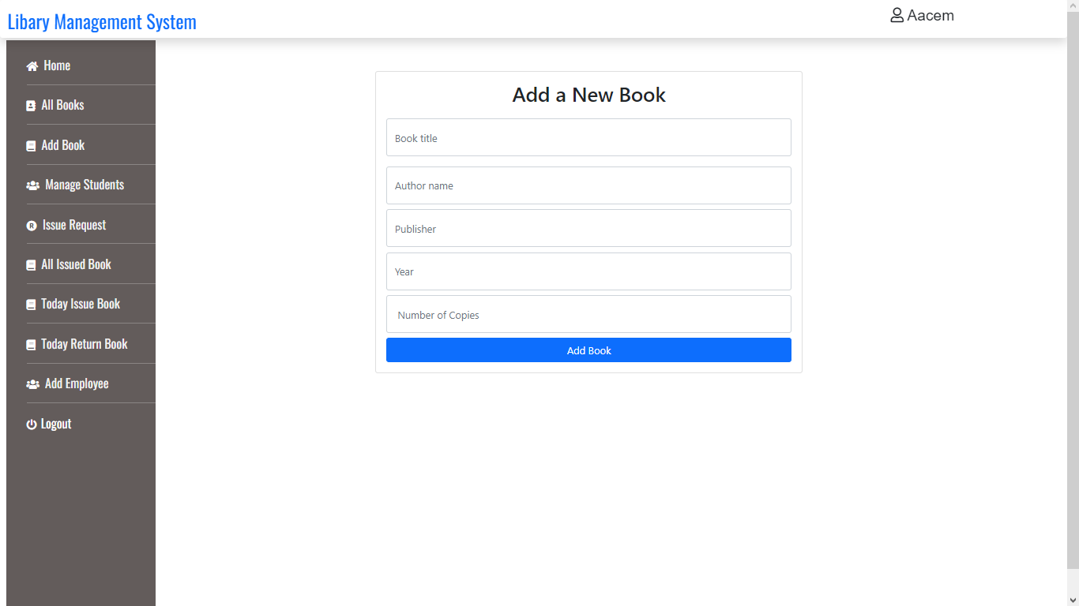

Slide 29
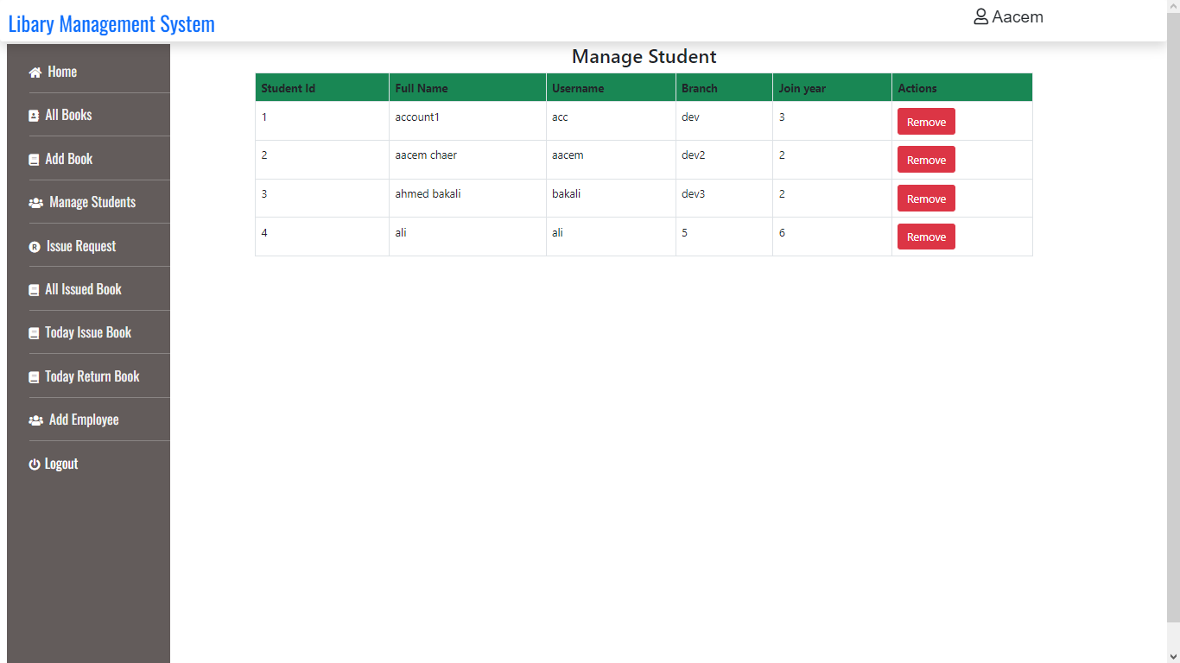

Slide 30
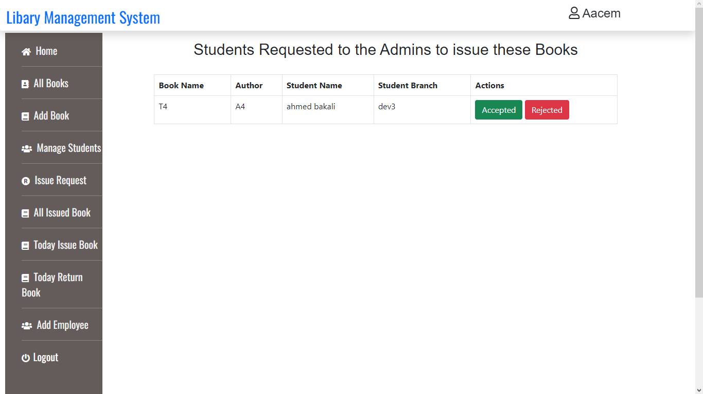

Slide 31
And to finish off with all the administration functions available, we have the ability to manage books that are currently borrowed (being able to confirm the return of the book by the student if he/she physically brings it to the librarians), as well as review books borrowed today as well as books returned today, and finally the ability to add an additional administration account if required.

Slide 32
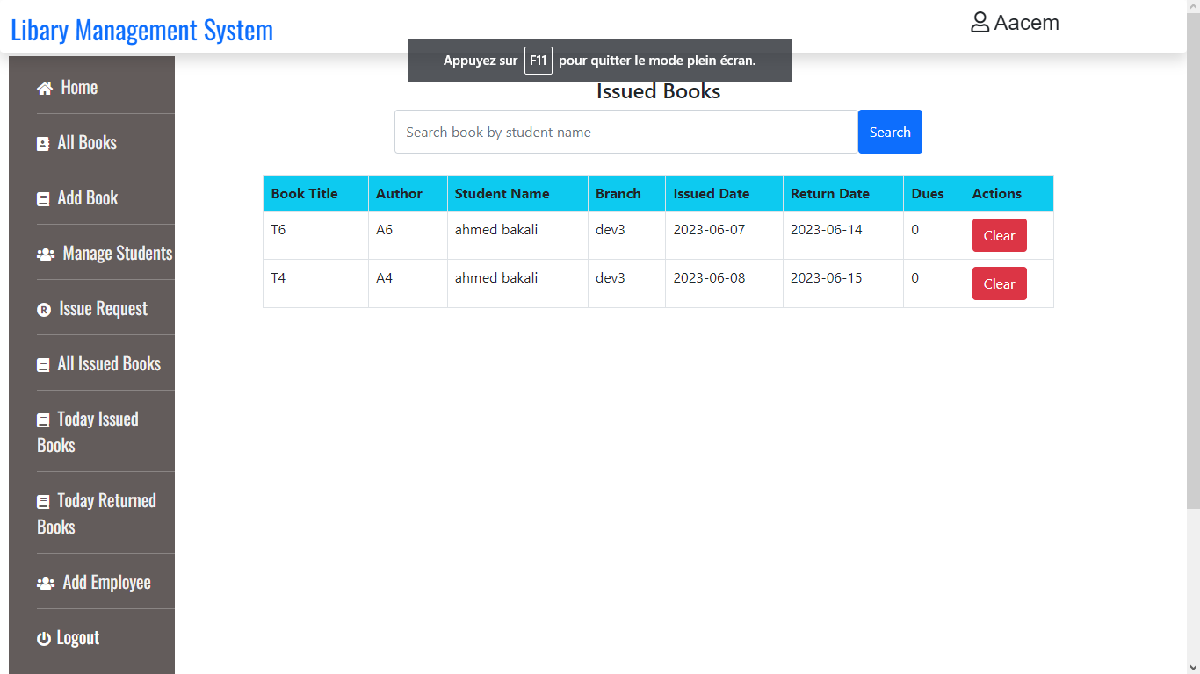

Slide 33
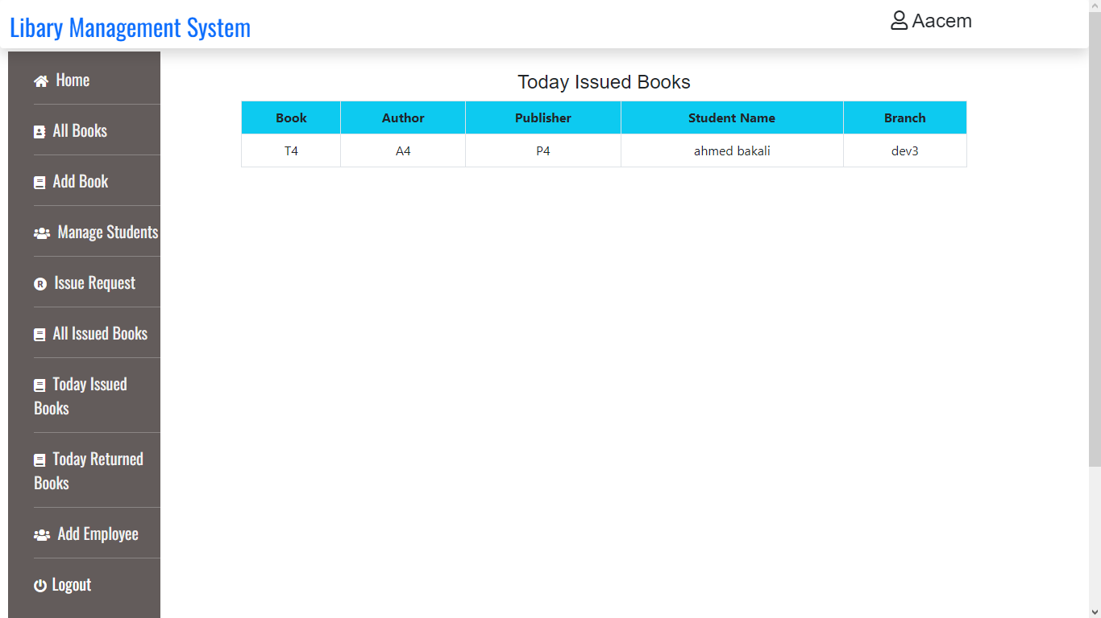

Slide 34


Slide 35
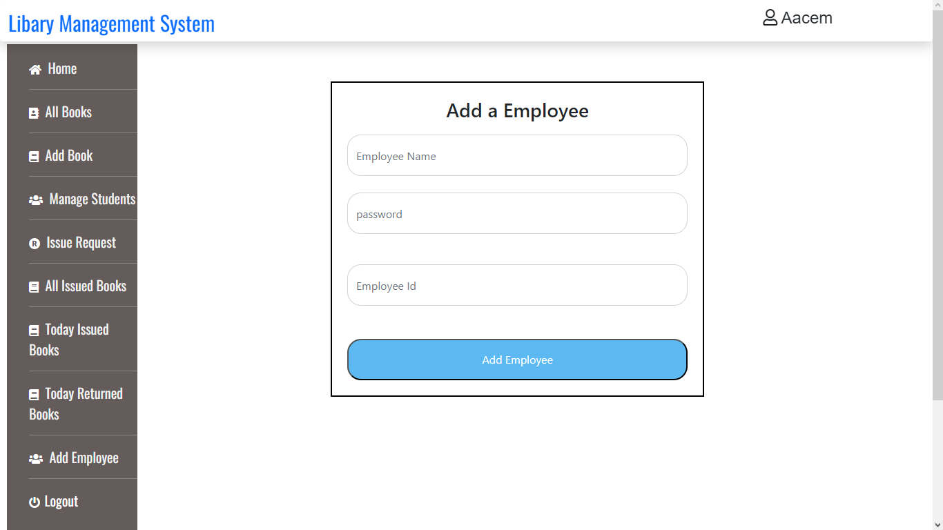

Slide 36
Thank you for listening to me

