Slide 1

HMS - Harmful Brain Activity Classification
Supervisor :
Georgios Moulantzikos
Team Members :
Aadit Thanekar, Qiyao Yang, Shaguan Toleugali, Lakshya Tripathi, Xin Quan, Zifan Wei

Slide 2
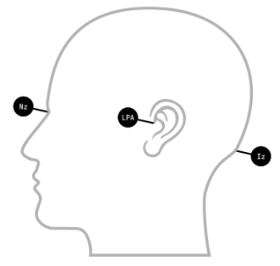
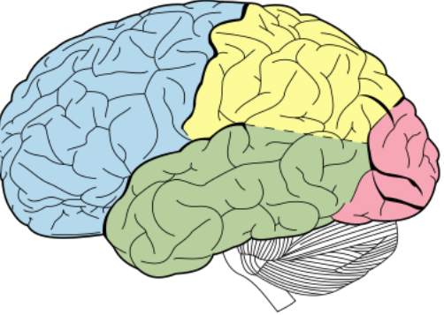
Introduction
What is this project ？
Project background
Kaggle competition, HMS - Harmful Brain Activity Classification
Goal
Detect and classify seizures and other harmful brain activity using electroencephalographic signals (EEG) from critically ill patients
Challenge
Currently relies on manual analysis by specialised neurologists, which is time-consuming, expensive, fatigue-prone, reliability issues
Importance of project
Seizures and other harmful brain activity can be better identified and classified
Supporting researchers by developing efficient algorithms

Slide 3
speech
Hello everyone, I would like to introduce you to a very important project today which is a topic in the Kaggle competition called HMS - Harmful Brain Activity Classification.Our goal is to use EEG signals to detect and classify epileptic seizures and other harmful brain activities. Doctors often rely on EEG to detect these abnormal activities when treating critically ill patients in order to prevent brain damage. There are many challenges with this current project, such as the fact that the process relies heavily on manual analysis by specialised neurologists, which has many drawbacks, such as being time-consuming, expensive, and fatiguing.
The importance of this project cannot be overstated. Through our work, we hope to develop automated EEG analysis models, that not only better identify and classify seizures and other harmful brain activity, but also have far-reaching implications for neurocritical care, treatment of patients with epilepsy, and drug development. Physicians, brain researchers, and drug development investigators are our target audience and will benefit from our work. By developing algorithms that accelerate and improve the detection of epilepsy and other brain activities, we support them with fast and accurate treatments and contribute to the advancement of the field of neurology.

Slide 4
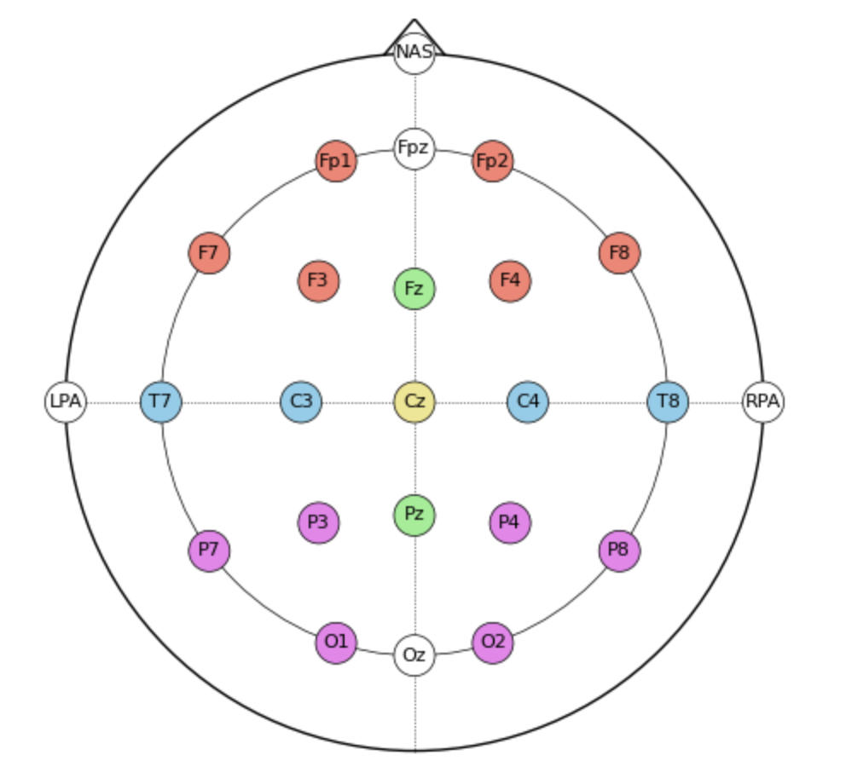
What is the Dataset - EEG & Spectrograms
EEG:
Recordings the electrical activity in the brain from 20 different electrodes over time.
A single EEG parquet file contains multiple 50-second EEG time windows.
Spectrograms:
Spectrograms assembled EEG data using exactly 10 minutes and are a visual analysis tool that shows the frequency spectrum of EEG signals over time.
Useful for identifying changes in brain activity that may not be as obvious in raw EEG signals.

Slide 5
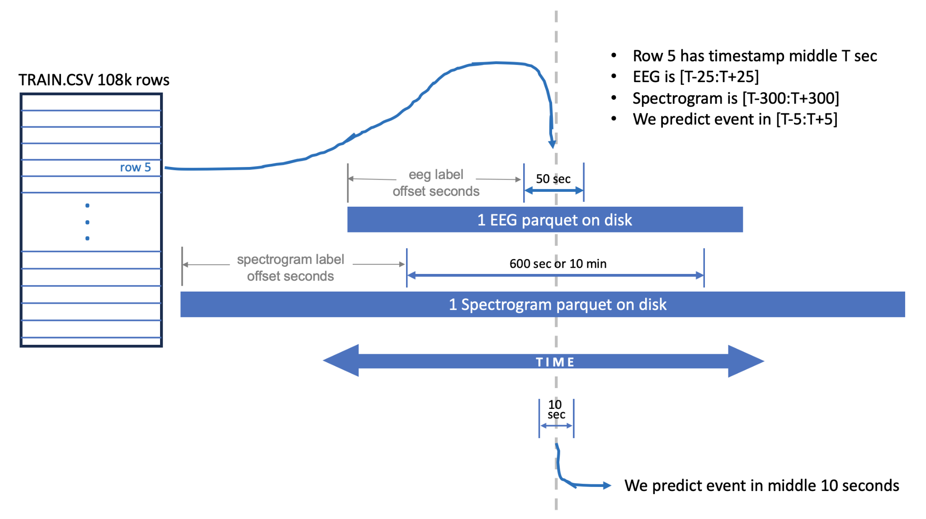
Understanding Competition Data
train.csv Overview:
Contains 106,800 time windows of data.
There are only 17,089 unique EEG IDs and 11,138 unique spectrogram IDs.
The data corresponds to 1,950 unique patients.
Each row in train.csv is centered around a specific moment in time for a given patient, with a unique timestamp that splits the EEG and spectrogram windows equally.
Example: A row might have the center timestamp T equal to May 3, 2023, 19:30:06.
Time Windows and Prediction Goals:
EEG Time Window:
A 50-second window centered around the timestamp T, i.e., from [T-25 seconds] to [T+25 seconds].
Spectrogram Time Window:
A 600-second window centered around the timestamp T, i.e., from [T-300 seconds] to [T+300 seconds].
Prediction Target:
The event to be predicted occurs within a critical 10-second window around the timestamp T, specifically from [T-5 seconds] to [T+5 seconds]

Slide 6
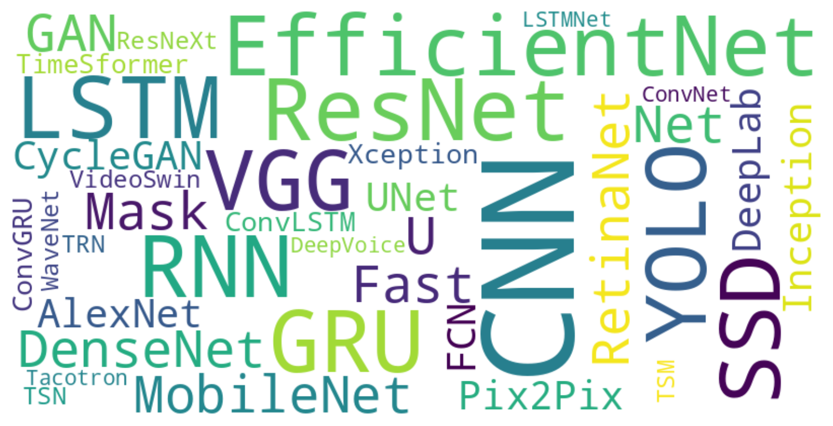
What model is suitable for this competition?

Slide 7
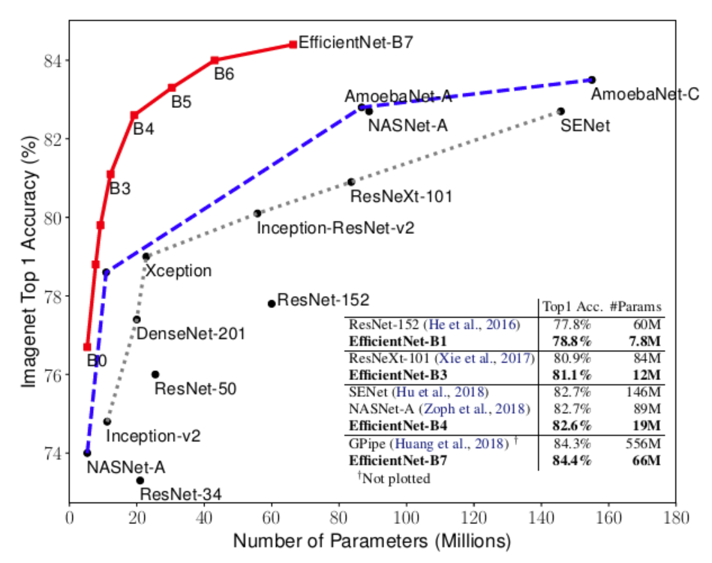
EfficientNet- Balancing network depth, width and resolution
EfficientNet represents a significant breakthrough in image recognition, innovatively scaling convolutional networks to achieve higher accuracy with efficient use of computational resources.
The central challenge was balancing resolution, depth, and width to optimize the network for both efficiency and performance.
By employing a compound scaling method—adjusting all three dimensions simultaneously—EfficientNet substantially improves model accuracy while maintaining efficiency.

Slide 8
Why EfficientNet?
Advanced Feature Extraction:
EfficientNet's architecture is designed to capture fine details in EEG signals and spectrogram images through an optimal balance of network depth and width. This is crucial for accurately classifying brain activity patterns.
Compound Scaling Strategy:
EfficientNet employs a compound scaling method that simultaneously adjusts the network's depth, width, and resolution. This approach enhances model accuracy and adaptability to data complexity, improving performance on challenging EEG patterns.
Adaptive Adjustments:
Targeted Fine-tuning: EfficientNet supports fine-tuning of layers and optimization of learning rates and regularization strategies, ensuring precise classification of various brain activities.

Slide 9
WaveNet - Deep generative model
WaveNet is a powerful model which has contributed to many Kaggle competition winning solutions.WaveNet's suitability for EEG data in harmful brain activity classification tasks stems from its ability to effectively capture temporal dependencies and subtle patterns in sequential data.
Temporal Modeling: WaveNet's stacked dilated causal convolutional layers effectively capture temporal dependencies in EEG data, crucial for modeling brain activity over time.
Fine-Grained Feature Extraction: WaveNet's use of dilated convolutions allows it to capture both local and global dependencies in the input waveform. This is particularly useful for EEG data, where subtle changes in the signal over time may contain valuable information about harmful brain activity. By spreading out the convolutions with increasing dilation rates, WaveNet can effectively extract fine-grained features from the EEG signals, enabling more accurate classification.
Frequency Analysis: EEG signals contain information about the frequency components of brain activity, which can be indicative of different brain states or conditions. WaveNet's ability to locate the presence of frequencies in waveforms makes it well-suited for analyzing EEG data.

Slide 10
Evaluation
Submissions are evaluated on the Kullback Liebler divergence between the predicted probability and the observed target.

Slide 11
