Slide 1
Sales Data Report
Business Reporting & Intelligence Associate Assessment

Slide 2
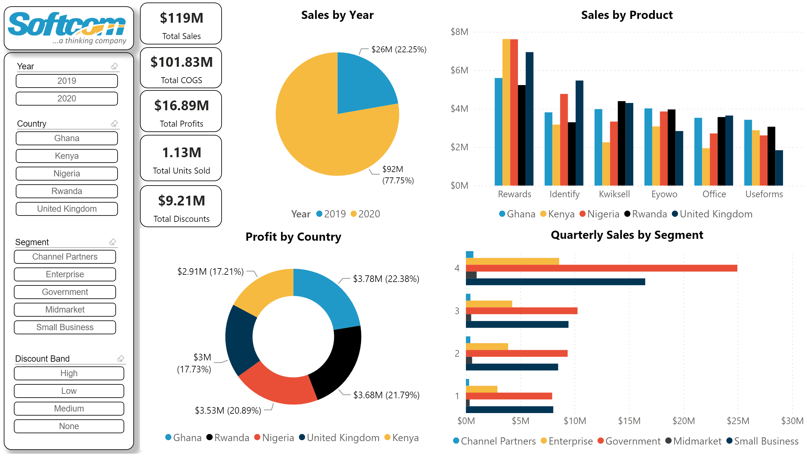
Executive Summary

Slide 3
Insights
Sales are highest in the quarter 4 of both year. It is also the period where discount is at its highest. To help increase sales in other quarters especially quarters 1 and 3, the discounts rate for those periods should be increased.
In general, Ghana is the most profitable country followed by Rwanda. Although, in 2019, Rwanda was the most profitable country, while in 2020, it was Ghana. The most sold product for the Ghanaian market is Rewards, followed by Eyowo.
Rewards products is responsible for most sales across all the five countries.
Quarter four has the largest sales for all customer segments. Government has the most sales and profit within all countries except in united Kingdom where small business rule. Government also carries the highest total discounts given.
We have a huge loss in the Enterprise customer segment even though it is the third most sold segment. Channel partner had the highest profit margin of 73%

Slide 4
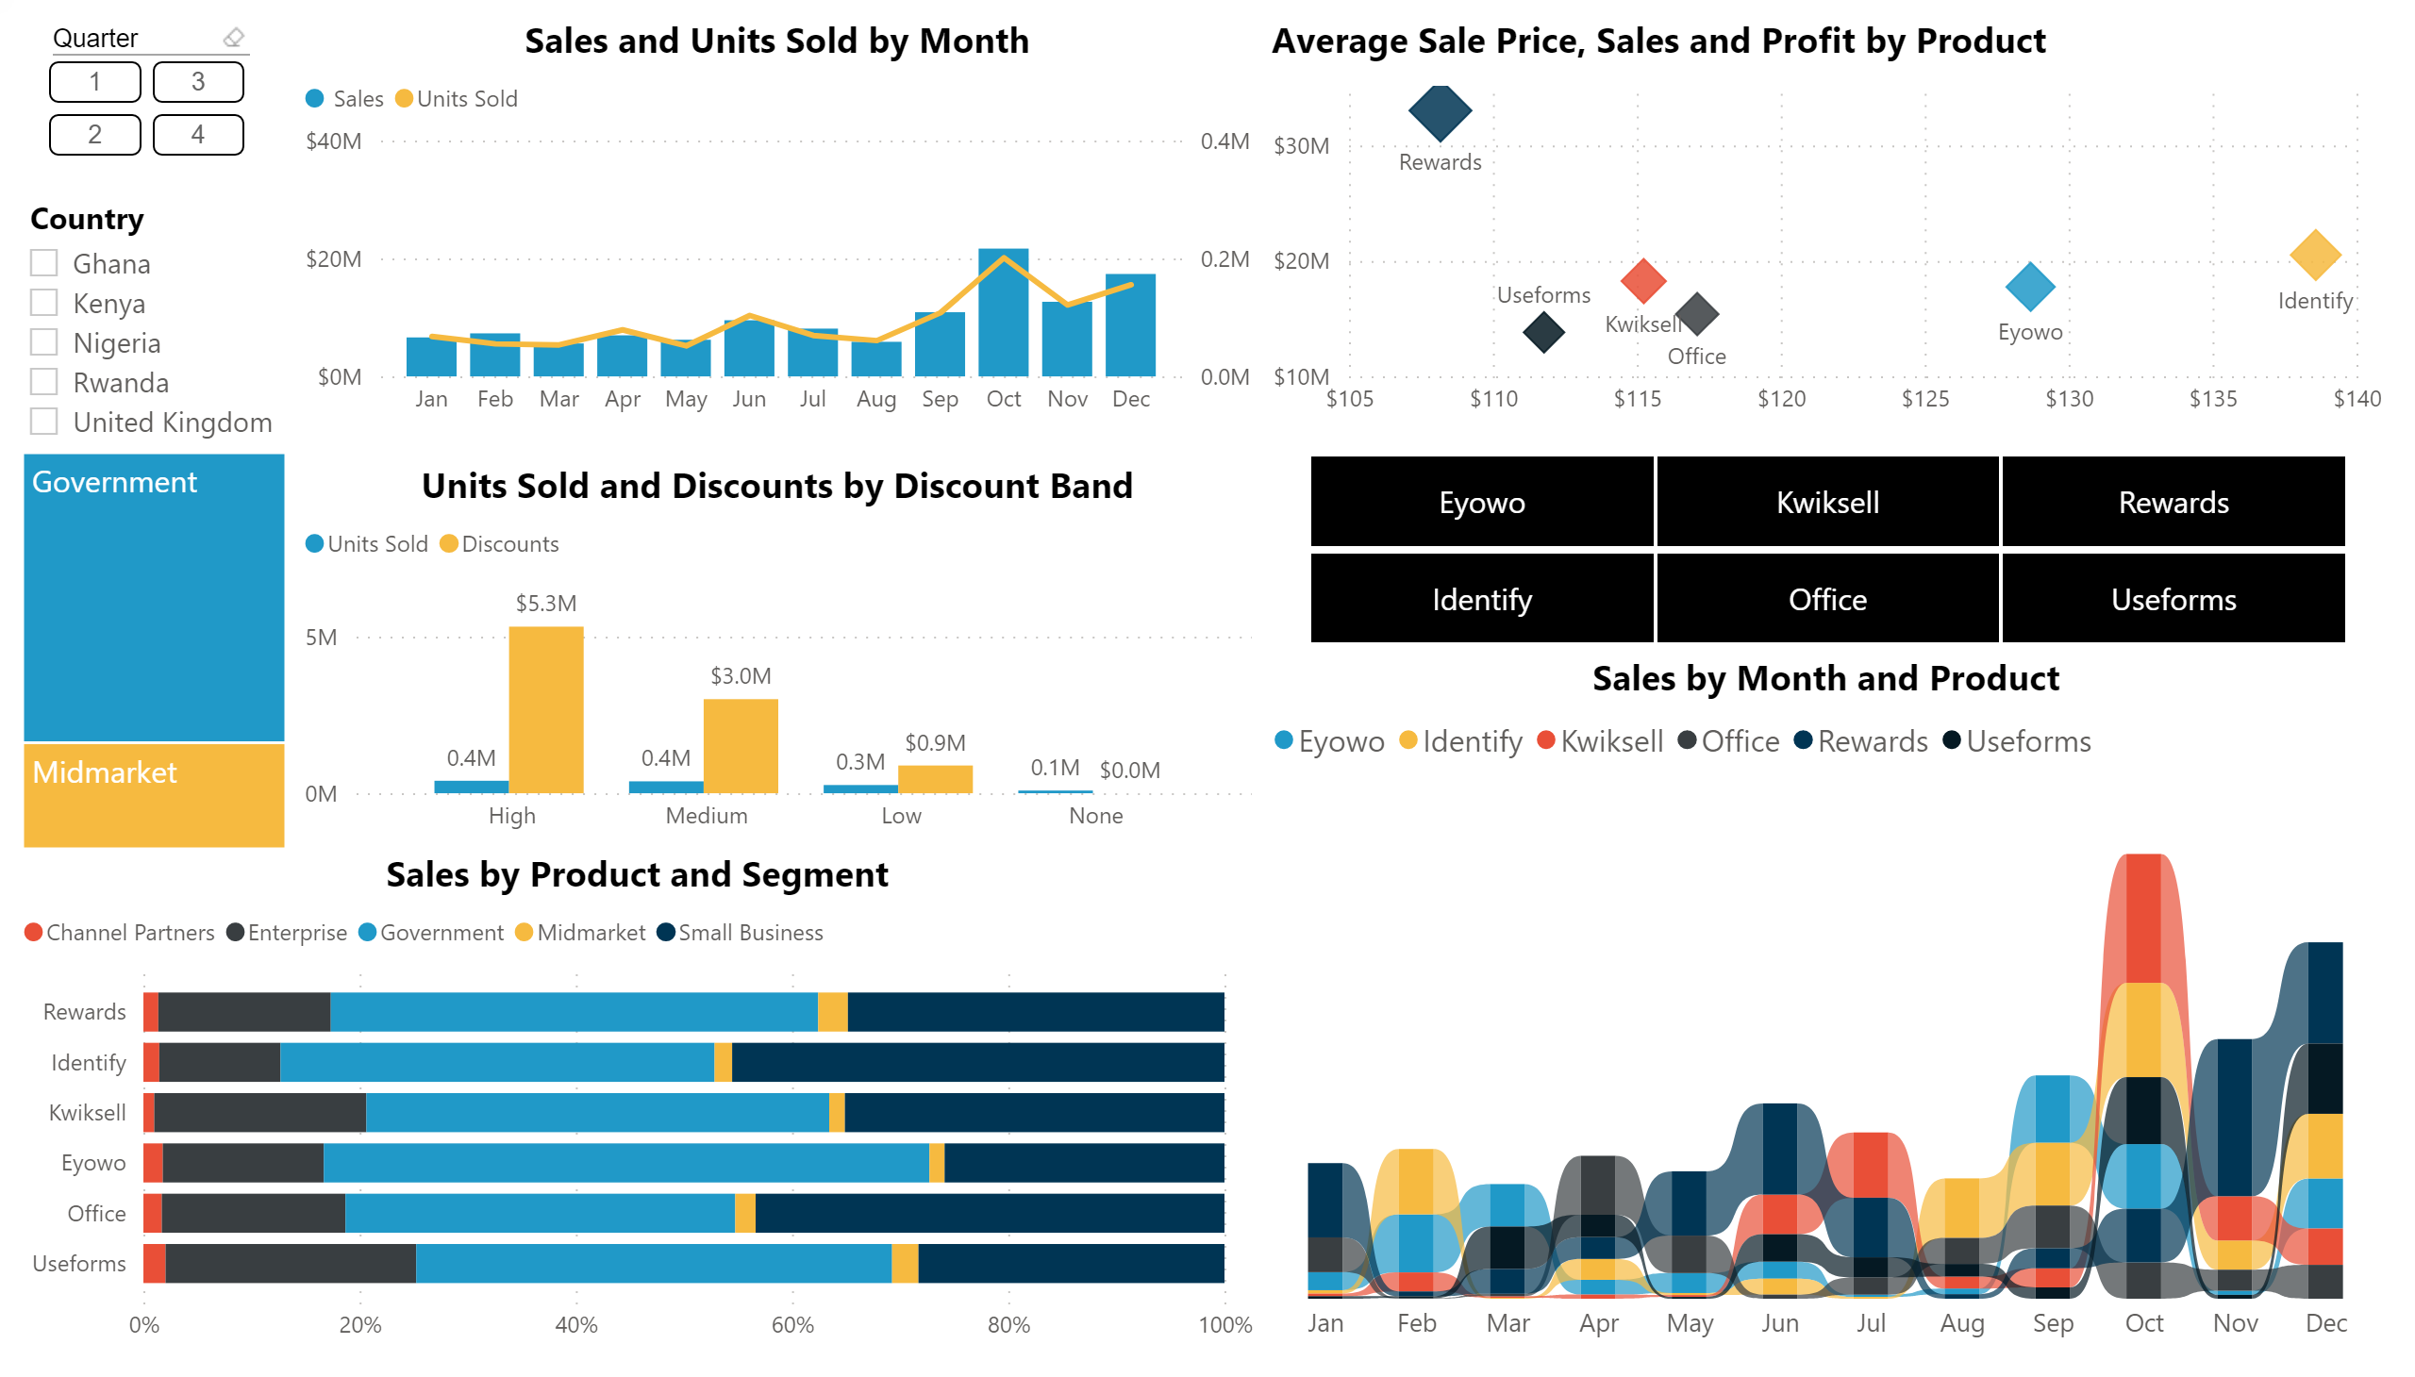
Sales and Products
Notes:
hundredPercentStackedBarChart
No alt text provided.
ribbonChart
No alt text provided.
lineStackedColumnComboChart
No alt text provided.
ChicletSlicer1448559807354
No alt text provided.
clusteredColumnChart
No alt text provided.
slicer
No alt text provided.
treemap
No alt text provided.
slicer
No alt text provided.
scatterChart
No alt text provided.

Slide 5
Strategic Recommendations
Sales, profit and discounts have a direct relationship. The higher the discounts, the higher the sales and profit. Low performing Products – especially Useforms and Enterprise should increase their discount rate in quarter 1 and 3.
Products like Eyowo and Identify average price should be reduced by 10-11%, its sales and Profit will be much higher than we currently have.
There should be increased sales in our product and segment in the Rwandan Market, Rwanda has the highest profit margin in our current African market.
To acquire a Total profit of about $38M at our current sales rate, average price need to increase from $118 to $130

