Slide 1
MVC
MVC stands for Model View and Controller.
It is an architectural design pattern used at the architecture level of an application(MVC is not a programming language, MVC is not a Framework).
Note:
MVC Design Pattern is basically used to develop interactive applications. An interactive application is an application where there is user interaction involved and based on the user interaction some event handling occurred.
MVC is not only used for developing web-based applications but also we can use this MVC design pattern to develop the Desktop or mobile-based application.

Slide 2
MVC
MVC divides an application into 3 major components.
They are Model, View, and Controller.
The main objective of the MVC design pattern is the separation of concerns.
It means the domain model and business logic are separated from the user interface (i.e. view). As a result, maintaining and testing the application becomes simpler and easier.

Slide 3
Model
The Model is the component in the MVC Design pattern which is used to manage that data.
The Model represents a set of classes that are used to describe the application’s validation logic, business logic, and data access logic.
Model contains a set of classes that is used to represent the data and also contains the logic to manage those data.
example, the Student class is the class that is used to represent the data. The StudentRepository class is the class that is used to manage the Student data.

Slide 4
View
The view component in the MVC Design pattern is used represent the model data as a user interface with which the end-user can interact.
view is used to render the domain data (i.e. business data) which is provided to it by the controller.
Views are basically the HTML pages that get rendered into the browser of the client.

Slide 5
Controller
The Controller is the component in an MVC application that is used to handle the incoming HTTP Request.
A Controller is a .cs (for C# language) file which has some methods called Action Methods. When a request comes on the controller, it is the action method of the controller which will handle those requests.
based on the user action, the respective controller will work with the model and view and then sends the response back to the user who initially made the request.
So, it is the one that will interact with both the models and views to control the flow of application execution.
The Controllers are used to manage the overall flow of the application.
Note: In the MVC design pattern both the Controller and View depend on the Model. But the Model never depends on either view or controller. This is one of the main reasons for the separation of concerns. This separation of concerns allows us to build the model and test independently of the visual presentation.

Slide 6
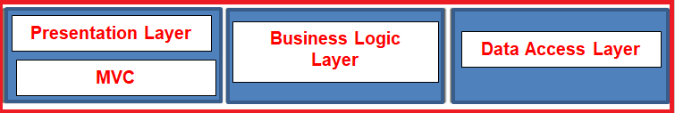
Where MVC is used in the real-time three-layer application?
In general, a real-time application may consist of the following layers
Presentation Layer: This layer is responsible for interacting with the user.
Business Layer: This layer is responsible for implementing the core business logic of the application.
Data Access Layer: This layer is responsible for interacting with the database to perform the CRUD operations.
The MVC design pattern is basically used to implement the Presentation Layer of the application. Please have a look at the following diagram.

Slide 7
ASP.NET Core MVC
The ASP.NET Core MVC is a lightweight, open-source, highly testable presentation framework.
Asp .NET Core MVC is used for building web apps and Web APIs using the Model-View-Controller (MVC) design pattern.
MVC is a design pattern and ASP.NET Core MVC is the framework that is based on MVC Design Pattern.
The ASP.NET Core MVC Framework provides us with a patterns-based way to develop dynamic websites and web apps with a clean separation of concerns.
The ASP.NET Core MVC framework provides us the full control over the mark-up. It also supports for Test-Driven Development and also uses the latest web standards.

Slide 8
ASP.NET Core MVC
The controller is the component in the MVC design pattern, who actually handles the incoming request. In order to handle the request, the controller components do several things are as follows. The controller component creates the model that is required by a view. The model is the component in the MVC design pattern which basically contains classes that are used to store the domain data or you can say business data.
In the MVC design pattern, the Model component also contains the required logic in order to retrieve the data from a database. Once the model created by the controller, then the controller selects a view to render the domain data or model data. While selecting a view, it is also the responsibility of the controller to pass the model data.
In the MVC design pattern, the only responsibility of view is to render the model data. So, in MVC, the view is the component whose responsibility is to generate the necessary HTML in order to render the model data. Once the HTML is generated by the view, then that HTML is then sent to the client over the network, who initially made the request.

Slide 9
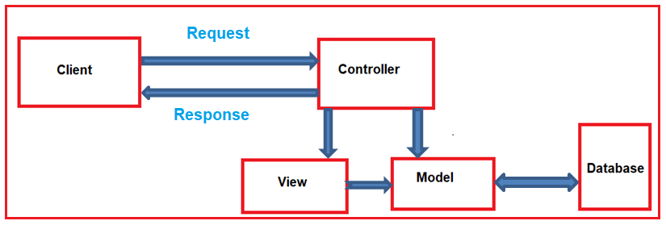
Request Processing in ASP.NET Core MVC

Slide 10
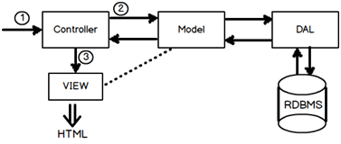
MVC Overview
Asp.Net MVC request flow
Step 1:- The first hit comes to the controller.
Step 2:- Depending on the action controller creates the object of the model. Model in turn calls the data access layer which fetches data in the model.
Step 3:- This data filled model is then passed to the view for display purpose.
when the user enters a URL in the browser, it goes to the server and calls appropriate controller. Then, the Controller uses the appropriate View and Model and creates the response and sends it back to the user.

Slide 11
MVC Flow
Request
Controller
Step 1
Incoming request directed to Controller

Slide 12

MVC Flow
Controller
Model
Step 2
Controller processes request and forms a data Model

Slide 13
MVC Flow
Controller
View
Step 3
Model is passed to View

Slide 14
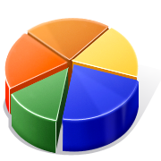
MVC Flow
Controller
View
Step 4
View transforms Model into appropriate output format

Slide 15
MVC Flow
Controller
View
Response
Step 5
Response is rendered

Slide 16
Controller
The Controller in MVC architecture handles any incoming URL request. Controller is a class, derived from the base class System.Web.Mvc.Controller. Controller class contains public methods called Action methods. Controller and its action method handles incoming browser requests, retrieves necessary model data and returns appropriate responses.
In ASP.NET MVC, every controller class name must end with a word "Controller". For example, controller for home page must be HomeController and controller for student must be StudentController. Also, every controller class must be located in Controller folder of MVC folder structure.
In the Visual Studio, right click on the Controller folder -> select Add -> click on Controller
Note: MVC will throw "The resource cannot be found" error when you do not append "Controller" to the controller class name.
New controller can be created using different scaffolding templates. You can create custom scaffolding template also.
Note:Scaffolding is an automatic code generation framework for ASP.NET web applications. Scaffolding reduces the time taken to develop a controller, view etc. in MVC framework.
Note:This base Controller class contains helper methods that can be used for various purposes.

Slide 17
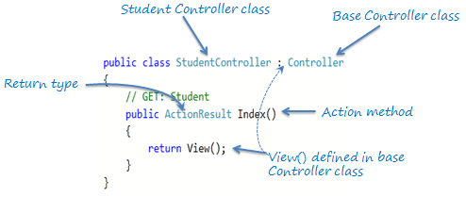
Action method
All the public methods of a Controller class are called Action methods. They are like any other normal methods with the following restrictions:
Action method must be public. It cannot be private or protected
Action method cannot be a static method.

Slide 18
Passing Data from Controller action method to View
In ASP.NET MVC offers us three options - ViewData, ViewBag and TempData to pass data from controller actions to view and in next request.
ViewData
ViewData is used to pass data from controller to corresponding view.
ViewData is Key-Value Dictionary collection.
ViewData is a dictionary object and it is property of ControllerBase class.
ViewData requires typecasting for complex data type and check for null values to avoid error.
Viewdata[“key”]=value
ViewBag
ViewBag is also used to pass data from controller to corresponding view.
ViewBag is a dynamic property that takes advantage of the new dynamic features in C# 4.0.
ViewBag is Dynamic property of ControllerBase class.
It doesn’t required typecasting for getting complex data type.
Note: Can we pass ViewData and get it as ViewBag?
Yes, We can. Vice versa is also possible.
Viewbag.PropName=value

Slide 19
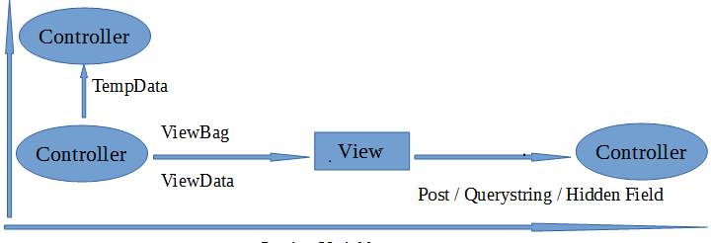
Controllers
TempData
TempData is also Key-Value Dictionary collection.
TempData is used to pass data from current request to subsequent request (pass data from controller to controller).
TempData requires typecasting for complex data type and check for null values to avoid error.

Slide 20
Problems with ViewData and ViewBag
ViewData and ViewBag is a good option for passing values between Controller and View. But in real time projects couple of disadvantages of using ViewData and ViewBag.
Performance issues
Values inside the ViewData are of type Object. We have to cast the value to correct type before using it. It adds additional overhead on performance.
No Type safety and no compile time errors
If we try to cast values to wrong type or if we use wrong keys while retrieving the values, we will get runtime error. As a good programming practice, error should be tackled in compiled time.
No Proper connection between Data sent and Data Received
In MVC, controller and View are loosely connected to each other. Controller is completely unaware about what’s happening in View and View is unaware about what’s happening in Controller.
From Controller we can pass one or more ViewData/ViewBag values. Now when Developer writes a View, he/she have to remember what is coming from the controller. If Controller developer is different from View developer then it becomes even more difficult. Complete unawareness. It leads to many run time issues and inefficiency in development.

Slide 21
Model
Model represents domain specific data and business logic in MVC architecture. It maintains the data of the application. Model objects retrieve and store model state in the persistance store like a database.
Model class holds data in public properties. All the Model classes reside in the Model folder in MVC folder structure.
namespace MVC_BasicTutorials.Models
{
public class Student
{
public int StudentId { get; set; }
public string StudentName { get; set; }
public int Age { get; set; }
}
}

