Slide 1


ML Predictive Model for Earthquakes Integrating Mass, Distance, Gravity, and Magnitude
Presented by:
Aadarsh Kushwaha
2023398
M.Sc. in Data Analytics
Guided by:
Taufique Ahmed

Slide 2
INTRODUCTION
Earthquake prediction is a critical challenge in seismology, impacting disaster preparedness and risk reduction. Traditional methods rely on historical data and seismic monitoring, but machine learning (ML) advancements present opportunities to improve accuracy through analyzing vast datasets and identifying overlooked patterns.
This research presents a different method for earthquake prediction by incorporating Mass, Gravity, Distance, and Magnitude data into a machine learning model. The aim is to enhance the accuracy of earthquake forecasts, bolster early warning systems, and reduce potential damages. By adding features such as the Moon's gravitational impact and Earth's non-uniform gravitational field to existing datasets, insights from seismic records, gravitational changes, and earthquake magnitudes can be extracted through feature engineering. Machine learning algorithms will then be utilized to detect patterns and forecast seismic events more reliably.

Slide 3
RESEARCH QUESTION AND OBJECTIVE
Research Question: How can the integration of Earth-Moon mass, gravitational dynamics, and advanced feature identification methods improve the accuracy of machine learning algorithms for earthquake prediction?
Investigate the influence of Earth-Moon gravitational forces on seismic events.
Enhance earthquake prediction models by integrating Earth’s non-uniform gravitational field and other key features.
Identify relevant features from seismic and gravitational data to improve model accuracy.
Evaluate and compare machine learning models for better earthquake prediction performance.

Slide 4
HYPOTHESIS
Hypothesis 1: Gravitational force between earth and moon plays a role in the occurrence of earthquakes.
Gravitational force has no effect on the frequency of earthquakes based on the evidence that is currently available.
Hypothesis 2: The gravity of Earth exhibits variations from one location to another. These fluctuations in gravitational acceleration (g) across different places contribute to or influence seismic activities, such as earthquakes.
Differences in the gravitational pull of Earth have a significant impact on earthquake magnitudes.
Hypothesis 3: The distance between the Moon and Earth undergoes periodic changes. There is a correlation between these variations in the Moon-Earth distance and the incidence of earthquakes.
Differences in the Moon-Earth distance and the frequency of earthquakes have a statistically significant relationship.

Slide 5
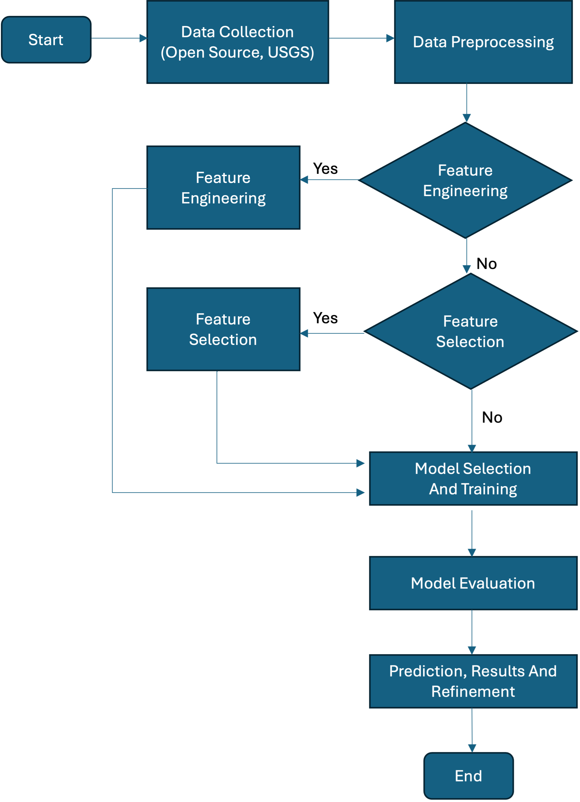
FLOW CHART OF RESEARCH

Slide 6
METHODOLOGY
Data Collection:
Earthquake event data (2011–2024) sourced from the US Geological Survey (USGS).
Scraping data from Api (skyfield, geodesy) for additional data like Earth-Moon distance, gravitational force, and acceleration (g).
Data Preprocessing:
Calculating distances, gravitational forces, and handling outliers.
Feature scaling, encoding, and cyclic encoding for time variables.
Machine Learning Models:
Regression-based models: Random Forest, XGBRegressor, CatBoost, ANN, etc.
Data Split: 70% training, 30% testing across different sample sizes.

Slide 7
ALGORITHM APPLIED
XGBRegressor
Random Forest
CatBoosting Regressor
Artificial Neural Networks
Gradient Boosting
AdaBoost Regressor
Polynomial Regression
Decision Tree
Linear Regression

Slide 8
RESULT
Best Model
XGBRegressor achieved an R² score of 0.8706 on the training set and 0.8632 on the test set.
Key Features:
Gravitational variations, magnitude, depth, and Moon-Earth distance.
Error Metrics:
RMSE = 0.333712
MSE = 0.111364
MAE = 0.247332
MAPE = 0.070678

Slide 9
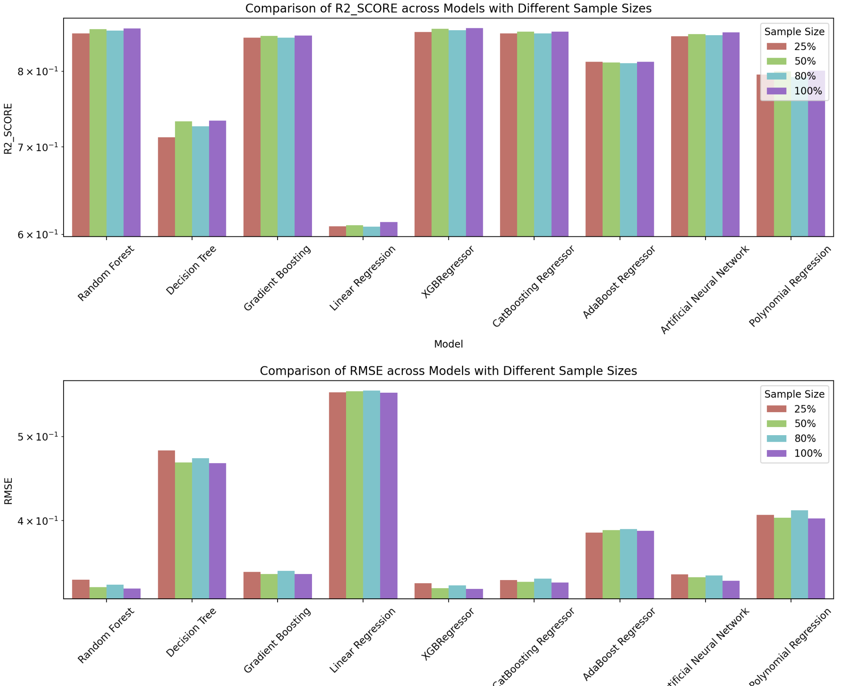
VISUALIZATION OF RESULT

Slide 10
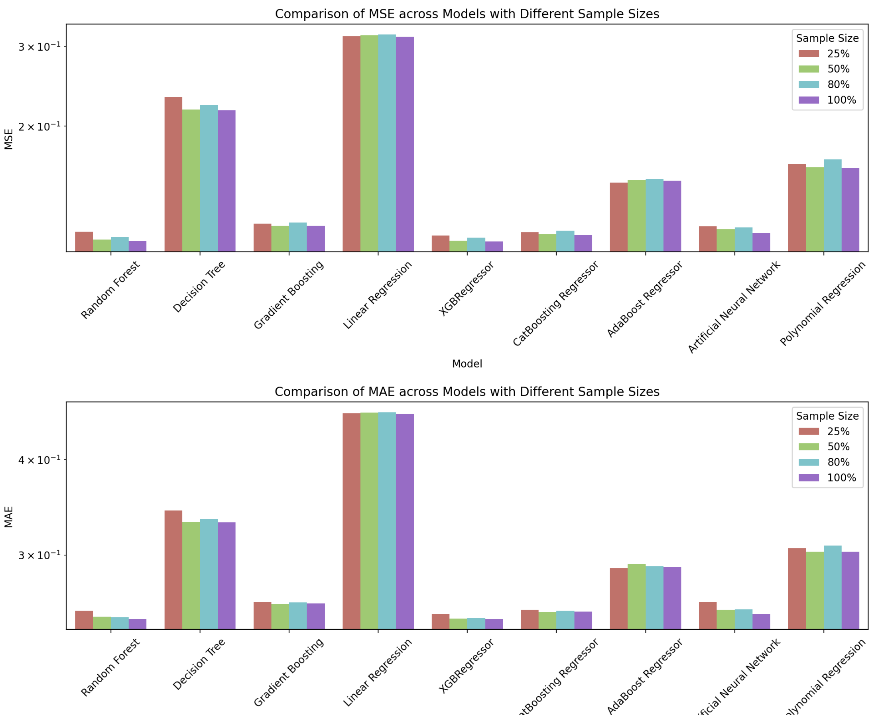

Slide 11
TOP 4 MODEL ON 100% SAMPLE DATA
Models | R2 score | Root Mean Square Error (RMSE) | Mean Square Error (MSE) | Mean Absolute Error (MAE) | Mean Absolute Percentage Error (MAPE)
XGBRegressor | 0.863236 | 0.333712 | 0.111364 | 0.247332 | 0.070678
Random Forest | 0.862888 | 0.334136 | 0.111647 | 0.247364 | 0.071030
CatBoosting Regressor | 0.858331 | 0.339644 | 0.115358 | 0.252918 | 0.072303
Artificial Neural Networks | 0.857207 | 0.340989 | 0.116273 | 0.251290 | 0.071355

Slide 12
INTRIGATED FEATURE VS MAGNITUDE
Magnitude vs. Force:
Force increases with magnitude, particularly around magnitude 4, then stabilizes at higher magnitudes. A saturation point suggests higher forces do not significantly raise the magnitude beyond this level.
Magnitude vs. Gravity:
The relationship is variable, suggesting a potential correlation between gravity and magnitude.
Magnitude vs. Distance:
Smaller earthquakes (< magnitude 2) occur closer to the reference point, while moderate earthquakes (magnitude 3-6) show greater distance variation. Larger earthquakes (magnitude 6+) stabilize at a consistent range, indicating specific geophysical ranges for larger events.
Magnitude vs. Depth:
Deeper earthquakes tend to have higher magnitudes, especially between magnitude 2 and 5.After magnitude 5, depths stabilize around 30-40 km, indicating consistent depths for larger earthquakes.

Slide 13
THANK YOU

