Slide 1
Smart Tourist Booking System
Problem: Manual booking systems are inefficient.
Target Users: Tourists & Travel Managers

Slide 2
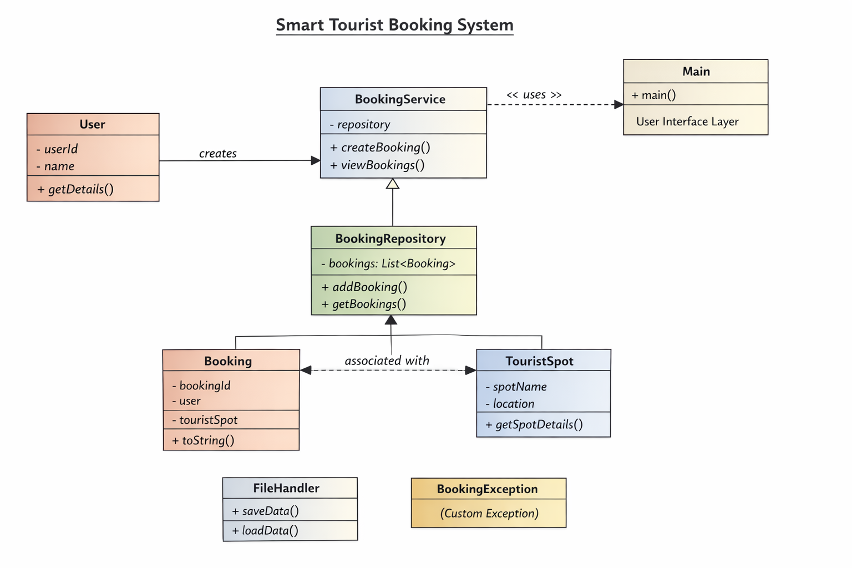
System Design
Architecture: Main → Service → Repository → Model
Key Classes: User, Booking, TouristSpot, BookingService, BookingRepository
Packages: model, service, repository, util, exception

Slide 3
OOP Concepts Used
Abstraction: Service layer
Encapsulation: Private variables
Exception Handling: BookingException
Design Pattern: Layered Architecture

Slide 4
Technical Highlight
Feature: Booking Management System
Logic: User → Booking → Storage
Why: Structured and efficient data handling

Slide 5
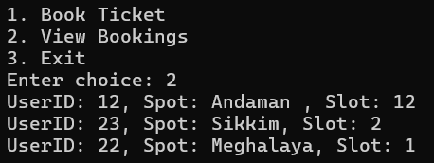
Live Demo
Run system
Create booking
View booking
Show error handling case

