Slide 1
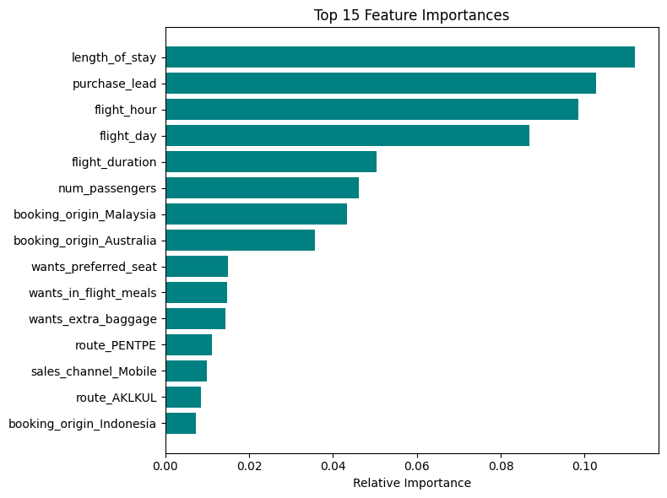
Customer Segmentation using Random Forest
Important Features
Key Insights
Customer Engagement Drives Conversions Long browsing sessions, more searches, and repeated interactions strongly correlate with higher booking completion.
High-Value Features Identified: Device type, location, and browsing behavior are key levers that can be optimized to increase bookings.
Missed Opportunities:
Customers showing strong interest but not completing bookings signal potential for re-engagement via reminders, offers, or follow-ups.
Strategic Actions:
Personalize recommendations for high-engagement users.
Optimize search filters and mobile experience to improve conversion.
Integrate booking-likelihood scores into CRM to enable real-time marketing interventions.
Model Performance Metrics:
- Accuracy: 0.83
- Precision: 0.88
- Recall: 0.93
- F1-Score: 0.90
Prepared by: Adrika Shukla | Project: British Airways Customer Analysis

