Slide 1

SUPERSTORE DATA ANALYSIS TABLEAU
By Aadershi Mohan

Slide 2
Stakeholder’s Needs
Terrence ( Board Member of Super Store Corporation) has heard anecdotal reports of the company discount policy being abused.
He is interested in learning if discounted sales are resulting in more or less profitable sales.
And, how much the company is profiting or losing based on discounted sales.

Slide 3
Overview of Process
1. Our Stakeholders are facing ups and downs in their company's growth. What could be the reason?
2. We need to analyze the data they provided and check Why is company having unstable profit?
3. After understanding the data and analyzing it, we need to provide insights to the company How can we fix unstability in profits and help them grow their business?

Slide 4
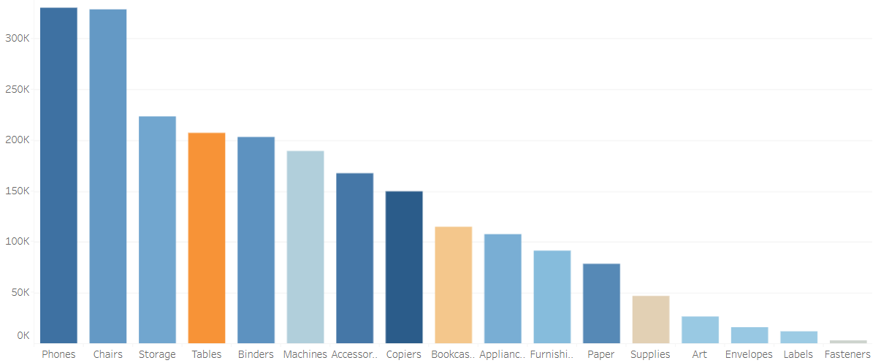
Tables are 4th highest in Sales still at maximum loss. Why?

Slide 5
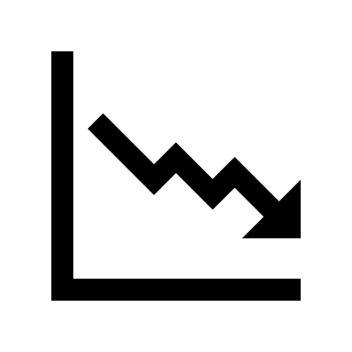
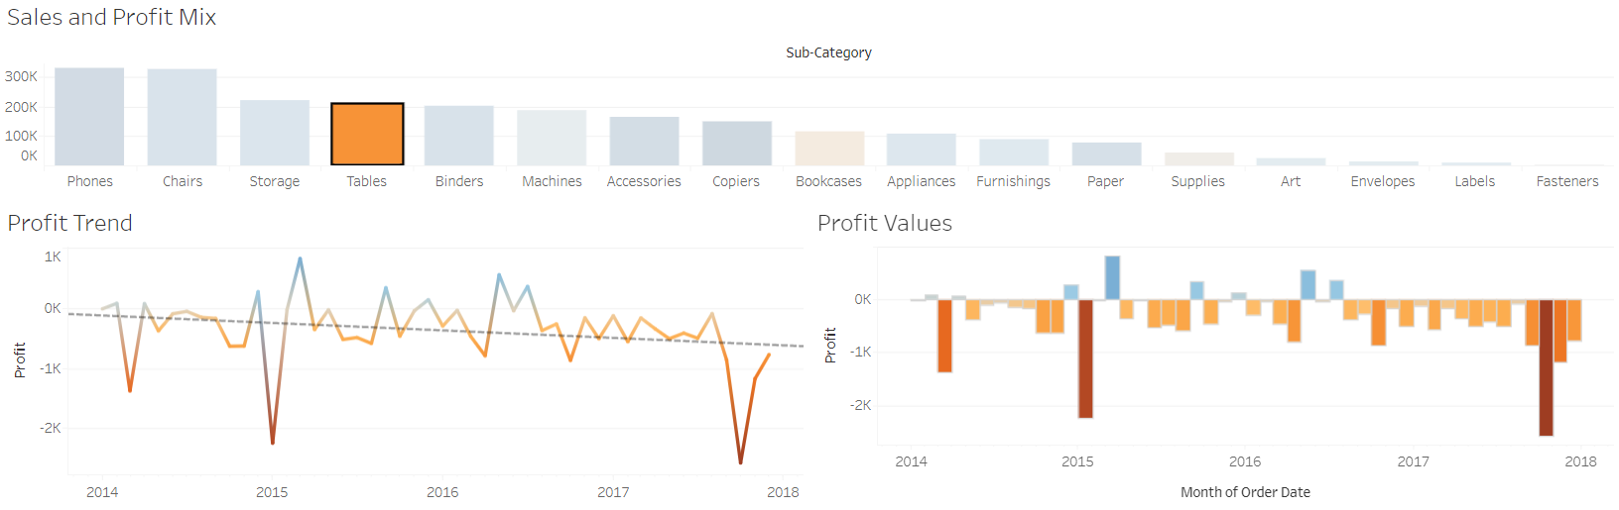
Lose has increased over the years, 2018 being the worst.

Slide 6

NO NEED TO...
SOMETHING GOOD IS COMING UP...
WORRIED ??

Slide 7
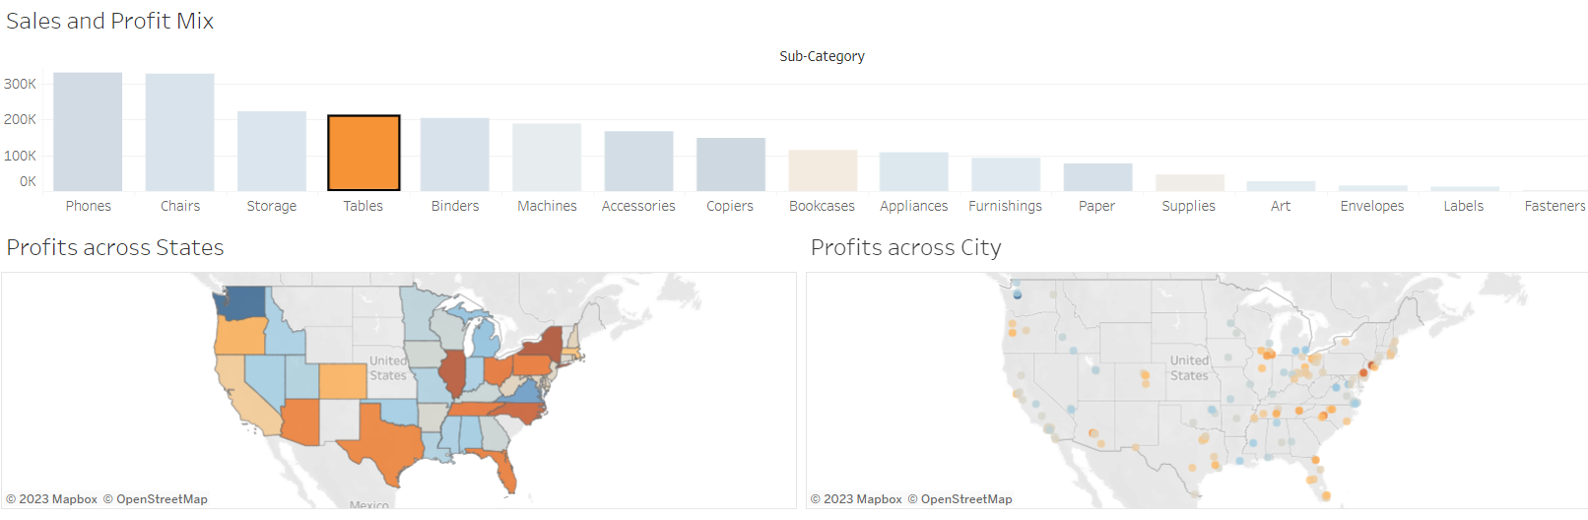
Tables are not at loss everywhere, states like Virginia and WA are profitable areas.

Slide 8


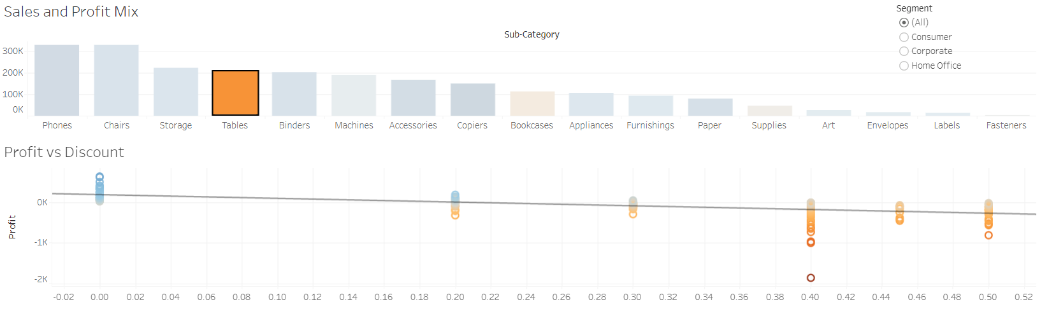
OOPS... Discounting is a Problem

Slide 9


SOLUTION:
Stop Discounting for Tables to minimize the Loss

