Slide 1



Android Programming

Slide 2
Overview
What is Android?
Why teach Android?
What do you need in order to teach Android?
Hello, Android
Links for android beginners: https://www.udacity.com/courses/android
Andriod Basics: (1) User Interface, (2) Multicscreen Apps, (3) User Input, (4) Data Storage, (5) Networking

Slide 3
What is Android?

Slide 4
Android
Includes a Java API for developing applications
It is not a device or product

Slide 5
The Android Open Source Project (AOSP)
An open source Linux-based operating system intended for mobile computing platforms
An initiative led by Google
  Makes the source code of the Android OS available for all
    Read, review, and modify the code to your liking
The main goals of the AOSP
  Provide a set of compatibility guidelines—for OEMs (Original Equipment Manufacturers) and device manufacturers—for porting Android to custom devices
  Build accessories that comply with Android’s open accessory standard Allows OEMs and manufacturers to deliver a standard experience
Making radical changes to that experience introduces fragmentation in the marketplace and in competing Android distributions.

Slide 6
The Open Handset Alliance
Android, Inc
Created by Andy Rubin, Acquired by Google in 2005.
Open Handset Alliance (OHA)
  Formed in November 2007
  Business alliance composed of mobile players
    Chip makers
    Handset manufacturers
    Software developers
    Service providers
OHA began developing open standards based on Android, Inc. technologies. The result is the Android project.
Google provided the initial code, online documentation, tools, forums, and SDK.

Slide 7
Manufacturers: Designing Android Devices
Samsung
Motorola
Dell
Sony Ericsson
HTC
LG
Amazon
Intel
Texas Instruments
ARM
NVIDIA
Qualcomm
Notes:
Here is just a partial list of manufacturers of Android devices.

Slide 8
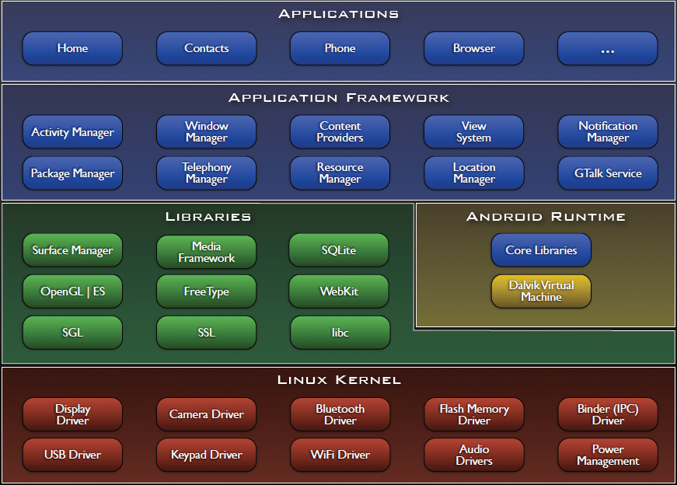

Slide 9
Why teach Android?

Slide 10
Engaging Students with Android
Android has a lot of “buzz” now
  Newness
  Coolness
  Googleness
UI and graphics made simple(r)
Advanced Java skills

Slide 11
What Skills Will Students Learn?
Reinforce the basics: OOP, decomposition, etc.
Separation of UI design and functionality
XML and resource files
Events and Listeners
Callback methods
Threads

Slide 12

Android vs. iPhone
Java vs. Objective-C
Direct install vs. Marketplace vs. App Store
Open source?

Slide 13
What do you need in order to teach Android?

Slide 14
What Should Students Already Know?
Java!
  inheritance, method overriding
  interfaces, casting
  exceptions
  debugging
  reading API documentation
Eclipse
  easy to pick up quickly, though

Slide 15
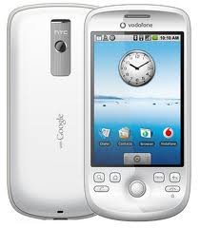
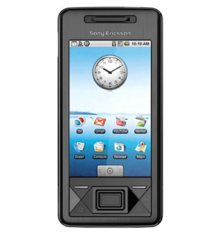
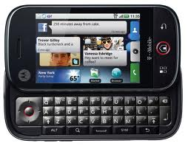
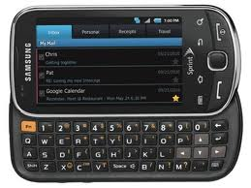
Do I Need Phones?
The emulator that is part of the Android toolset for Eclipse is quite good (though a bit slow)
You may be able to get free “developer phones” from Google

Slide 16
Online Resources
developer.android.com
code.google.com/p/apps-for-android/
stackoverflow.com
videos from Google I/O conferences

Slide 17

“Hello, Android”

Slide 18
Creating Your First(?) Android App
Set up your development environment
Create a new Android project in Eclipse
Run it in the emulator
Hilarity ensues

Slide 19
1. Set Up Your Android Environment
http://developer.android.com/sdk
Install Android Studio with Android SDK
(Android libraries)
Install JDK if it is not in your computer
Create AVD (Android virtual device)

Slide 20
2. Create an Android Project
File → New → Project
Select “Android Project”
Fill in Project details...

Slide 21
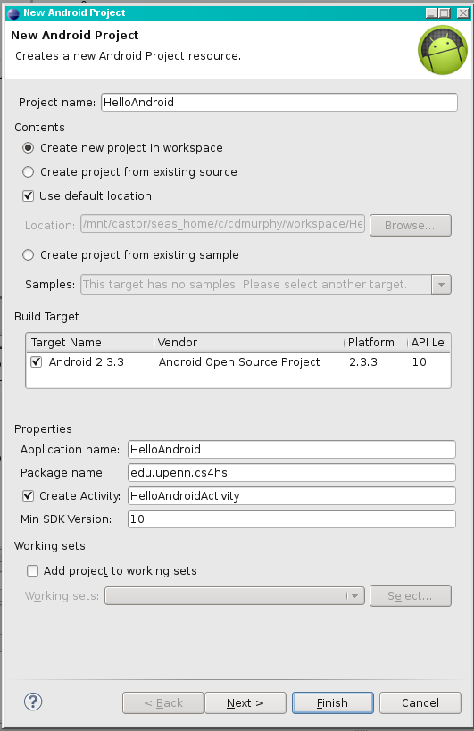
Directory
name
Android
version
Java package
Name that appears
on device
Class to
automatically
create

Slide 22
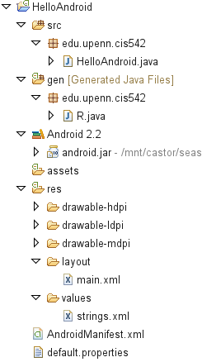
Source
code
Auto-generated
code
String
constants
UI
layout
Configuration

Slide 23
3. Run the Android Application
Run → Run (or click the “Run” button)
Select “Android Application”
The emulator may take a few minutes to start, so be patient!
You don't need to restart the emulator when you have a new version of your application

Slide 24
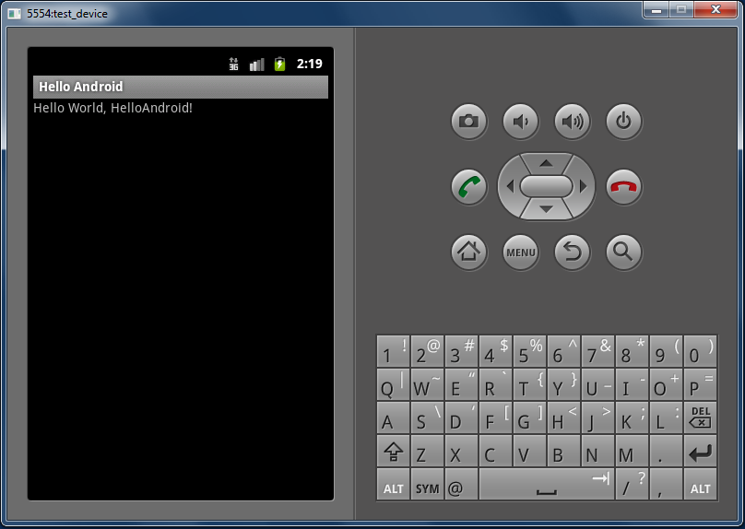

Slide 25
HelloAndroid.java
1 public class HelloAndroid extends Activity {
2 /** Called when the activity is first created. */
3 @Override
4 public void onCreate(Bundle savedInstanceState)
5 {
6 super.onCreate(savedInstanceState);
7 setContentView(R.layout.main);
8 }
9 }

Slide 26
main.xml
1 <?xml version="1.0" encoding="utf-8"?>
2 <LinearLayout
3 xmlns:android="http://schemas.android.com/apk/res/android"
4 android:orientation="vertical"
5 android:layout_width="fill_parent"
6 android:layout_height="fill_parent"
7 >
8 <TextView
9 android:layout_width="fill_parent"
10 android:layout_height="wrap_content"
11 android:text="@string/hello "
12 />
13 </LinearLayout>

Slide 27
strings.xml
1 <?xml version="1.0" encoding="utf-8"?>
2 <resources>
3 <string name="hello">Hello World, HelloAndroid!
4 </string>
5 <string name="app_name">Hello, Android</string>
6 </resources>

Slide 28
AndroidManifest.xml
1 <?xml version="1.0" encoding="utf-8"?>
2 <manifest
3 xmlns:android="http://schemas.android.com/apk/res/android"
4 package="edu.upenn.cis542"
5 android:versionCode="1"
6 android:versionName="1.0">
7 <application android:icon="@drawable/icon"
8 android:label="@string/app_name">
9 <activity android:name=".HelloAndroid"
10 android:label="@string/app_name">
11 <intent-filter>
12 <action
13 android:name="android.intent.action.MAIN" />
14 <category
15 android:name="android.intent.category.LAUNCHER"/>
16 </intent-filter>
17 </activity>
18 </application>
19 </manifest>

