Slide 1
GROUP 9 · HR ANALYTICS
GUESS FIRST
Out of these 100 trainees, how many are job hunting?
Who is about to leave?
Predicting which data-science trainees are looking for a job change
25. One in four is looking to move.
Data: Kaggle, HR Analytics: Job Change of Data Scientists · 19,158 candidates
Notes:
SPEAKER 1 (The detective), about 1:00
Hi everyone, we're Group 9. Before we explain anything, a quick game.
Each of these 100 dots is a trainee at a company that teaches data science. Some of them are quietly looking for a new job. How many? Just shout out a number.
[Pause. Take two or three guesses and react to them: "Optimistic." "Ooh, bold."]
[CLICK]
Twenty-five. One in four.
That's our whole project in one picture. This company wants to hire the people it trains, so it needs to find that one in four before somebody else does.

Slide 2
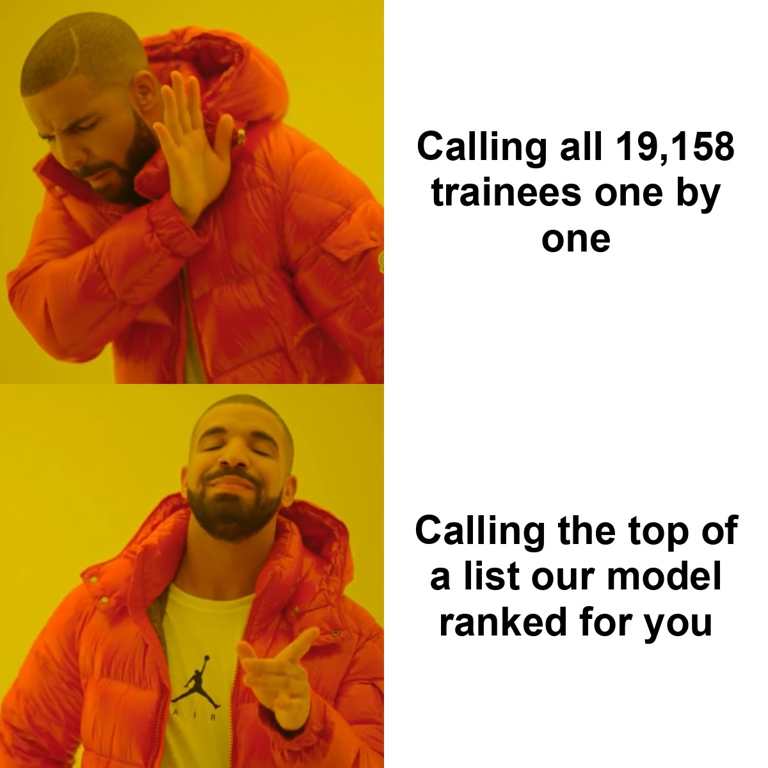
PART 1 · THE BUSINESS QUESTION
HR's problem: 19,158 trainees, not enough recruiters
THE QUESTION
Given a trainee's education, experience, current employer and city, can we predict whether they are looking for a job change?
19,158
2,129
labelled trainees
new trainees to score
12
25%
input features
looking to move
How we score success: ROC-AUC and F1. Accuracy is useless here, because a model that says "nobody is leaving" is already 75% accurate.
2
Notes:
SPEAKER 1 (The detective), about 1:00
Here's HR's problem. Just over nineteen thousand trainees in our data, and a handful of recruiters.
Drake has the right idea. Nobody wants to call nineteen thousand people one by one. We'd rather have a model rank them, so recruiters start at the top of the list.
So our question is: from someone's education, experience, current employer and city, can we predict whether they're looking for a job change?
One thing before we go on, because it catches everyone out. Only a quarter of people are looking. So a lazy model that says "nobody's leaving" is right 75% of the time. Sounds great. Finds zero people.
That's why we judge our models on ROC-AUC and F1, not accuracy. Hold on to that, it comes back later.

Slide 3
PART 1 · DATA UNDERSTANDING
Spot the job hunter
GUESS FIRST
Two real trainees from the test file. Which one is leaving?
Trainee A
Trainee B
City
city_103 (index 0.92)
Experience
more than 20 years
Employer
Pvt Ltd, 10,000+ staff
Last job change
more than 4 years ago
Studying
not enrolled
City
city_21 (index 0.62)
Experience
under 1 year
Employer
none on record
Last job change
2 years ago
Studying
full-time course
26% chance of moving
96% chance of moving
45% vs 15%
job hunting with under 1 year vs over 20 years of experience
-0.02
correlation of training hours with the target: basically none
3
Notes:
SPEAKER 1 (The detective), about 1:30
Another game. These are two real trainees from the test file. Both are graduates, both studied STEM.
Trainee A has over twenty years of experience, works at a huge private company, and hasn't changed jobs in more than four years.
Trainee B has less than a year of experience, no employer on record, is doing a full-time course, and lives in city 21.
Hands up if you think it's A... and hands up for B.
[CLICK]
The model gives A a 26% chance of moving, and B 96%.
The chart shows the biggest reason. This is the job-change rate by how developed a trainee's city is. In the least developed cities it's close to 60%. In the most developed ones, under 20%.
Experience matters too: 45% of people with under a year are looking, against 15% after twenty years. And training hours, which you'd think a training company cares about? A correlation of minus 0.02. Basically nothing.
Hand-off: Which brings us to the messy part. [Speaker 2], over to you.

Slide 4
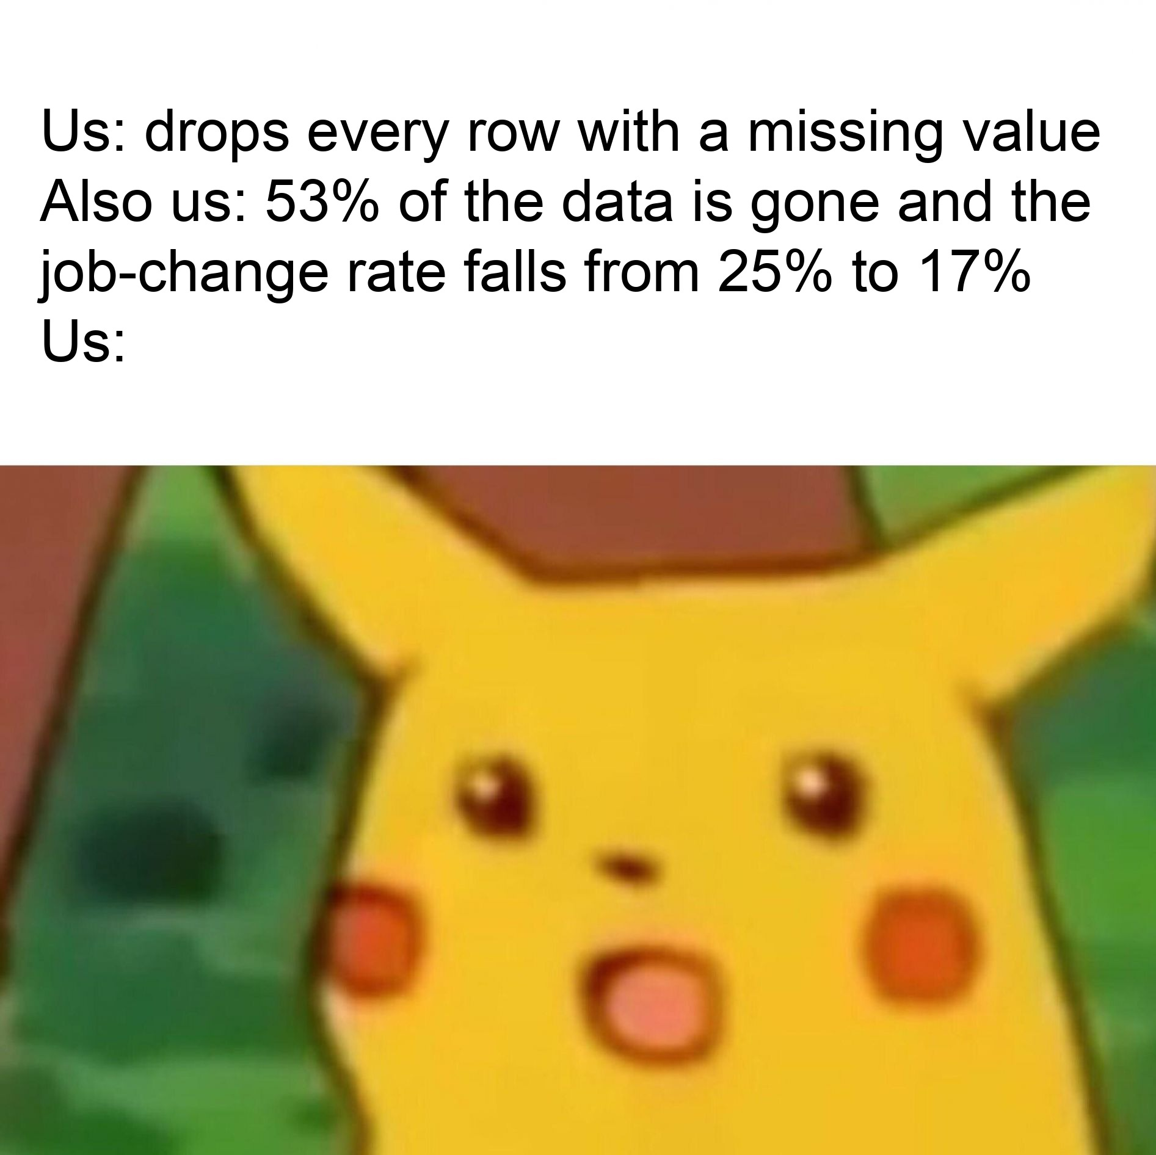
PART 2 · DATA PREPARATION
The missing data was hiding the job hunters
What we did instead: kept every row. Missing categories became an "Unknown" level and missing numbers got the median, fitted on training data only.
4
Notes:
SPEAKER 2 (The cleaner), about 1:00
Thanks. So, real data is messy. Some of our columns were missing a third of their values.
The textbook move is to drop every row with a missing value. Nice and clean.
We checked what that would actually do first. It deletes 53% of the data, and the job-change rate in what's left falls from 25% to 17%. Pikachu's face is our face.
The chart shows why. When company size is missing, 41% of those people are job hunting. When it's filled in, it's 18%. The job hunters are hiding in the missing rows, probably because a lot of them don't have an employer to write down.
So we kept every row. A missing category became its own "Unknown" category, and missing numbers got the median.

Slide 5


PART 2 · DATA PREPARATION
From messy text to 152 numbers a model can read
Nominal · 6 columns
One-hot. Missing becomes Unknown; unseen categories are ignored
city, gender, relevent_experience, enrolled_university, major_discipline, company_type
Feature engineering
Drop enrollee_id: an ID predicts nothing
experience to years: <1 = 0.5, >20 = 21
last_new_job to years: never = 0, >4 = 5
Keeps the order, saves 28 dummy columns
13
raw columns
152
model features
Ordinal · 2 columns
Ordered codes: Primary School up to Phd, <10 up to 10000+
education_level, company_size
Numeric · 4 columns
Median fill, then standard scaling
city_development_index, training_hours, experience_num, last_new_job_num
80/20 stratified split
15,326 train and 3,832 test rows, 25% job-change rate in both
No leakage
Everything is fitted inside each cross-validation fold, on training data only
5
Notes:
SPEAKER 2 (The cleaner), about 1:00
Models only speak numbers, so this is how our text turned into numbers.
We start with 13 columns. The ID goes first, because an ID number tells you nothing about a person. Experience and years since the last job change were text, like "less than 1" or "more than 20", so we turned them into actual numbers of years.
Then each type of column gets its own treatment. Categories with no order, like city or gender, get one-hot encoded: one yes-or-no column for each category. Things with a real order, like education level and company size, get ordered codes. Numbers get scaled, so no column shouts louder than the others.
End result: 152 features. And all of this lives inside one pipeline, so it only ever learns from the training data. No peeking at the test set.
Hand-off: [Speaker 3], take it away.

Slide 6
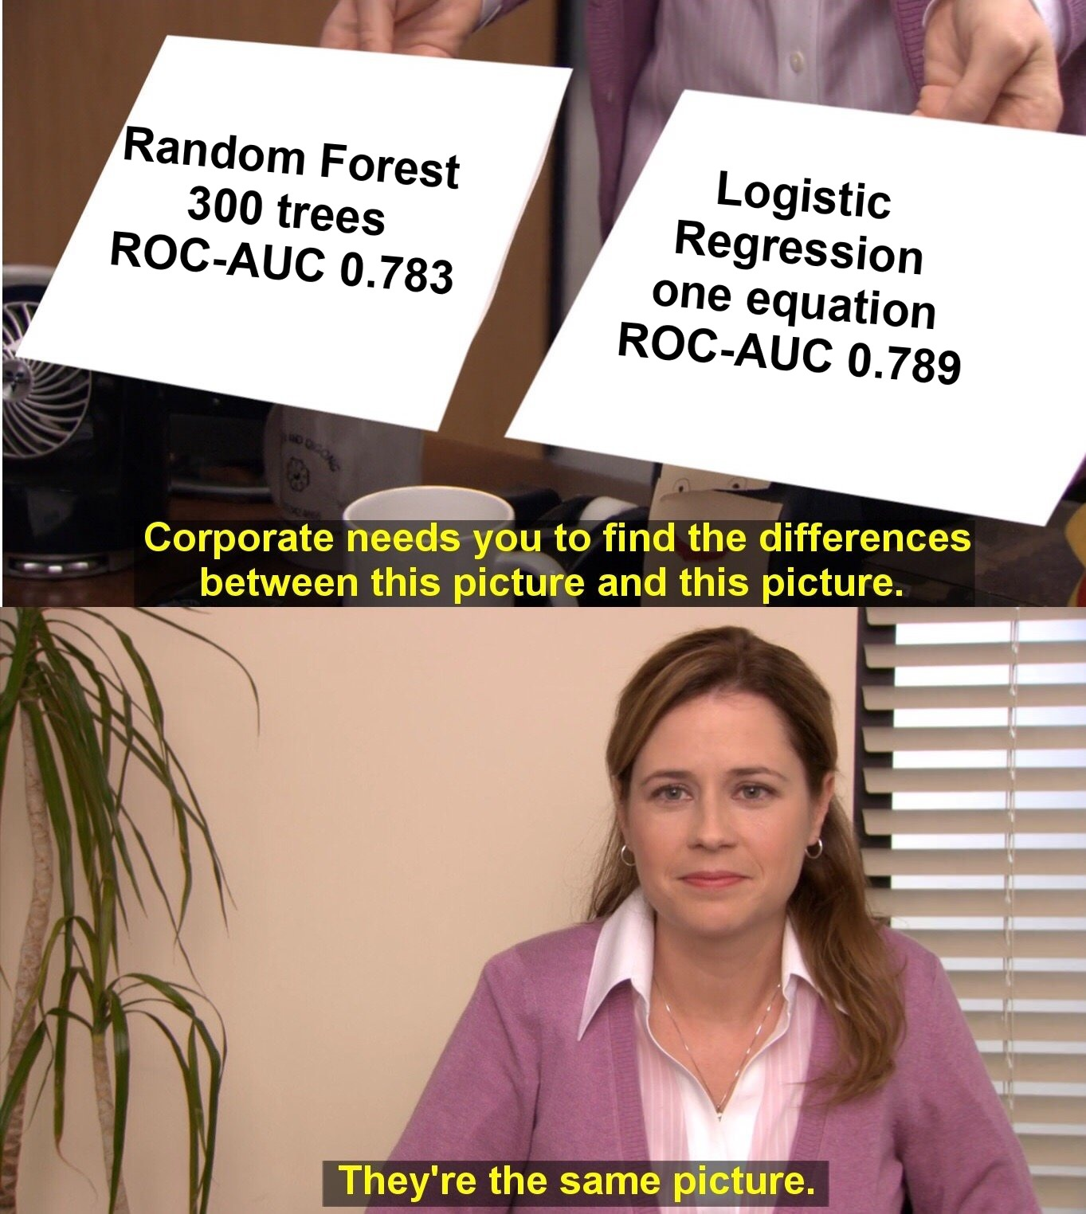
PART 3 · MODELLING & TUNING
Five models walked into a cross-validation
PLACE YOUR BETS
Which one wins: Logistic Regression, KNN, Random Forest, Decision Tree or the Dummy?
Tuned with GridSearchCV: C = 0.1, L2 penalty, ROC-AUC 0.789 to 0.791. The unpruned decision tree memorised its homework (0.62).
6
Notes:
SPEAKER 3 (The trainer), about 1:15
Right. We took five models and made them compete: logistic regression, KNN, random forest, a decision tree, and a dummy model that always says "not leaving". Place your bets. Who wins?
[Pause for a guess or two.]
[CLICK]
Logistic regression, the simplest real model on the list. Random forest and KNN finished within 0.007 of it, which is about the normal wobble between folds. The decision tree basically memorised its homework and scored 0.62.
[CLICK]
So yes: corporate needs you to find the difference between a 300-tree random forest and one equation, and there isn't one.
When it's a tie, we keep the simple one, because when HR asks "why was this person flagged?", logistic regression can actually answer. Then we tuned it with grid search: C of 0.1 with L2 regularisation, which nudged it from 0.789 to 0.791.
Hand-off: Now let's see how it did on data it had never seen. [Speaker 4]?

Slide 7
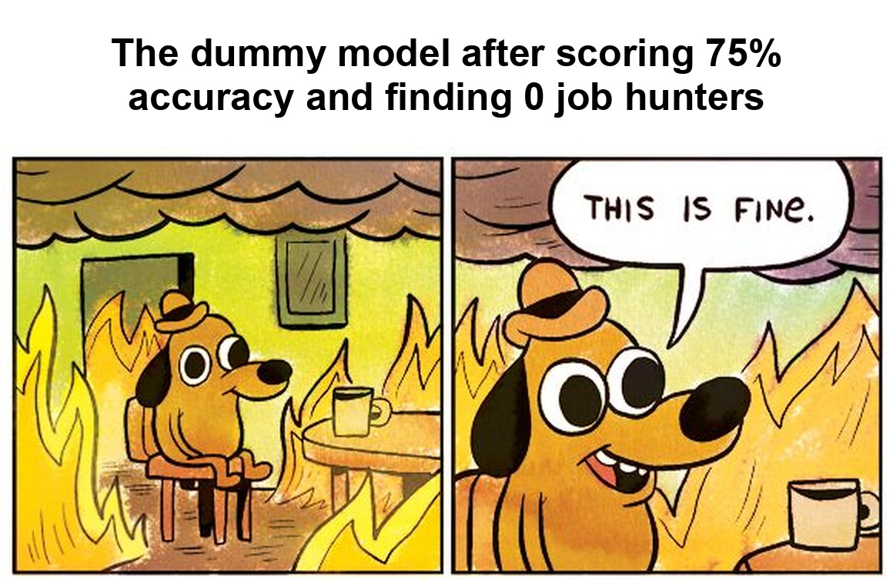
PART 3 · RESULTS
Report card: 78% of the job hunters caught
0.81
78%
52%
0.63
ROC-AUC
picks the job hunter over a non-hunter 81% of the time
Recall
of real job hunters are found
Precision
of flagged trainees really are looking: 2.1x random calling
F1
balance of precision and recall
Predicted: not looking
Predicted: looking
Actually not looking
2,197
True negative
680
False positive
Actually looking
207
False negative
748
True positive
3,832 test trainees at threshold 0.5. No overfitting: CV ROC-AUC 0.791.
7
Notes:
SPEAKER 4 (The judge), about 1:15
Report card time. We kept 20% of the data locked away for the whole project and opened it once, right at the end.
ROC-AUC of 0.81. In plain English: pick one person who's job hunting and one who isn't, and 81% of the time the model ranks the job hunter higher.
Recall is 78%, so out of everyone who's actually looking, we find almost four in five. Precision is 52%: about half the people we flag really are looking. That might sound low, but if you called people at random you'd hit one in four. So we're twice as good as guessing.
In the grid: 748 job hunters caught, 207 missed, and 680 false alarms.
[CLICK]
And remember the dummy model? 75% accuracy, zero job hunters found, sitting in a burning room saying this is fine. That's exactly why we never trusted accuracy.

Slide 8
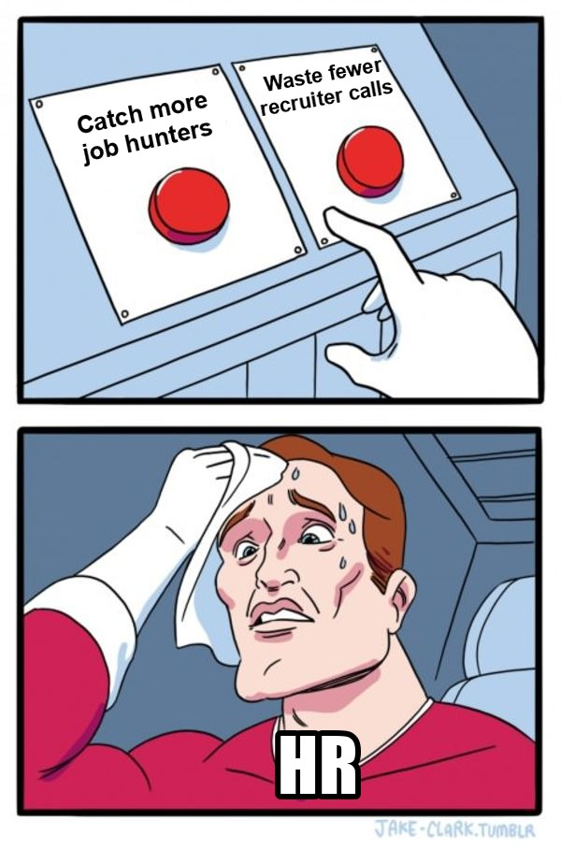
PART 3 · RESULTS
You're HR. Two recruiters. Pick a cut-off.
YOUR CALL
Catch more job hunters, or waste fewer calls?
0.5
Wide net
0.7
Short list
Call 37% of trainees, reach 78% of job hunters, 52% of calls land.
Call 21% of trainees, reach 51% of job hunters, 60% of calls land.
8
Notes:
SPEAKER 4 (The judge), about 1:00
Now you're HR, and you've got two recruiters. The model gives every trainee a probability, and you decide the cut-off. Do you want to catch more job hunters, or waste fewer calls?
[Pause. Let someone answer.]
[CLICK]
Cut-off at 0.5: you call 37% of trainees and reach 78% of the job hunters. That's the wide net.
[CLICK]
Cut-off at 0.7: you call only 21%, you reach about half the job hunters, but 60% of your calls land. That's the short list.
Neither one is wrong. It depends on how many recruiters you have and how bad it is to miss someone. That's a business decision, not a maths one.

Slide 9
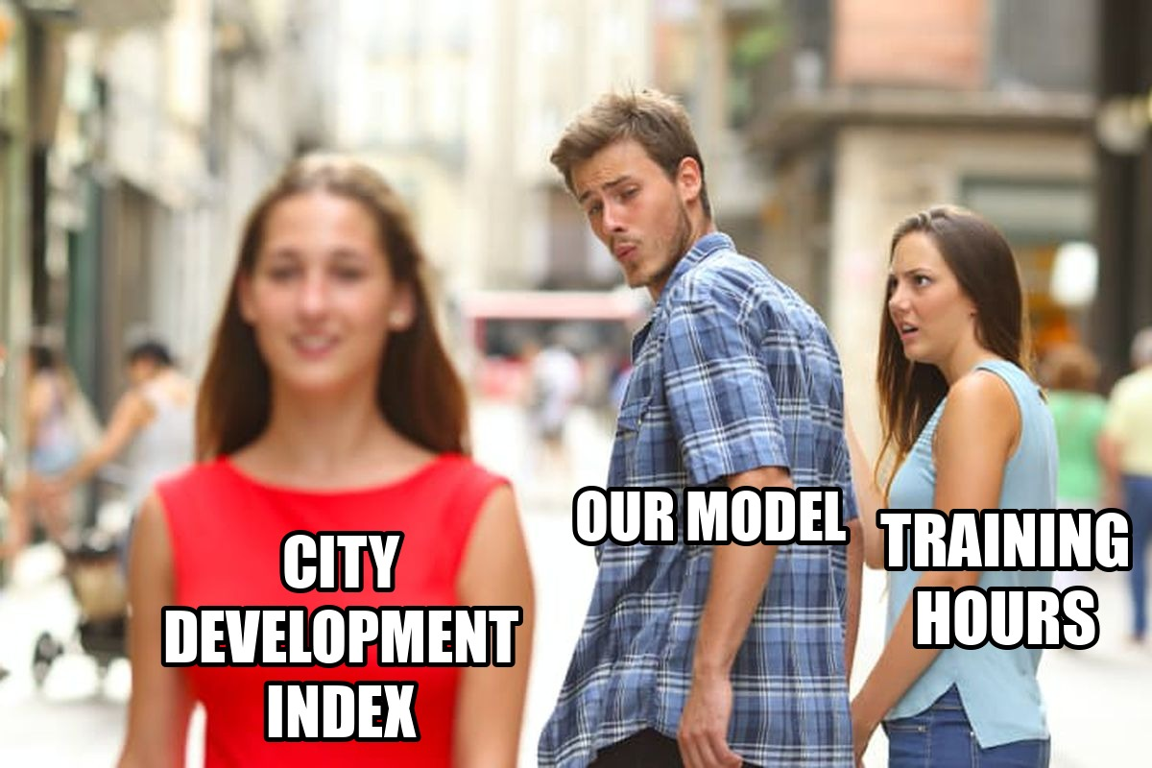
PART 3 · RESULTS
Plot twist: it's mostly about where you live
58% vs 17%
job hunting in cities below 0.60 vs 0.90 and up
39% vs 18%
no employer on record vs Pvt Ltd
0.0003
ROC-AUC lost when we drop gender
9
Notes:
SPEAKER 4 (The judge), about 1:00
So what is the model actually looking at? We shuffled one column at a time and watched how much the score dropped. The bigger the drop, the more the model depends on that column.
And the model only has eyes for one thing: city development index. Company type and city come next. Training hours, the one you'd expect a training company to care about, barely gets a glance. Hence the meme.
Two numbers to remember: in the least developed cities 58% are job hunting, against 17% in the most developed. And gender? Taking it out of the model costs 0.0003. Basically nothing, so we'd remove it.
Hand-off: [Speaker 5], bring it home.

Slide 10
PART 4 · CONCLUSIONS
So, should HR call them? Yes, in the right order.
Test ROC-AUC 0.81, against 0.50 for a coin flip. Across five different random splits it stays between 0.78 and 0.81.
1
2
3
Rank, don't label
Set the cut-off by capacity
Target where movers are
Use the score to decide who to call first, never as a yes or no verdict on a person.
0.5 when HR wants coverage, 0.7 when recruiter time is short.
Trainees from less developed cities and people early in their careers.
Remember: 1 in 4 trainees is looking to move
10
Notes:
SPEAKER 5 (The storyteller), about 1:00
So, the big question: can we tell HR who's about to leave? Yes, well enough to rank people.
ROC-AUC of 0.81, and when we re-ran the whole thing with five different random splits, it stayed between 0.78 and 0.81. So it wasn't a lucky split.
Three things we'd tell HR. One: rank, don't label. Use the score to decide who to call first, never to decide anything about a person. Two: pick the cut-off based on how many recruiters you've got. Three: focus campaigns on trainees from less developed cities and people early in their careers, because that's where the movers are.

Slide 11







PART 4 · LIMITATIONS & WAY FORWARD
Things our model is bad at, and what we'd do next
LIMITATIONS
WAY FORWARD
1 in 2 flags is a false positive
Some people just like free courses. A recruiter still reviews every case
Try gradient boosting
LightGBM or CatBoost, plus target encoding for the 123 cities
Possible proxy bias
Gender and city can stand in for background, so a fairness check is needed
Drop gender, audit errors by group
Compare recall and precision across cities and genders
One programme, one point in time
The model has to be re-checked on newer cohorts
Calibrate, then cost the cut-off
Class weighting inflates scores; calibrate, then pick the threshold from recruiter cost
Cut-off shown on test data
A real threshold should be chosen on validation data
Retrain with every cohort
Track recall and precision against what people actually did
11
Notes:
SPEAKER 5 (The storyteller), about 1:00
Now the honest bit. Our model isn't perfect.
About half the people it flags aren't actually looking. Some people just like free courses. So a person should always check the list before anyone picks up the phone.
City and gender could act as stand-ins for someone's background, so before anyone used this for real we'd want a proper fairness check. And this is one programme at one point in time, so it needs re-checking on new groups.
With more time, we'd try gradient boosting, which usually does a bit better on data like this. We'd drop gender and compare errors between groups, calibrate the probabilities, and retrain with every new batch of trainees.

Slide 12





GROUP 9
Who did what
[Name]
[Name]
[Name]
[Name]
[Name]
THE DETECTIVE
PART 1
THE CLEANER
PART 2
THE TRAINER
PART 3
THE JUDGE
PART 3
THE STORYTELLER
PART 4
Business question, data understanding and the data dictionary
Missing values, data cleaning and the encoding pipeline
Model comparison and hyperparameter tuning
Test evaluation, thresholds and feature importance
Conclusions, recommendations and this deck
12
Notes:
SPEAKER 5 (The storyteller), about 0:30
And that's who did what.
[Point to each card, or have each person give a quick wave when their card is mentioned.]
Thanks for listening. We're happy to take questions. And yes, we can explain the memes.

