Slide 1

Optimizing Virtual Memory Management
The critical role of virtual memory management in optimizing system performance, especially in the context of modern multi-core architectures.
By V.Aadharsh Vishal
Reg:192311009

Slide 2
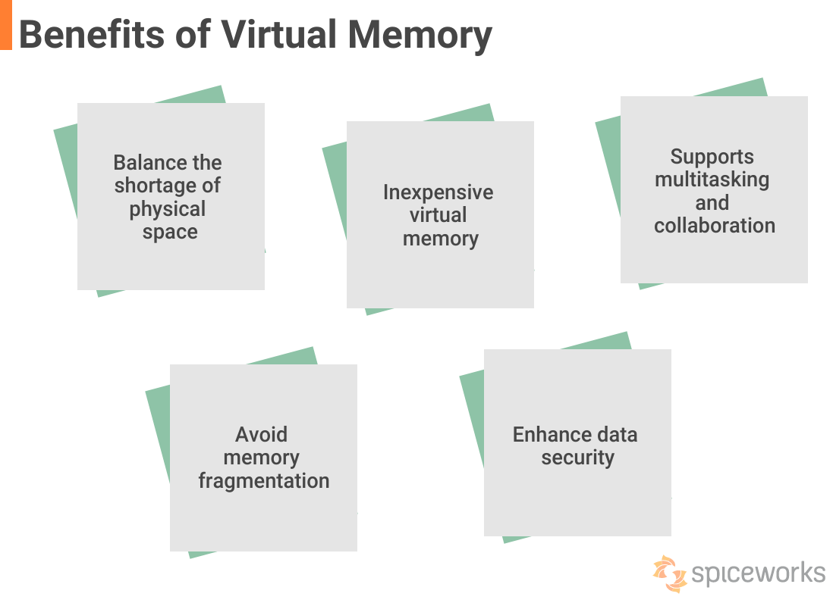
Address Translation: Mapping Virtual to Physical Addresses
1
Virtual Address
2
Page Table
3
Physical Address

Slide 3
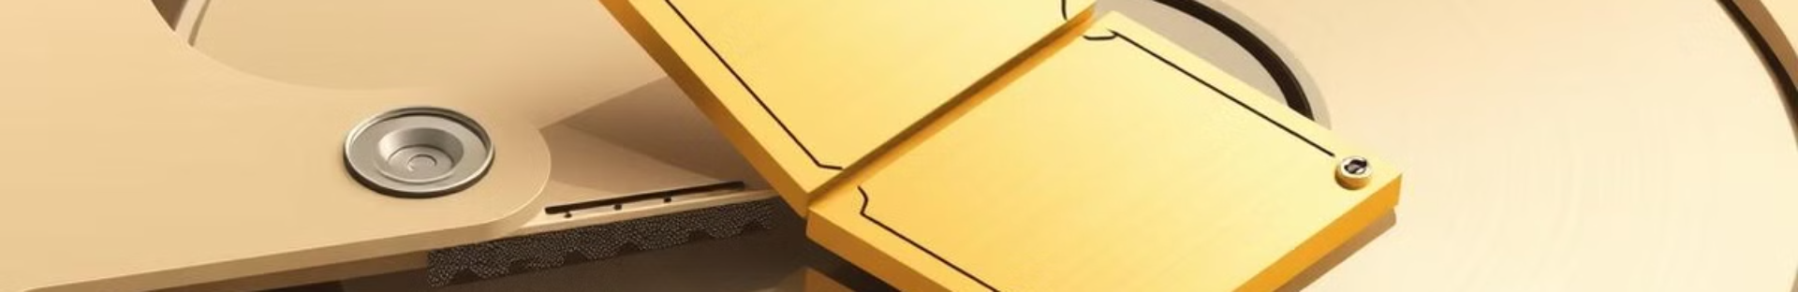
Page Replacement Algorithms: Maximizing Memory Utilization
FIFO
LRU
First-In, First-Out: The oldest page is replaced regardless of its usage.
Least Recently Used: The page that has not been accessed for the longest time is replaced.
Optimal
Clock
Optimal: The page that will not be used for the longest period in the future is replaced. This is theoretical and impossible to implement in practice.
A combination of FIFO and LRU, tracking page usage with a circular queue. The oldest page with a 'use bit' set to 0 is replaced.

Slide 4
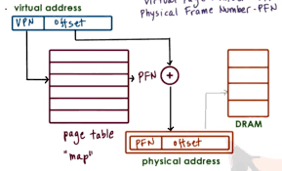
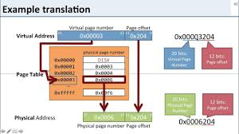
Working of the model
Example of the Virtual Address to Physical Address

Slide 5

Conclusion and Future Directions
Virtual memory management remains an essential aspect of system performance optimization. As technology continues to evolve, ongoing research and development will continue to drive advancements in this field.

