Slide 1


Department of Information Technology
An AI-Powered Placement Preparation and Resume Analysis System
Project Guide:
Dr. P. Sakthivel, Assistant Professor
Project Team Members:
Aadhikesavan S (61782323110001)
Gowrisankar V (61782323110038)
Hari Vignesh M (61782323110041)

Slide 2
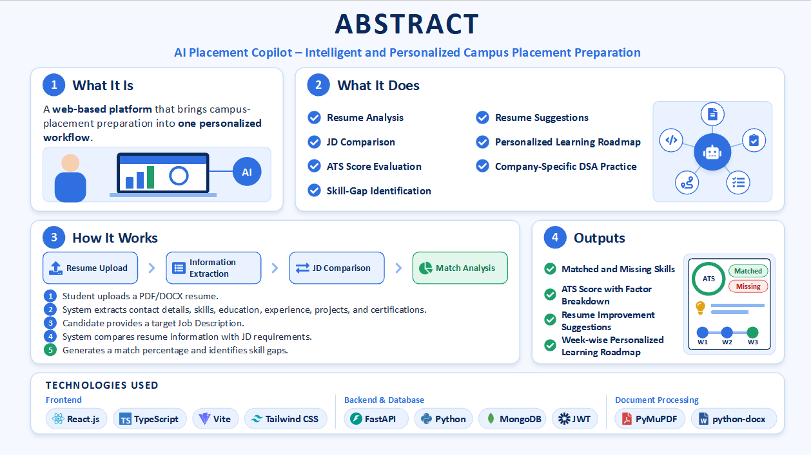
Abstract
What it is: A web-based platform that brings campus-placement preparation into one personalized workflow.
What it does: Resume analysis, Job Description (JD) comparison, ATS score evaluation, skill-gap identification, resume suggestions, learning roadmap and company-specific DSA practice.
How it works: A student uploads a PDF/DOCX resume; the system extracts contact details, skills, education, experience, projects and certifications, then compares them with a target JD to give a match percentage.
Output: Matched / missing skills, an ATS score with factor breakdown, resume improvements and a week-wise roadmap built from the gaps.
Stack: React.js, TypeScript, Vite, Tailwind CSS, FastAPI, Python, MongoDB, JWT, PyMuPDF and python-docx.

Slide 3
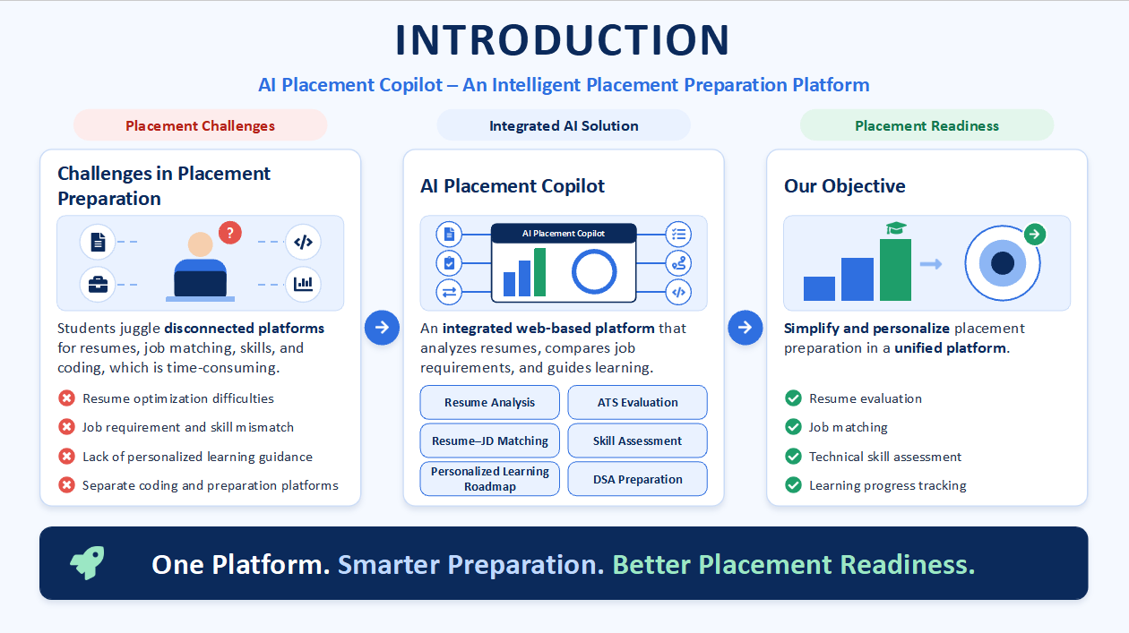

Slide 4
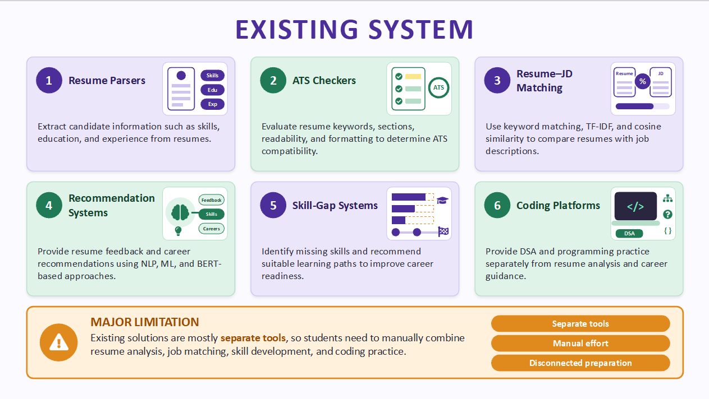
Existing System / Literature Review
Existing System:
Resume Parsers – Extract candidate information such as skills, education and experience.
ATS Checkers – Evaluate keywords, resume sections, readability and formatting.
Resume–JD Matching – Use keyword matching, TF-IDF and cosine similarity to compare resumes with job descriptions.
Recommendation Systems – Provide resume feedback and career recommendations using NLP, ML and BERT-based approaches.
Skill-Gap Systems – Identify missing skills and recommend suitable learning paths.
Coding Platforms – Provide DSA and programming practice separately.
Major Limitation:
Existing solutions are mostly separate tools, so students need to manually combine resume analysis, job matching, skill development and coding practice.

Slide 5
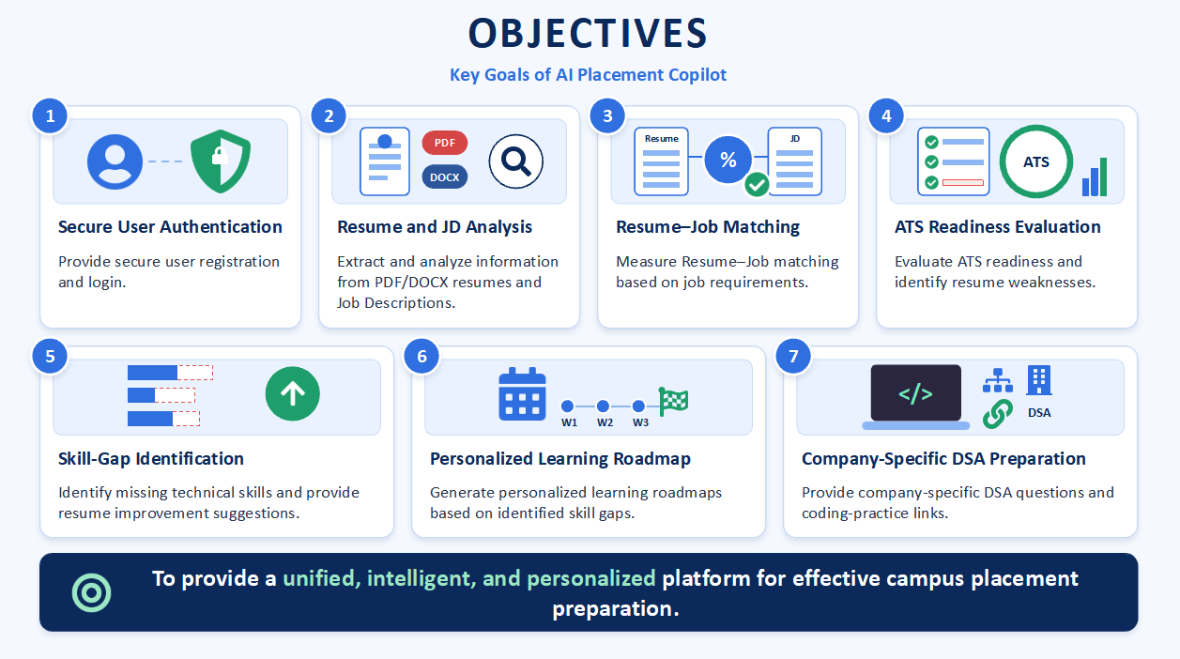
Objective of the project work
Provide secure user registration and login.
Extract and analyze information from PDF/DOCX resumes and Job Descriptions.
Measure Resume–Job matching based on job requirements.
Evaluate ATS readiness and identify resume weaknesses.
Identify missing technical skills and provide resume improvement suggestions.
Generate personalized learning roadmaps based on identified skill gaps.
Provide company-specific DSA questions and coding-practice links.

Slide 6
Proposed System
Integrated workflow: every stage consumes the output of the previous one, from resume parsing to DSA practice.
Transparent scoring: scores are shown together with the matched and missing items behind them.
Actionable output: each weakness becomes a concrete resume suggestion or learning task.
Modular and extensible: parsing, matching, ATS and recommendation are separate services; NLP / LLM can be added later.
Open-source and low cost: no paid external API is needed for the core functions.
Register / Login
Upload Resume
Upload / Enter JD
Match + ATS Score
Skill Gap + Suggestions
Learning Roadmap
Company DSA Practice

Slide 7
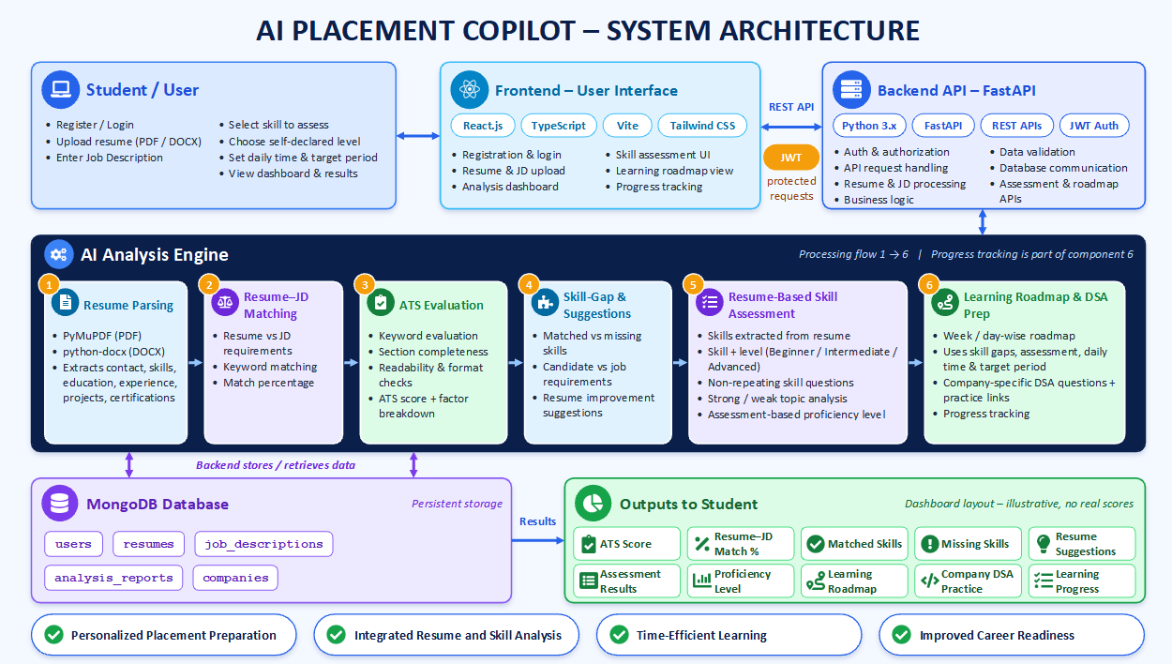
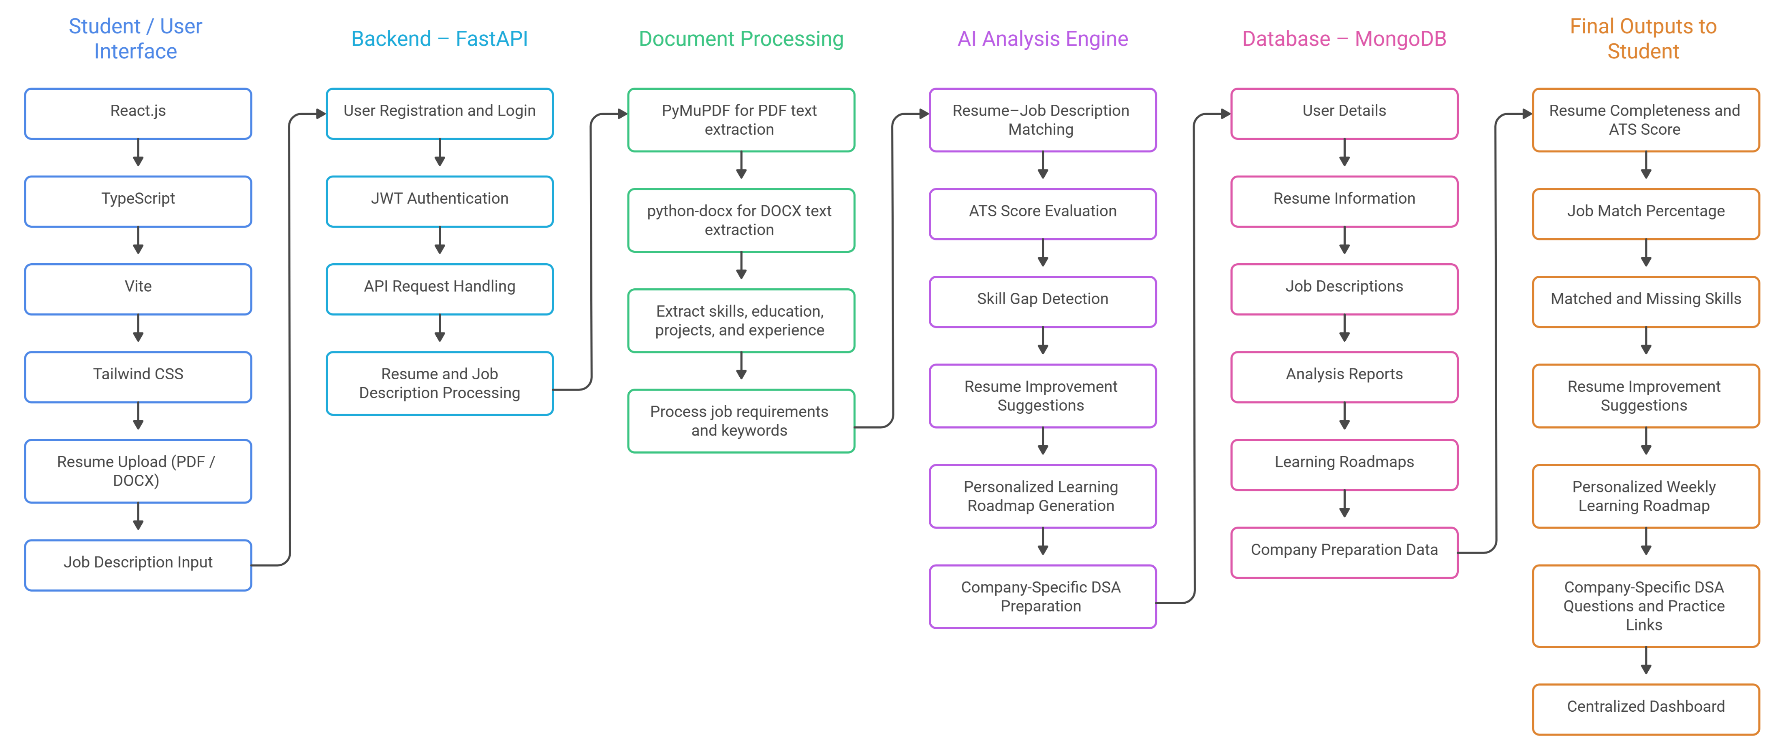
Architecture Diagram

Slide 8
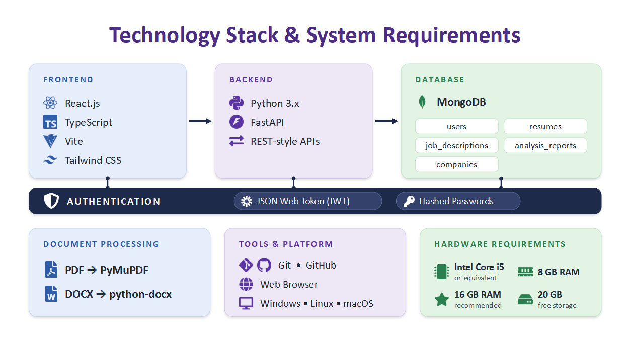
Technology Used
Frontend: React.js, TypeScript, Vite, Tailwind CSS
Backend: Python 3.x with FastAPI (REST-style APIs)
Database: MongoDB (document collections: users, resumes, job_descriptions, analysis_reports, companies)
Authentication: JSON Web Token (JWT) with hashed password storage
Document processing: PyMuPDF for PDF and python-docx for DOCX text extraction
Tools: Git and GitHub for version control; runs on Windows, Linux or macOS through a web browser
Hardware: Intel Core i5 or equivalent, 8 GB RAM (16 GB recommended), 20 GB free storage

Slide 9
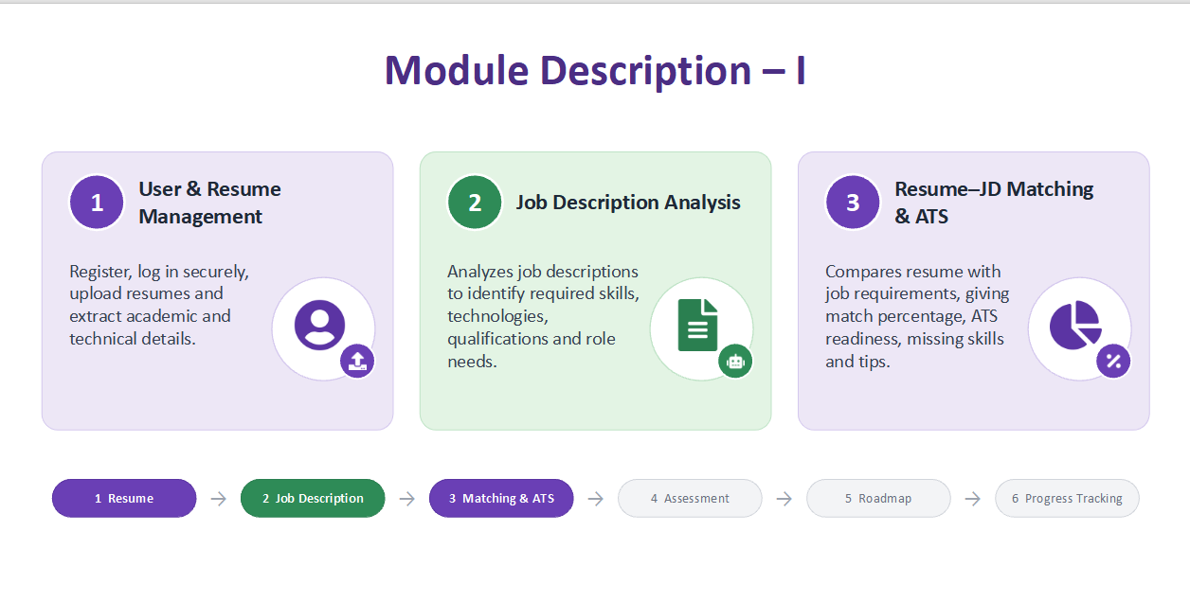
Module Description
User Authentication: registration and login; FastAPI issues a signed JWT that protects every API and restricts access to each user's own data.
Resume Upload and Parsing: accepts PDF/DOCX, extracts contact details, skills, education, experience, projects and certifications, with a completeness indicator.
Job Description Processing: upload or manual entry; extracts job title, required skills, technologies, responsibilities, qualifications and keywords.
Resume-JD Matching: reports matched, missing and additional skills plus keyword, experience and education match and an overall percentage.
ATS Score Calculation: rule-based check of contact info, sections, keyword coverage, readability and completeness.

Slide 10
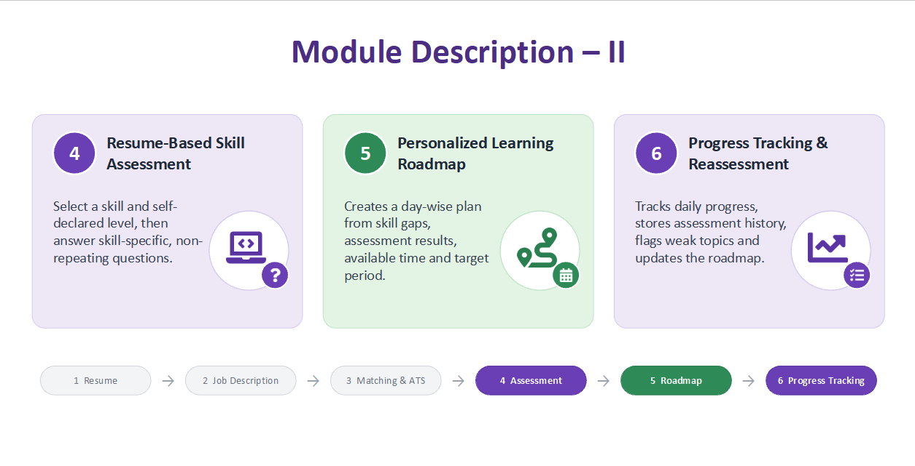
Module Description
Skill Gap Analysis: compares current skills with job needs, e.g. Docker, AWS and Redis flagged when absent from the resume.
AI Resume Suggestions: measurable achievements, stronger project descriptions, missing keywords, certifications, action verbs and profile links.
Personalized Learning Roadmap: turns missing skills into a week-wise plan that ends with a capstone project and interview readiness.
Company-Specific DSA Preparation: company-wise questions with direct LeetCode practice links.
Dashboard: one place for ATS scores, match results, skill gaps, suggestions, roadmaps and analysis history.

Slide 11
Results & Discussion
86%
Resume completeness
68
ATS resume score
63%
JD skill match
SQL, AI
Missing skills
Sample run: a student resume was analyzed against an Infosys System Engineer job description.
Roadmap generated: four weeks covering foundations, frameworks and architecture, cloud and infrastructure, and capstone with interview readiness.
Extra outputs: resume suggestions, strengths and weaknesses, tailored technical interview questions.
Note: values come from a single sample run and are not statistical performance measures.

Slide 12
Results & Discussion
Functional test results: all supported
PDF and DOCX resume extraction
JD upload / manual entry
Resume-JD comparison
ATS evaluation
Skill gap detection
Suggestions and learning roadmap
Company DSA questions and links
Centralized dashboard
Strengths
One workflow replaces several disconnected tools
Explainable scores and charts
Skill gaps feed the roadmap
Open-source, modest hardware
Limitations
Heuristic extraction on unusual layouts
Vocabulary-based skill matching
Rule-based ATS, not a commercial one
No OCR; large-scale validation pending

Slide 13
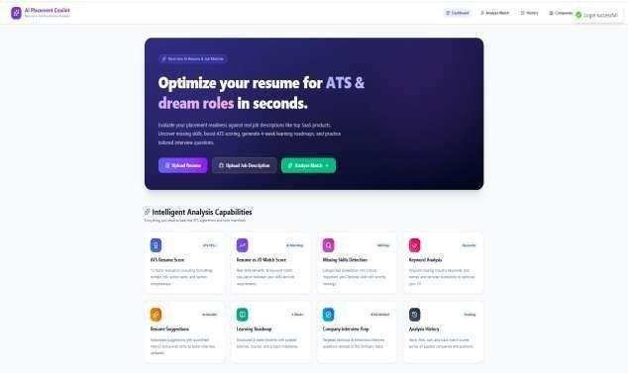
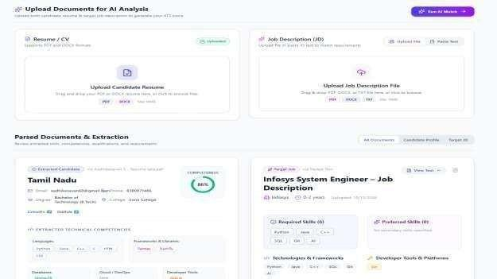
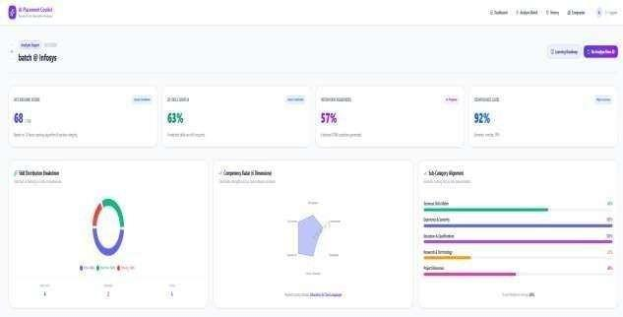
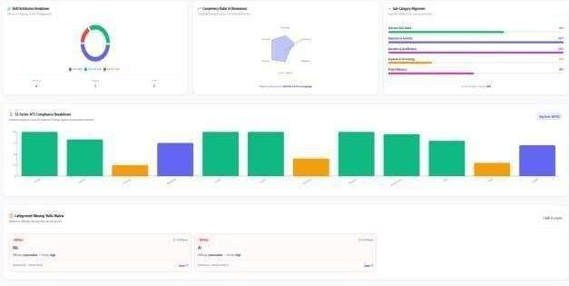
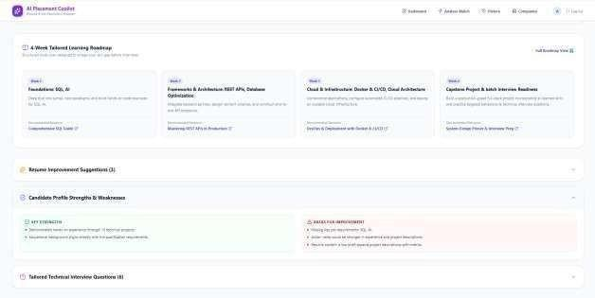
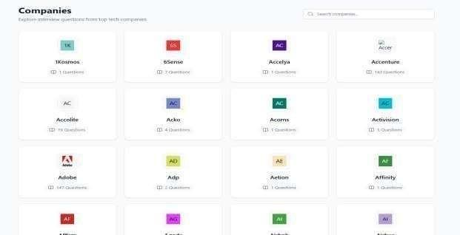
Screenshots
Dashboard
Resume and JD parsing
ATS score and match result
Skill gap analysis
AI suggestions and roadmap
Company DSA preparation

Slide 14
Conclusion
AI Placement Copilot unifies resume parsing, ATS scoring, JD matching, skill-gap detection, a learning roadmap and company DSA practice in one workflow.
It removes manual copying between tools and gives students targeted, explainable guidance for placements.
Future Enhancements:
LLM / semantic matching and job recommendations
Mock interviews, OCR for scanned resumes, downloadable reports
Progress analytics, fairness evaluation and live job-market data

Slide 15
References
Ubale S. et al., "An AI-Powered Platform for Interview Simulation and Comprehensive Placement Preparation," ICSFT, IEEE, 2026.
Ranjit K. N. et al., "Engipath: A Personalized Learning and Career Companion," ICTCS, Springer, 2025.
Lunawat S. et al., "PlaceMate: Integrated Placement Preparation Platform with AI Powered Assistance," ESCI, IEEE, 2026.
Tardalkar K. et al., "AI-Based Career Copilot for Skill Gap Analysis and Job Recommendation Using Semantic Embeddings," IJSREM 10(6), 2026.
George M. N. et al., "AceIt: An AI-Powered Career Preparation Platform for Personalized Campus Placement Readiness," J. Electronics and Information Technology 26(3), 2026.
Gajjela K., "Generative AI in HRM: Exploring Fine-Tuning Large Language Models for Candidate Sourcing and Screening," 2026.
Tigani S., "Next-gen HR interview process parametric AI copilot design," Pattern Analysis and Applications 28(4), 2025.

Slide 16
Publication / Patent
Publication: No publication at the time of submission.
Patent: None at the time of submission.
SDG 4 - Quality Education: turns skill gaps into a personalized learning roadmap (Target 4.4).
SDG 8 - Decent Work and Economic Growth: improves resume quality and interview preparation for employability (Target 8.5).
SDG 9 - Industry, Innovation and Infrastructure: applies modern web and AI-assisted technology to an education-to-employment problem (Target 9.5).

