Slide 1
PROJECT TITLE
CAPSTONE PROJECT
Presented By:
1. Aadhil Kassim P N-Toc H Institute of Science and Technology-Computer Science and Engineering

Slide 2
OUTLINE
Problem Statement (Should not include solution)
Proposed System/Solution
System Development Approach (Technology Used)
Algorithm & Deployment
Result (Output Image)
Conclusion
Future Scope
References

Slide 3
Problem Statement
The Challenge: Develop a predictive maintenance model for a fleet of industrial machines to anticipate failures before they occur.
Analysis: The project involves analyzing sensor data from machinery to identify patterns that precede a failure.
The Goal: The primary objective is to create a classification model that can predict the type of failure (e.g., tool wear, heat dissipation, power failure) based on real-time operational data.
Business Impact: This will enable proactive maintenance, which helps in reducing machinery downtime and overall operational costs.

Slide 4
Proposed Solution
Automated Machine Learning: Utilized IBM WatsonX AutoAI to automate model selection, feature engineering, and hyperparameter optimization, which significantly accelerated the development process.
Data-Driven Prediction: The system analyzes sensor readings to identify patterns indicative of future failures.
Incremental Learning: The model is trained incrementally, allowing it to learn from new batches of data over time using a partial_fit approach to continuously improve its accuracy.
Cloud Deployment: The best-performing model is deployed on IBM Cloud as a web service, making it accessible for real-time failure predictions.

Slide 5
System Approach
IBM Cloud Services:
WatsonX AI (for AutoAI and model deployment)
IBM Cloud Object Storage
IBM Cloud Runtime
Development Environment & Libraries:
Python Version: 3.11
Machine Learning Libraries: scikit-learn 1.3, snapml, lale, autoai-libs
Cloud Integration: ibm-watsonx-ai

Slide 6
Algorithm & Deployment
Algorithm Selection:
An AutoAI experiment was conducted, which generated and evaluated 9 different machine learning pipelines.
The top-performing pipeline was "Pipeline_5", which uses a Snap Random Forest Classifier. This model was chosen for its high accuracy and efficiency.
Training Process:
The model was initially trained and subsequently fine-tuned incrementally on data batches of 10,000 rows each.
Deployment:
The final trained model was stored in the IBM WatsonX AI repository.
It was then promoted to an IBM Cloud deployment space and deployed as an online web service for real-time scoring.
Deployment Region: Sydney (au-syd)

Slide 7
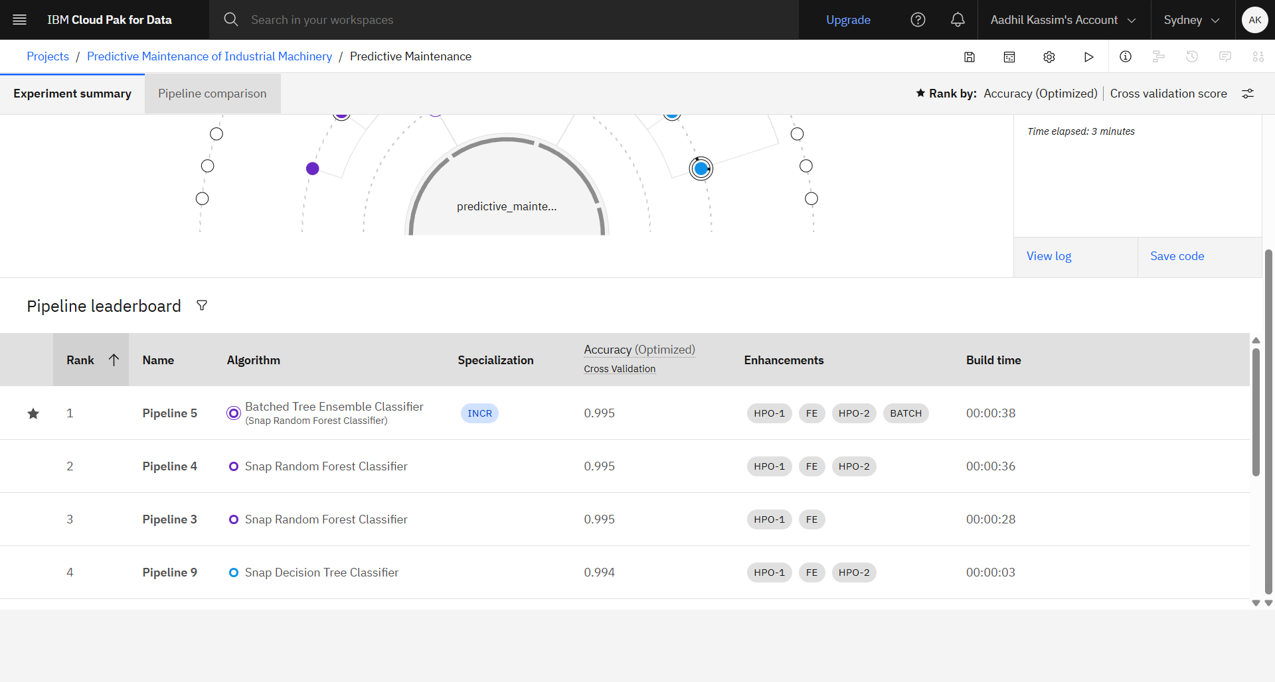
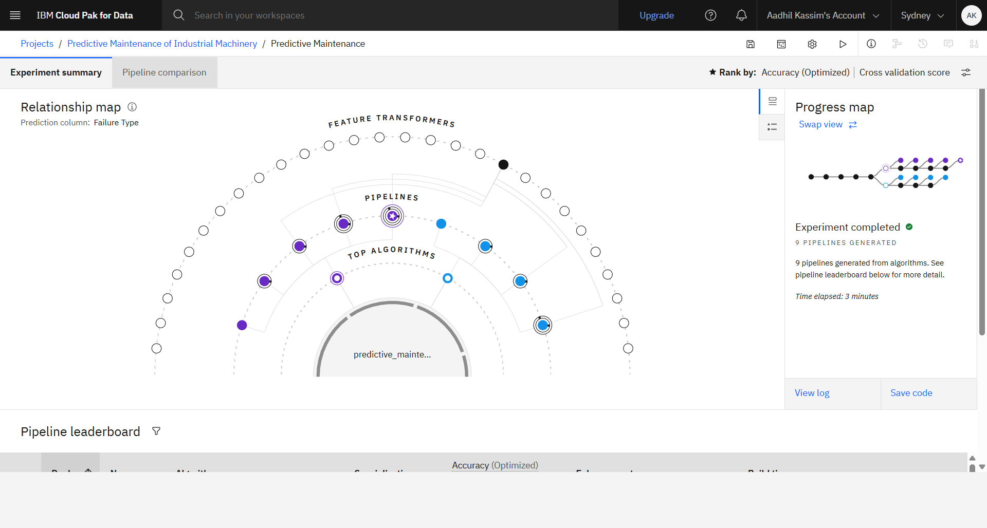
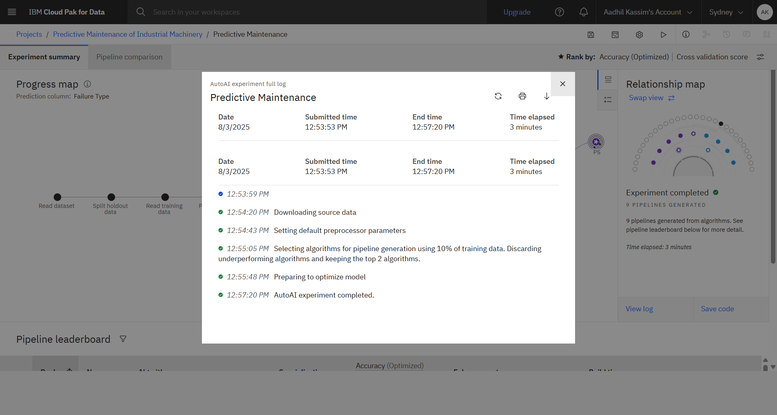
Result

Slide 8
Conclusion
The project successfully demonstrates the effectiveness of using IBM WatsonX AutoAI to build a high-accuracy predictive maintenance model.
The Snap Random Forest Classifier was identified as the most suitable algorithm for this dataset and problem.
The implementation of proactive maintenance predictions can lead to significant reductions in operational downtime and costs for industrial machinery.

Slide 9
Future scope
Enhanced Data Integration: Incorporate a wider variety of data sources, such as unstructured maintenance logs or real-time environmental conditions, to improve prediction accuracy.
Advanced Modeling: Explore more advanced techniques like deep learning or edge computing to provide faster, more localized predictions.
System Expansion: Scale the solution to cover a larger and more diverse fleet of industrial machines across different locations.

Slide 10
References
IBM Watson Studio AutoAI Documentation. Retrieved from
https://dataplatform.cloud.ibm.com/docs/content/wsj/analyze-data/autoai-notebook.html
Shivam, B. (2020). Machine Predictive Maintenance Classification. Kaggle. Retrieved from
https://www.kaggle.com/datasets/shivamb/machine-predictive-maintenance-classification
Licensed Materials - Copyright © 2025 IBM.

Slide 11
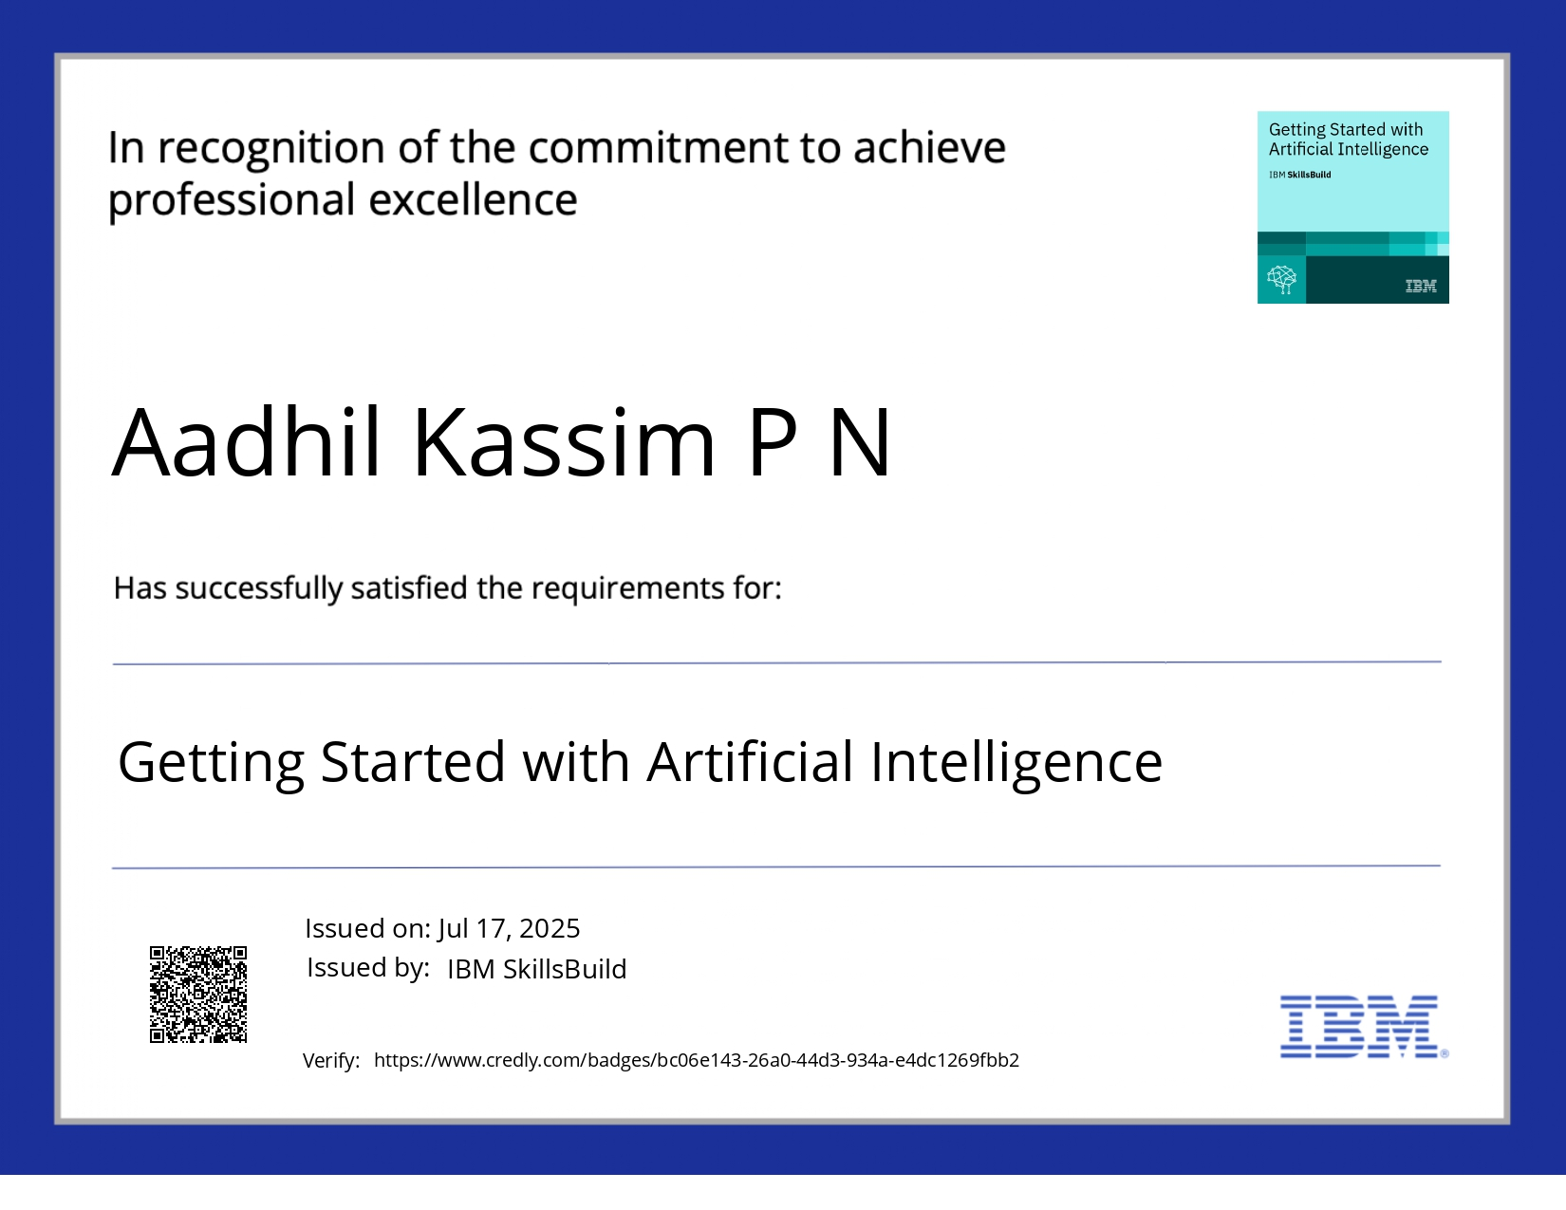
IBM Certifications

Slide 12
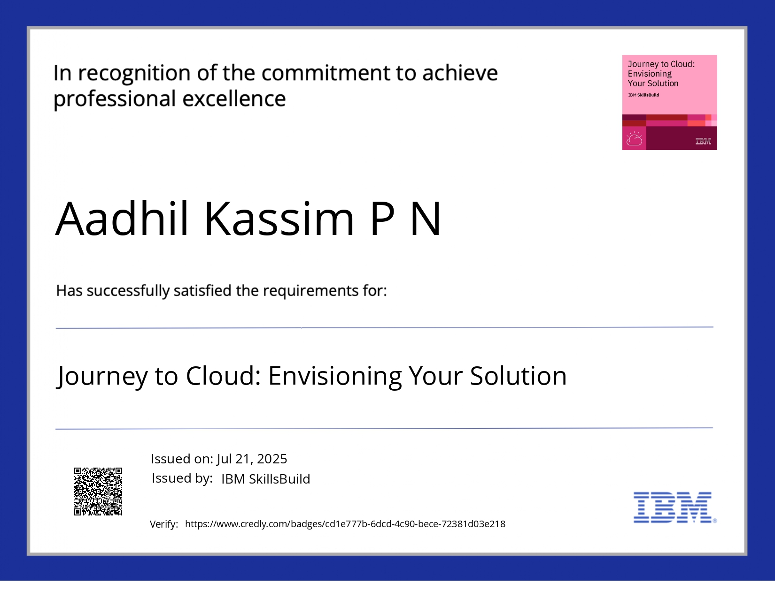
IBM Certifications

Slide 13
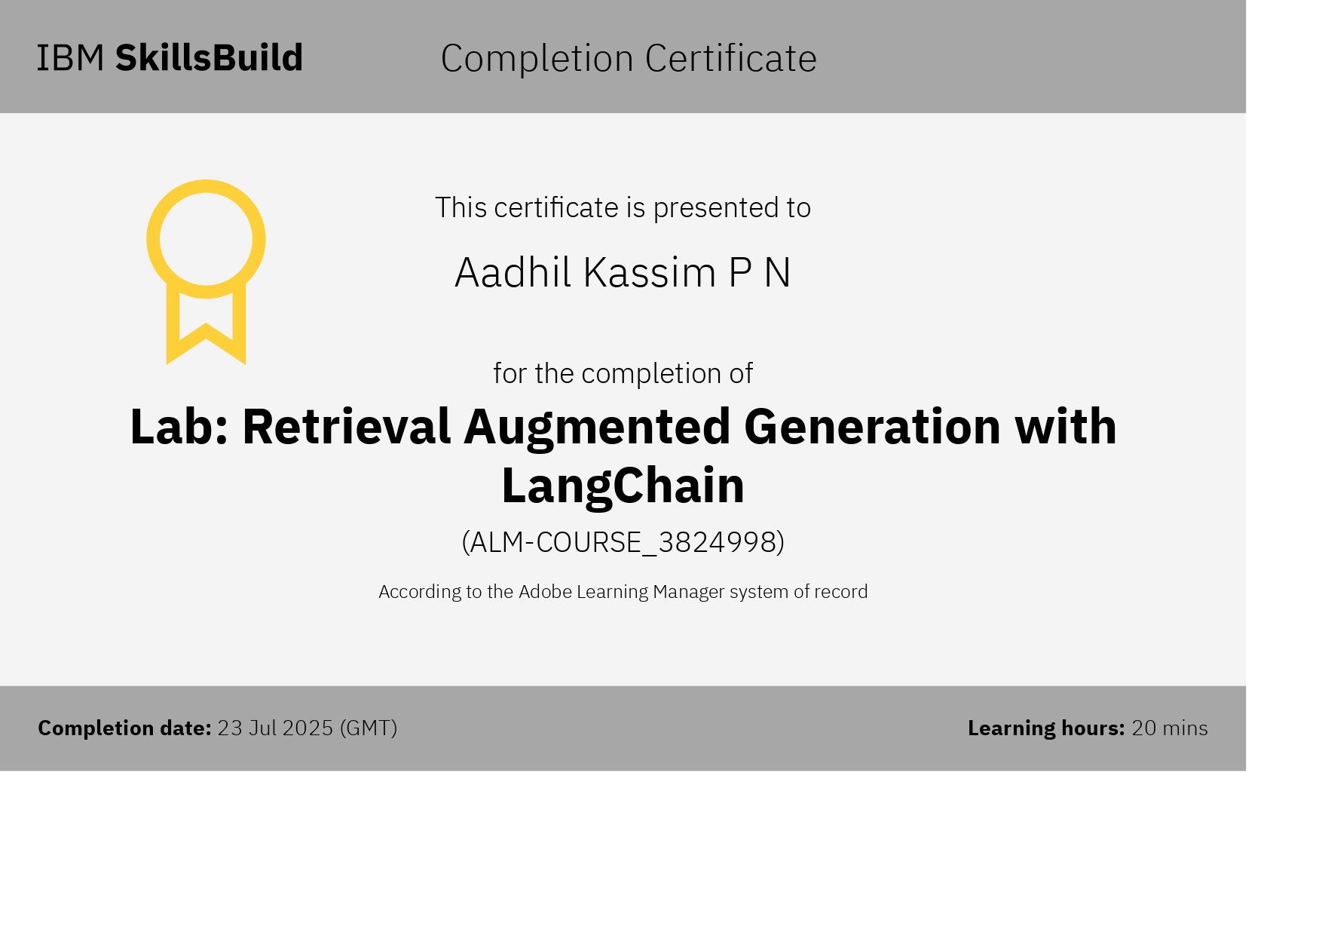
IBM Certifications

Slide 14
THANK YOU

