Slide 1


Game Theory and Applications
A Friendly Tutorial
June 2, 2009
Y. NARAHARI (IISc), DINESH GARG (Yahoo! Labs) ,
RAMASURI NARAYANAM (IISc)
E-Commerce Laboratory
Computer Science and Automation
Indian Institute of Science, Bangalore
E-Commerce Lab, CSA, IISc

Slide 2
Talk Based on
Y. Narahari, Dinesh Garg, Rama Suri, Hastagiri Prakash
Game Theoretic Problems in Network Economics and Mechanism Design Solutions
Monograph Published by
Springer, London, 2009
E-Commerce Lab, CSA, IISc

Slide 3
OUTLINE
Strategic Form Games, Examples,
Dominant Strategy Equilibrium, Nash Equilibrium,
Key Results
Mechanism Design and Application to Auctions
Application to Design of Sponsored Search
Auctions on the Web
Cooperative Games, Shapley Value,
Application to Social Networks
To Probe Further
E-Commerce Lab, CSA, IISc

Slide 4
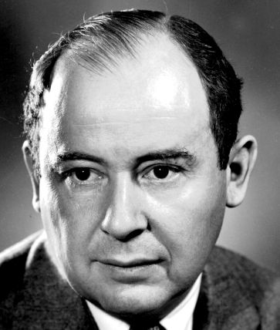
Inspiration: John von Neumann
Founded Game Theory with Oskar Morgenstern (1928-44)
Pioneered the Concept of a Digital Computer and Algorithms
60 years later (2000), there is a convergence; this has been the inspiration for our research
John von Neumann (1903-1957)
created two intellectual currents in the 1930s and 40s
E-Commerce Lab, CSA, IISc

Slide 5
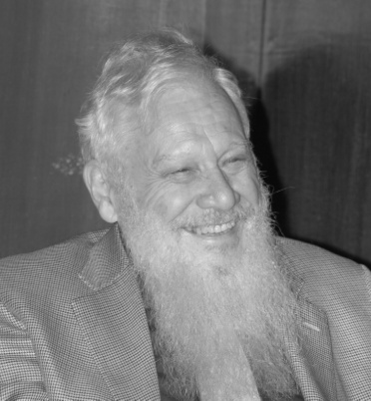
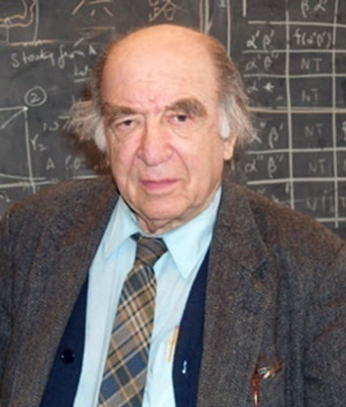
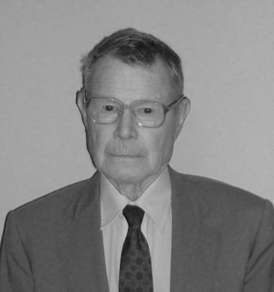
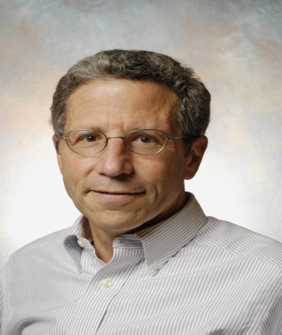
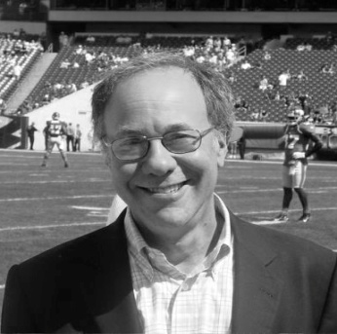
Excitement: The Nobel Prizes in Economic Sciences
The Nobel Prize was awarded to two Game Theorists in 2005 – Aumann visited IISc on January 16, 2007
The prize was awarded to three mechanism designers in 2007
Myerson has been one of our heroes since 2003
Eric Maskin visited IISc on December 16, 2009 and gave a talk in the Centenary Conference
Robert Aumann
Nobel 2005
Leonid Hurwicz
Nobel 2007
Thomas Schelling
Nobel 2005
Eric Maskin
Nobel 2007
Roger Myerson
Nobel 2007
E-Commerce Lab, CSA, IISc

Slide 6
Applications of Game Theory
Microeconomics, Sociology, Evolutionary Biology
Auctions and Market Design: Spectrum Auctions,
Procurement Markets, Double Auctions
Industrial Engineering, Supply Chain Management,
E-Commerce, Resource Allocation
Computer Science: Algorithmic Game Theory,
Internet and Network Economics, Protocol Design
An important tool to model, analyze, and solve
decentralized design problems involving multiple
autonomous agents that interact strategically
E-Commerce Lab, CSA, IISc

Slide 7
MOTIVATING PROBLEMS
Indirect Materials Procurement at Intel (2000)
Direct Materials Procurement at GM (2002)
Network Formation Problems at GM (2003)
Infosys (2006), and IBM (2006)
Sponsored Search Auctions on the Web (2006-09)
Optimal solutions translate into significant benefits
E-Commerce Lab, CSA, IISc

Slide 8
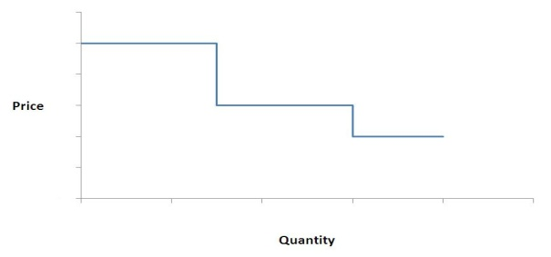

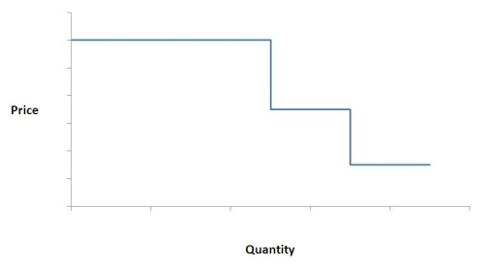
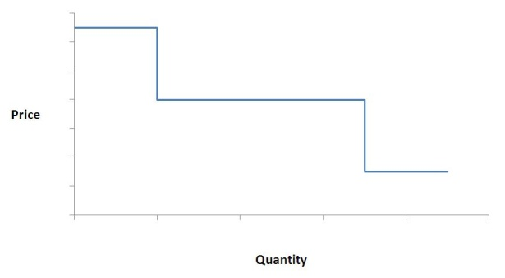
Problem 1: Direct Materials Procurement at IISc
SUPPLIER 1
SUPPLIER 2
Buyer
1,00,000
units of
raw material
SUPPLIER 3
Supply Curves
Incentive Compatible Procurement Auction with Volume Discounts
Even 1 percent improvement could translate into millions of rupees

Slide 9









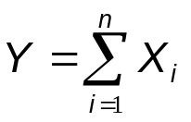

PROBLEM 2: Supply Chain Network Formation
Supply Chain Network Planner
Stage
Manager
E-Commerce Lab, CSA, IISc

Slide 10
Abstraction: Shortest Path Problem with Incomplete Information
A
SP1
SP4
S
SP3
B
SP5
T
SP3
C
SP6
The costs of the edges are not known with certainty
E-Commerce Lab, CSA, IISc

Slide 11
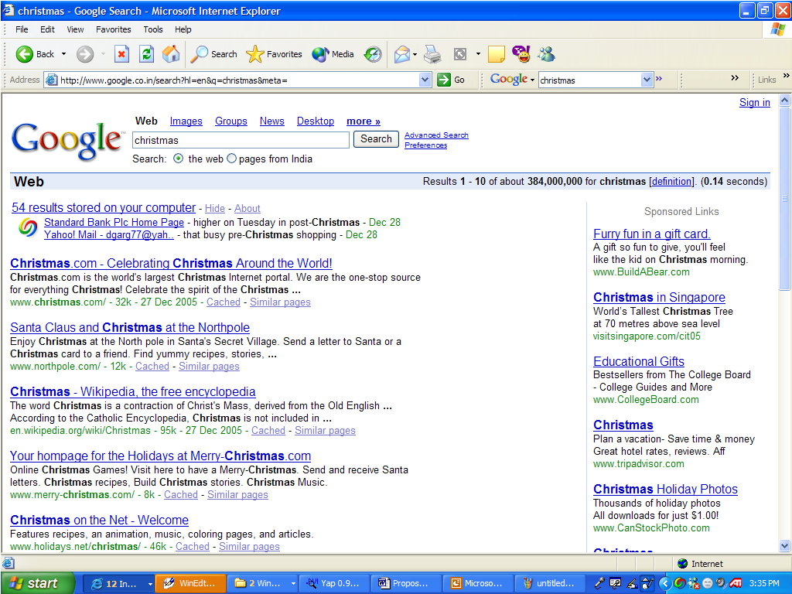




PROBLEM 3: Sponsored Search Auction
CPC
Advertisers
Paid search auction is the leading revenue generator on the web
E-Commerce Lab, CSA, IISc

Slide 12
NATURE OF THESE PROBLEMS
All these are optimization problems
with incomplete information
Problem solving involves two phases:
(1) Preference Elicitation (2) Preference Aggregation
Preference Elicitation – Game Theory and Mechanism Design
Preference Aggregation – Optimization Theory and algorithms
Other mathematical paraphernalia are also needed
E-Commerce Lab, CSA, IISc

Slide 13
KEY OBSERVATIONS
Players are rational,
Intelligent, strategic
Both conflict and
cooperation are “issues”
Some information is
“common knowledge”
Other information is
“private”, “incomplete”,
“distributed”
Our Goal: To implement a system wide solution
(social choice function) with desirable properties
Game theory is a natural choice for modeling
such problems
E-Commerce Lab, CSA, IISc

Slide 14



Game Theory
Mathematical framework for rigorous study of conflict and cooperation among rational, intelligent agents
Market
Buying Agents (rational and intelligent)
Social Planner (Mechanism Designer)
Selling Agents (rational and intelligent)
E-Commerce Lab, CSA, IISc

Slide 15

Strategic Form Games (Normal Form Games)
S₁
U₁ : S R
S_{n}
U_{n} : S R
N = {1,…,n}
Players
S₁, … , S_{n}
Strategy Sets
S = S₁ X … X S_{n}
Payoff functions
(Utility functions)
E-Commerce Lab, CSA, IISc

Slide 16


Example 1: Matching Pennies
 | 1, -1 | -1,1
 | -1,1 | 1,-1
Two players simultaneously put down a coin, heads up or tails up.
Two-Player zero-sum game
N = {1, 2}; S₁ = S₂ = {H,T}
E-Commerce Lab, CSA, IISc

Slide 17
Example 2: Prisoner’s Dilemma
 | No Confess NC | Confess C
No Confess NC | - 2, - 2 | - 10, - 1
Confess C | -1, - 10 | - 5, - 5
E-Commerce Lab, CSA, IISc

Slide 18
Example 3: Coordination Game
B A | IISc | MG Road
IISc | 100,100 | 0,0
MG Road | 0,0 | 10,10
Models the strategic conflict when two players
have to choose their priorities
E-Commerce Lab, CSA, IISc

Slide 19
Dominant Strategy Equilibrium
A dominant strategy is a best response whatever the strategies of the other players
 | No Confess NC | Confess C
No Confess NC | - 2, - 2 | - 10, - 1
Confess C | -1, - 10 | - 5, - 5
(C,C) is a dominant strategy equilibrium
E-Commerce Lab, CSA, IISc

Slide 20
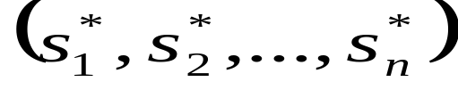



Pure Strategy Nash Equilibrium
A profile of strategies is said to be
a pure strategy Nash Equilibrium if is a best
response strategy against
E-Commerce Lab, CSA, IISc

Slide 21
Nash Equilibrium
A Nash equilibrium strategy is a best response against the Nash equilibrium strategies of the other players
 | No Confess NC | Confess C
No Confess NC | - 2, - 2 | - 10, - 1
Confess C | -1, - 10 | - 5, - 5
(C,C) is a Nash equilibrium
Every DSE is a NE but not vice-versa
E-Commerce Lab, CSA, IISc

Slide 22
Equilibria in Matching Pennies
 | (1,-1) | (-1,1)
 | (-1,1) | (1,-1)
No pure strategy NE here, only a mixed strategy NE
E-Commerce Lab, CSA, IISc

Slide 23
Equilibria in Coordination Game
B A | IISc | MG Road
IISc | 100,100 | 0,0
MG Road | 0,0 | 10,10
Two pure strategy Nash equilibria and
one mixed strategy Nash equilibrium
E-Commerce Lab, CSA, IISc

Slide 24
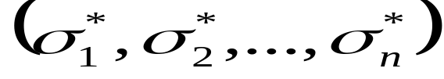


Nash’s Theorem
Every finite strategic form game has at least one mixed strategy Nash equilibrium
Mixed strategy of a player ‘i’ is a probability distribution on S_{i .}
is a mixed strategy Nash equilibrium if
is a best response against ,
E-Commerce Lab, CSA, IISc

Slide 25
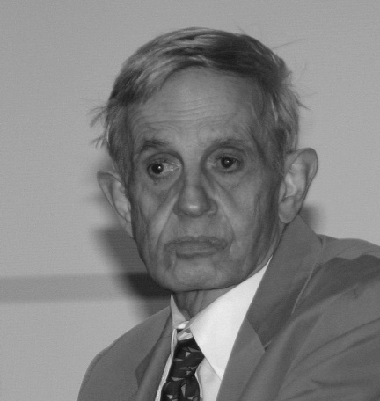
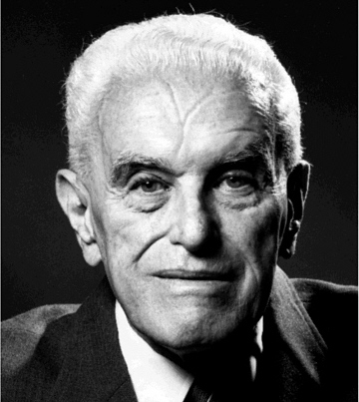
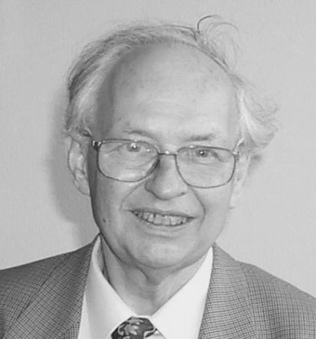
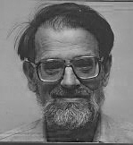
GAME THEORY PIONEERS
John Harsanyi
1920 - 2000
Nobel 1994
Richard Selten
1930 -
Nobel 1994
John Nash Jr
1928 -
Nobel 1994
Robert Aumann
1930 -
Nobel 2005
Thomas Schelling
1921 -
Nobel 2005
Lloyd Shapley
1923 -
Nobel ????
E-Commerce Lab, CSA, IISc

Slide 26
MECHANISM DESIGN
Game Theory involves analysis of games –
computing NE, DSE, MSNE, etc and
analyzing equilibrium behaviour
Mechanism Design is the design of games or
reverse engineering of games; could be called
Game Engineering
Involves inducing a game among the players
such that in some equilibrium of the game,
a desired social choice function is implemented
E-Commerce Lab, CSA, IISc

Slide 27



Example 1: Mechanism Design
Fair Division of a Cake
Mother
Social Planner
Mechanism Designer
Kid 1
Rational and
Intelligent
Kid 2
Rational and
Intelligent

Slide 28

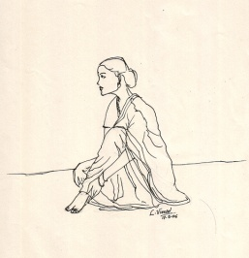

Example 2: Mechanism Design
Truth Elicitation through an Indirect Mechanism
Tenali Rama
(Birbal)
Mechanism Designer
Baby
Mother 1
Rational and
Intelligent Player
Mother 2
Rational and
Intelligent Player

Slide 29
MECHANISM DESIGN: EXAMPLE 3 : VICKREY AUCTION
One Seller, Multiple Buyers, Single Indivisible Item
Example: B1: 40, B2: 45, B3: 60, B4: 80
Winner: whoever bids the highest; in this case B4
Payment: Second Highest Bid: in this case, 60.
Vickrey showed that this mechanism is Dominant Strategy
Incentive Compatible (DSIC) ;Truth Revelation is good for
a player irrespective of what other players report
E-Commerce Lab, CSA, IISc

Slide 30
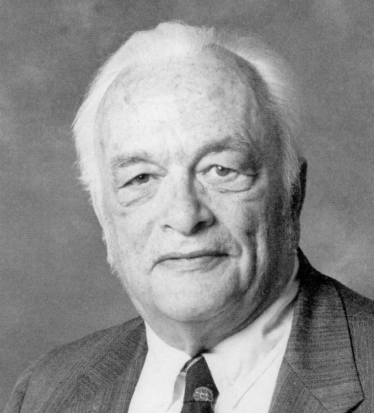
William Vickrey
(1914 – 1996 )
Inventor of the celebrated Vickrey auction
Nobel Prize : 1996
E-Commerce Lab, CSA, IISc

Slide 31


Four Basic Types of Auctions
Dutch Auction
English Auction
1
1
0, 10, 20, 30,
40, 45, 50, 55,
58, 60, stop.
100, 90, 85, 75, 70, 65, 60, stop.
n
Seller
n
Buyers
Auctioneer or seller
Buyers
First Price Auction
Vickrey Auction
1
40
40
1
2
50
Winner = 4 Price = 60
2
45
Winner = 4 Price = 60
3
55
3
60
4
60
4
80
Buyers
Buyers
E-Commerce Lab, CSA, IISc

Slide 32











Social Choice Function (SCF)
E-Commerce Lab, CSA, IISc

Slide 33

















Mechanism
E-Commerce Lab, CSA, IISc

Slide 34



Implementing an SCF
Dominant Strategy Implementation
We say that mechanism implements SCF in dominant strategy equilibrium if
Bayesian Nash Implementation
We say that mechanism implements SCF in Bayesian Nash equilibrium if
Observation
Dominant Strategy-implementation Bayesian Nash- implementation
E-Commerce Lab, CSA, IISc

Slide 35
PROPERTIES OF SOCIAL CHOICE FUNCTIONS
DSIC (Dominant Strategy
Incentive Compatibility)
Reporting Truth is always good
BIC (Bayesian Nash
Incentive Compatibility)
Reporting truth is good whenever
others also report truth
AE (Allocative Efficiency)
Allocate items to those who
value them most
BB (Budget Balance)
Payments balance receipts and
No losses are incurred
Non-Dictatorship
No single agent is favoured all
the time
Individual Rationality
Players participate voluntarily
since they do not incur losses
E-Commerce Lab, CSA, IISc

Slide 36
IMPOSSIBILITY THEOREMS
Arrow’s Impossibility
Theorem
Gibbard Satterthwaite
Impossibility Theorem
Green Laffont Impossibility
Theorem
Myerson Satterthwaite
Impossibility Theorem
E-Commerce Lab, CSA, IISc

Slide 37


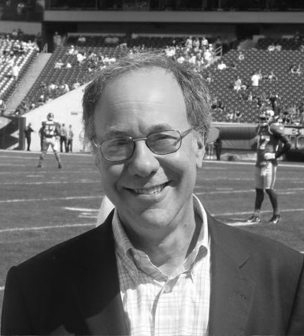
PIONEERS IN MECHANISM DESIGN
Leonid Hurwicz
Nobel 2007
Eric Maskin
Nobel 2007
Roger Myerson
Nobel 2007
E-Commerce Lab, CSA, IISc

Slide 38
WBB
SBB
AE
EPE
dAGVA
BIC
IR
CBOPT
DSIC
GROVES
SSAOPT
VDOPT
MYERSON
MECHANISM
DESIGN SPACE
E-Commerce Lab, CSA, IISc

Slide 39
Application to Sponsored Search Auction
CPC
Advertisers
Paid search auction is the leading revenue generator on the web
E-Commerce Lab, CSA, IISc

Slide 40
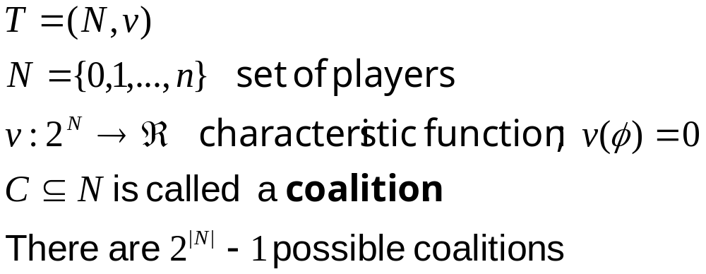
Cooperative Game with Transferable Utilities (TU Games)

Slide 41
Given a TU game, two central questions are:
Which coalition(s) should form ?
How should a coalition that forms divide the surplus among its members ?
Cooperative game theory offers several solution concepts:
  The Core
  Shapley Value

Slide 42
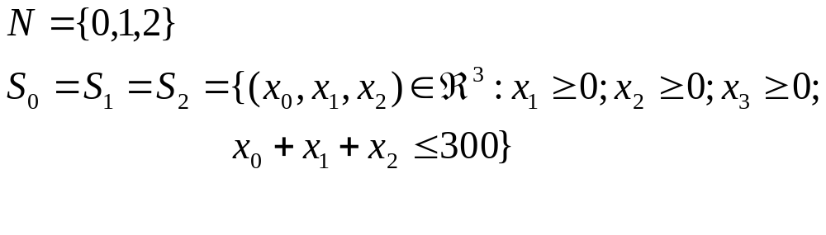
Divide the Dollar Game
There are three players who have to share 300 dollars. Each one proposes a particular allocation of dollars to players.

Slide 43
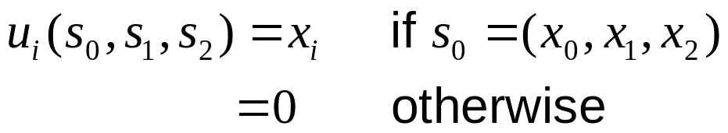
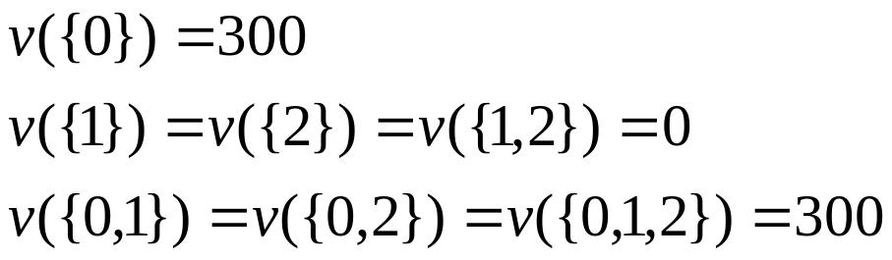
Divide the Dollar : Version 1
The allocation is decided by what is proposed by player 0
Apex Game or Monopoly Game
Characteristic Function

Slide 44
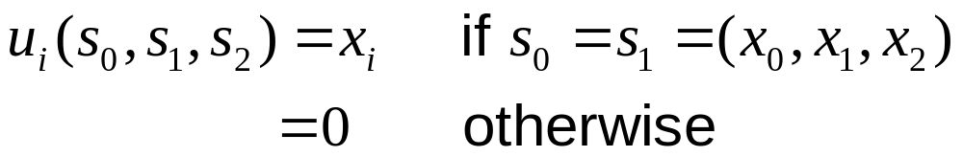
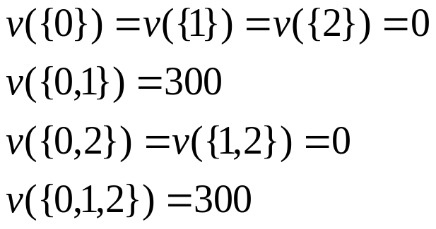
Divide the Dollar : Version 2
It is enough 0 and 1 propose the same allocation
Players 0 and 1 are equally powerful; Characteristic Function is:

Slide 45
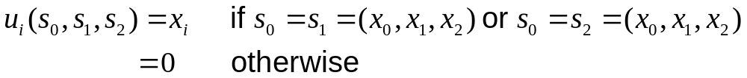
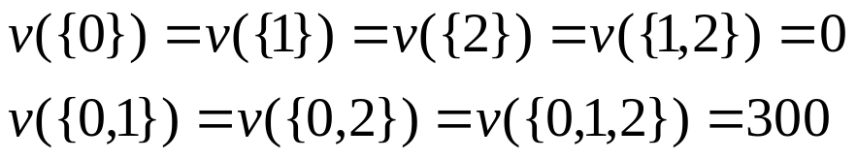
Divide the Dollar : Version 3
Either 0 and 1 should propose the same allocation or 0 and 2 should propose the same allocation
Characteristic Function

Slide 46
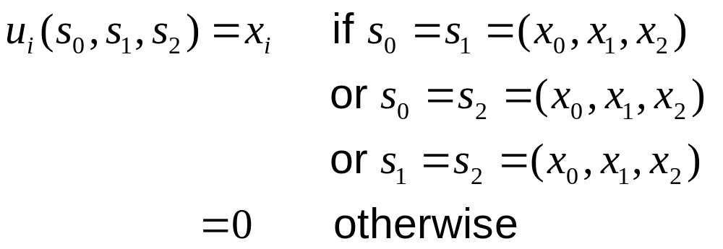
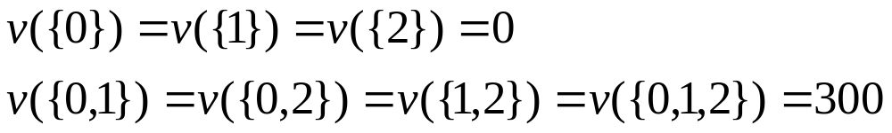
Divide the Dollar : Version 4
It is enough any pair of players has the same proposal
Also called the Majority Voting Game
Characteristic Function

Slide 47


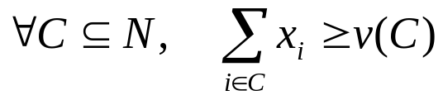

The Core
Core of (N, v) is the collection of all allocations (x₀ , x₁ ,…, x_{n}) satisfying:
Individual Rationality
Coalitional Rationality
Collective Rationality

Slide 48

The Core: Examples
Version of Divide-the-Dollar Core
Version 1
Version 2
Version 3
Version 4
{(300, 0, 0)}
Empty

Slide 49
Some Observations
If a feasible allocation x = ( x₀ ,…, x_{n} ) is not in the core, then there is some coalition C such that the players in C could all do strictly better than in x.
If an allocation x belongs to the core, then it implies that x is a Nash equilibrium of an appropriate contract signing game, so players are reasonably happy.
Empty core is bad news so also a large core!

Slide 50
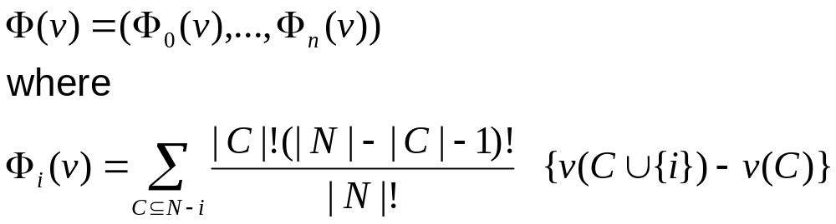
Shapley Value : A Fair Allocation Scheme
Provides a unique payoff allocation that describes a fair way of dividing the gains of cooperation in a game (N, v)

Slide 51
Shapley Value: Examples
Version of Divide-the-Dollar Shapley Value
Version 1
Version 2
Version 3
Version 4
(300,0,0)
(150,150,0)
(200,50,50)
(100,100,100)

Slide 52
Shapley Value: An Application to Finding Influential Nodes in a Social Network

Slide 53
TO PROBE FURTHER
Philip D Straffin, Jr. Game Theory and Strategy,
American Mathematical Society, 1993
Martin Osborne. Introduction to Game Theory.
Oxford University Press, 2003
Roger Myerson. Game Theory and Analysis of
Conflict. Harvard University Press, 1997
A, Mas-Colell, M.D. Whinston, and J.R. Green.
Microeconomic Theory, Oxford University Press, 1995
E-Commerce Lab, CSA, IISc

Slide 54
TO PROBE FURTHER (contd.)
Y. Narahari, Dinesh Garg, Ramasuri, and Hastagiri
Game Theoretic Problems in Network Economics
and Mechanism Design Solutions, Springer, 2009
http://www.gametheory.net
A rich source of material on game theory and game
theory courses
http://lcm.csa.iisc.ernet.in/hari
Several survey articles can be downloaded
http://lcm.csa.iisc.ernet.in/gametheory/index.html
Game Theory Course Offered at IISc
E-Commerce Lab, CSA, IISc

Slide 55

Questions and Answers …
Thank You …
E-Commerce Lab, CSA, IISc

