Slide 1
💚
FitBuddy
Digital Wellness Monitoring Application
Submitted By:
Sheli Jaju 2022UCP1240
Aadhya Joshi 2022UCP1326

Slide 2
Project Overview
Objectives:
  Monitor digital screen time
  Track health metrics manually
  AI-powered health assistance
  Medication & appointment reminders
Deliverables
  React Native mobile application
  Node.js REST API backend
  MongoDB database
  Complete API documentation
  User authentication system

Slide 3
Technology Stack
Frontend Technologies
  React Native (Cross-platform mobile framework)
  Expo (Development platform)
  TypeScript (Type safety)
  Zustand (State management)
  Axios (HTTP client)
  React Navigation (Navigation)
  Expo Notifications (Push notifications)
  AsyncStorage (Local storage)
Backend Technologies
  Node.js (Runtime environment)
  Express.js (Web framework)
  MongoDB (NoSQL database)
  JWT (Authentication)
  Bcrypt.js (Password hashing)
  Express Validator (Input validation)
  Gemini API (AI chatbot) (pending)
  CORS (Cross-origin requests)

Slide 4
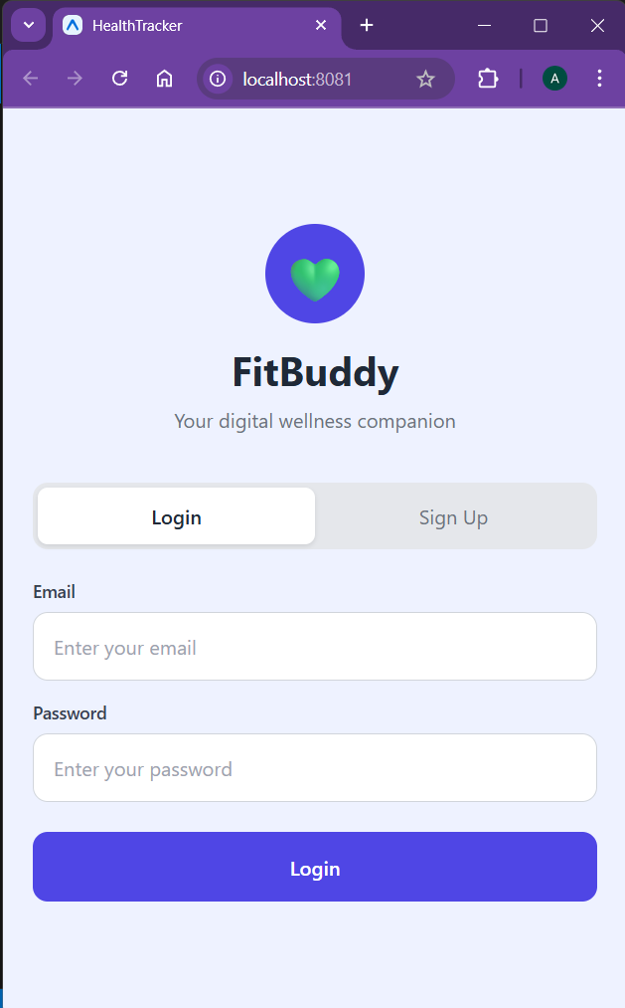
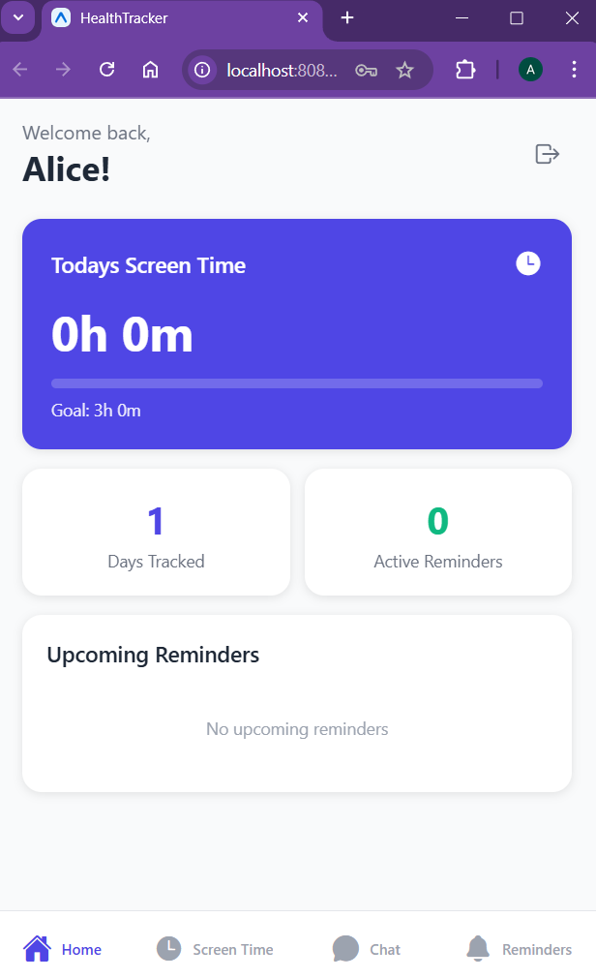
Core Features
User Authentication
Secure Sign Up and Login
Healthcare Dashboard

Slide 5
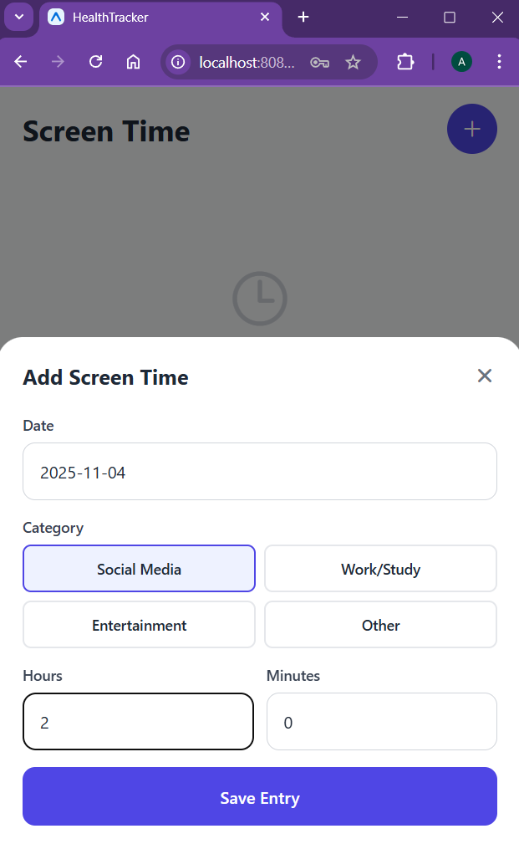
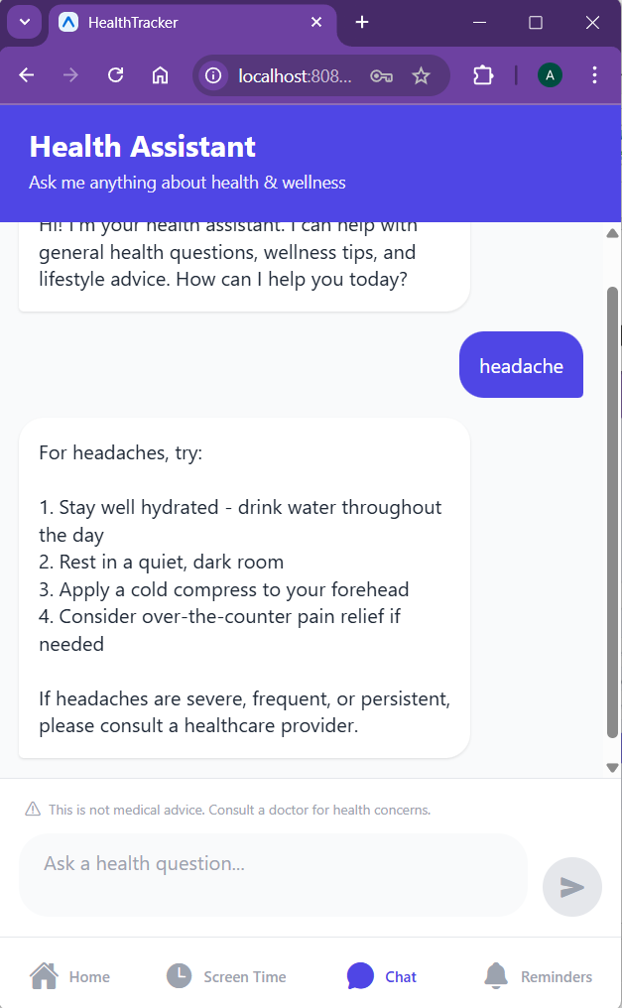
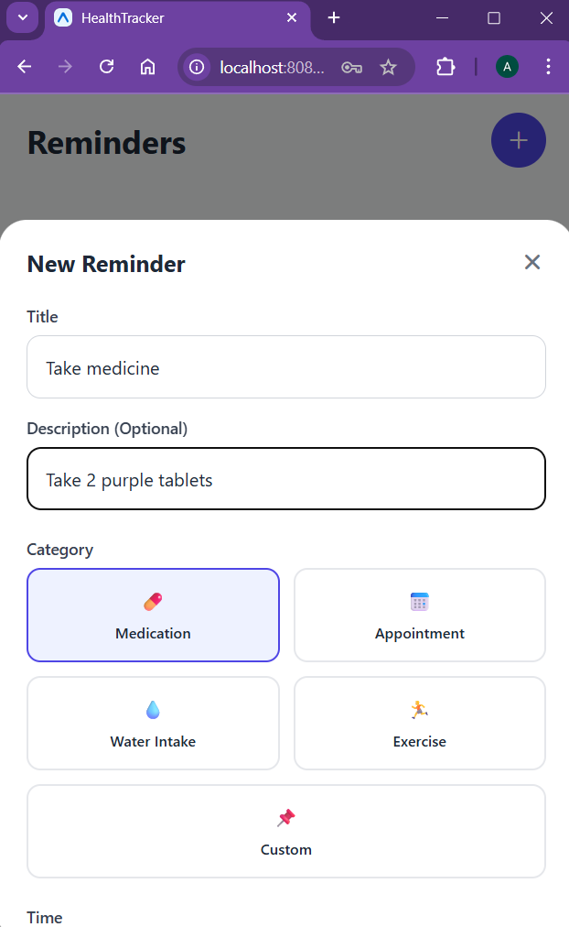
Core Features
Screen Time Tracking
Health Care Chatbot
Setting Reminders

Slide 6
System Architecture
Layer 1: Mobile Client
Technology: React Native + Expo
iOS & Android applications
State Management (Zustand)
Local Storage (AsyncStorage)
Push Notifications (Expo Notifications)
HTTP Client (Axios)
UI Components & Navigation
Layer 2: REST API
Technology: Node.js + Express
RESTful endpoints
JWT Authentication middleware
Request validation (Express Validator)
Error handling middleware
CORS configuration
Business logic controllers
Layer 3: Database
Technology: MongoDB
NoSQL document database
Collections: Users, ScreenTime, Reminders, ChatMessages
Mongoose schemas and models
Data validation
Indexing for performance
Data Flow: Mobile App ⟷ REST API ⟷ MongoDB

Slide 7
RESTful API Endpoints
Authentication
- `POST /api/auth/signup` - Register new user
- `POST /api/auth/login` - Login user
- `GET /api/auth/me` - Get current user
- `PUT /api/auth/updatedetails` - Update user details
- `PUT /api/auth/updatepassword` - Update password
Reminders
- `GET /api/reminders` - Get all reminders
- `GET /api/reminders/active` - Get active reminders
- `GET /api/reminders/today` - Get today's reminders
- `POST /api/reminders` - Create reminder
- `PUT /api/reminders/:id` - Update reminder
- `PATCH /api/reminders/:id` - Toggle completion
- `DELETE /api/reminders/:id` - Delete reminder
Screen Time
- `GET /api/screentime` - Get all screen time entries
- `GET /api/screentime/today` - Get today's screen time
- `GET /api/screentime/stats` - Get statistics
- `POST /api/screentime` - Create screen time entry
- `PUT /api/screentime/:id` - Update entry
- `DELETE /api/screentime/:id` - Delete entry
Chat
- `POST /api/chat` - Send message to chatbot
- `GET /api/chat/history` - Get chat history
- `GET /api/chat/conversations` - Get all conversations
- `DELETE /api/chat/history/:conversationId` - Delete chat history

Slide 8
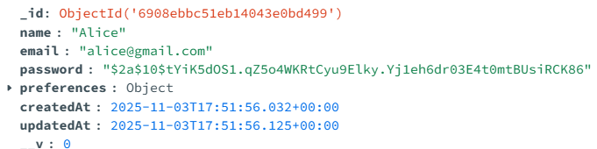
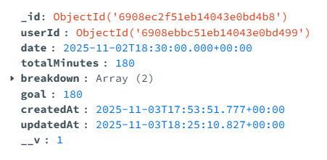
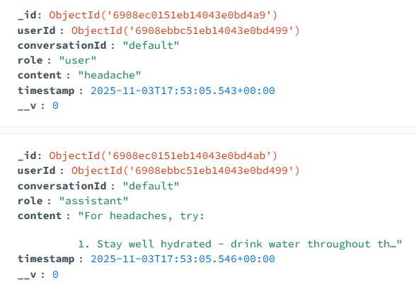
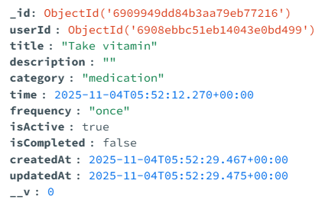
MongoDB Database Schema
Users
Screen Time
Reminder
Chat Messages

Slide 9
Future Enhancements
Wearable device integration
Advanced data analytics with ML
Mood Journaling and Analytics
Social features (friend challenges)
Health metrics export (CSV/PDF)
Dark mode support
Multi-language support
GitHub Repo: https://github.com/AadhyaJoshi/FitBuddy

Slide 10
THANK YOU!

