Slide 1

LearnScape
The Virtual Classroom App
By - Aadhya Joshi
2022UCP1326

Slide 2
To be covered:
SRS (Software Requirements Specifications)
Life-cycle Process Model used
Analysis and Designing:
DFD Level 0,1,2 (Structured Paradigm)
E-R Diagram (Structured Paradigm)
Class Diagram (Structured Paradigm)
Use-Case Diagram (Object-Oriented Paradigm)
Sequence Diagram (Object-Oriented Paradigm)
Pseudocode/Algorithm generation of various processes in the system
Coding and GUI
Testing and Quality Assurance

Slide 3
SOFTWARE REQUIREMENTS SPECIFICATIONS
Functional Requirements:
User Authentication: secure signup, login using their email and password.
Role-based Access Control: offers distinct dashboards and permissions.
Class Creation and Enrollment: Instructors can create and delete class. Students shall be able to enroll in available class.
Assignment Management: Instructors shall be able to post assignments with due dates, and students shall be able to submit assignments within deadlines.
Discussion Forum: students and instructors can post class comments.
Grade Management:
Notifications: about upcoming assignments, deadlines, or class comments
Profile Management: Users shall be able to update their profiles
Resource Sharing: Instructors shall be able to upload and share study materials, and students shall be able to download and view these resources.

Slide 4





SOFTWARE REQUIREMENTS SPECIFICATIONS
Quality Requirements:
Usability
Security
Reliability
Compatibility & Maintainability
Scalability

Slide 5
Process Model used: Iterative Waterfall
Why?
Most widely used
The set of requirements (quality and performance) is well-known, from the client’s side.
There may be possibility of errors in each phase, which (if not corrected in the same phase), can be corrected by usage of “corrective paths” provided by the model.

Slide 6
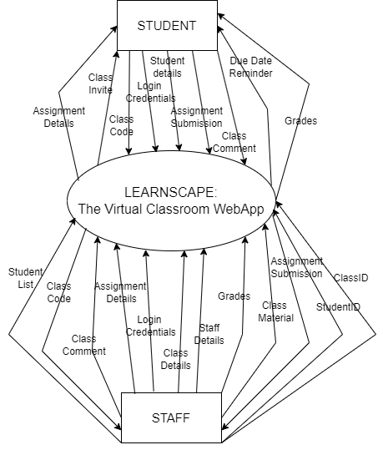
DESIGN AND ANALYSIS: DFD Level 0

Slide 7
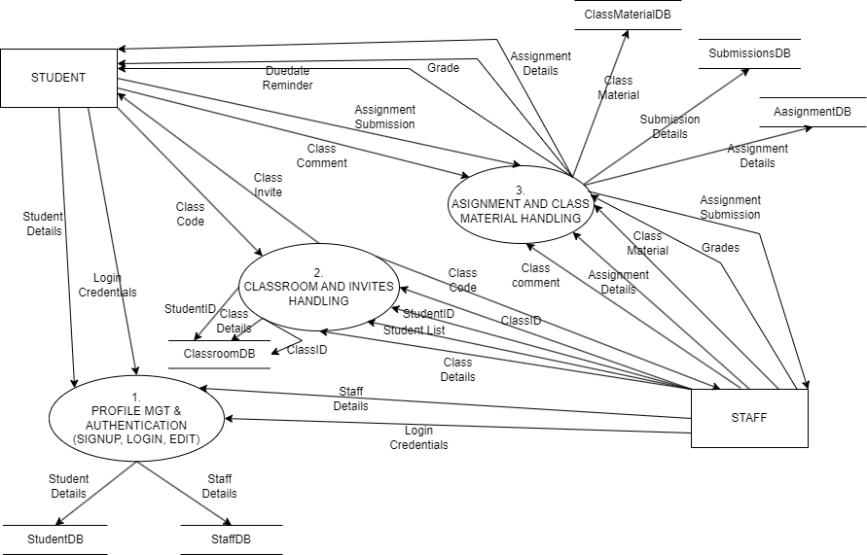
DESIGN AND ANALYSIS: DFD Level 1

Slide 8
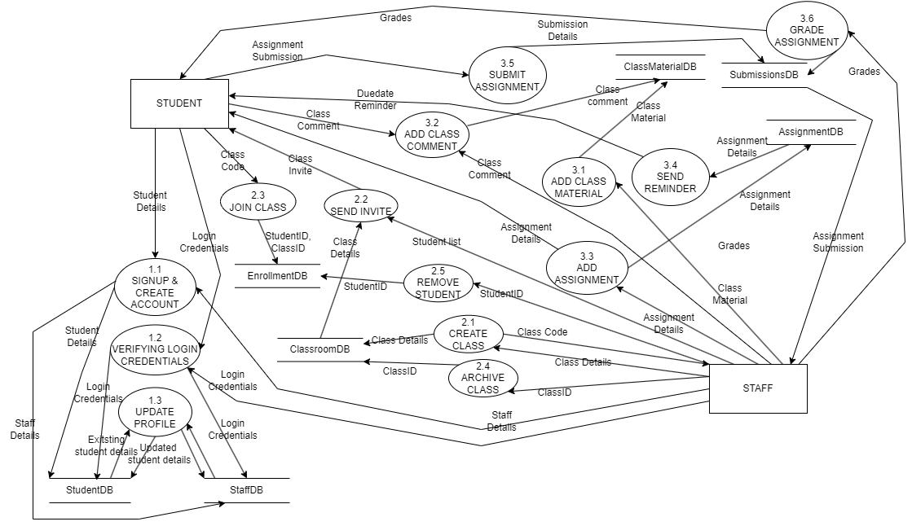
DESIGN AND ANALYSIS: DFD Level 2

Slide 9
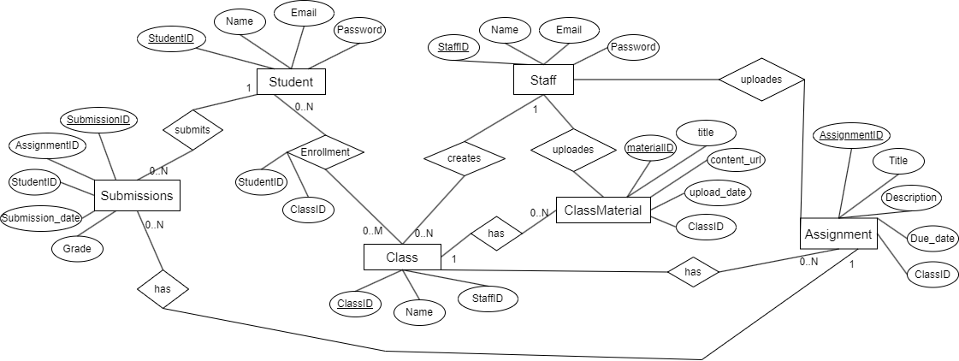
DESIGN AND ANALYSIS: Entity Relationship Diagram

Slide 10
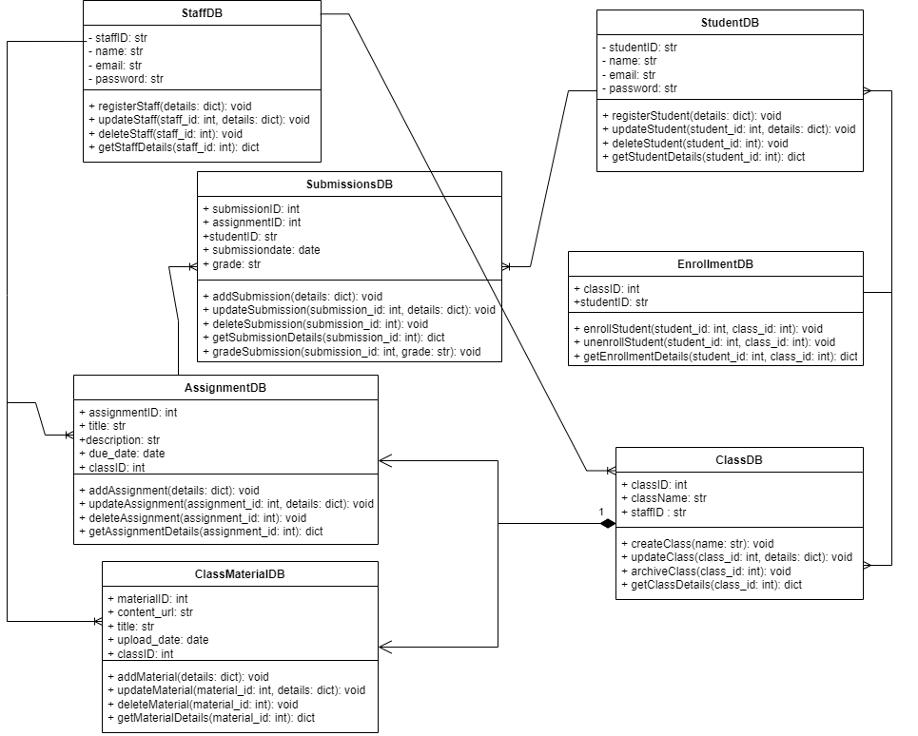
DESIGN AND ANALYSIS: Class Diagram

Slide 11
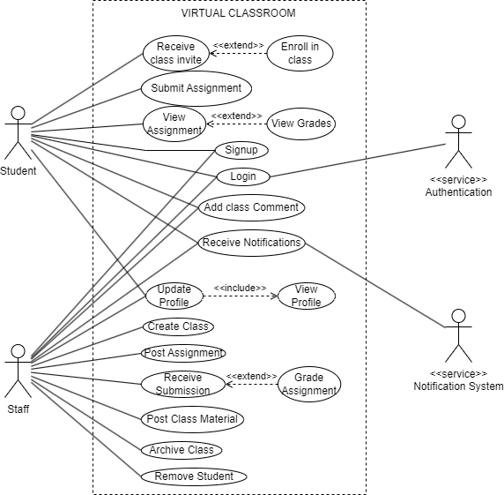
DESIGN AND ANALYSIS: Use Case Diagram

Slide 12
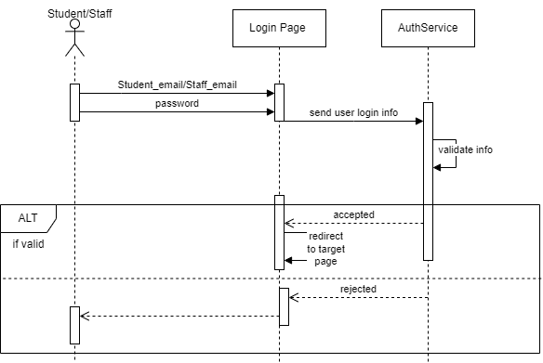
DESIGN AND ANALYSIS: Sequence Diagram
LOGIN PROCESS (for both Student & Staff)

Slide 13
DESIGN AND ANALYSIS: Sequence Diagram
ENROLLMENT PROCESS

Slide 14
DESIGN AND ANALYSIS: Sequence Diagram
ASSIGNMENT UPLOAD PROCESS

Slide 15
DESIGN AND ANALYSIS: Sequence Diagram
ASSIGNMENT SUBMISSION PROCESS

Slide 16
DESIGN AND ANALYSIS: Sequence Diagram
ASSIGNMENT GRADING PROCESS

Slide 17
DESIGN AND ANALYSIS: Sequence Diagram
VIEW CLASS MATERIAL PROCESS

Slide 18
DESIGN AND ANALYSIS: Sequence Diagram
NOTIFICATION PROCESS

Slide 19
DESIGN AND ANALYSIS
Process List:

