Slide 1

LearnScape
The Virtual Classroom App
By - Aadhya Joshi 2022UCP1326

Slide 2
To be covered:
SRS (Software Requirements Specifications)
Life-cycle Process Model used
Analysis and Designing:
DFD Level 0,1,2 (Structured Paradigm)
E-R Diagram (Structured Paradigm)
Class Diagram (Structured Paradigm)
Use-Case Diagram (Object-Oriented Paradigm)
Sequence Diagram (Object-Oriented Paradigm)
Pseudocode/Algorithm generation of various processes in the system
Coding and GUI
Testing and Quality Assurance

Slide 3
SOFTWARE REQUIREMENTS SPECIFICATIONS
Functional Requirements:
User Authentication: secure signup, login using their email and password.
Role-based Access Control: offers distinct dashboards and permissions.
Class Creation and Enrollment: Instructors can create and delete class. Students shall be able to enroll in available class.
Assignment Management: Instructors shall be able to post assignments with due dates, and students shall be able to submit assignments within deadlines.
Discussion Forum: students and instructors can post class comments.
Grade Management:
Notifications: about upcoming assignments, deadlines, or class comments
Profile Management: Users shall be able to update their profiles
Resource Sharing: Instructors shall be able to upload and share study materials, and students shall be able to download and view these resources.

Slide 4





SOFTWARE REQUIREMENTS SPECIFICATIONS
Quality Requirements:
Usability
Security
Reliability
Compatibility & Maintainability
Scalability

Slide 5
Process Model used: Iterative Waterfall
Why?
Most widely used
The set of requirements (quality and performance) is well-known, from the client’s side.
There may be possibility of errors in each phase, which (if not corrected in the same phase), can be corrected by usage of “corrective paths” provided by the model.

Slide 6
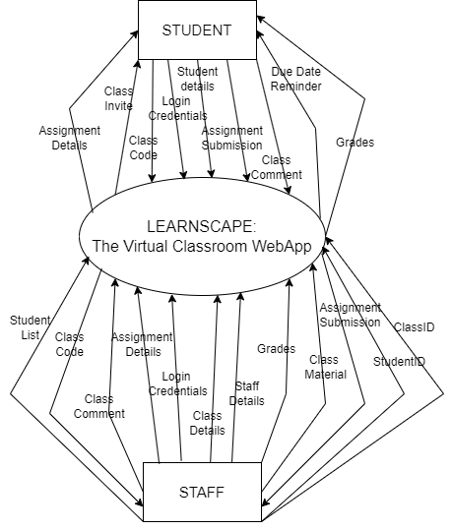
DESIGN AND ANALYSIS: DFD Level 0

Slide 7
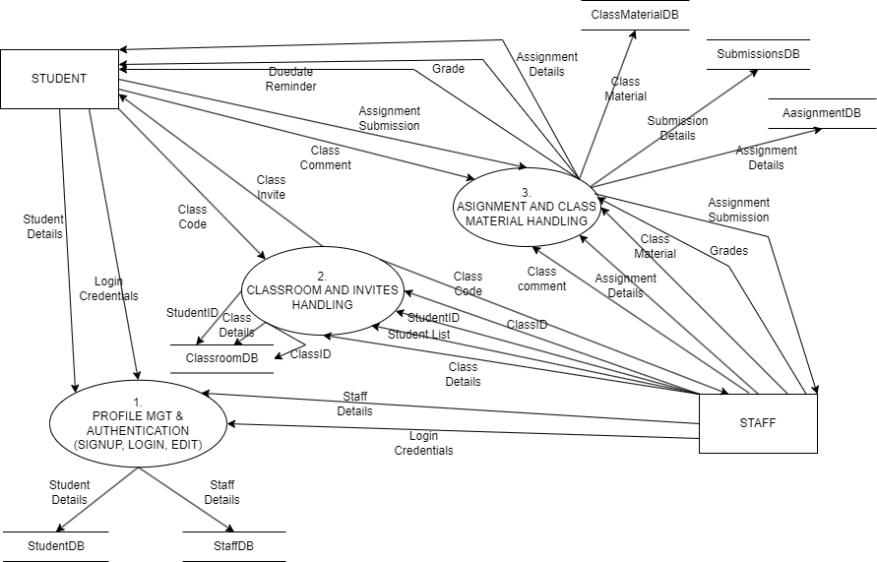
DESIGN AND ANALYSIS: DFD Level 1

Slide 8
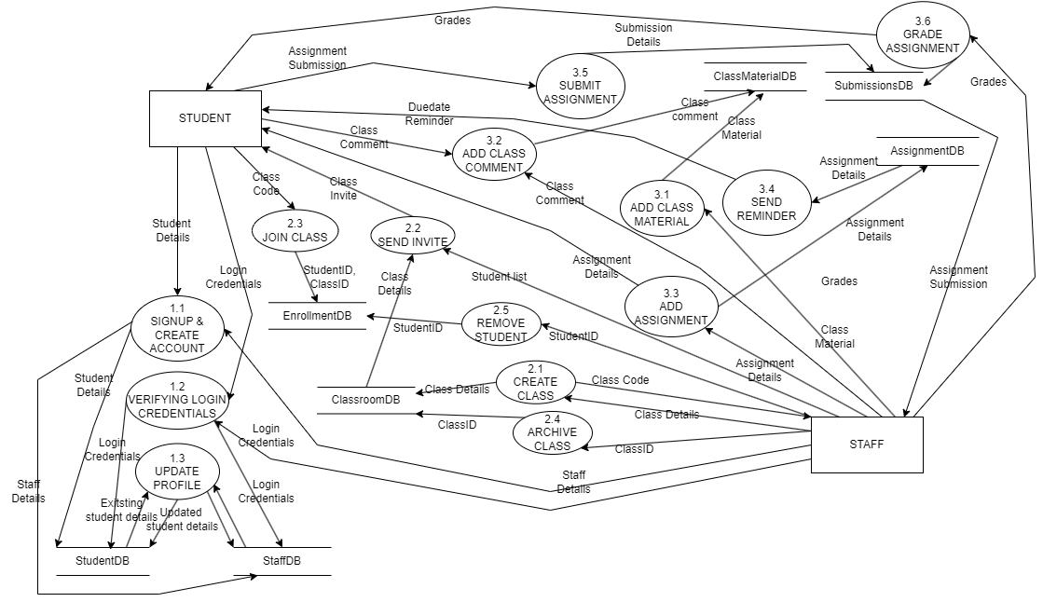
DESIGN AND ANALYSIS: DFD Level 2

Slide 9
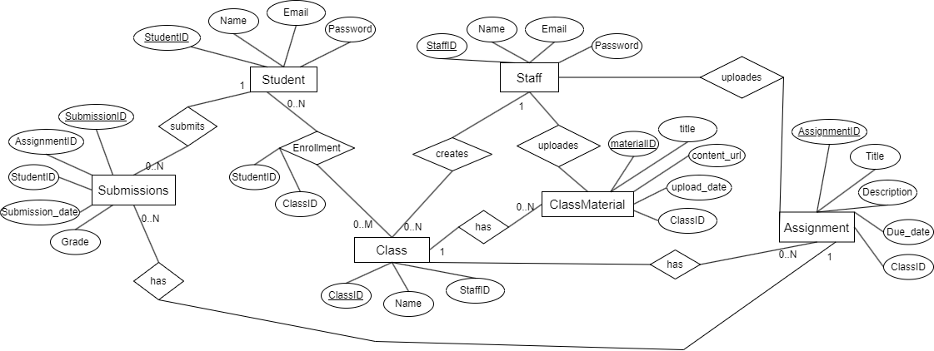
DESIGN AND ANALYSIS: Entity Relationship Diagram

Slide 10
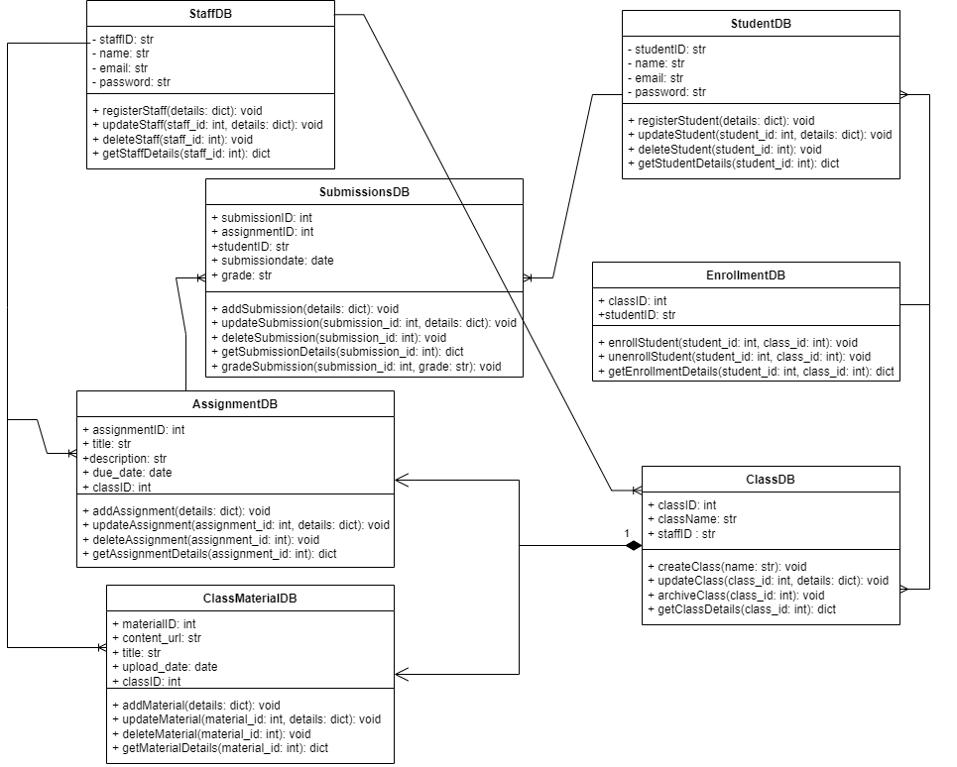
DESIGN AND ANALYSIS: Class Diagram

Slide 11
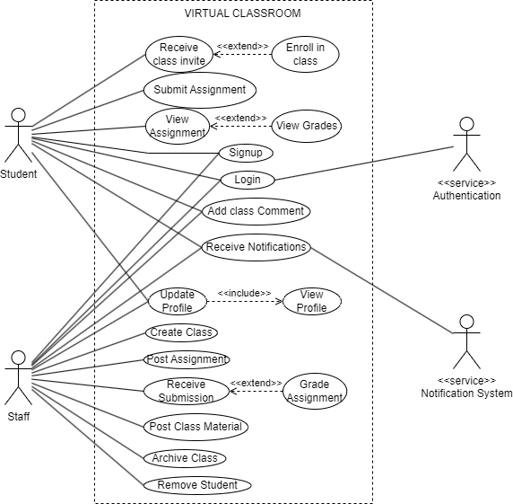
DESIGN AND ANALYSIS: Use Case Diagram

Slide 12
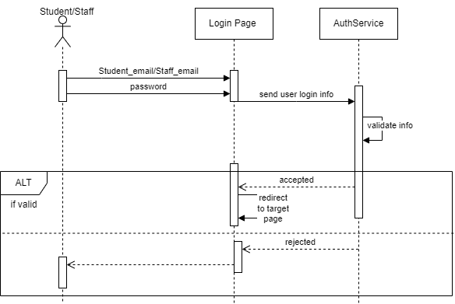
DESIGN AND ANALYSIS: Sequence Diagram
LOGIN PROCESS (for both Student & Staff)

Slide 13
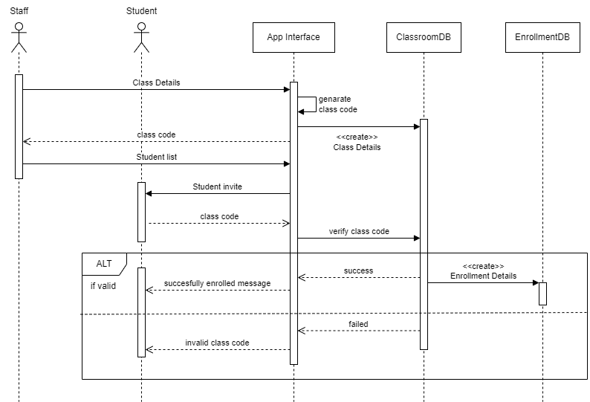
DESIGN AND ANALYSIS: Sequence Diagram
CLASS CREATION & ENROLLMENT PROCESS

Slide 14
DESIGN AND ANALYSIS
Detailed Process List:
1. Authentication and Authorization
1. User Signup
2. User Login/Logout
2. Student Enrollment and Management
1. Enroll in Class
2. View Enrolled Classes
3. Classroom and Course Management (by Staff)
1. Create Class
2. Update Class Details
3. Archive Class
4. Send Student Invite
4. Content and Material Management
1. Upload Class Materials
2. View Class Materials
3. Delete Class Materials
5. Assignment Management
Create Assignment
Update Assignment
View Assignment
6. Assignment Submission and Grading
Submit Assignment
Grade Assignment
View Grades
7. Notifications and Alerts
Send Notifications as reminders, grade updates, etc.
8. Profile Management
View Profile
Update Profile
Change Password
9. Discussion Forum
Post class comment
View class comment

Slide 15
DESIGN AND ANALYSIS: Pseudocode
1) enroll_in_class(student_id, class_id):
Step 1: Check if class exists
class_details = ClassroomDB.get_class_details(class_id)
if class_details is None: return "Class not found“
Step 2: Check if student is already enrolled
enrollment_status = EnrollmentDB.check_enrollment(student_id, class_id)
if enrollment_status is True: return "Already enrolled in this class"
Step 3: Record enrollment
enrollment_date = current_date()
success = EnrollmentDB.save_enrollment(student_id, class_id, enrollment_date)
if success: return "Enrollment successful"
else: return "Enrollment failed, please try again"

Slide 16
DESIGN AND ANALYSIS: Pseudocode
2) create_assignment(staff_id, class_id, title, description, due_date):
Step 1: Verify staff authorization
authorized_classes = ClassroomDB.get_classes_by_staff(staff_id)
if class_id not in authorized_classes: return "Unauthorized: You are not assigned to this class"
Step 2: Verify class exists
class_exists = ClassroomDB.check_class_exists(class_id)
if class_exists is False: return "Class does not exist"
Step 3: Save assignment details
assignment_details = { "class_id": class_id, "title": title, "description": description, "due_date": due_date }
assignment_id = AssignmentDB.save_assignment(assignment_details)
if assignment_id: return f"Assignment created successfully with ID {assignment_id}“
else: return "Failed to create assignment, please try again"

Slide 17
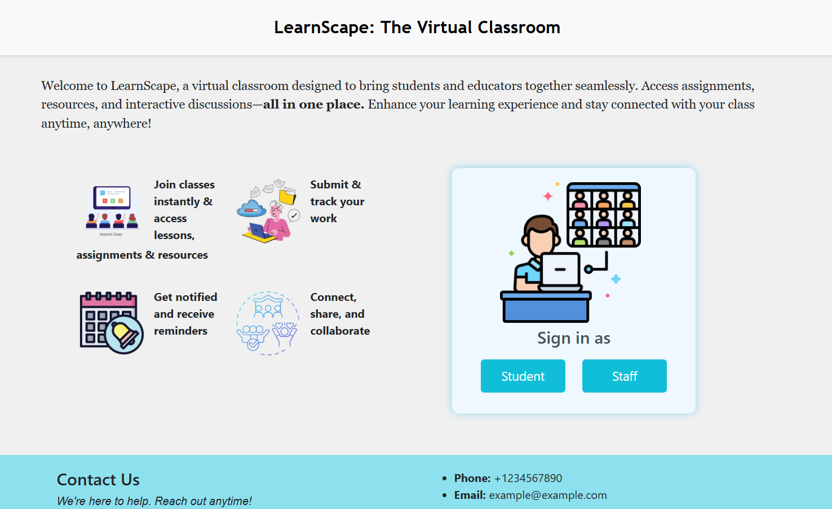
CODING (IMPLEMENTATION PHASE):
- Front end: HTML, CSS, JavaScript - Framework: Django (Python) - Back end: DB SQLite

Slide 18
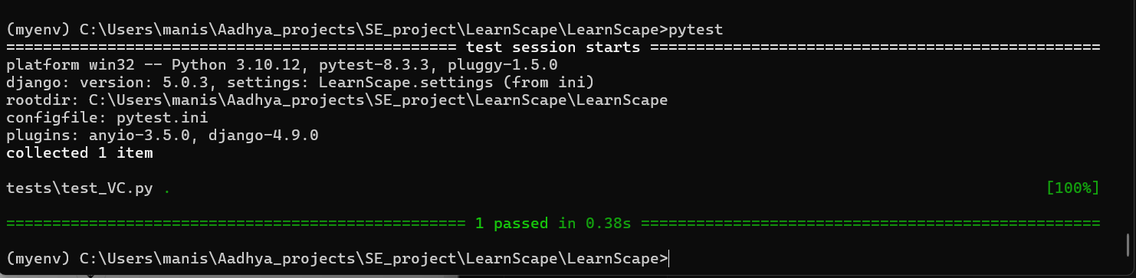
Testing
Tool used for unit testing: Pytest
Flexible to specifically test certain modules
Provides usage of “fixtures”, which are reusable components for setting up test data and environments, help create mock data for your database, reducing code repetition.
Integration and compatibility with Django projects.
Test for home page loading using pytest

Slide 19
Thankyou

