Slide 1
Image compression using pca
Linear Algebra Project (UE21MA241B)

Slide 2
Team Members
Aaditya Dev Sharma (PES2UG21CS003)
Aayush Kumar (PES2UG21CS008)
Abhishek V Sagarnal (PES2UG21CS023)

Slide 3
What is image compression ?
Image compression is the process of encoding or converting an image file in such a way that it consumes less space than the original file.
It is a type of compression technique that reduces the size of an image file without affecting or degrading its quality to a greater extent.
Image compression is an important step before we start the processing of larger images or videos.

Slide 4
HOW WE IMPLEMENTED THE PROJECT
In this project, we will use PCA to compress images in Python. We will use the scikit-learn library to perform PCA on images and compare the original and compressed images.
The code will load an image from the data folder, perform PCA with different numbers of components, and display the original and compressed images. You can change the image name and the number of components in the model.ipynb file.

Slide 5
Linear algebra concepts used
Principal Component Analysis (PCA) is a technique for dimensionality reduction that can be used to compress images.
PCA transforms the original data into a lower-dimensional space by finding the directions of maximum variance in the data.
These directions are called principal components and they capture most of the information in the data.
By keeping only a few principal components, we can reduce the size of the data while preserving most of its features.

Slide 6
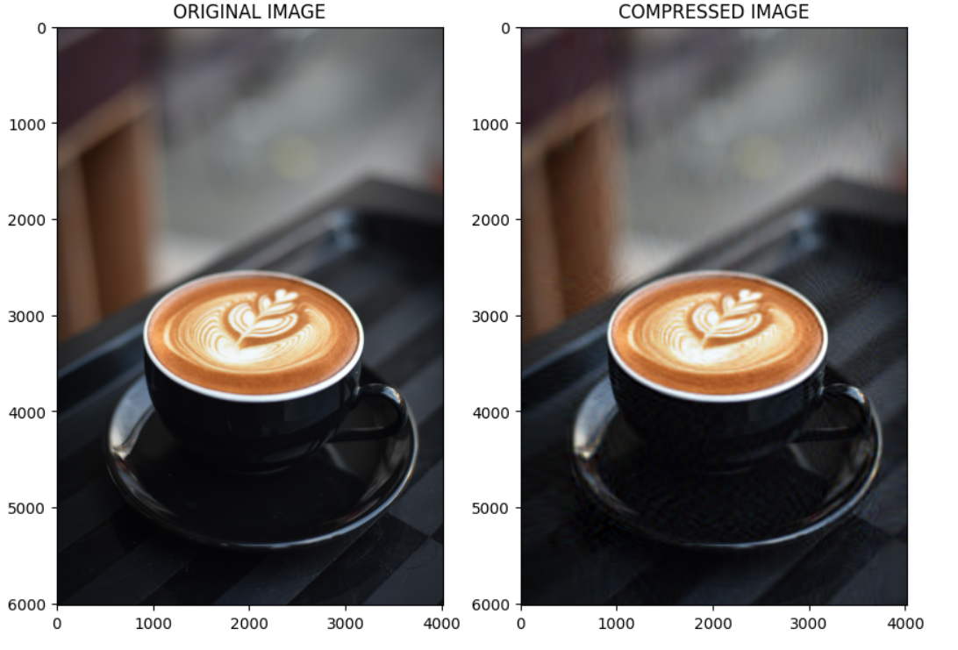
OUTPUT

Slide 7
Reference link
Github - https://github.com/Aadi1659/Image-Compression-using-PCA.git

