Slide 1
ET AI HACKATHON 2.0
AI for Industrial Knowledge Intelligence: Unified Asset & Operations Brain
Aaditya Dev Sharma
Industrial plants lose millions every year because the right information is trapped in the wrong place. We built the solution.

Slide 2
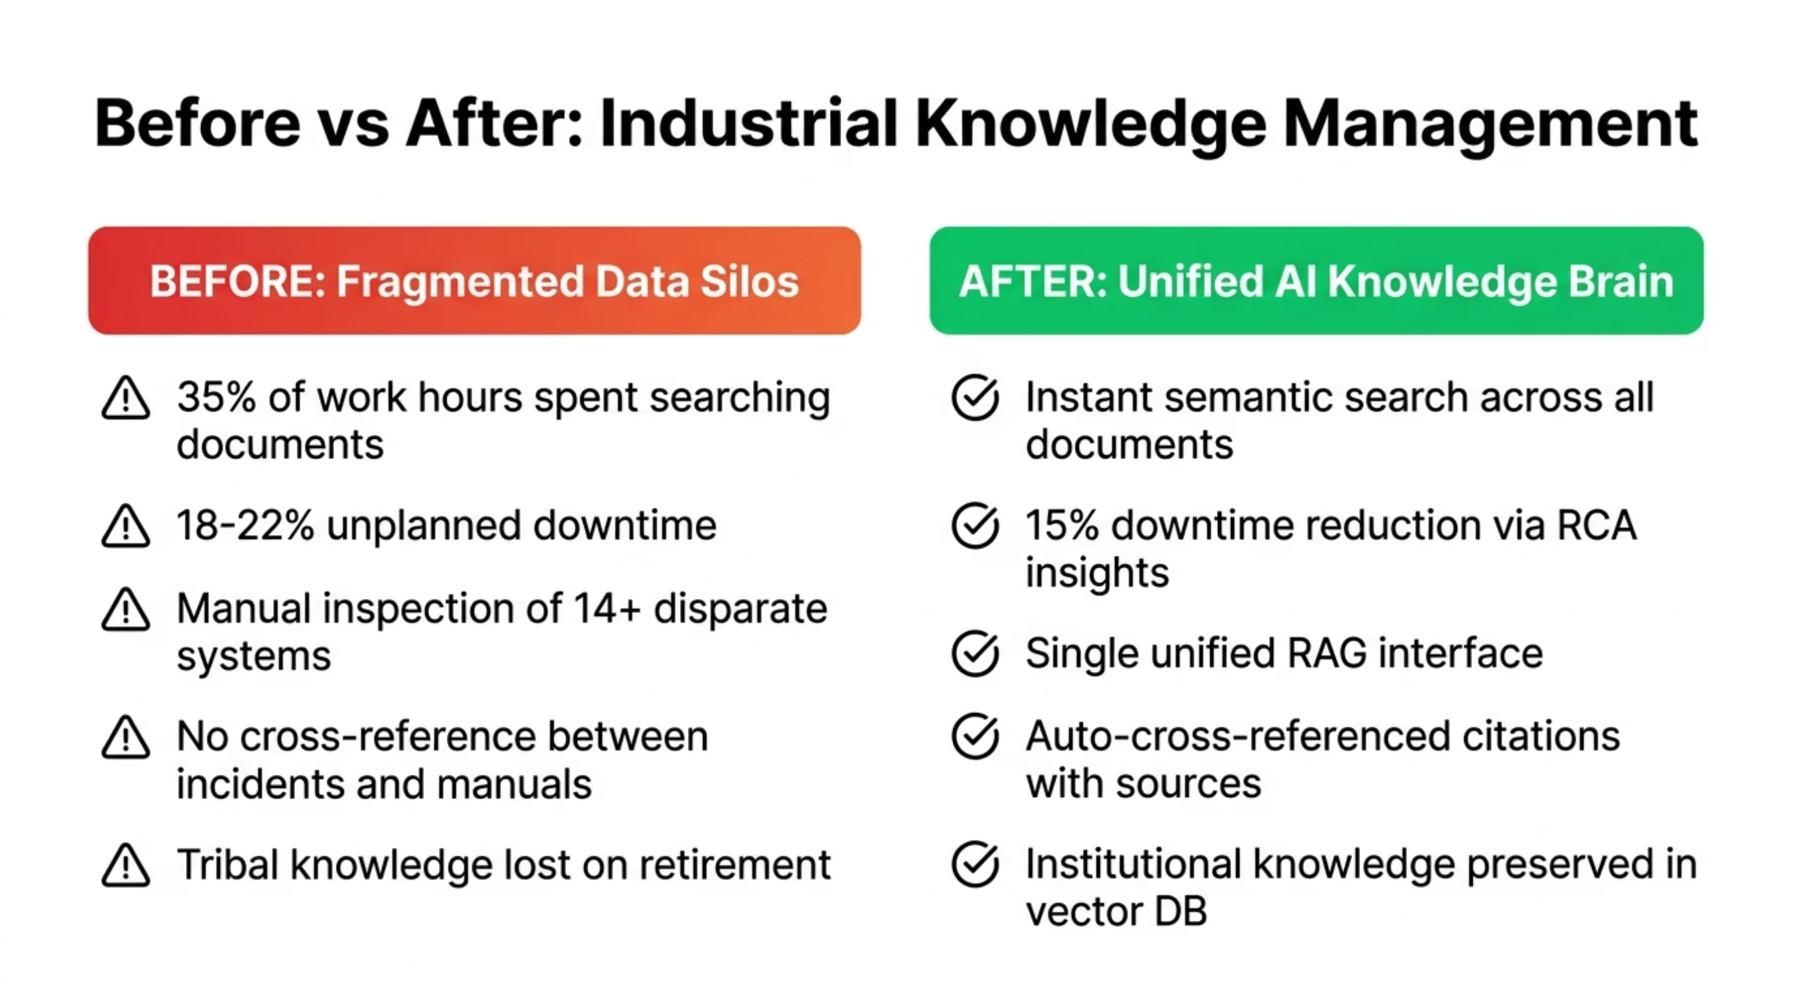
THE PROBLEM
35% of an engineer's day is wasted searching for answers

Slide 3
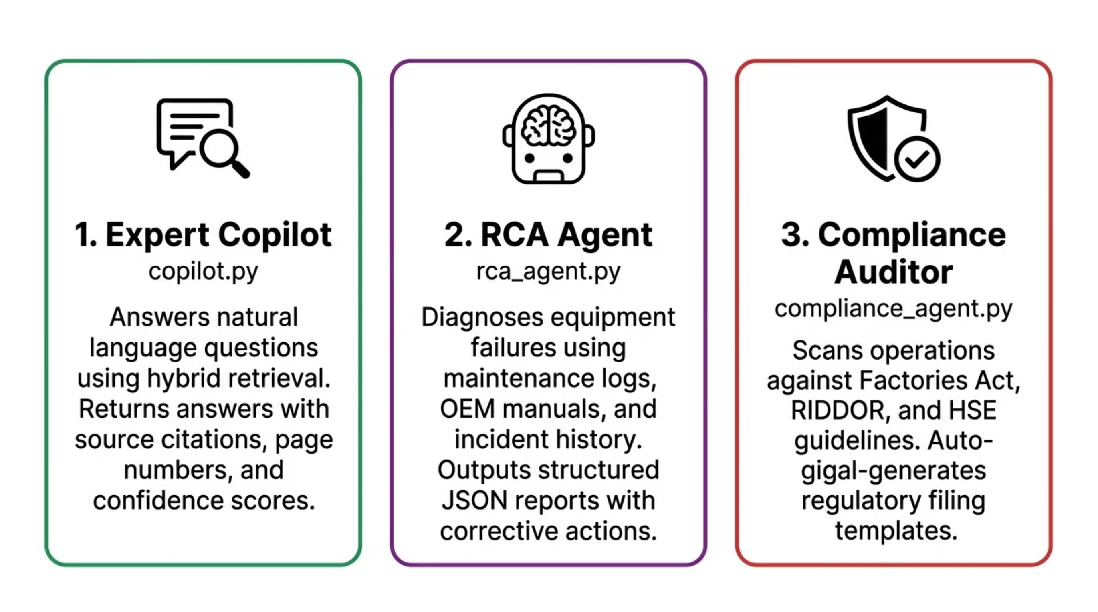
OUR SOLUTION
One Brain. Three Agents. Instant Answers.

Slide 4
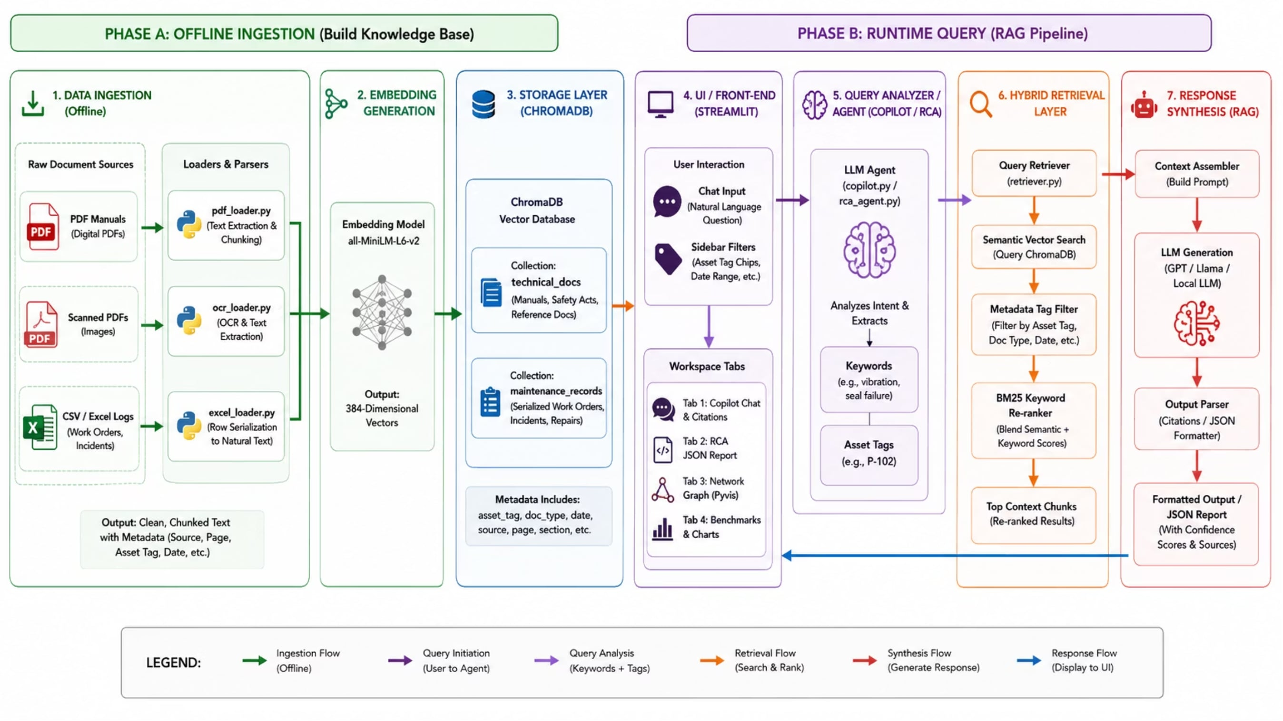
ARCHITECTURE
Two-Phase Hybrid RAG Pipeline

Slide 5
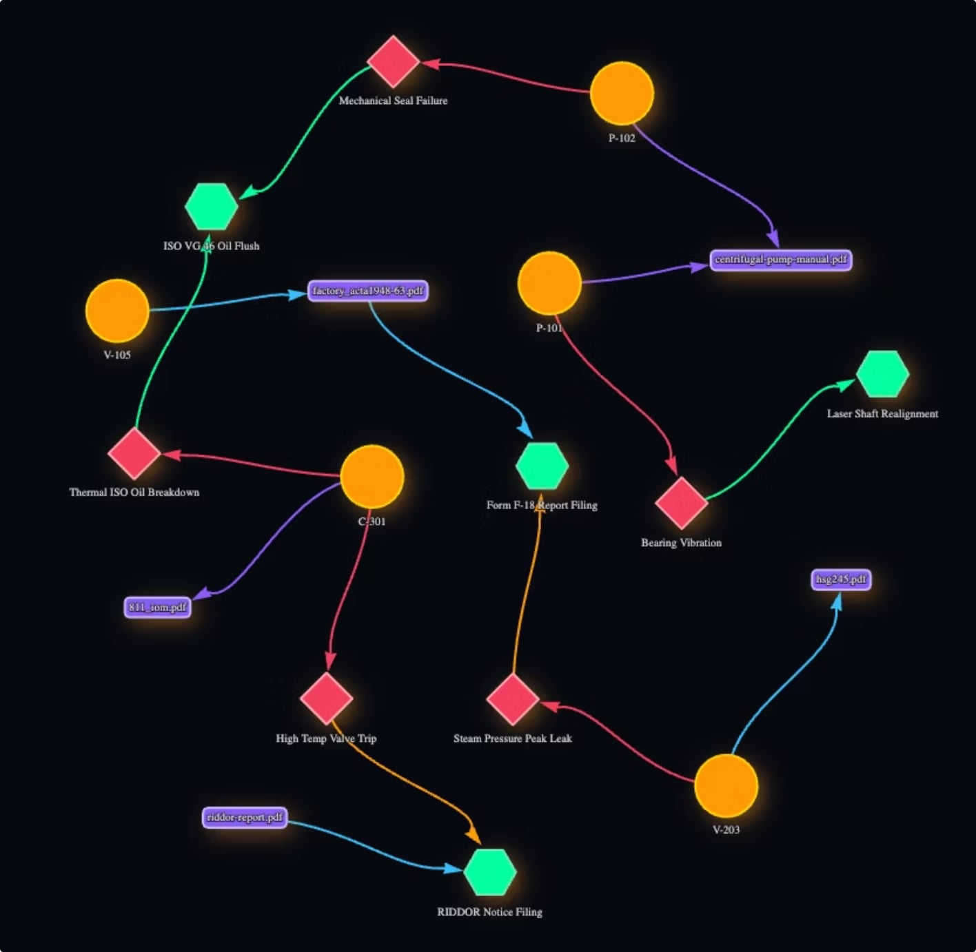
KNOWLEDGE GRAPH
A Living Map of Your Plant's Institutional Knowledge
This graph reveals hidden relationships invisible in spreadsheets — like which failure mode has recurred across three different machines in six months.
🟣 Equipment nodes linked to OEM manuals (HASMANUAL)
🔴 Equipment nodes linked to historical failure modes (HASFAILURE)
🔵 Failure modes cross-referenced to regulatory manuals (DOCUMENTEDIN)

Slide 6
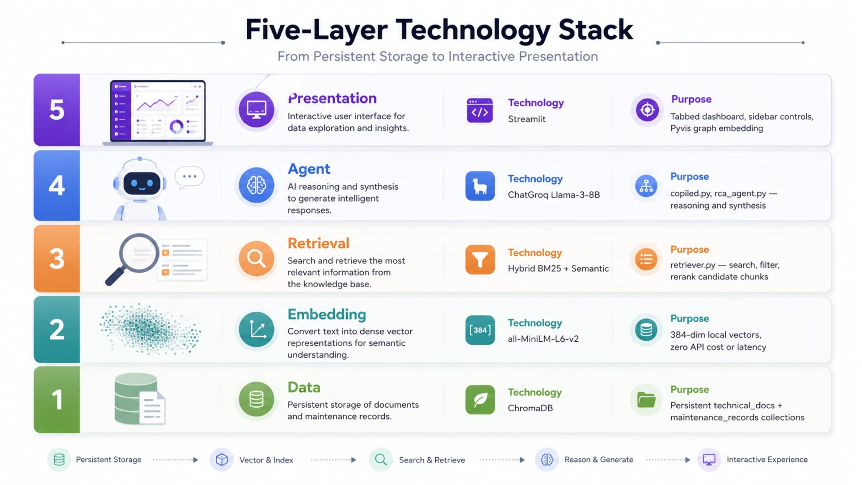
TECHNOLOGY STACK
Production-Grade Stack. Fully Local. Zero Cloud Inference Cost.

Slide 7
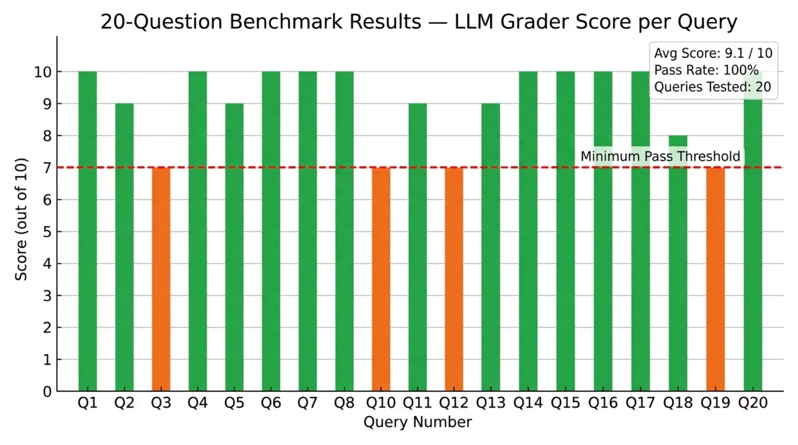
BENCHMARKS
Rigorously Evaluated Against 20 Real Engineering Queries
Every single query was answered correctly, with the exact source cited, in under 2 seconds.
9.1
100%
1.84s
100%
Avg LLM Grader Score
Pass Rate
Avg Response Latency
Citation Accuracy
Out of 10
Across all 20 queries
End-to-end inference
Page-level attribution

Slide 8
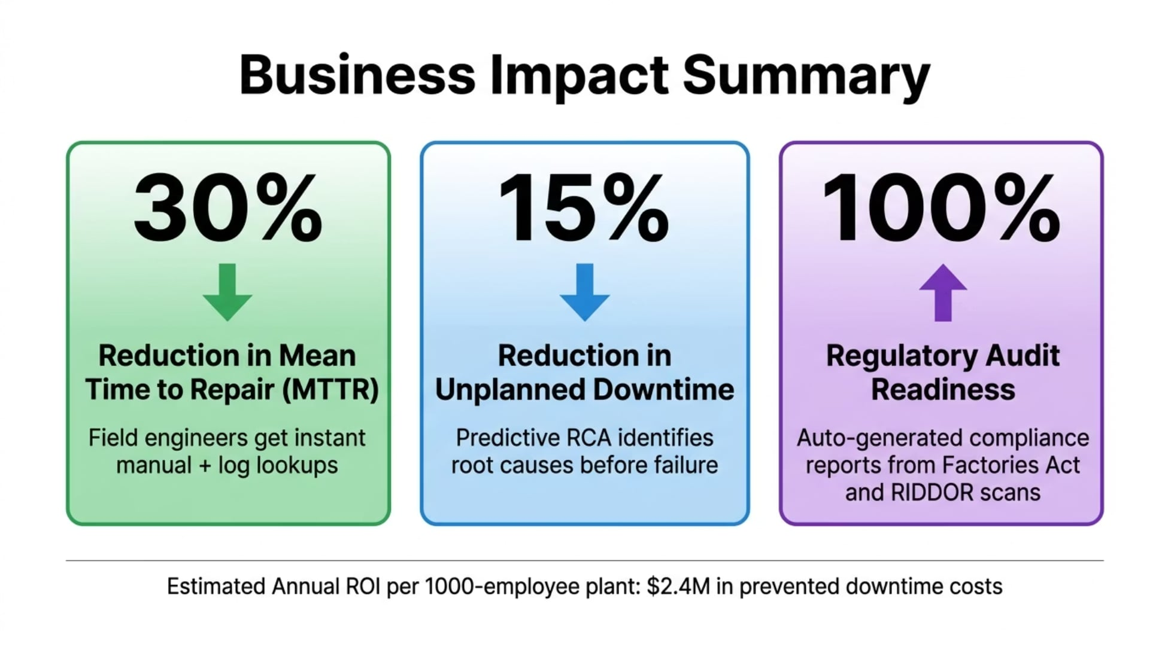
BUSINESS IMPACT
$2.4M Estimated Annual ROI per 1,000-Employee Plant
Metric
Before
After
Mean Time to Repair (MTTR)
4.2 hrs
2.9 hrs (−30%)
Document Search Time
45 min
8 min (−82%)
Audit Preparation Time
5 days
4 hours (−90%)
The 30% MTTR reduction alone recovers the platform cost in under 3 months.

Slide 9
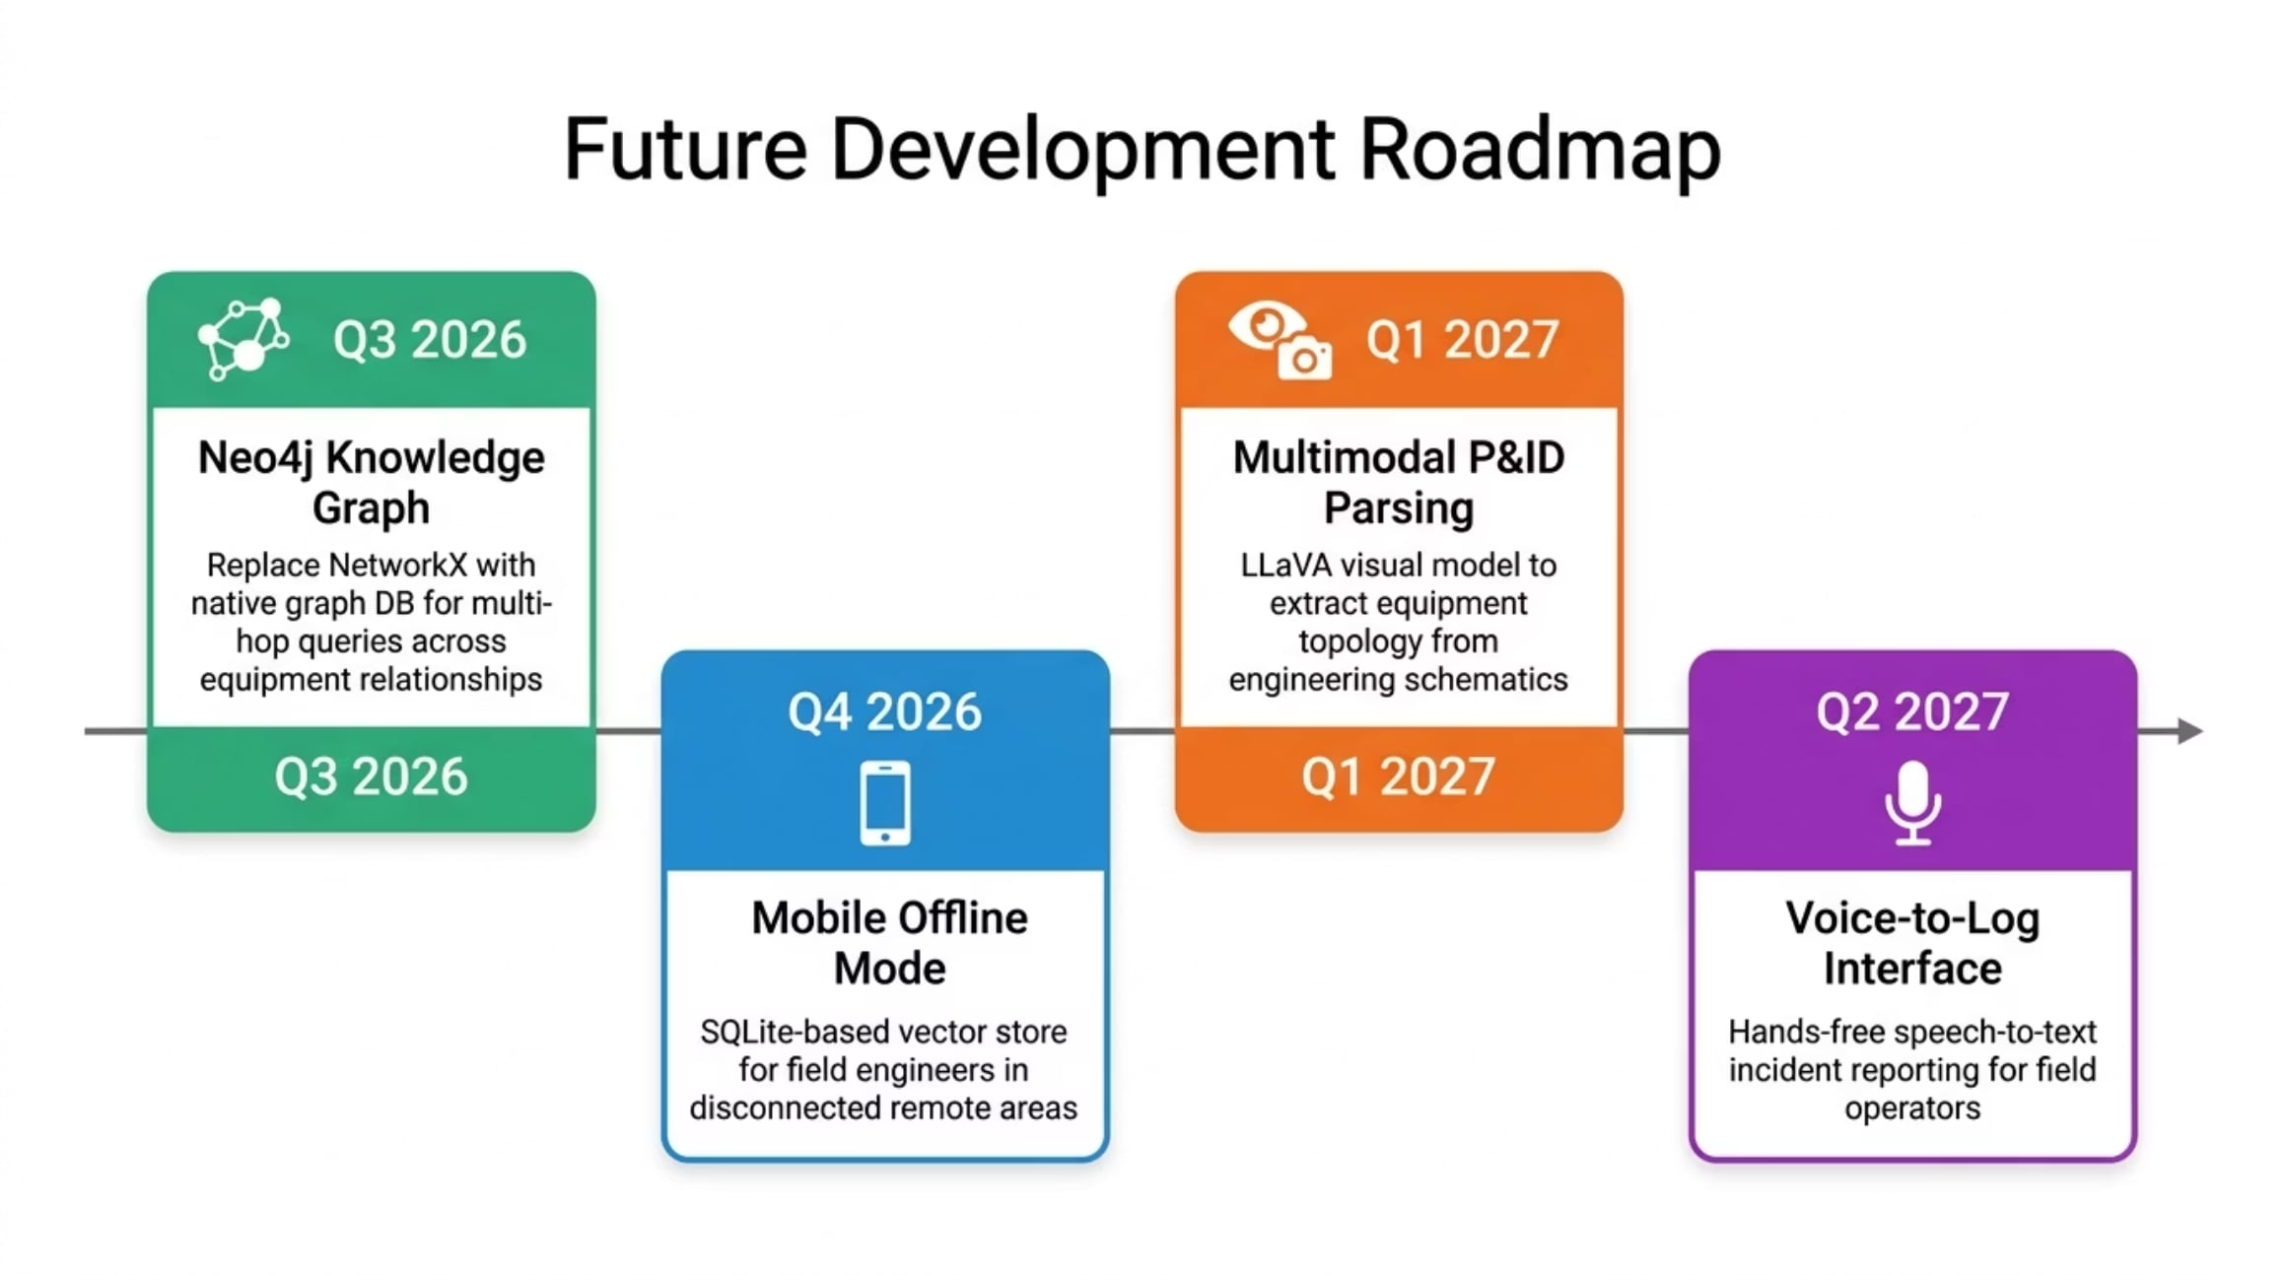
ROADMAP & CLOSE
Built in 3 Weeks. Ready to Scale.
"Every plant deserves an engineer who never sleeps, never forgets, and always cites their sources."
We have a working prototype, a validated benchmark, and a clear path to enterprise scale.
Thank you

