Slide 1
IPL 2025 Performance Insights
Teams, players and venues: what the data says
60 matches | 8 teams | 10 venues | 22 Mar to 19 May 2025

Slide 2
Executive summary
SRH 69.2%
Kohli 982
Bumrah 25
Best win rate (9 of 13), CSK 66.7%
Runs, avg 65.5, SR 162.6
Wickets, economy 6.95
185.7
60% / 30%
174.5
Bengaluru avg score, highest venue
Home win rate / toss winners win rate
Average innings score; only 3 scores of 200+
Batting depth does not guarantee wins: RCB scores the most per match but wins only 54.5%.

Slide 3
SRH and CSK lead; PBKS, DC and MI trail
SRH won 9 of 13 decided matches; CSK 8 of 12.
Bottom three (PBKS, DC, MI) each won under 40%.
Win % uses the 50 matches with a valid recorded winner.

Slide 4
Scoring does not equal winning
RCB has the highest average score (182.6) but also concedes the most (180.6).
PBKS has a positive run margin (+1.4) yet the lowest win rate.
SRH wins 69% with a margin near zero: close wins may be hard to repeat.

Slide 5
Kohli stands out: 1.6x the next batter
982 runs in 15 innings, average 65.5.
Most Man of the Match awards (4).
Buttler has the best average among top runs scorers (74.6 in 8 innings).

Slide 6
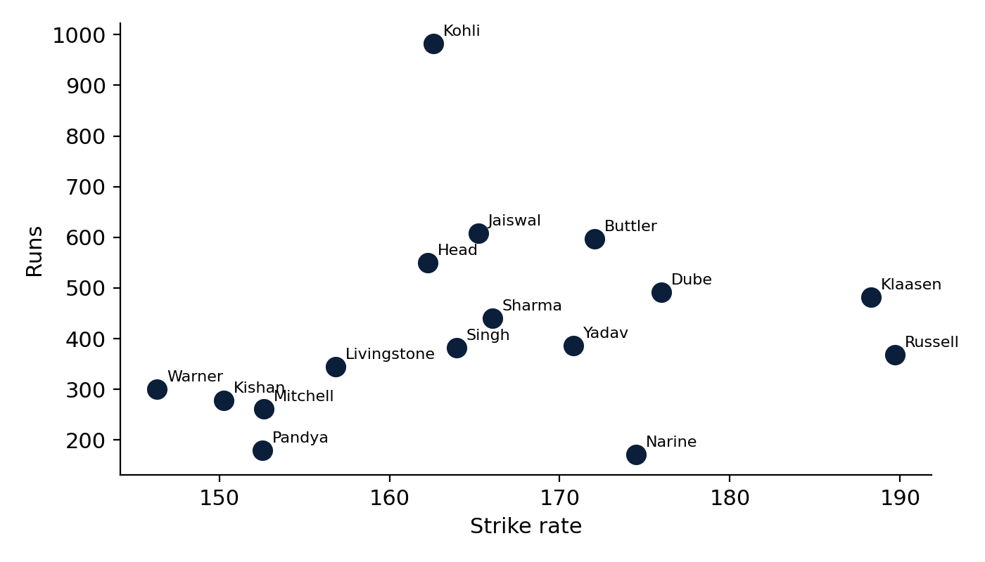
Finishers: Russell and Klaasen hit hardest
189.7
Andre Russell strike rate
188.3
Heinrich Klaasen strike rate
25.7%
Players with 5+ innings. Wicketkeepers have the highest role strike rate (171).
Share of runs from sixes

Slide 7
Bumrah leads wickets; Kuldeep is the tightest
Bumrah: 25 wickets, economy 6.95.
Kuldeep Yadav: best economy (4.60) over 20 overs.
Varun Chakravarthy: best bowling average (7.5).
Russell takes wickets but is costly (economy 9.00).

Slide 8
Bengaluru is the batter's ground; Jaipur the lowest
Spread of 20 runs between the highest and lowest venue.
Delhi and Mohali were won by the batting-first side in only 2 of 5 and 2 of 7 decided matches.
Venue samples are small (5 to 8 matches).

Slide 9
Toss is not decisive; home side won 60%
30% (15 of 50)
60% (30 of 50)
Toss winners who won the match
Matches won by the home side (also bats first)
Winning the toss gave no edge this season.
Home advantage and batting first overlap in the data (Team1 is both), so they cannot be separated.
Plan around ground conditions rather than the toss.

Slide 10
Data quality issues to fix
10 of 60 matches list a winner who did not play (e.g. M047, M048, M051); excluded from win analysis.
Dashboard average strike rate is 106.7 because bowling-only rows count as 0. Correct value: 166.0.
Dashboard Economy KPI sums the column (613.4). Correct value: 7.08 runs per over.
Player rows cover about 3 players per match (178 wickets vs 799 team-level), so leaderboards are a sample.

Slide 11
Recommendations
RCB
MI, DC, PBKS
Invest in bowling; batting is already the best
Review death-over bowling and match-up planning
Selection
Dashboard
Back high-SR finishers and economical spinners
Use weighted SR and economy; validate the winner field
Set targets by venue: about 185 at Bengaluru, about 165 at Jaipur.

