Slide 1


Identity Ownership Management
Inventarous •Blockchain

Slide 2
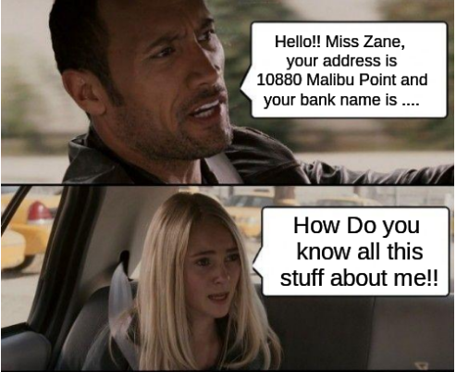


IDENTITY THEFTS AND THREATS!

Slide 3


TERRORIST
CAN MISUSE YOUR
IDENTITY
YOU NEVER KNOW !!!

Slide 4
IDENTITY THEFT STATS. 6.64 percent of consumers became victims of identity That equals 16.7 million victims

Slide 5
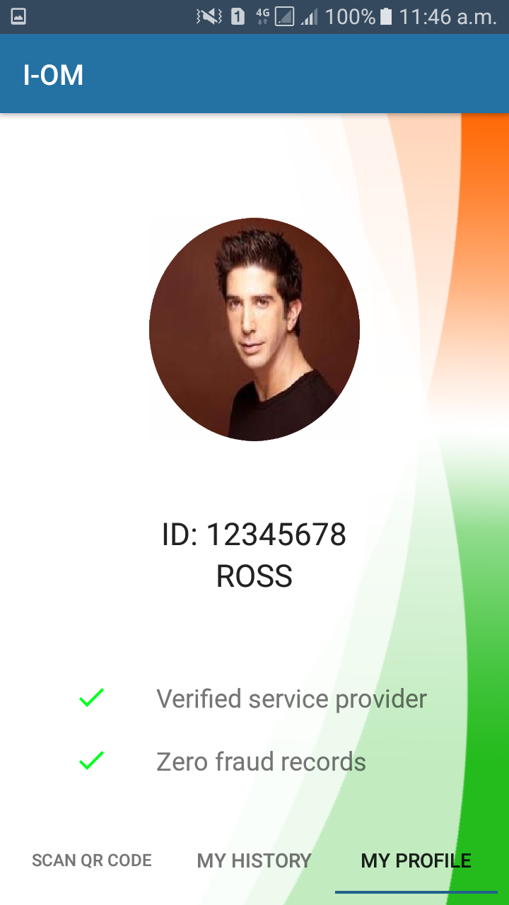
HERE COMES OUR PRODUCT!!
I-OM

Slide 6

MANAGE
YOUR
IDENTITY
#_#
NO MORE THREATS, NO MORE SPAMS

Slide 7
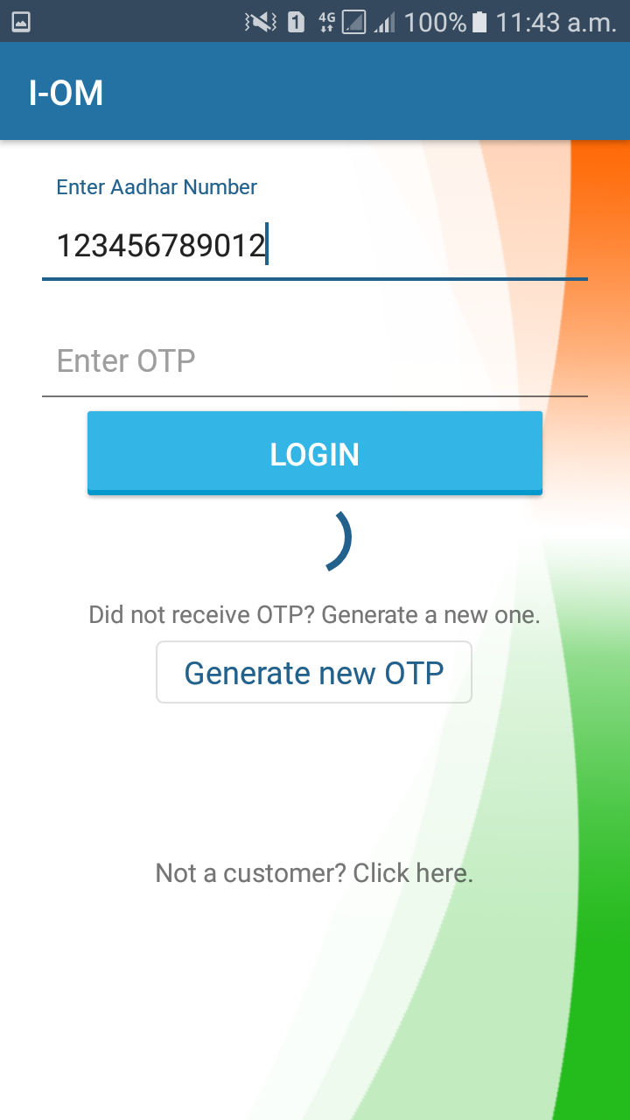
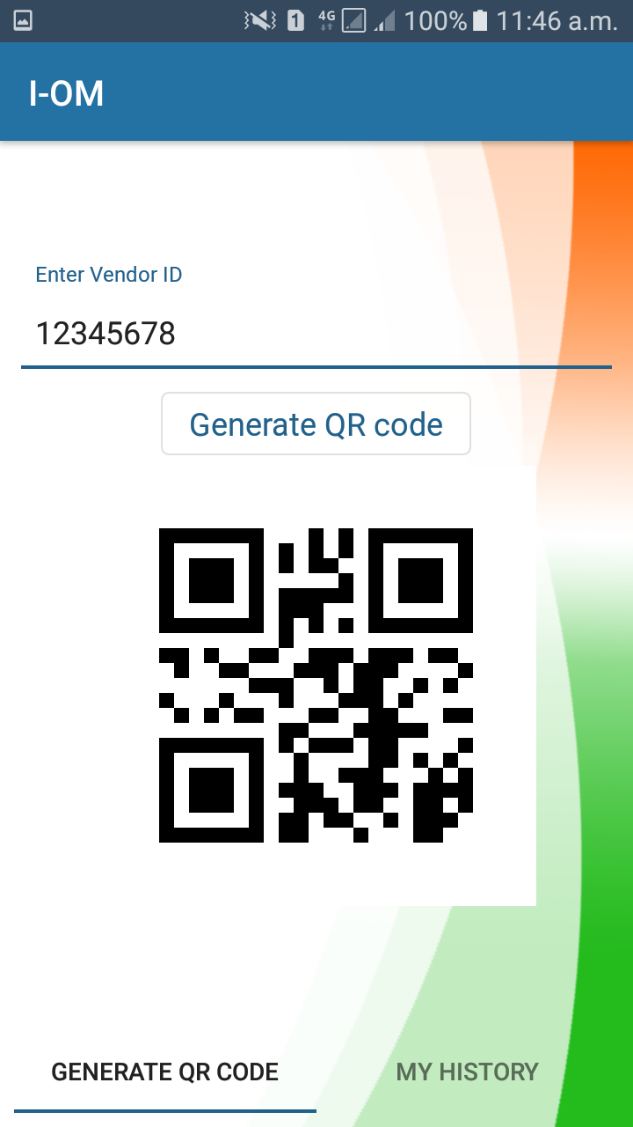
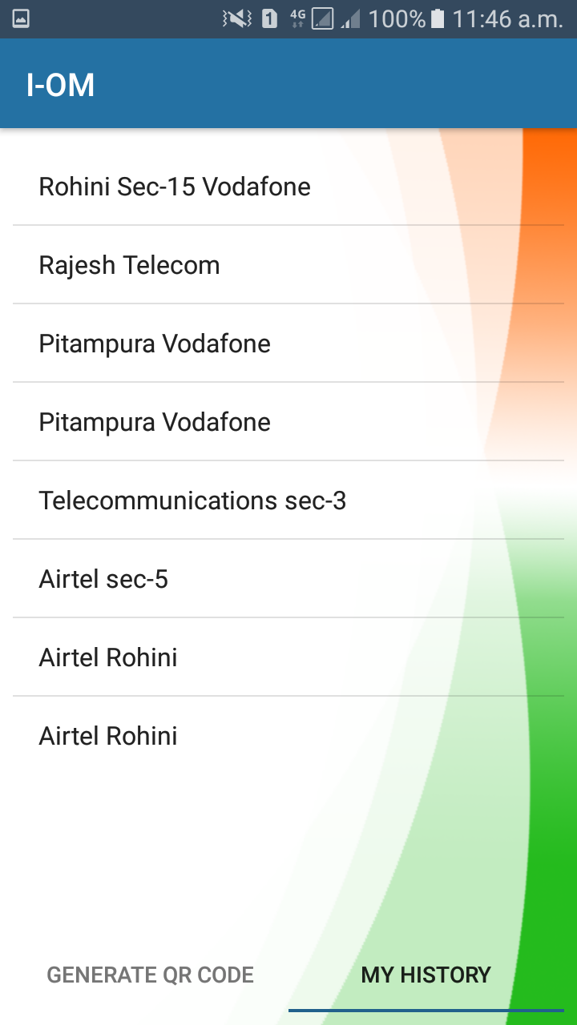
IDENTITY IS SECURED USING BLOCKCHAIN !!
(IT KEEPS ALL THE TRACKS)

Slide 8
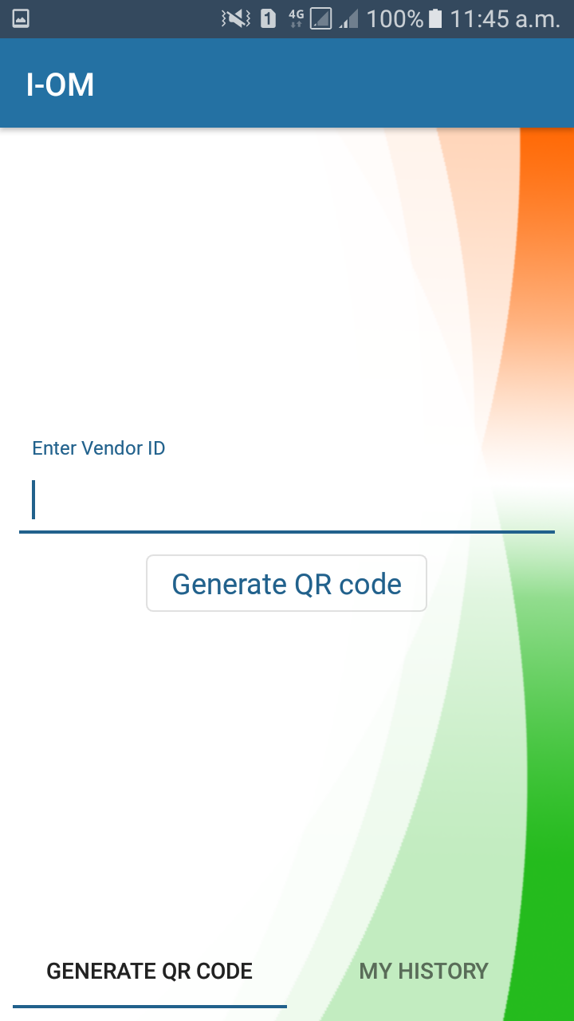

SAFE
SECURED
AND
EASY TO USE !!

Slide 9
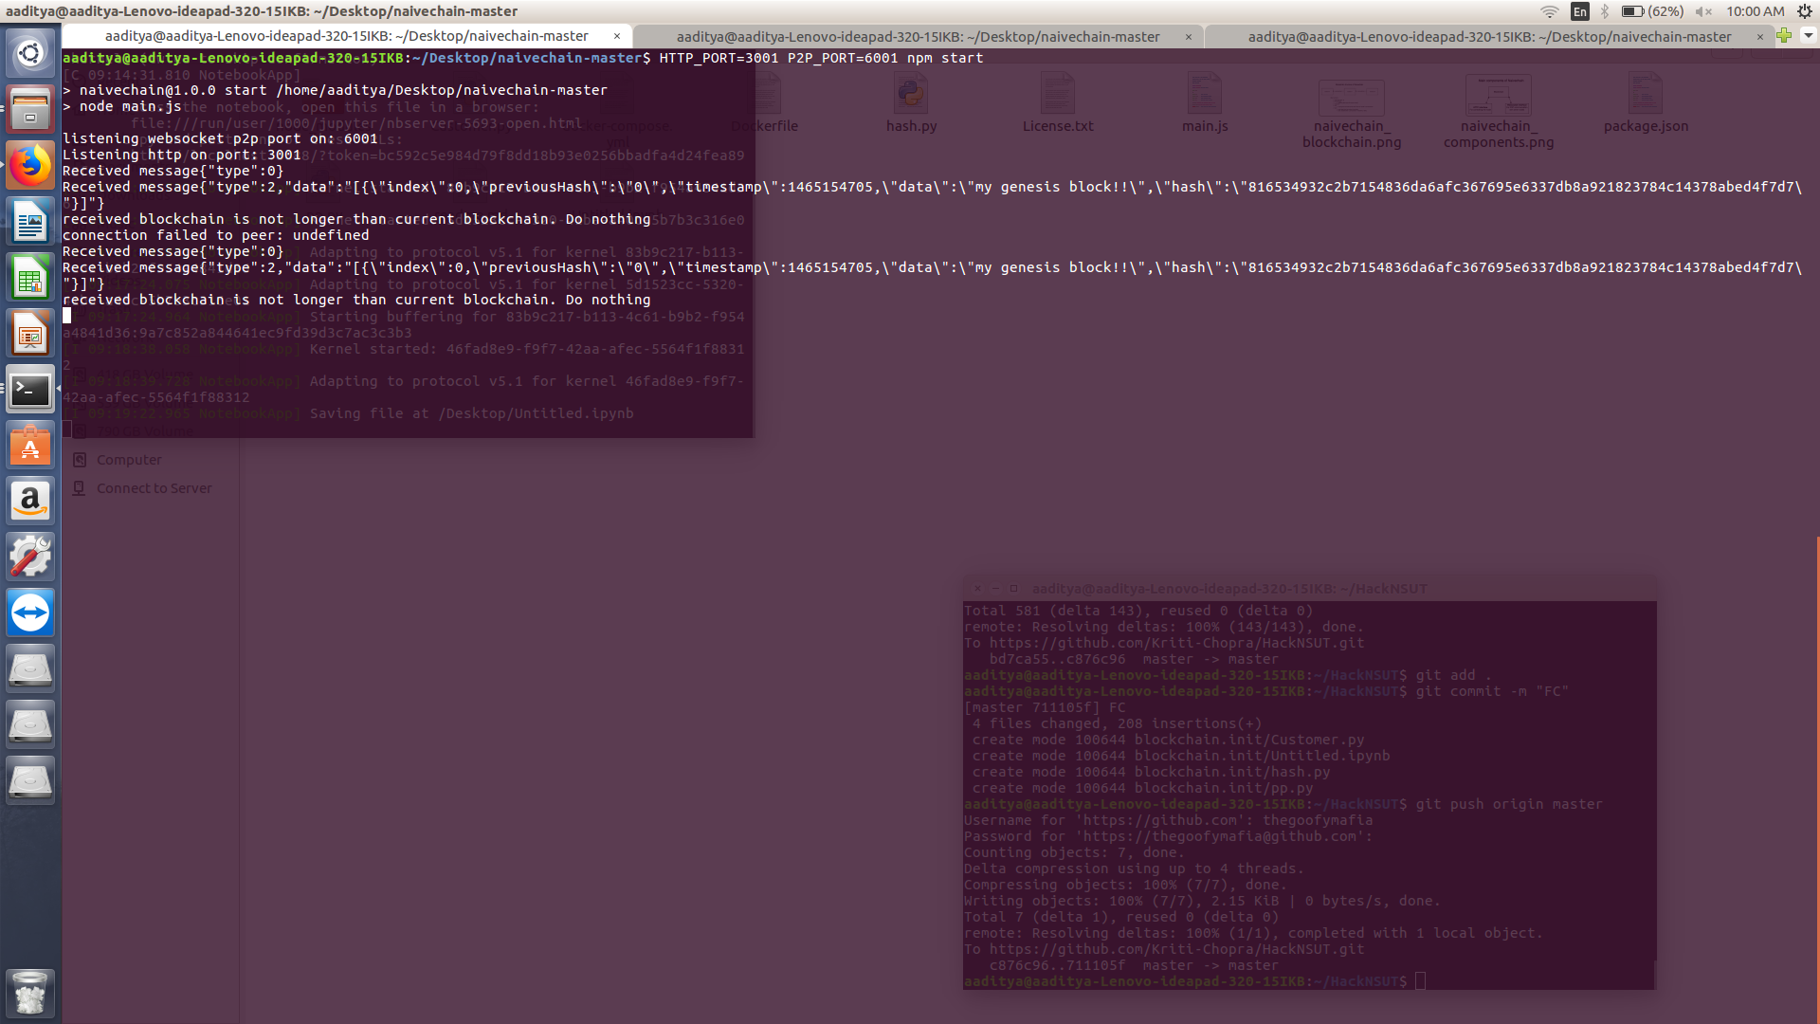

Slide 10
