Slide 1

SAMSUNG PRISM
Generative AI
Hackathon
3rd Edition 2026 – 27
Theme ID - 2
Team Name –Brutal Bruteforcers
College Name -MSRIT
Member Name & Email 1- Aadi Yathaarth Kulshrestha & 1ms24cs001@msrit.edu
Member Name & Email 2- Aditya Hegde & 1ms24cs010@msrit.edu
Member Name & Email 3- Chinmay Panghri & 1ms24cs054@msrit.edu
Submission Github link - https://github.com/Aadi546/prism_project.git

Slide 2
Theme
Theme 2: Smart Guided Troubleshooting Engine
What customers actually type (from the kit)
What the engine sends back
Follow these steps to perform this Touchscreen Troubleshooting
“My Galaxy S22 screen inputs are delayed and the touch responsiveness is laggy.”
auto
Enable Touch Sensitivity
bixby://masked/act/14eb42b895
“My Galaxy phone's screen is completely cracked, it's a total crack and I can't use the device.”
manual
Check the Charger
no link, you do it by hand
“My Galaxy S24 Ultra screen is completely black and won't turn on, even though the phone powers on.”
critical
Restart in Safe Mode
only if the rest didn't help
The job: turn a vague complaint into an ordered plan where every Settings step opens in one tap. Today an agent spends about 15 minutes per ticket reading articles and typing steps. The brief asks for under 300 ms on issues we've seen before and under 8 s for new ones.
Notes:
Start with the three complaints, they're straight from input.txt. Point out none of them say which setting is wrong. Right side is a trimmed version of our real output for the first one.

Slide 3
Existing Solutions & Gaps
How it's done today
What we found missing
1
Agent reads the SIIS article
long help pages, half of it is background
Where | Gap
Brief | validationDeeplink is in the schema but nothing says how to fill it, so no one checks the fix worked
Brief | “Return empty if no viable fix” is never defined, and a search always returns something
Brief | Assumes one problem per message. Kit query 17 has three
Brief | A wrong plan in the cache gets served to every paraphrase
Brief | Factory reset is only “ordered last”. No backup first, no gate
Starter code | Titles cut to 3 words: “Some things to”, “Blank or black”
Starter code | Factory reset marked auto, “Charge the device” linked to Connected devices
Starter code | Rule compliance 5%, 0% cache hits on real paraphrases
2
Picks and orders the steps by hand
different agents give different answers
3
Customer digs through menus
Settings > Display > Navigation bar, on their own
~15 min
per ticket, per the brief
Notes:
Left is the current manual process. Right: the first five are holes in the brief itself, the last three are what we saw when we actually ran the starter engine on the 20 kit queries.

Slide 4
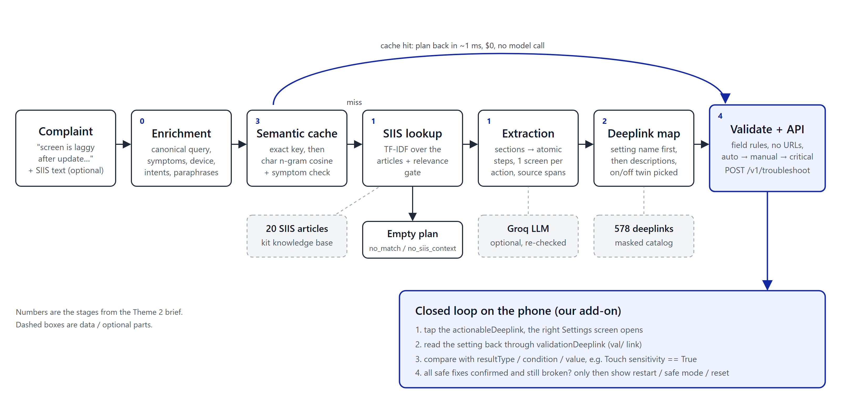
Our Solutions & Architecture Diagram
Stages 0-4 follow the brief. The cache sits in front, so stages 1-2 only run on a miss. The closed loop at the bottom is the part we added.
Notes:
Walk left to right. Mention the two exits that return early: cache hit (about 1 ms) and empty plan when no article fits. Then the bottom box, which is our innovation, more on slide 8.

Slide 5
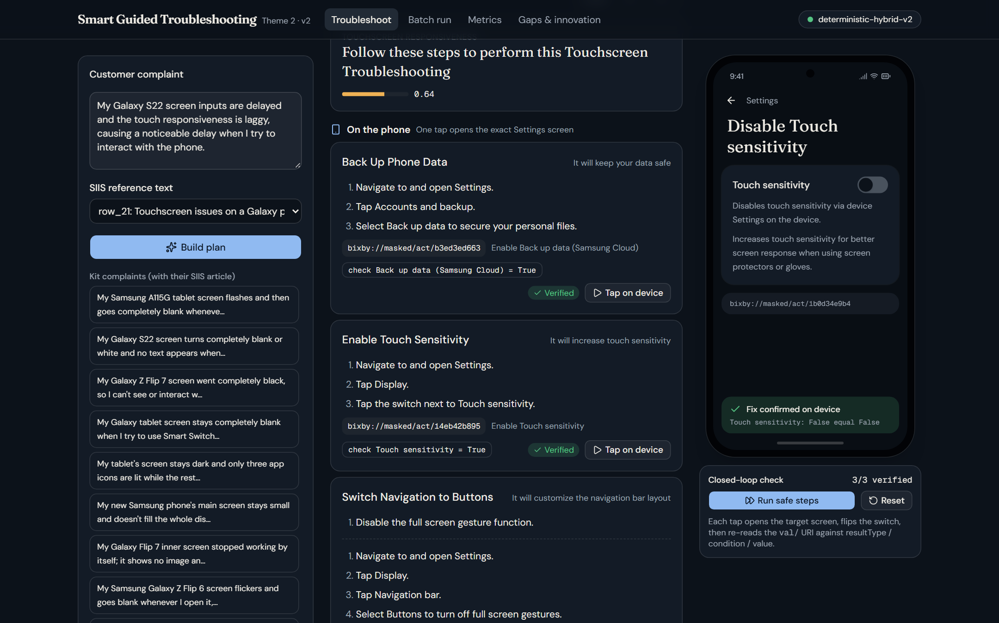
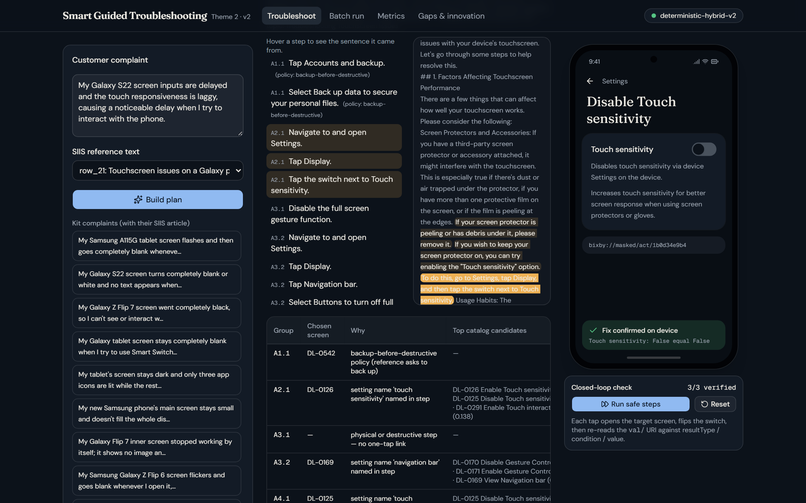
Demo & Product Walkthrough
Trace tab: hover a step, the source sentence lights up
1
Pick a kit complaint (or type one)
2
Plan comes back in tiers: phone, by hand, last resort
3
Run safe steps: the phone opens each screen and reads the setting back
Touchscreen complaint with its SIIS article: cold run, 7/8 toggles confirmed across the kit. Pages: Troubleshoot, Batch run, Metrics, Gaps.
4
Trace and JSON tabs show where every step came from
Notes:
Live demo order: touchscreen complaint -> Run safe steps -> show the phone flipping Touch sensitivity -> unlock last resort -> Trace tab hover -> Batch run for all 20.

Slide 6
Tools and tech stack used
Engine
Retrieval
LLM (optional)
Console
Testing
Python 3.13
FastAPI + Uvicorn
Pydantic (kit schema.py)
scikit-learn TF-IDF
word + char n-grams
NumPy / SciPy
Groq Cloud
llama-3.3-70b-versatile
OpenAI-compatible client
Next.js 16 + React 19
Tailwind 4 + shadcn
lucide icons
pytest (18 tests)
own Appendix C scorer
gold labels, 60 paraphrases
used for
REST API, validators, simulator
used for
SIIS lookup, deeplink map, cache
used for
drafts get re-checked, falls back offline
used for
plan, trace, phone simulator
used for
before/after numbers
Runs with no API key at all. Default path is deterministic and costs $0 per query; set GROQ_API_KEY to switch on the LLM path.
Notes:
Keep it quick. The main point: no paid model needed to hit the targets, Groq is there for article layouts we haven't seen.

Slide 7
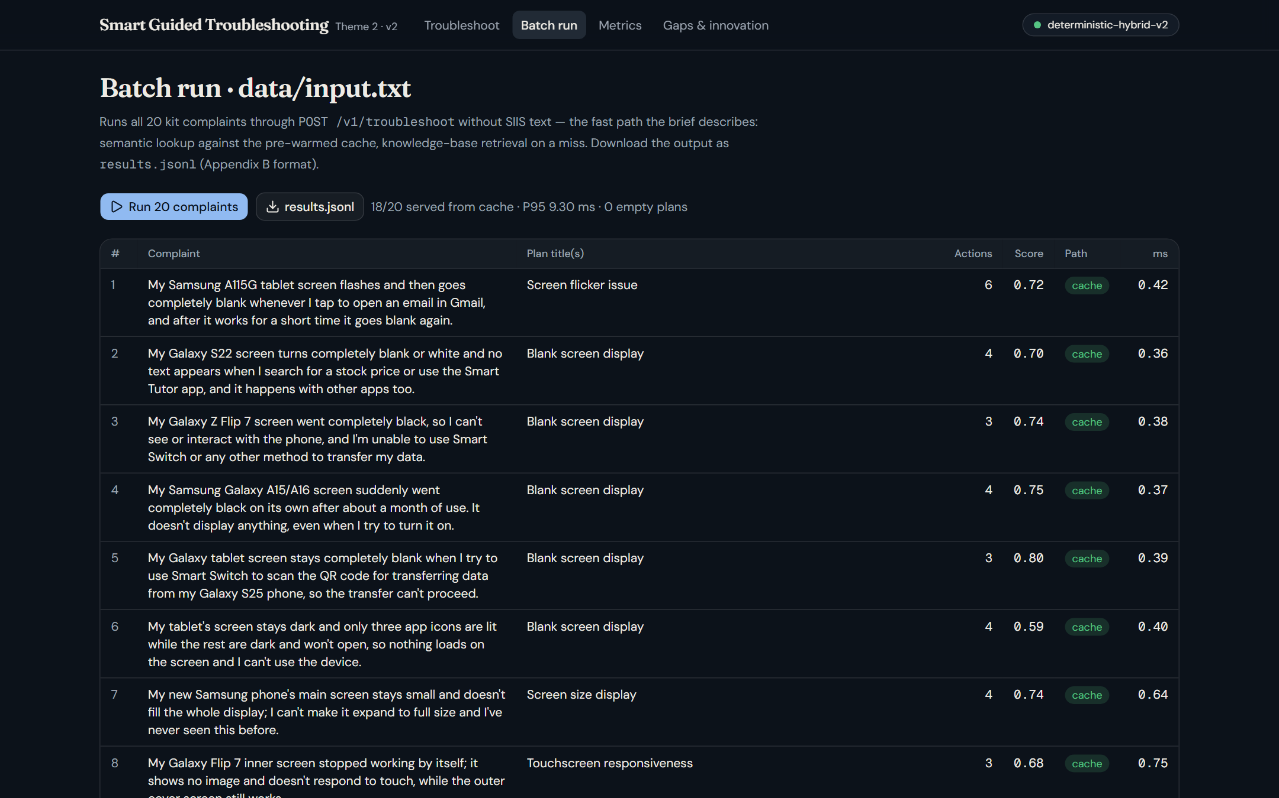
Impact & Use case
31 ms
P95 for a brand-new complaint
vs ~15 min manual, target 8 s
4 ms
P95 when a paraphrase hits the cache
$0, no model call
90%
of 60 unseen paraphrases served from cache
was 0% before
A typical ticket
1
“S22 touch is laggy and inputs are delayed”
2
Plan: enable Touch sensitivity, switch nav to buttons, check charger
3
Phone confirms each setting really changed
4
Only if it's still laggy: restart, safe mode, then reset (backup first)
Batch run: all 20 kit complaints in one go
Notes:
Who benefits: call-centre agents (no manual triage), customers (one tap instead of menu hunting), and service centres (fewer resets and walk-ins for things a toggle fixes).

Slide 8
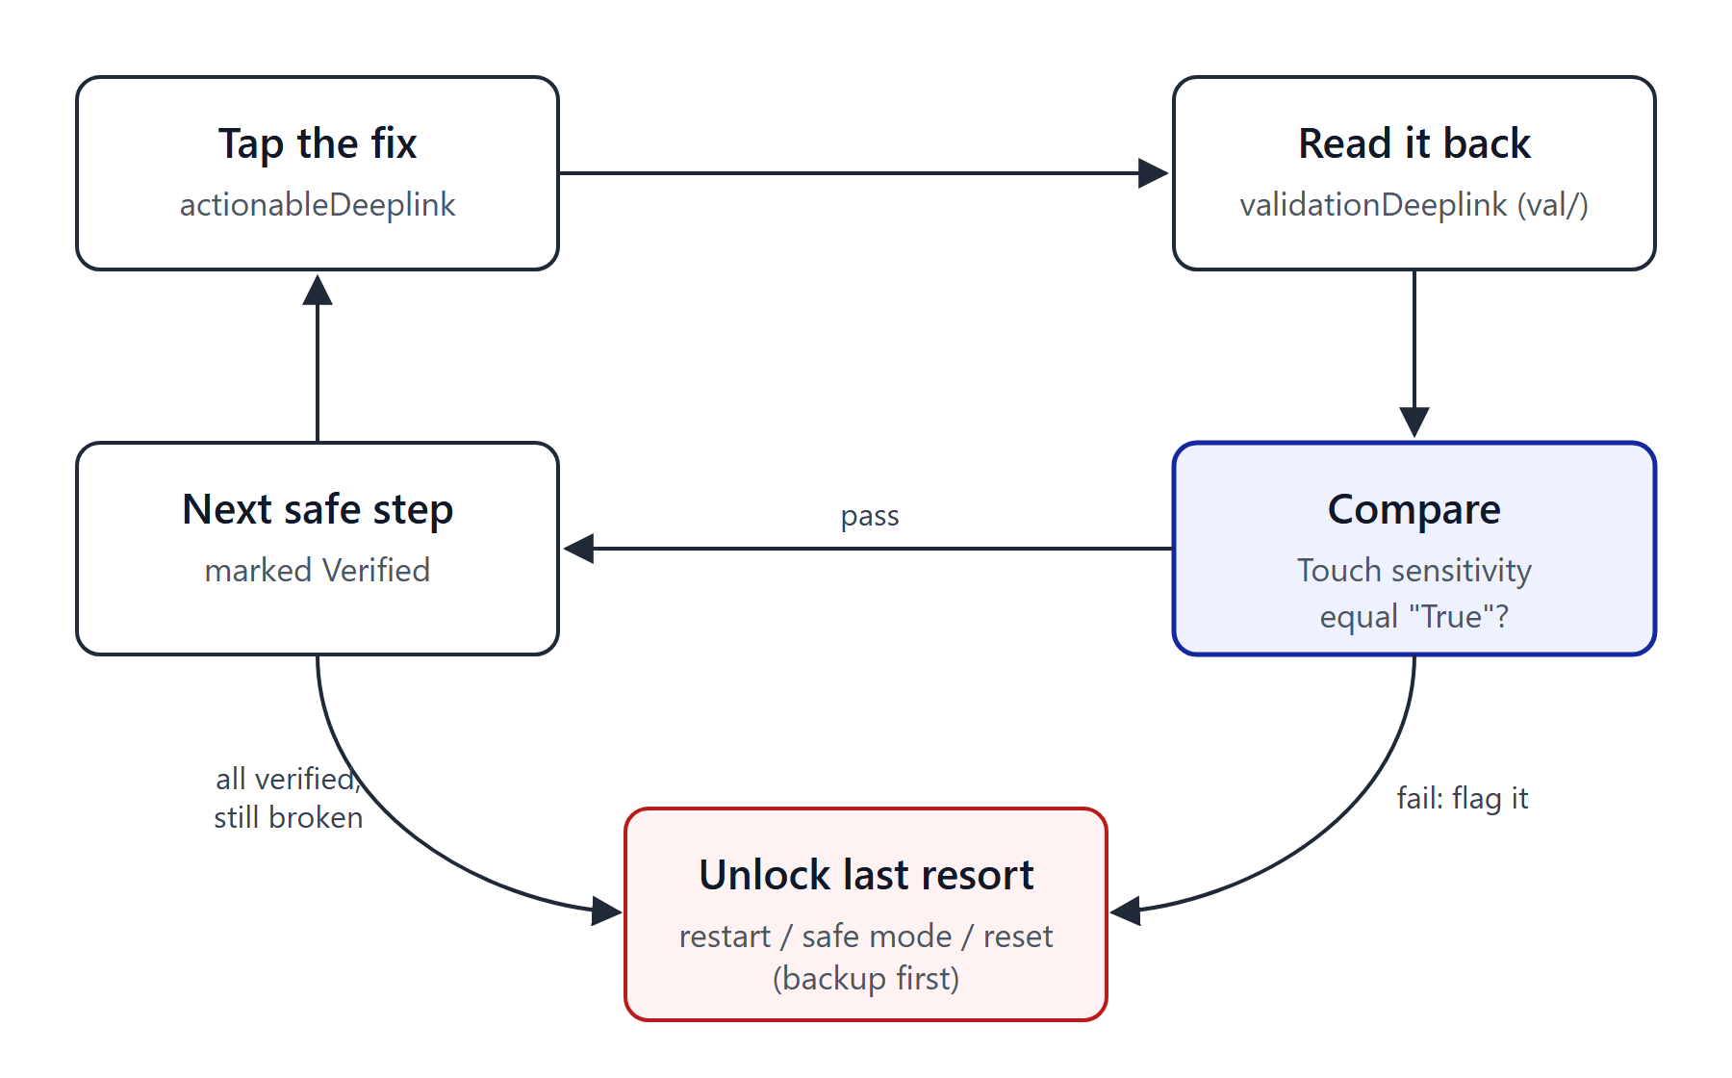
Innovation highlights, results and limitations
Before (starter code) vs after, same scorer
Innovation: check the fix actually worked
We fill validationDeeplink from the catalog: onURL means expect True, offURL means False, updateURL means the number went up or down.
On the kit: 7/8 simulated toggles confirmed. Restart / reset stay locked until the safe fixes are done.
Also: step-to-sentence trace, relevance gate, one plan per problem.
Step accuracy 2.74 → 2.99 (of 3). URL leaks 0, catalog-valid links 100% in both.
Limitations
Some kit queries come with loosely related articles (floating circle → Multi window).
Catalog has no Safe mode, Software update or Auto rotate screens.
Offline extractor is tuned on 11 articles; the phone in the demo is simulated.
Notes:
Chart is all percentages; deeplink relevance was out of 2 so we doubled it to a percent. Be upfront on limitations, judges like that. The simulator is the honest weak spot.

Slide 9
What’s next
1
2
3
4
Real device check
Run the val/ reads through Bixby on an actual Galaxy instead of our simulator.
Learn from outcomes
Log which fix actually solved the ticket and rank plans with that.
Hindi / Hinglish
Most complaints in India mix languages. Add normalisation and multilingual embeddings.
Per-device screens
Flip cover vs inner display, tablets. We already detect the model, the catalog doesn't split yet.
Short term (next few weeks): run the Groq path on the full kit and add those numbers to metrics.md.
Notes:
Roadmap, left to right is roughly the order we'd do it in. Number 1 matters most since the loop is only simulated right now.

Slide 10
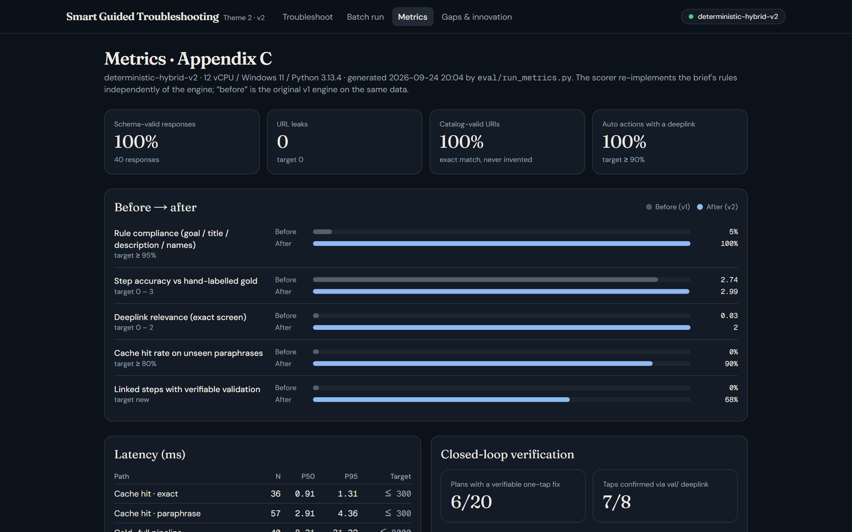
Brownie points ( differentiation)
We measured it
Our own scorer, hand-labelled gold and 60 paraphrases we wrote. We ran it on the starter code too, so the “before” numbers are real (5% → 100% rule compliance).
Fixes get checked
A deeplink only proves a screen opened. We read the setting back and only then move on.
Nothing made up
Every step points to the sentence in the SIIS text it came from. No match means an empty plan, not a guess.
Works offline
No API key needed, $0 per query. The LLM is an optional extra and its output is re-checked like everything else.
Metrics page in the console. Same numbers as metrics.md
Notes:
If time is short, just say the first two cards.

Slide 11
Checklist- Updated on Public GitHub
Working prototype code — public or shared GitHub repo (Y/N) Y
README with reproducible setup instructions (Y/N) Y
Demo video, max 5 minutes (YouTube or Drive link) link: ________
Presentation file (PPT or PDF) (Y/N) Y

Slide 12
Thank you
Organised by the Language AI Team and the PRISM Team, Samsung R&D Institute India
Notes:
Closing slide. Add the Google Form URL and a contact email before sharing. Edition 2 organising team for reference: Language AI - Sourabh Tiwari, Gaurav, Sanjeeth Pothireddy, Gorang Maniar; PRISM - Binny Lakra, Prakhar Chandrakar, Vishu Kumar; Kick-off and mentors - Giridhar Jakki, Deepraj Prabhakar Patkar (Language AI), Srimanu Prasad Nagaraju, Ashish Kumar (Tech Strategy).

