Slide 1
Hand Gesture Detection
Aditya Raj
Vikas Singh

Slide 2
Introduction
Procedure
Result
Conclusion
References
Hand Gesture Detection

Slide 3
Introduction
Hand Gesture recognition is a topic in computer science and language technology with the goal of interpreting human hand gestures via mathematical algorithms
Gesture recognition enables humans to communicate with the machine and interact naturally without any mechanical devices.
Challenge :
For image-based gesture recognition there are limitations on the equipment used and image noise.
Images may not be under consistent lighting, or in the same location.
Items in the background or distinct features of the users may make recognition more difficult.
Application :
Researchers in this field asserted to find solutions for Stroke patients who cannot move their bodies
The Hand Gesture (HG) has become an alternative to traditional input devices such as a mouse and keyboard and etc

Slide 4
Procedure
There are three main stages in Hand Gesture Recognition Process (HGRP):
Image Capture Phase (ICP).
Gesture Extraction(Feature Extraction)
Gesture Recognition(GR)
These stages are contain the below :
Designing of Algorithm.
Speed of processing.
Architecture of system

Slide 5






Hand Gesture Variation

Slide 6
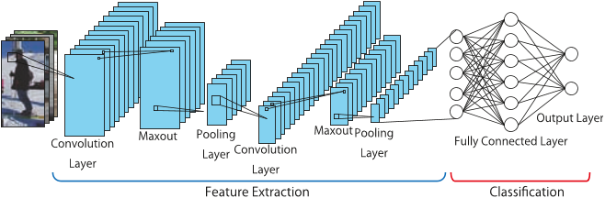
Convnet trained from scratch

Slide 7
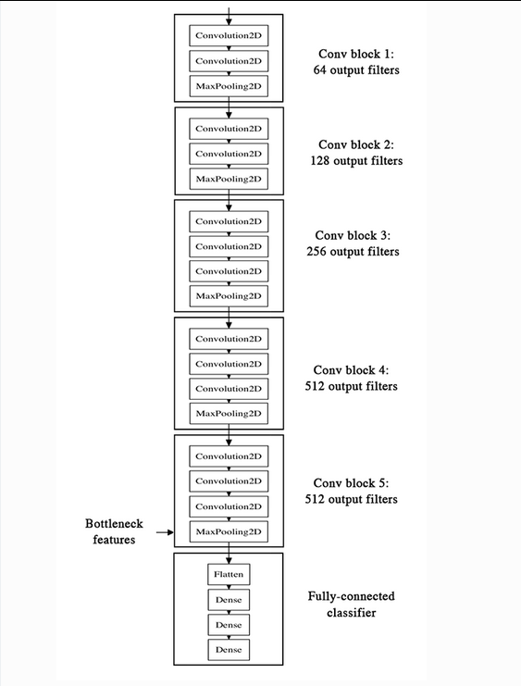
Bottleneck features

Slide 8
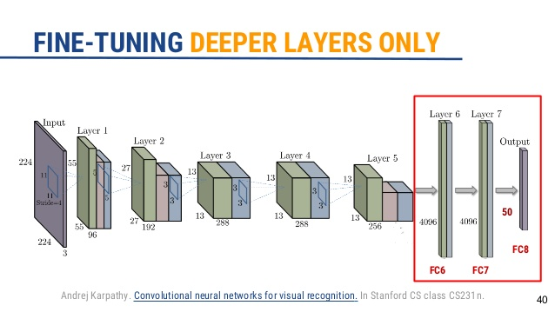
Fine-tuning

Slide 9
Result
Convnet trained from scratch accuracy
Bottleneck features accuracy
Fine tune accuracy

Slide 10
Conclusion
Hand Gesture Recognition is very bright especially for disabled patients.
This technique is natural and easy way to make a contact with a machine

Slide 11
References
1:ImageNet Classification with Deep ConvolutionalNeural NetworksAlex KrizhevskyUniversity of Torontokriz@cs.utoronto.caIlya SutskeverUniversity of Torontoilya@cs.utoronto.caGeoffrey E. Hinton
2:Hand Gestures Detection and Recognition Building System for Stroke Patients usingSupervised Neural Networks
Azmi Shawkat Abdulbaki
Computer College , University of Anbar/Iraq

