Slide 1

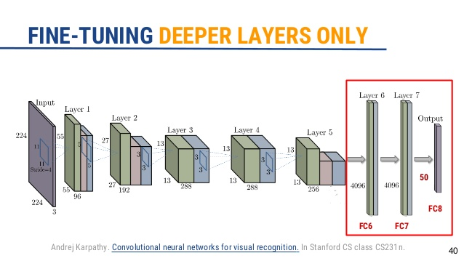
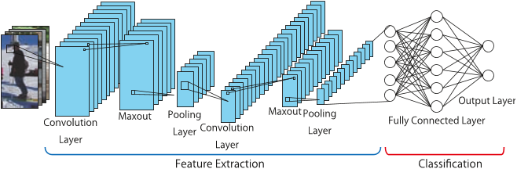
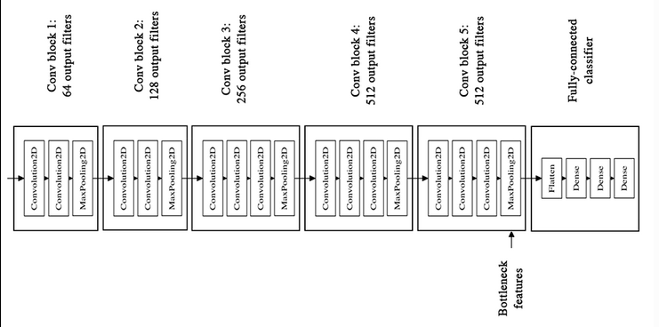
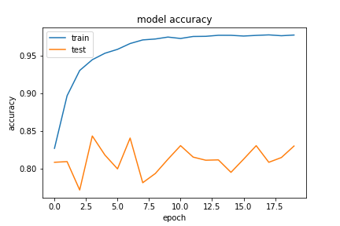



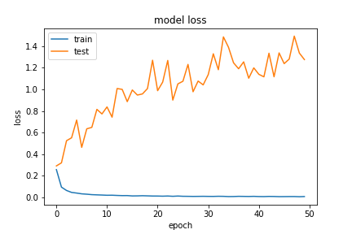
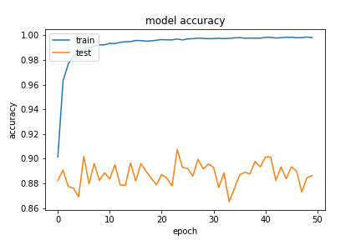
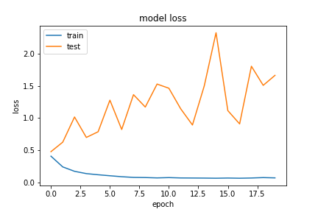
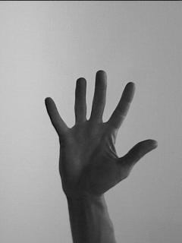


Hand Gesture Recognition
Aditya Raj -201451032
Vikas Singh-201452047
^{IIIT Vadodara}
Abstract
Abstract
Methods and Materials
Conclusions
This project is consist of various Mathematical Algorihtms used for hand gesture detection system. Hand gesture detection is boon for those patients who can not move their body due to paralysis.So basically hand gesture detection system is a human language interpretor.
We implemented various Mathematical algorithms (Convolutional neural network, Fine tune, Bottleneck feature)to make hand gesture detection system.
We will go over the following options:
training a small network from scratch (as a baseline)
using the bottleneck features of a pre-trained network
fine-tuning the top layers of a pre-trained network
Hand Gesture Recognition is very broad and difficult problem , in this project we have implement a hand gesture recognition system that recognize hand gesture of pre-defined sign with the implementation of Convolutional neural network model and computer vision.
Introduction
Future Work
Hand gesture detection can include combining hand shapes,orientation of hands to fluidly express speaker's thought.So it is basically language interpretor for person with disabilities.
This project focuses on gesture recognition and it uses computer vision and machine learning techniques to achieve this goal.
We used three mathematical algorithms to train the parameter for different gesture.
there are three step to accomplish hand gesture detection system.
1-Hand detection
2-Feature extraction
3-Recognition
we can expand on the system in the future to take image in real time and predict the instruction for that gesture in real time.
Basically we can work on making the recognition phase more autonomous and recognize the gestures in real time.
Figure 1. Convnet trained from scratch.
Figure 2.Bottleneck features
Figure 2.Fine tune
Introduction
Results
This section discusses the accuracy of hand gesture detection system that has been produced on different mathematical algorithms for the dataset.
Accuracy Of Convnet:
After training convolutional neural network we found accuracy about 83 so we decided to implement more appropriate model that could achieve more accuracy than convnet.
Accuracy of Bottleneck feature:
When we trained this model's parameters with the hand gesture image dataset and tested it with the testing dataset we found a better accuracy than previous one.This model was much appropriate than previous one with accuracy 90.
Accuracy of Fine tune :
After training this model's parameter when we tested our dataset with the trained parameter we found a much better accuracy than both of the previous case.
As this model was much accurate than previous trained model with accuracy 93.
Gesture
Figure 1. Convnet loss function
Figure 2. Convnet accuracy graph
Figure 3.Bottleneck Loss graph
Figure 4Bottleneck Accuracy Graph.
References
1:ImageNet Classification with Deep ConvolutionalNeural NetworksAlex KrizhevskyUniversity of Torontokriz@cs.utoronto.caIlya SutskeverUniversity of Torontoilya@cs.utoronto.caGeoffrey E. HintonUniversity of Torontohinton@cs.utoronto.ca
2:Hand Gestures Detection and Recognition Building System for Stroke Patients usingSupervised Neural Networks
Azmi Shawkat Abdulbaki
Computer College , University of Anbar/Iraq

