Slide 1
Agentic AI-Driven Self-Healing Cloud Infrastructure
Explainable anomaly detection, digital-twin simulation, and autonomous shift-left PR intelligence — a unified, closed-loop platform for zero-downtime cloud operations.
By – Group 8:
Raghuram Sekar (CB.SC.U4AIE24247)
Aadi Haldar (CB.SC.U4AIE24201)
Aaditya Paul(CB.SC.U4AIE24202)
Shravan Rajesh Menon(CB.SC.U4AIE24253)

Slide 2
Abstract
Modern Kubernetes-based cloud systems require mechanisms that can prevent defective code from reaching production while also detecting and remediating runtime faults with minimal human intervention. To address this challenge, we propose an end-to-end closed-loop platform that integrates shift-left pull-request intelligence, a real-time digital twin (TDTdb), explainable anomaly detection via Isolation Forest and KernelSHAP, a dual-agent consensus decision engine based on SimiFed RL and Gemini ReAct, and a SimPy-driven pre-execution safety gate. Implemented natively on Microsoft Azure with GitOps integration, the proposed framework improves deployment safety, interpretability, and operational resilience by combining proactive admission control with autonomous self-healing for cloud workloads.

Slide 3
Problem Statement
Modern distributed cloud systems suffer from two major sources of downtime: faulty code slipping through manual reviews (Shift-Left) and slow, opaque recovery tools when live servers experience traffic spikes or crashes (Runtime Operations).
This project presents an Agentic AI-Driven Self-Healing Framework that bridges the gap between software development and live infrastructure management through a single, continuous closed loop:
Proactive Shift-Left Quality: Automatically inspects Pull Requests using static AST linters, security scanners, test-coverage auditors, and Gemini LLM reasoning to catch defects before code is merged.
Real-Time Digital Twin Monitoring: Continuously mirrors live microservice states and dependency call chains in an in-memory graph model (TDTdb).
Explainable Anomaly Detection: Replaces black-box thresholding with Isolation Forest and KernelSHAP to show operators exactly which metrics (CPU, RAM, latency, request rate) triggered an alert.
Dual-Agent Consensus Decision Engine: Evaluates incident remediation by running a fast SimiFed reinforcement learning reflex alongside deep Gemini ReAct chain-of-thought analysis.
Pre-Execution Safety Simulation: Validates proposed healing actions (scale up, restart, patch limits) inside a 0.01-second SimPy discrete-event queue before touching live cloud servers.
Enterprise Cloud Delivery: Deployed natively on Microsoft Azure with automated GitOps PR creation and a real-time operator control console.

Slide 4
Foundation from Base Paper (SF-DTM)
Built on SF-DTM (Saxena & Singh, IEEE TII 2025) and augmented with multi-source research:
Digital Twin Theory
Dual-Speed Intelligence
Explainability & Safety
TDTdb models temporal execution traces and dependencies for accurate what-if simulation.
KernelSHAP for attribution and SimPy dry-runs (0.01s) to verify actions before execution.
Fast local reflexes (0.001s) + deep centralized reasoning (2.4s) to balance safety and responsiveness.

Slide 5

Comparative Literature Survey Matrix
A concise visual comparison of 10 foundational papers across monitoring, explainability, automation, simulation, and safe remediation.
Paper Name & Citation
Summary of the Paper
What We Took from Paper
Our Novelty & Innovation
SF-DTM (Saxena & Singh, IEEE TII 2025)
A Self-Healing Cloud Digital Twin Model [arXiv:2505.01215]
Proposes SimiFed cosine similarity with Q-learning for digital twin task resource estimation.
SimiFed cosine similarity & state baseline concept for 3.1ms reflex decisions.
Augmented SimiFed with dual-agent LLM consensus & SimPy safety simulation.
MT-SeCom (Saxena & Singh, IEEE TII 2026)
Trust-Driven Communication in Cloud DTs [arXiv:2605.23566]
Multi-factor trust monitoring combining anomaly detection with supervised client classification.
Multi-metric telemetry isolation & anomaly signal scoring for cluster nodes.
Coupled anomaly classification with KernelSHAP mathematical feature attribution.
Fault-Tolerant Elasticity (IEEE TNSM 2023)
High Availability Cloud Framework [arXiv:2212.03547]
Proactively allocates elastic resources under dynamic workload changes to guarantee 99.999% SLA.
SLA availability formulation: A = MTTF / (MTTF + MTTR) and proactive autoscaling.
Added upstream Shift-Left PR quality gates to prevent faults before deployment.
RRFT (IEEE Trans. Cloud Computing 2023)
Rank-Based Fault Tolerant Strategy [arXiv:2111.00579]
Rank-based resource management prioritizing degraded nodes during severe cloud contention.
Heuristic priority ranking for microservice failure remediation.
Replaced static ranking with dynamic Q-table RL policy for adaptive recovery.
Adaptive AIoT Digital Twin (IEEE IoT-J 2024)
Device-Edge Collaboration [arXiv:2405.17664]
Maintains virtual synchronized digital twins to mirror physical runtime telemetry & latency.
Real-time Digital Twin synchronization (TDTdb) mirroring active container states.
Integrated with 4-tier Google Online Boutique microservice dependency DAG.
Multi-Expert Consensus (JAISE 2026)
Auto-Scaling Serverless Systems [arXiv:2607.15511]
Uses multi-expert voting mechanisms to prevent autoscaling thrashing and oscillation.
Multi-agent agreement voting framework for autonomous infrastructure operations.
Engineered Dual-Agent Consensus combining SimiFed RL with Gemini 3.6 ReAct.
SQUIRO (Elsevier FGCS 2026)
Security-Aware Scheduling on K8s [arXiv:2607.16089]
Enforces security policies & quality admission gates on Kubernetes workloads.
Quality gate admission blocker intercepting unverified deployment artifacts.
Built 11-stage Shift-Left GitHub App check runs blocking critical vulnerabilities.
Consensus In Asynchrony (Taylor & Francis 2026)
Formal Distributed Consensus [arXiv:2607.24095]
Formal mathematical proofs for consensus reaching under asynchronous network delays.
Consensus thresholds and timeout fallbacks for distributed agent coordination.
Implemented 5.0s asynchronous ReAct timeout with automatic RL reflex fallback.
Cold-Start Model Delivery (IEEE Access 2026)
Kubernetes Inference Serving [arXiv:2607.16596]
Analyzes container distribution latency and integrity for sub-second recovery.
OCI image layer caching and rapid Kubernetes container actuation mechanics.
Sub-second pod restart & scaling actuation via official Kubernetes Python SDK.
Hybrid Service Placement (Springer 2026)
Continuum Multi-Objective Optimization [arXiv:2607.13200]
Multi-objective Pareto optimization balancing latency, compute cost, and availability.
Multi-objective optimization objectives for evaluating self-healing trade-offs.
Integrated SimPy M/M/c queuing dry-run simulation to validate SLOs in 0.01s.
All 10 papers are organized in a professional, scan-friendly table to make thematic overlap, extracted insights, and our contribution easy to compare at a glance.

Slide 6
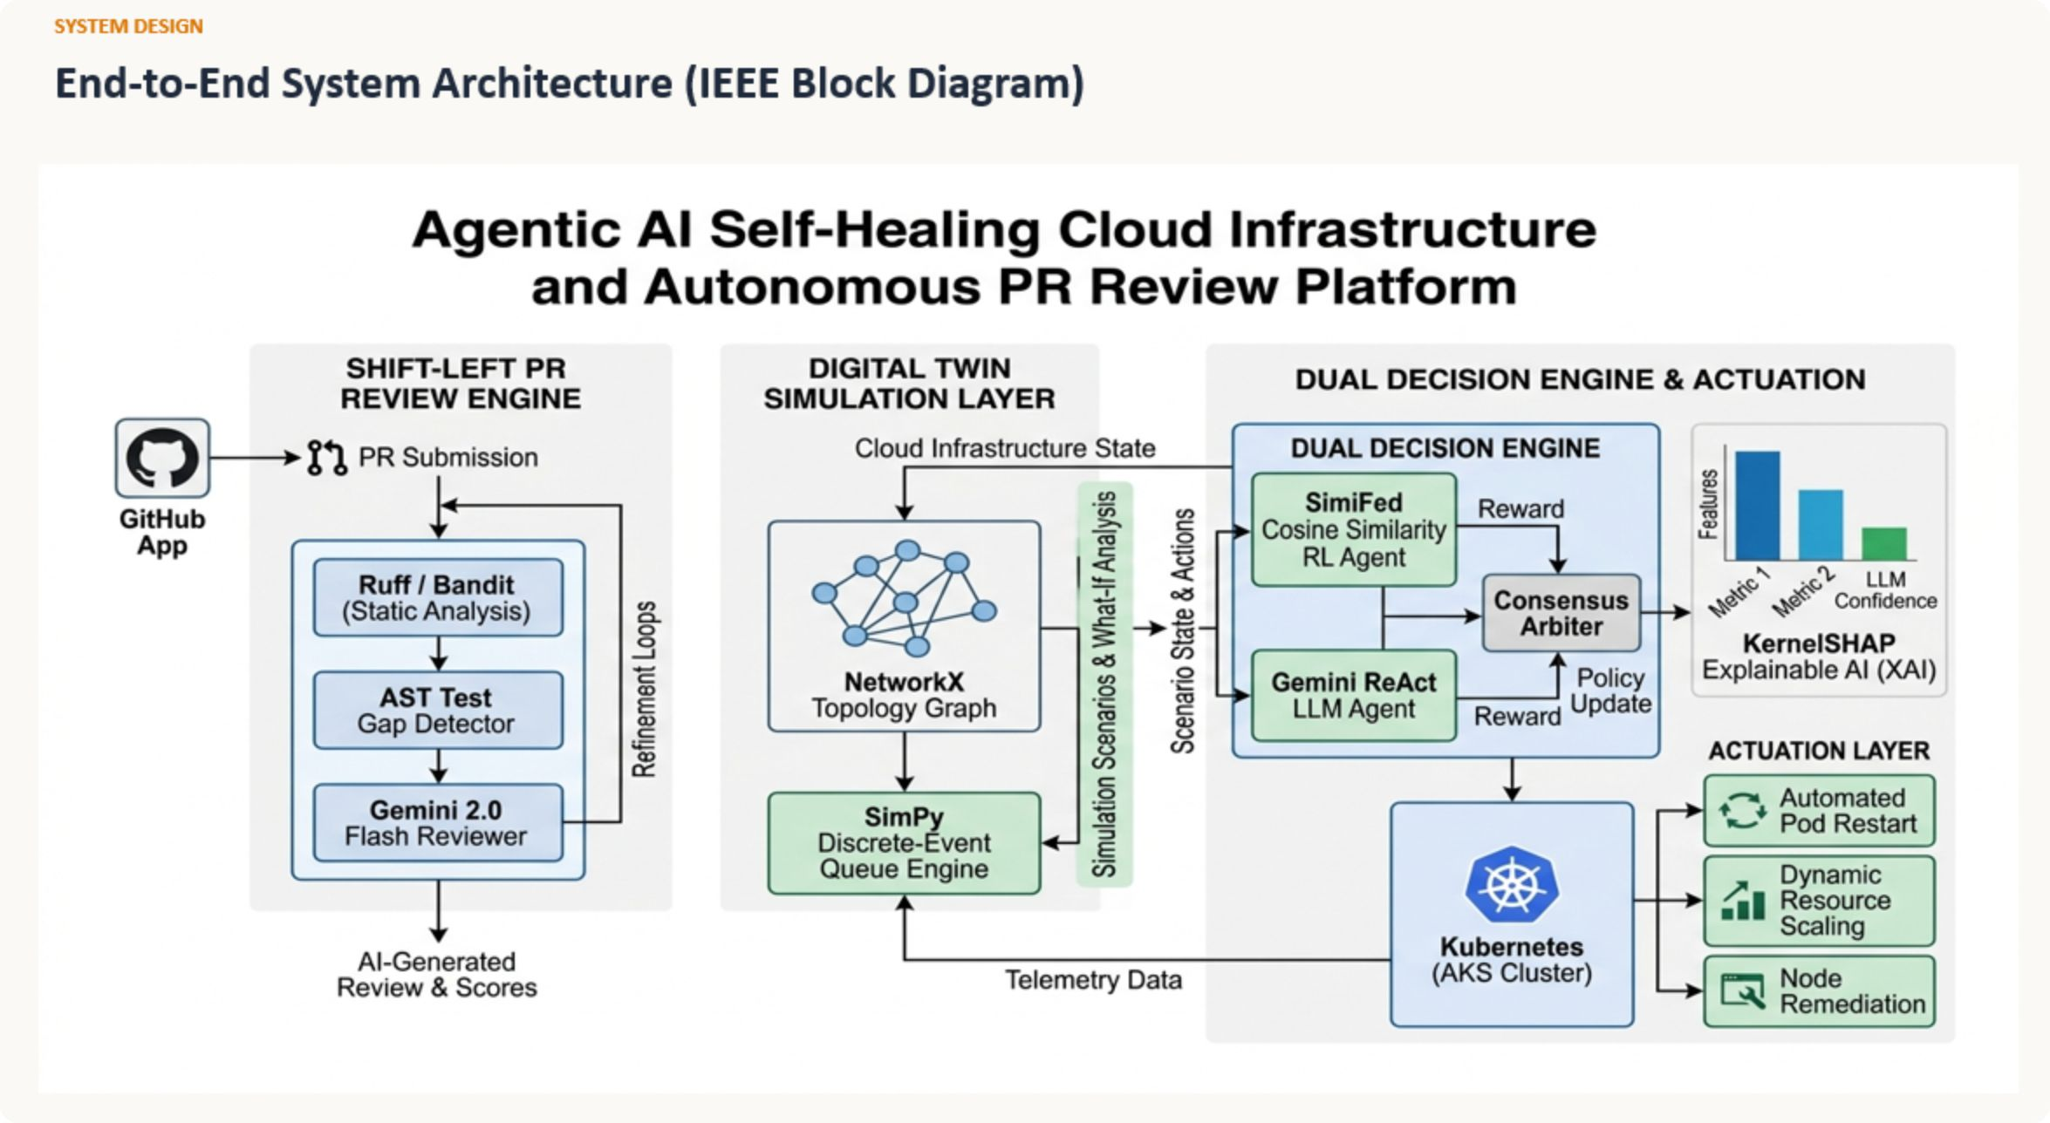
System Architecture Overview

Slide 7
Proactive Code Quality & Security Gates
How the Agent Protects Code Before Deployment — simple step-by-step methodology
1
Step 1 — Fast Static Scanning
Concurrently run Ruff, Bandit, Detect-Secrets, and Pip-Audit. The Shift-Left PR Review Engine collects findings and surfaces them to the developer.
2
Step 2 — Gemini Contextual Review
Gemini 2.0 Flash analyzes the code diff, scanner outputs, and project context to propose line-level fixes and improvements.
3
Step 3 — AST Test-Gap Audit
The system parses the Abstract Syntax Tree of modified functions and checks whether new or modified public functions have corresponding unit tests. Missing coverage triggers a test-gap alert.
4
Step 4 — Quality Gate Enforcement
The GitHub Check Run status is updated. If critical findings exist, the system blocks the merge until issues are resolved and all critical policies are satisfied.
5
Step 5 — Autonomous Auto-Fix PRs
For common issues such as missing imports or unused variables, the system can create an auto-fix branch, commit fixes, and open a ready-to-merge pull request.

Slide 8
Methodology: Closed-Loop Runtime Self-Healing
How the System Heals Live Cloud Infrastructure (Simple Step-by-Step)
1
Step 1 - Digital Telemetry Ingestion & Anomaly Detection
Continuously pull CPU, RAM, error rates, and request rates from Prometheus/Datadog and update a live in-memory dependency graph (TDTdb). An Isolation Forest model detects anomalies.
2
Step 2 - Root Cause Analysis
Once an anomaly is detected, KernelSHAP computes Shapley values to identify which metrics (e.g., CPU spike, memory leak, high latency) are the primary drivers of the anomaly.
3
Step 3 - Explainable Root Cause & Consensus
Summarize the root cause (e.g., "Pod X is consuming 95% CPU due to a memory leak"). Run a 0.01-second SimPy simulation to verify the proposed action (e.g., "if we restart Pod X, will latency drop below SLO?"). If simulation confirms safety, the system executes the remediation on AKS.
4
Step 4 - Dual-Agent Decision & Arbitration
Run a 0.001-second SimiFed RL Agent (fast reflex) and a 2.4-second Gemini ReAct LLM (deep reasoning) in parallel. Both agents vote; consensus is required before action.
5
Step 5 - Operator Enactment & Verification
Execute the remediation on AKS. Post-action health checks verify the fix worked. If the anomaly persists or new anomalies emerge, the loop restarts.

Slide 9
Key Innovations
Explainable AI (KernelSHAP): Shapley attributions show exactly which metrics caused the anomaly — essential for operator trust and auditability.
SimPy 0.01s Dry-Run Gate: Action-aware queuing simulation verifies safety and SLO impact before any live remediation.
Dual Parallel Decision Engine: Fast SimiFed reflex (0.001s) + Gemini ReAct (2.4s) reach consensus to avoid single-algorithm failures.
Autonomous Shift-Left PR Fixes: Extends self-healing upstream: automated fixes and GitOps PRs reduce repeat incidents.

Slide 10
Deployment & Operational Considerations
Production stack highlights:
Operational safety & governance:
Azure Container Apps / AKS for workload execution
PostgreSQL for TDTdb persistence; Key Vault for secrets
Container Registry + GitOps for automated delivery
Hardened Kubernetes operator for idempotent actuations
Action approval policies and operator override UI
Audit logs, SHAP explanations, and simulation evidence for compliance
Rate-limited, deduplicated queues to prevent remediation flapping
Post-action health checks and automatic rollback triggers

Slide 11

Next Steps & Roadmap
1. Pilot on a Critical Microservice
Instrument telemetry, enable PR intelligence, run closed-loop in passive mode for 2–4 weeks.
2. Safety Policy Tuning
Calibrate SHAP thresholds, simulation constraints, and consensus weights with SREs.
3. Gradual Automation Rollout
Move from advisory to automated actuation in controlled stages with rollback safeguards.
4. Enterprise Integration
Connect to corporate SIEM, change management, and compliance audit pipelines.
5. Measure & Iterate
Track MTTR, MTBF, false-positive rate, and developer merge-failure reduction; iterate models and policies.
Recommended metrics to track: MTTR, incident frequency, PR defect catch rate, successful auto-fix merges, and simulation false-negatives.

