Slide 1
Medical Insurance Price Prediction
using Machine Learning

Slide 2

Abstract
This project aims to develop a machine learning model that can accurately predict medical insurance prices based on various factors such as age, location, and health conditions. By leveraging data science techniques, we can help individuals and organizations make informed decisions about their healthcare coverage

Slide 3

Introduction
Importance of Accurate Pricing :
Precise medical insurance pricing is crucial for both consumers and providers to ensure affordable and sustainable healthcare coverage.
Challenges in Pricing :
Factors like individual health profiles, regional variations, and changing regulations make medical insurance pricing a complex task.
Objective :
To develop a predictive model that can forecast medical insurance prices based on relevant data points.

Slide 4
Dataset Description
Age : age of primary beneficiary
Sex : insurance contractor gender, female, male
Bmi : Body mass index, providing an understanding of body, weights that are relatively high or low relative to height
Children : Number of children covered by health insurance / Number of dependents
Smoker : Smoking(yes/no)
Region : the beneficiary's residential area in the US, northeast, southeast, southwest, northwest.
Charges : Individual medical costs billed by health insurance

Slide 5
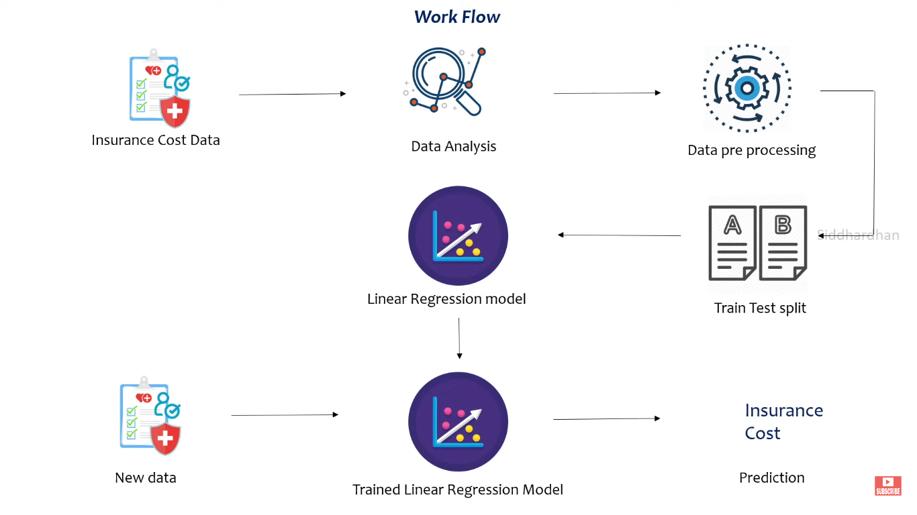

Slide 6
Technologies Involved
Python: programming language for development.
Numpy : For numerical computations and array operations.
Pandas : Data manipulation and analysis.
Seaborn : Statistical data visualization.
scikit-learn : Machine learning models and evaluation metrics.
FastAPI : Fast web framework for building APIs with Python.

Slide 7
Data Collection and Preprocessing
Data Sources
Data Cleaning
Feature Selection
Gather data from various sources, including insurance providers, government databases, and healthcare organizations.
Clean and preprocess the data, addressing missing values, outliers, and inconsistencies to ensure data quality.
Identify the most relevant features that influence medical insurance pricing, such as age, location, and health conditions.

Slide 8
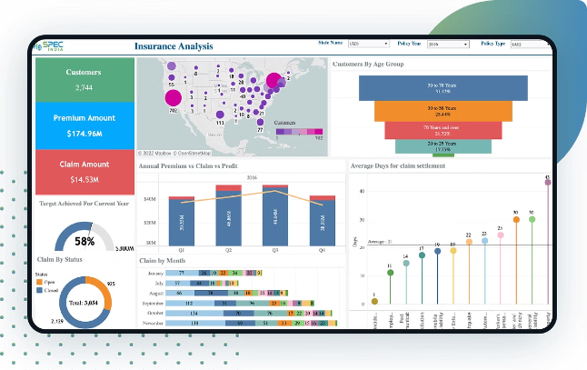
Exploratory Data Analysis
Identify Patterns
Understand Distributions
Analyze the data to uncover trends, correlations, and relationships between different variables.
Examine the distribution of insurance prices and other key features to gain insights into the data.
Visualize Insights
Identify Outliers
Create visualizations, such as charts and graphs, to effectively communicate the findings from the data analysis.
Detect any outliers or anomalies in the data that may require further investigation or handling.

Slide 9
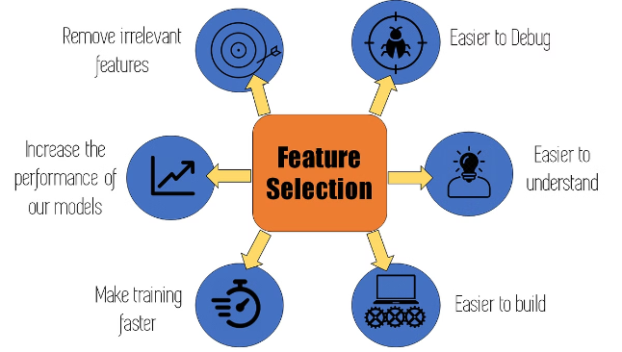
Medical Insurance Price Prediction
using Machine Learning

Slide 10
Model Selection and Tuning
Model Evaluation
Hyperparameter Tuning
Cross-Validation
Test various machine learning algorithms, such as regression models, decision trees, and ensemble methods, to identify the best-performing model.
Optimize the model's hyperparameters to improve its performance and generalization capabilities.
Employ cross-validation techniques to ensure the model's robustness and prevent overfitting.

Slide 11
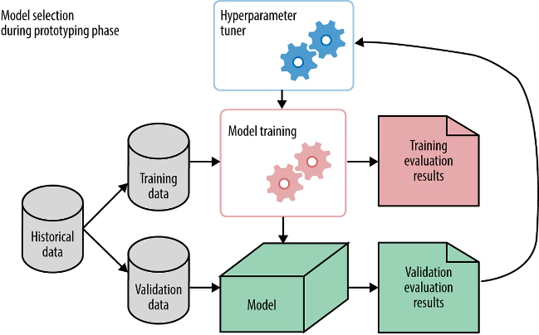
Model Evaluation and Validation
Evaluation Metrics
Assess the model's performance using relevant metrics, such as mean squared error, R-squared, and root mean squared error.
Validation
Validate the model's performance on unseen data to ensure its generalizability and real-world applicability.
Sensitivity Analysis
Analyze the model's sensitivity to changes in input variables to understand its robustness and limitations.

Slide 12
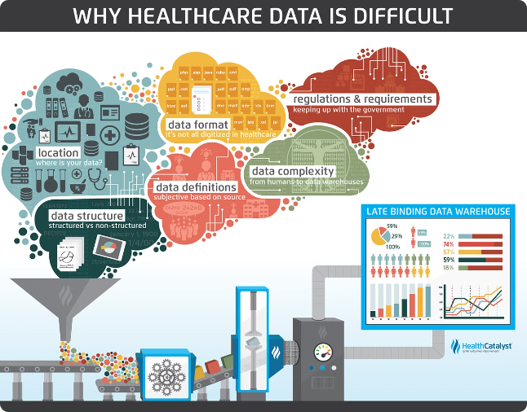
Challenges and Limitations
1
Data Availability
2
Privacy Concerns
Obtaining comprehensive and reliable data on medical insurance pricing can be a significant challenge.
Ensuring the protection of sensitive personal health information is crucial when working with medical data.
3
Model Complexity
4
Regulatory Considerations
Developing a highly accurate and interpretable model for medical insurance price prediction can be a complex task.
Understanding and adhering to evolving regulations in the healthcare industry is essential for the model's deployment.

Slide 13

Future Enhancements
Incorporate Real-time Data
Integrate the model with real-time data sources to enable dynamic pricing updates.
Personalized Recommendations
Develop personalized insurance recommendations based on individual health profiles and preferences.
Predictive Analytics
Expand the model's capabilities to predict future healthcare trends and potential cost changes.
Explainable AI
Enhance the model's interpretability to provide transparent and understandable insights to users.

Slide 14
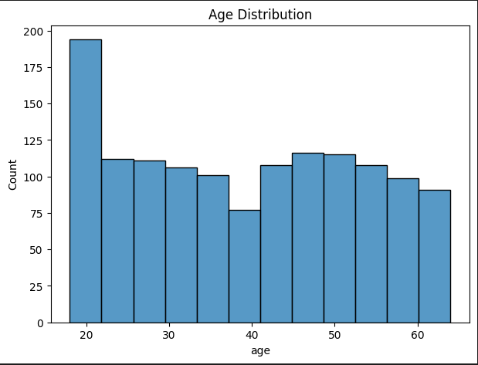
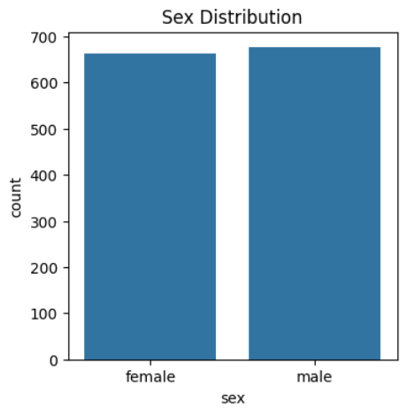
Explorative Data Analysis

Slide 15
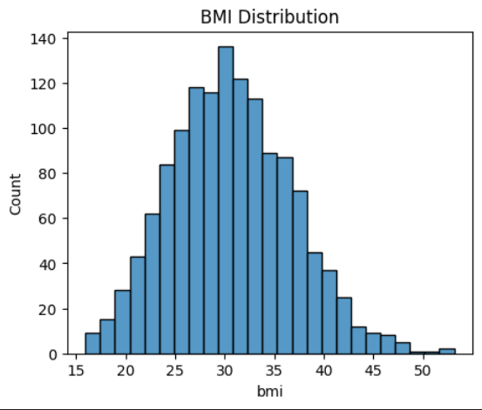
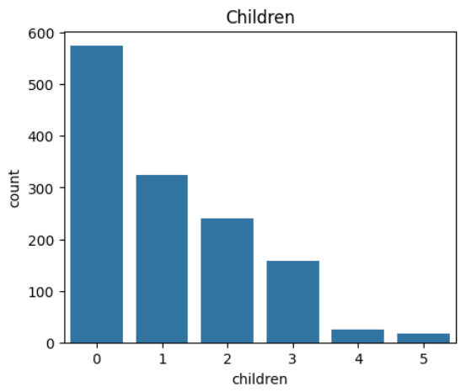

Slide 16
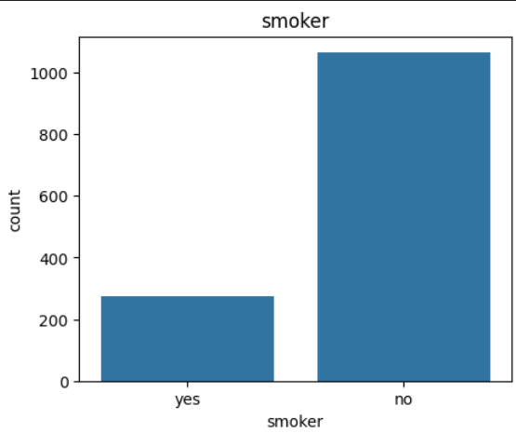
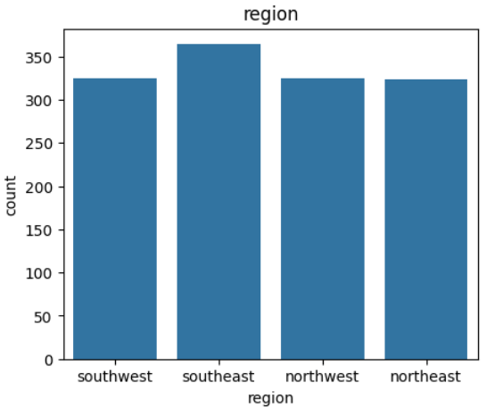

Slide 17
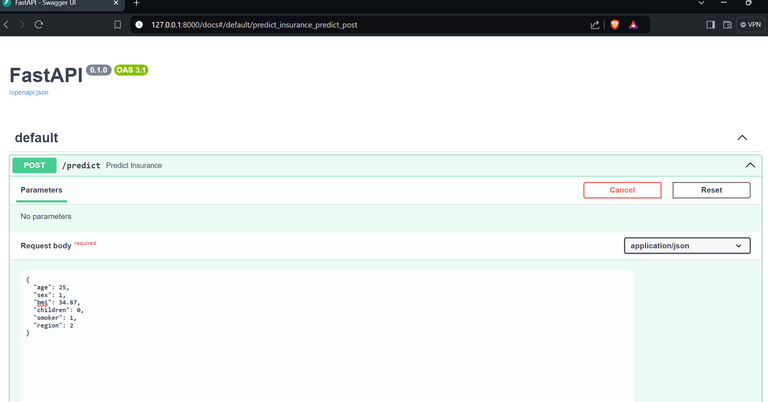
Output Screenshots

Slide 18
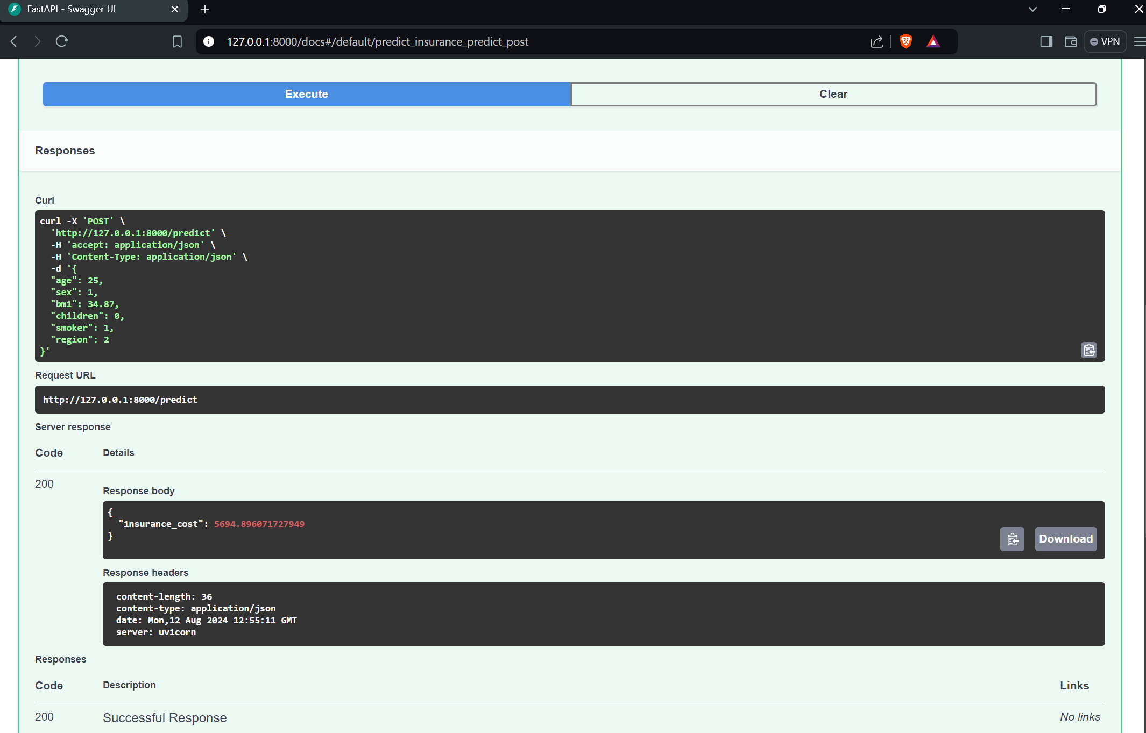
Thank You !

Slide 19
Thank You !

