Slide 1



Slide 2
Crime Rate Prediction

Slide 3
Predictive Analytics Project Crime Rate Prediction
Member’s Name | Roll Number | Sap ID | Branch
Suraj Tuteja | R2142221174 | 500109573 | AIML(B9 Non-Hons)
Aaditya Vikram Joshi | R2142220378 | 500105913 | AIML(B9 Non-Hons)
Harshvardhan Singh | R2142220918 | 500106133 | AIML(B9 Non-Hons)
Under the guidance of
Dr. Achala Shakya
Group-?

Slide 4
CONTENTS
Introduction
Motivation
Literature Review
Problem Statement
Objective
Methodology
Result and Discussion
Conclusion and Future scope, Application of project
References

Slide 5
INTRODUCTION
As our project is all about prediction and analysis of crime ,to be better prepared to respond to criminal activity, it is important to understand patterns in crime. In our project, we analyze crime data from the city of Gujrat, scraped from publicly available website of Gujrat Police and from the research papers through google.
A better understanding of crime is beneficial in multiple ways: it can lead to targeted and sensitive practices by law enforcement authorities to mitigate crime, and more concerted efforts by citizens and authorities to create healthy neighborhood environments. With the advent of the Big Data era and the availability of fast, efficient algorithms for data analysis, understanding patterns in crime from data is an active and growing field of research.

Slide 6
MOTIVATION
With Gujarat experiencing a rise in custodial deaths, crimes against women, and drug-related offenses, there is growing concern about public safety. Cities like Ahmedabad and Surat report some of the highest crime rates in the country, despite a decline in the overall crime rate. Urbanization has fueled these challenges, including theft, sexual violence, and trafficking. However, initiatives like the VISHWAS CCTV project have shown promise in crime prevention. This project aims to use machine learning to predict crime patterns, helping law enforcement act before crimes happen and improve safety across cities.

Slide 7
LITERATURE REVIEW
There is a great deal of literature on crime prediction, both scientific and lay. Much of the scientific literature on crime prediction has focused on the development of statistical models that can be used to predict crime rates in specific geographic areas. These models typically take into account a variety of factors, including population density, demographics, economic conditions, and the like. While such models can be quite accurate, they are often criticized for being too general and for failing to take into account the specific circumstances of individual crimes.
The lay literature on crime prediction is often much more speculative, and often focuses on the idea of using psychological profiling to predict who is likely to commit a crime. This approach has been popularized in books and movies, but has little scientific basis.

Slide 8
Shiju Sathyadevan, Devan M.S, proposed that Day by day the crime rate is increasing considerably. Crime cannot be predicted since it is neither systematic nor random. Also the modern technologies and hi-tech methods help criminals in achieving their misdeeds. According to Crime Records Bureau crimes like burglary, arson etc have been decreased while crimes like murder, sex abuse, gang rape etc have been increased. Even though we cannot predict who all may be the victims of crime but can predict the place that has probability for its occurrence. The predicted results cannot be assured of 100% accuracy but the results shows that our application helps in reducing crime rate to a certain extent by providing security in crime sensitive areas. So for building such a powerful crime analytics tool we have to collect crime records and evaluate it .It is only within the last few decades that the technology made spatial data mining a practical solution for wide audiences of Law enforcement officials which is affordable and available. Since the availability of criminal data or records is limited we are collecting crime data from various sources like web sites, news sites, blogs, social media, RSS feeds etc. This huge data is used as a record for creating a crime record database. So the main challenge in front of us is developing a better, efficient crime pattern detection tool to identify crime patterns effectively.

Slide 9
PROBLEM STATEMENT
Criminals are nuisance for the society in all corners of world for a long time now and measures are required to eradicate crimes from our world. Our mission is to offer crime prevention application to keep public safe. Current policing strategies work towards finding the criminals, basically after the crime has occurred. But, with the help of technological advancement, we can use historic crime data to recognize crime patterns and use these patterns to predict crimes beforehand. We are using clustering algorithms to predict crime prone areas.

Slide 10
OBJECTIVE
The objective of our work is to:
• Predicting crime before it takes place.
• Predicting hotspots of crime.
• Understanding crime pattern.
• Classify crime based on location.
• Analysis of crime in Indore
Some of the goals :-
Much of the current work is focused in two major directions:-
Predicting surges and hotspots of crime, and
Understanding patterns of criminal behavior that could help in solving criminal investigations.

Slide 11
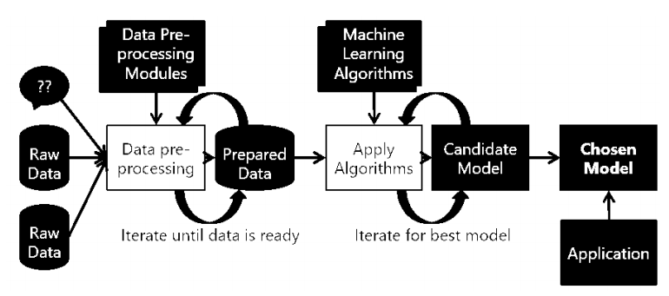
BASIC METHODOLOGY
The term machine learning refers to the automated detection of meaningful patterns in data. In the past couple of decades it has become a common tool in almost any task that requires information extraction from large data sets
The inputs to our algorithms are time (hour, day, month, year), place (latitude and longitude), class of crime
Act 379-Robbery, Act 13-Gambling, Act 279-Accident, Act 323-Violence, Act 302-Murder, Act 363-Kidnapping
The output is the class of crime that is likely to have occurred. We try out multiple classification algorithms, such as KNN (K-Nearest Neighbors), Decision Trees, and Random Forests.
Before implementing machine learning algorithms on our data, we went through a series of preprocessing steps with our classification task in mind. These included:
Dropping features such police station, station number, Complainant name & address Accused name & address
Dropping features such as Resolution, Description and Address
The timestamp contained the year, date and time of occurrence of each crime. This was decomposed into five features: Year (2022), Month (1-12), Date (1-31), Hour (0-23) and Minute (0-59).

Slide 12
timestamp | act379 | act13 | act279 | act323 | act363 | act302 | latitude | longitude
28-02-2022 21:00 | 1 | 0 | 0 | 0 | 0 | 0 | 22.73726 | 75.87599
28-02-2022 21:15 | 1 | 0 | 0 | 0 | 0 | 0 | 22.72099 | 75.87608
28-02-2022 10:15 | 0 | 0 | 1 | 0 | 0 | 0 | 22.73668 | 75.88317
28-02-2022 10:15 | 0 | 0 | 1 | 0 | 0 | 0 | 22.74653 | 75.88714
After the preprocessing described in the previous sections, we had three different classifications problems to solve, which we proceeded to attack with an assortment of classification algorithms. The following are the algorithms which we are using:
• KNN( K- Nearest neighbors)
• Decision Tree
• Random Forests

Slide 13
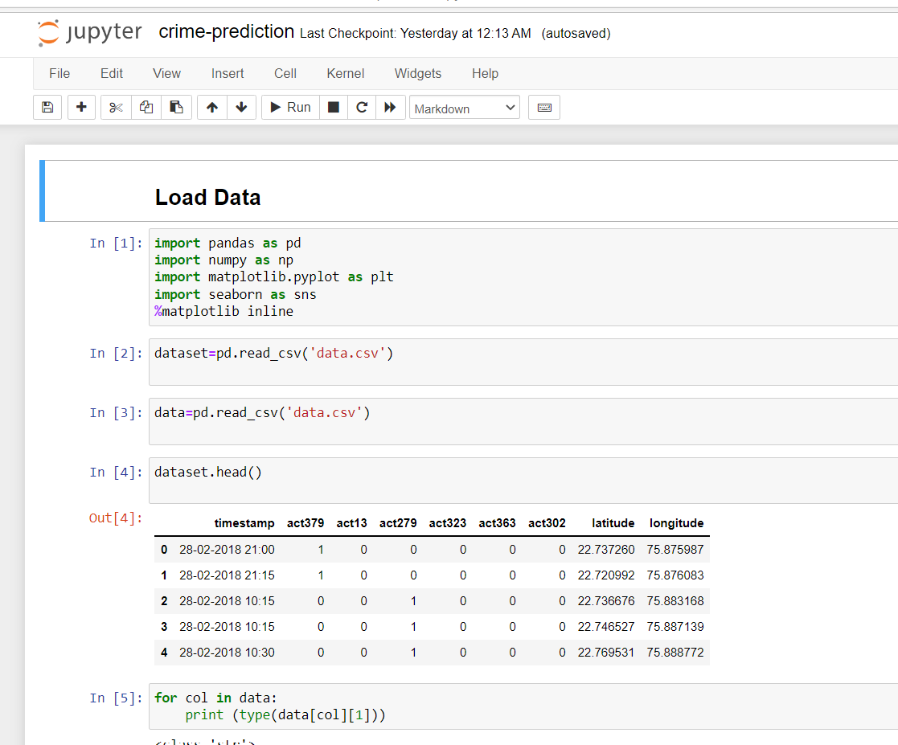
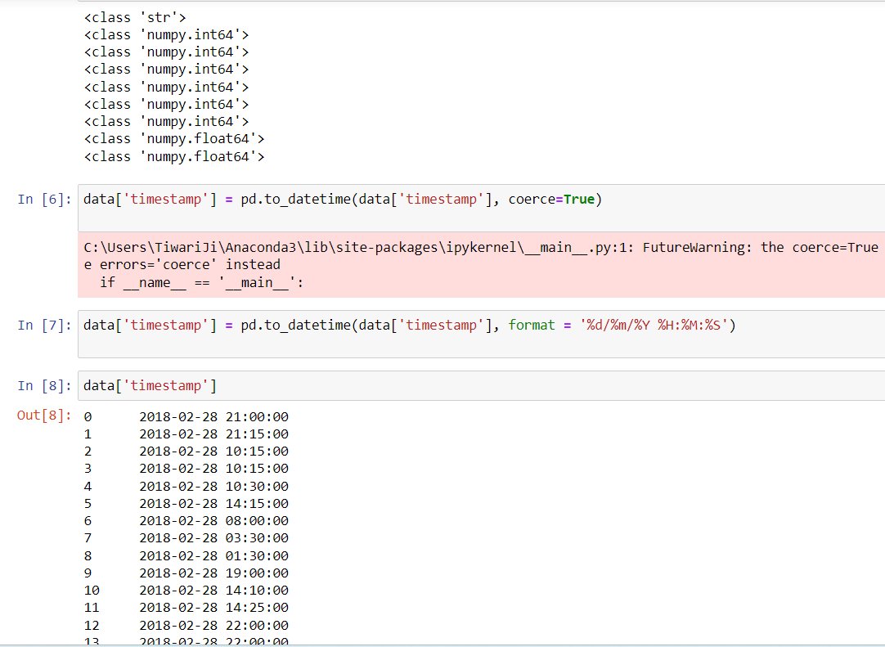
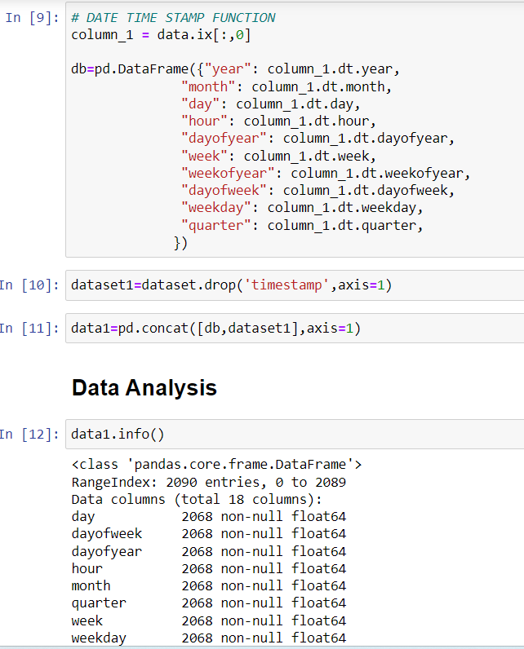
RESULT AND DISCUSSION
1.
2.
3.

Slide 14
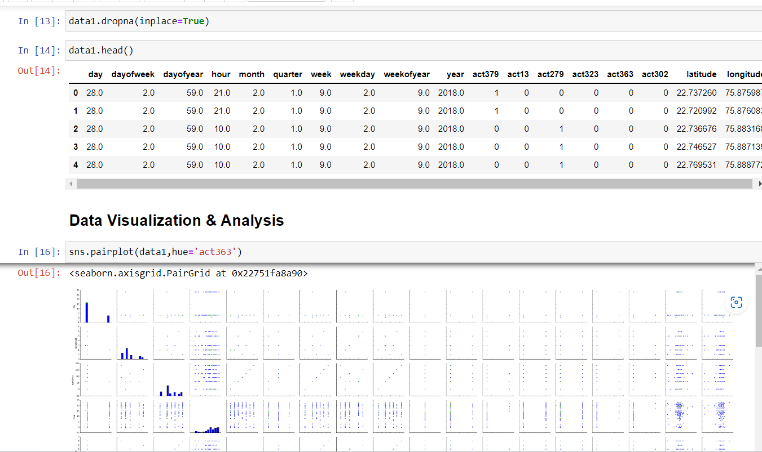
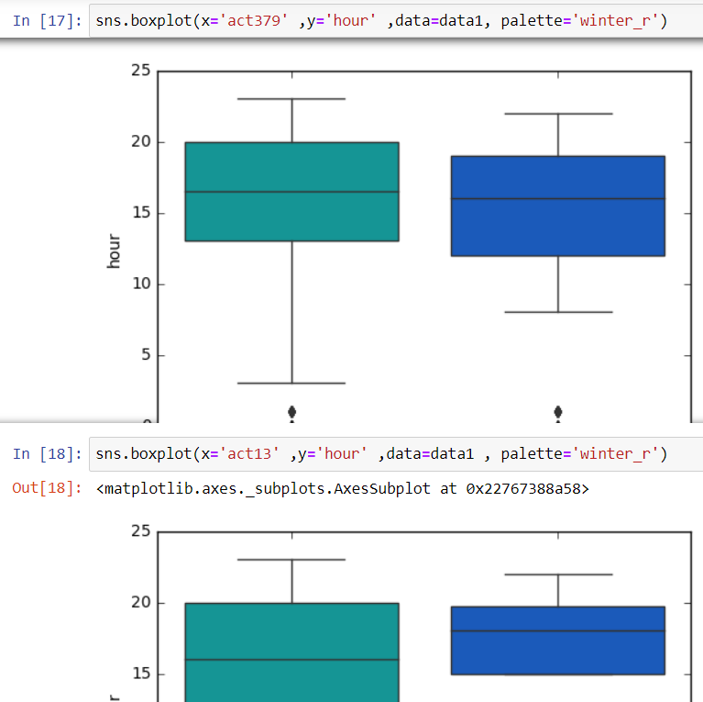
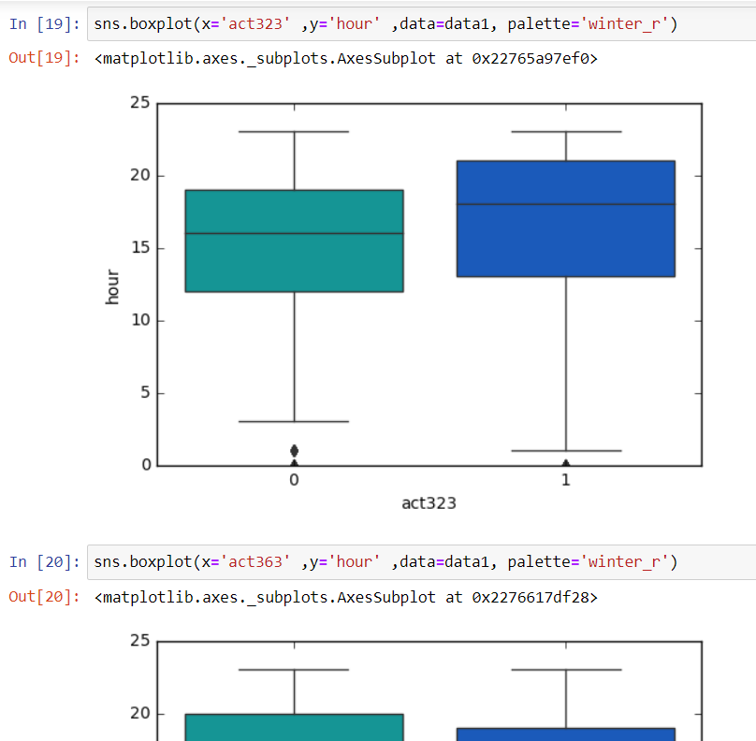
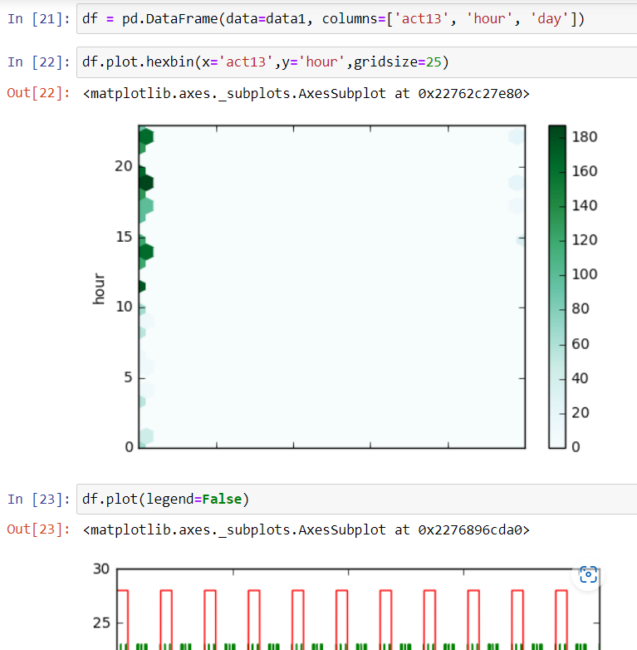
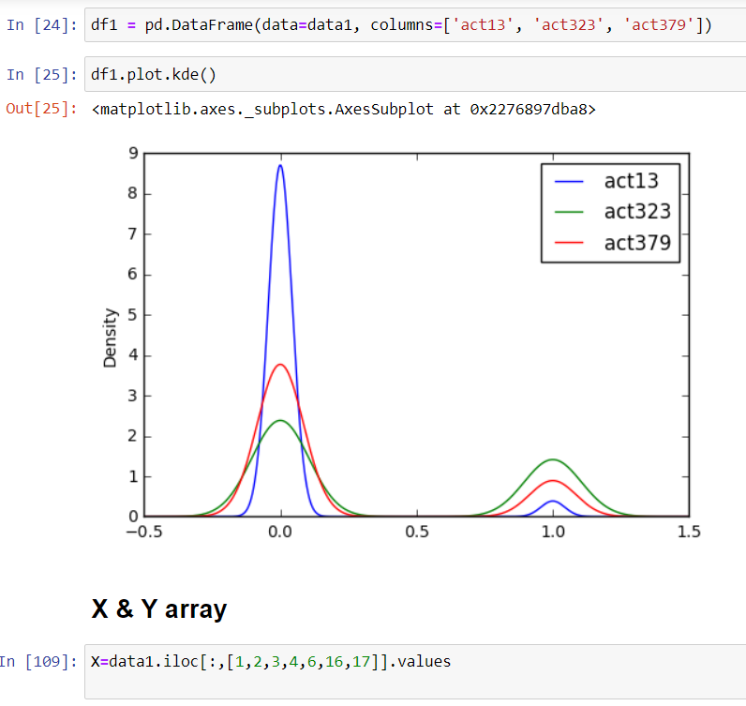
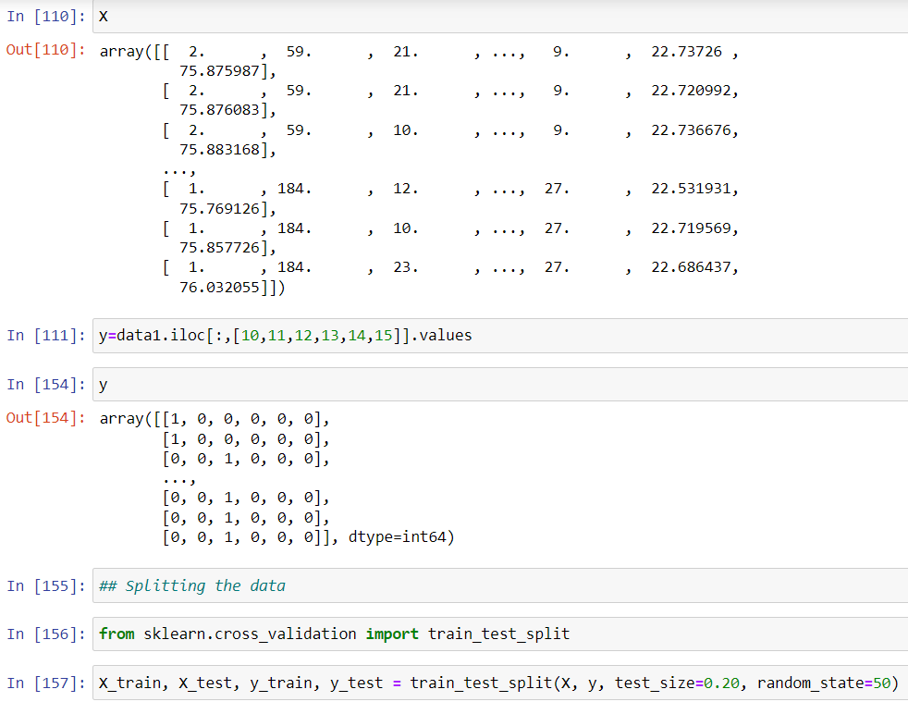
4.
5.
6.
9.
8.
7.

Slide 15
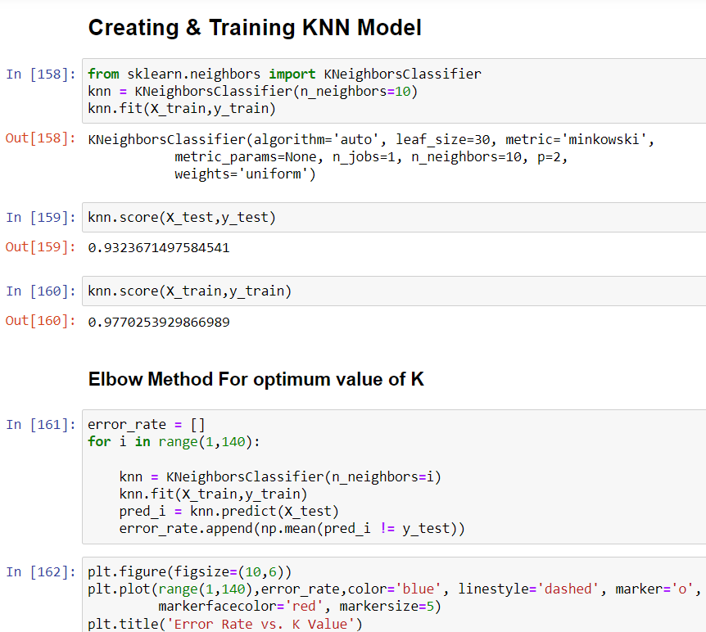
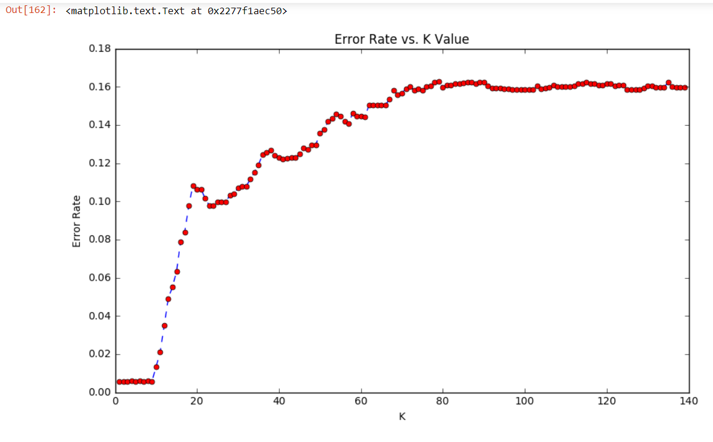
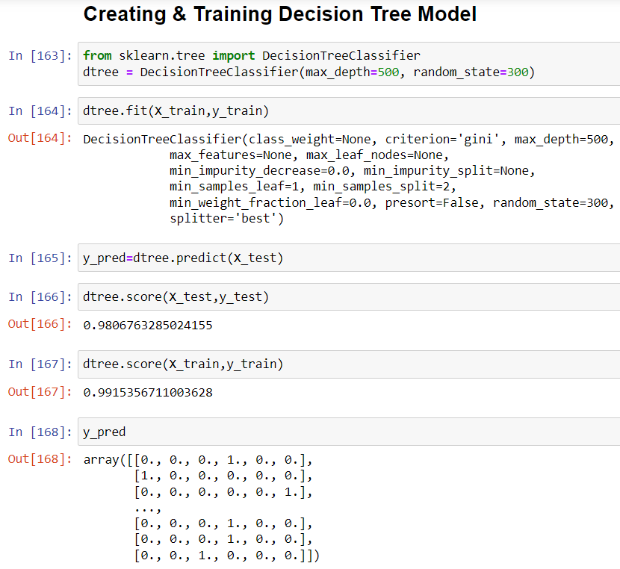
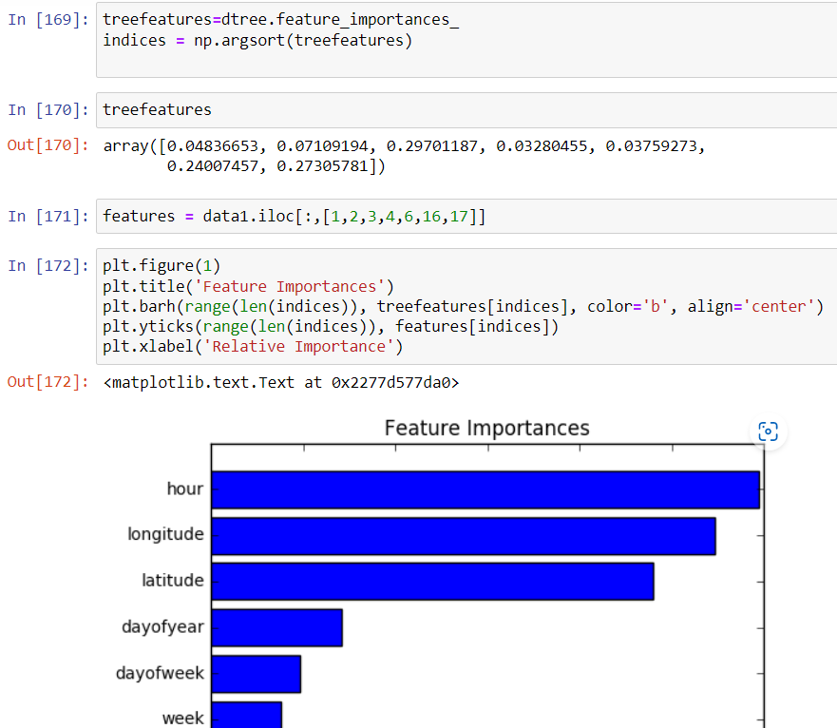
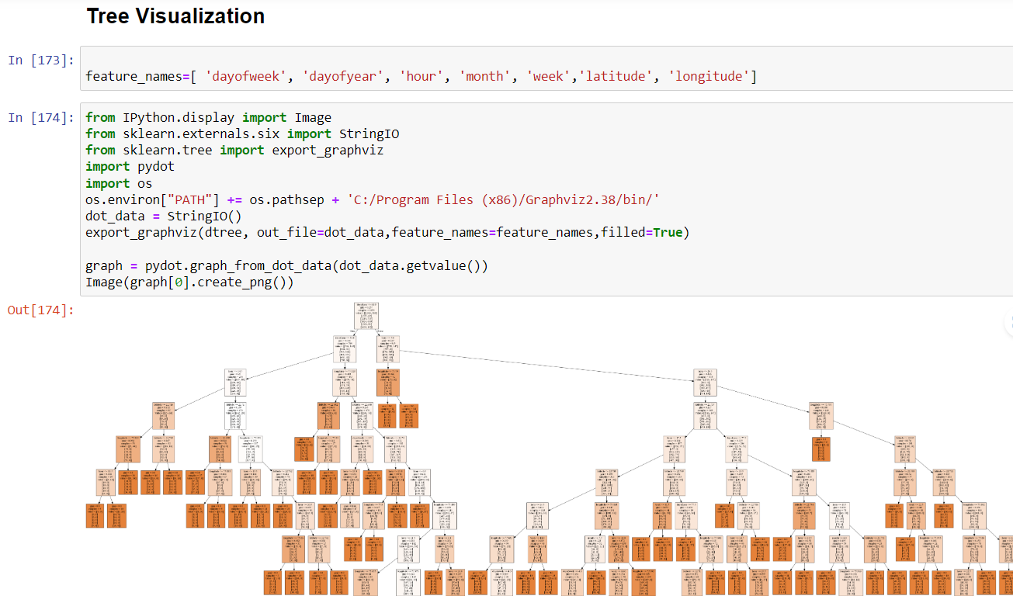
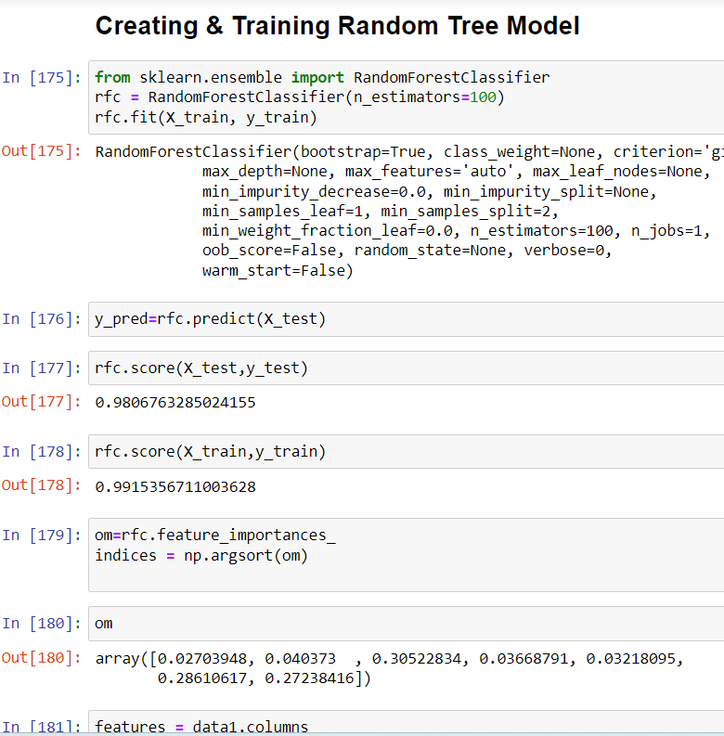
10.
11.
12.
13.
15.
14.

Slide 16
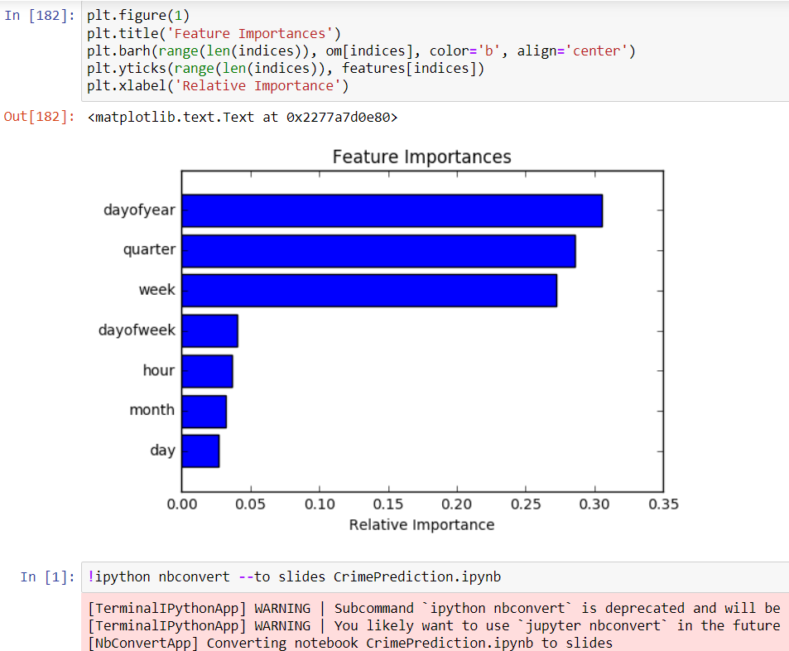
16.
the main aim for our project is to make people of our coutry feel safe and secure even when they are alone or with their family the can move anywhere at anytime freely and securly , and we will try our best to convert this website into an application so that officals can also get a small amount of help from our side too.

Slide 17
CONCLUSION AND FUTURE SCOPE
The initial problem of classifying 6 different crime categories was a challenging multi-class classification problem, and there was not enough predictability in our initial data-set to obtain very high accuracy on it. We found that a more meaningful approach was to collapse the crime categories into fewer, larger groups, in order to find structure in the data. We got high accuracy and precision on Prediction. However, the Violent/Non-violent crime classification did not yield remarkable results with the same classifiers – this was a significantly harder classification problem. Thus, collapsing crime categories is not an obvious task and requires careful choice and consideration. Possible avenues through which to extend this work include time-series modeling of the data to understand temporal correlations in it, which can then be used to predict surges in different categories of crime. It would also be interesting to explore relationships between surges in different categories of crimes – for example, it could be the case that two or more classes of crimes surge and sink together, which would be an interesting relationship to uncover. Other areas to work on include implementing a more accurate multi-class classifier, and exploring better ways to visualize our results.

Slide 18
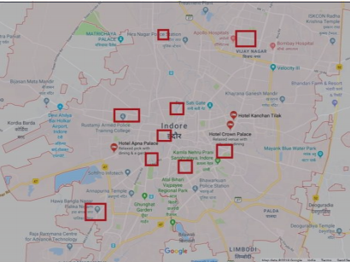
Future Scope
The goal of any society shouldn’t be to just catch criminals but to prevent crimes from happening in the first place
Predicting Future Crime Spots: By using historical data and observing where recent crimes took place we can predict where future crimes will likely happen. For example a rash of burglaries in one area could correlate with more burglaries in surrounding areas in the near future. System highlights possible hotspots on a map the police should consider patrolling more heavily
Predicting Who Will Commit a Crime: Using Face Recognition to predict if a individual will commit a crime before it happens. The system will detect if there are any suspicious changes in their behavior or unusual movements. For example if an individual seems to be walking back and forth in a certain area over and over indicating they might be a pickpocket or casing the area for a future crime. It will also track individual over time.
Pretrial Release and Parole: After being charged with a crime, most individuals are released until they actually stand trial. In the past deciding who should be released pretrial or what an individual’s bail should be set at is mainly now done by judges using their best judgment.

Slide 19
APPLICATION OF PROJECT
Software Requirements
Hardware Requirements
Anaconda Distribution (v5.1) •
Python (3.6.5) •
Packages Used:
Flask(0.12.2);Pandas(0.22.1);Numpy(1.14.2); Sklearn(0.19.1) ; Geopy (1.13.0)
HTML 5
CSS 3
Bootstrap 4
Java Script 1.8
Operating system: Windows 7 or newer, 64-bit macOS 10.9+, or Linux.
System architecture: 64-bit x86, 32-bit x86 with Windows or Linux.
CPU: Intel Core 2 Quad CPU Q6600 @ 2.40GHz or greater.
RAM: 4 GB or greater.

Slide 20
References
Gujarat Police Department, 2023. Annual Crime Report: Crime Trends and Statistics in Gujarat. Available at: https://gujaratpolice.gov.in
Shah, Neerav, 2022. Predictive Analytics in Gujarat: Machine Learning Approaches for Crime Hotspot Identification, Journal of Indian Law and Crime Analytics, Vol. 4, pp. 110-125.
Joshi, Harish, 2021. Urban Crime in Gujarat: A Statistical Approach to Crime Prediction, Proceedings of the 15th National Conference on Data Science.
Government of Gujarat, 2020. VISHWAS CCTV Project and Crime Prevention Strategies, Official Government Publication, Ministry of Home Affairs.
Patel, Vinod, 2019. Demographic Influences on Crime Rates in Gujarat: A Spatial Data Mining Approach, Journal of Public Safety and Policy Research, Vol. 7, Issue 3.
Rao, Karthik, 2018. Drug-Related Offenses and Public Safety in Gujarat: Data-Driven Insights, Applied Social Studies Research Journal.
Mehta, Priya, 2017. Urbanization and Crime: A Study of Ahmedabad and Surat, Indian Journal of Criminology and Data Science.

Slide 21


