Slide 1
Topic
Presentation on Full Stack Project
Restaurant Reservation
by
G-4
Aadi Dayal 2310990256
Abhay Sood 2310990261 Arjit Surana 2310990295 Aryan Walia 2310990305
Supervised by: Rahul Sir
Department of Computer Science and Engineering, Chitkara University, Punjab

Slide 2
Table of Contents
Problem Statement
Objective / Purpose
Main Topics / Sections (Depends on your topic)
Future Scope
Conclusion
References (if applicable)
Q&A / Discussion

Slide 3
Problem Statement
Reservation Management Issues: Manual handling of table bookings leads to scheduling conflicts, lost reservations, and poor customer experience
Lack of Digital Presence: Absence of modern web presence limits customer reach and engagement
Authentication Challenges: No secure system for customer registration and login, making it difficult to track customer preferences and reservation history
Administrative Overhead: Restaurant staff spend excessive time managing reservations manually instead of focusing on service quality
Limited Customer Self-Service: Customers cannot easily view menus, make reservations, or track their booking status online

Slide 4
Objective / Purpose
Digital Menu Access: Provide customers with an interactive, categorized online menu with high-quality images and detailed descriptions
Seamless Reservation System: Enable customers to book tables online 24/7 without phone calls
User Account Management: Allow customers to create accounts, track reservation history, and manage their bookings
Mobile Accessibility: Ensure optimal user experience across all devices (desktop, tablet, mobile)
Automated Reservation Management: Replace manual booking systems with digital workflow
Admin Dashboard: Provide restaurant staff with centralized control panel to manage all reservations and users
Real-time Status Updates: Enable instant approval/rejection of reservations with customer notifications
Data Analytics: Track reservation patterns, customer preferences, and business metrics
Secure Authentication: Implement JWT-based user authentication and authorization system
Database Management: Utilize MongoDB Atlas for scalable cloud-based data storage
resources,

Slide 5
Main Topics / Sections
1. Frontend Development (React.js)
User Interface Components
Navigation System (Navbar.js) - Responsive navigation with user authentication states
Home Page (Home.js) - Hero section, features showcase, menu highlights
Menu Display (Menu.js) - Interactive menu with categories and search functionality
About Page (About.js) - Restaurant story, team information, and values
Contact System (Contact.js) - Contact form and restaurant information
Authentication & User Management
User Registration (Signup.js) - New user account creation
User Login (Login.js) - Secure user authentication interface
User Dashboard (MyReservations.js) - Personal reservation management

Slide 6
Main Topics / Sections
2. Backend Development (Node.js/Express)
API Architecture
Main Server (app.js) - Express server configuration and middleware setup
Route Management (index.js) - Centralized API endpoint routing
Health Monitoring - API status and health check endpoints
Authentication & Authorization
User Authentication (authRoutes.js) - Login/signup API endpoints
JWT Middleware (auth.js) - Token-based authentication system
Admin Authorization (adminAuth.js) - Role-based access control
Business Logic Controllers
Menu Controller (menuController.js) - Menu data management
Reservation Controller (reservationController.js) - Booking system logic
Admin Controller (adminController.js) - Administrative operations
Contact Controller (contactController.js) - Contact form handling

Slide 7
Future Scope
1. Advanced Booking & Table Management
Smart Table Allocation
Real-time Table Mapping: Visual floor plan with table availability status
Capacity Optimization: AI-powered table assignment based on party size and dining duration
Waitlist Management: Queue system for busy periods with automated notifications
Time Slot Management: Flexible booking slots with dynamic pricing during peak hours
2. E-commerce & Online Ordering
Food Delivery Integration
Online Menu Ordering: Full e-commerce functionality for takeout/delivery
Payment Gateway Integration: Stripe, PayPal, UPI, and other payment methods
Order Tracking System: Real-time order status updates for customers
Delivery Management: Integration with delivery partners or in-house delivery tracking
3. Customer Relationship Management (CRM)
Loyalty Programs
Points System: Reward frequent customers with points and discounts
Membership Tiers: VIP, Gold, Silver customer categories with benefits
Birthday & Anniversary Specials: Automated celebration offers
Referral System: Customer referral rewards and tracking

Slide 8
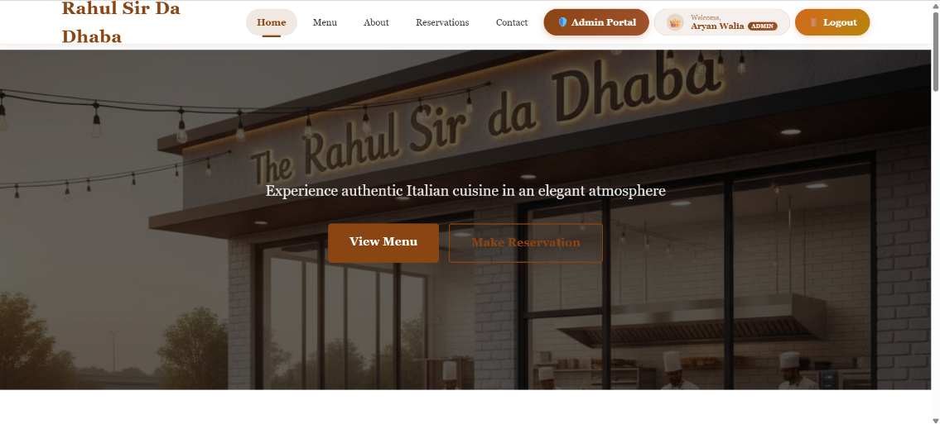
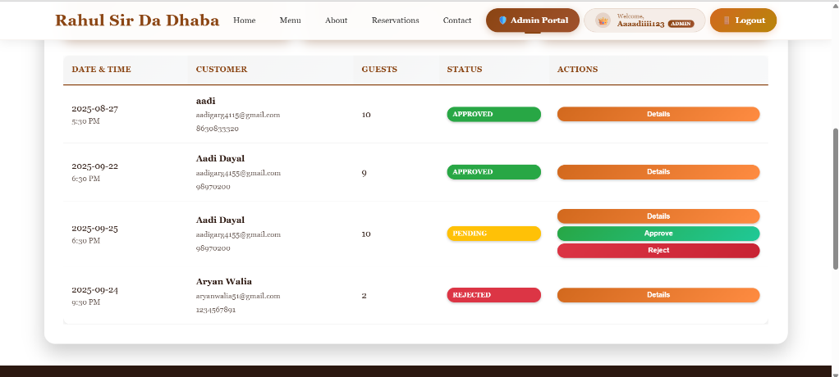
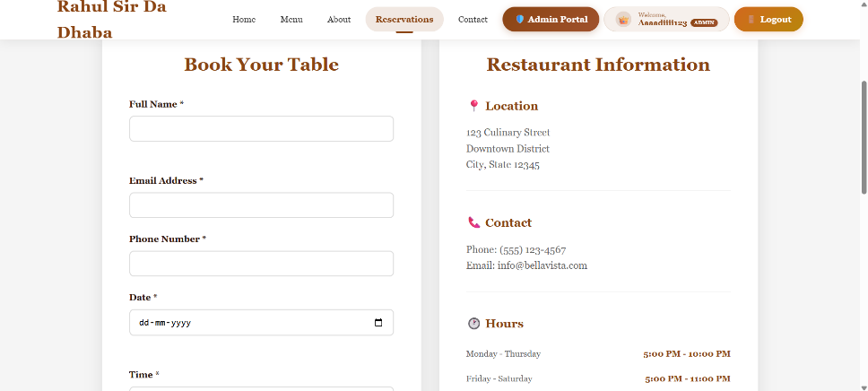
Project Snippets

Slide 9
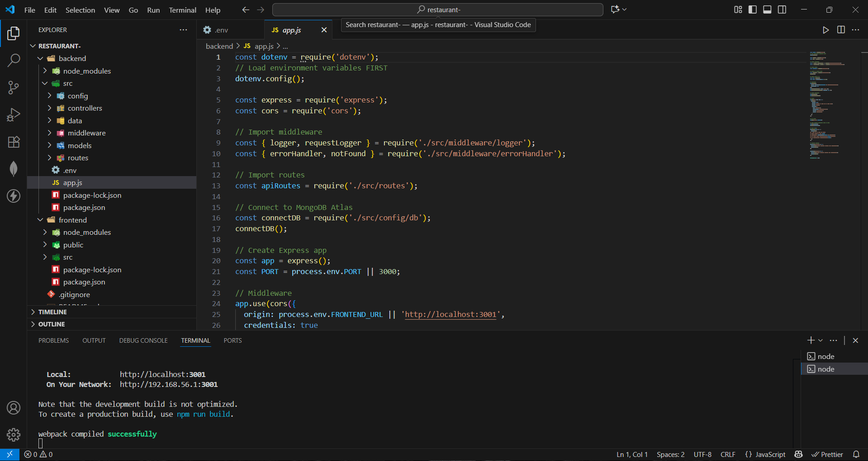
Code Snippets

Slide 10
Conclusion
Frontend Implementation:
Successfully developed a responsive React.js application with intuitive user interface
Implemented secure user authentication with JWT token management
Created dynamic components for menu display, reservation booking, and user management
Achieved mobile-responsive design ensuring accessibility across all devices
Backend Architecture:
Built robust Node.js/Express.js RESTful API with proper error handling
Implemented secure authentication and authorization middleware
Established efficient MongoDB Atlas cloud database integration
Created modular controller structure for scalable business logic
Security Implementation:
Integrated JWT-based authentication system for secure user sessions
Implemented role-based access control (admin vs regular users)
Applied password encryption using BCrypt for data protection
Established protected routes with proper middleware validation

Slide 11
References
Official Documentation: Documentation for libraries, frameworks, and tools used in the project, as well as APIs or services integrated.
https://www.google.com/
Tutorials and Guides: Online tutorials, guides, blog posts, and educational videos that provided assistance or insights during development.
https://www.geeksforgeeks.org/
Code Repositories: GitHub repositories or other code repositories where code snippets, examples, or inspiration were found.
https://chat.openai.com/
Forums and Communities: Online forums, such as Stack Overflow or Reddit, and developer communities where questions were asked, advice was sought, or discussions were participated in.
Personal Communication: Mentors, peers who provided guidance, feedback, or support during development.

Slide 12
Q&A / Discussion
Q1: Why did you choose the MERN stack for this restaurant management system?
A: The MERN stack (MongoDB, Express.js, React.js, Node.js) was chosen because:
JavaScript Ecosystem: Single language across frontend and backend reduces development complexity
Scalability: MongoDB provides flexible schema for restaurant data that may evolve
Real-time Updates: React's component-based architecture enables dynamic UI updates for reservation status
Community Support: Extensive documentation and libraries available for restaurant-specific features
Q2: How does the JWT authentication system enhance security?
A: JWT implementation provides:
Stateless Authentication: No server-side session storage required
Token Expiration: Automatic logout for security
Role-based Access: Different permissions for customers vs. admins
Cross-platform Compatibility: Works seamlessly between web and potential mobile apps

Slide 13
Q&A / Discussion
Q3: What makes the reservation system robust and reliable?
A: The system ensures reliability through:
Database Validation: Mongoose schemas prevent invalid data entry
Authentication Requirements: Only logged-in users can make reservations
Admin Approval Workflow: Prevents overbooking and allows quality control
Email Confirmations: Automated notifications reduce miscommunication
Q4: How does this system solve real-world restaurant problems?
A: The solution addresses:
Booking Conflicts: Digital system prevents double-booking
Customer Experience: 24/7 online booking availability
Staff Efficiency: Reduces phone call handling time
Data Management: Centralized customer and reservation database
Q5: What are the advantages of requiring user registration for reservations?
A: Registration provides:
Customer Tracking: Build customer profiles and preferences
Spam Prevention: Reduces fake or duplicate bookings
Communication: Direct email contact for confirmations and updates
Analytics: Better understanding of customer behavior patterns

