Slide 1
Introduction to Artificial Intelligence
AI-Generated Presentation
Generated by MatrixAI
Powered by MatrixAI
Generated on 8/2/2025

Slide 2
What is Artificial Intelligence?
Artificial Intelligence (AI) refers to the simulation of human intelligence in machines designed to think
and learn
It includes subfields like machine learning, natural language processing, and computer vision
AI systems can perform tasks such as decision-making, problem-solving, perception, an
AI Fundamentals - Page 1
Page 1 of 3
Generated by MatrixAI

Slide 3
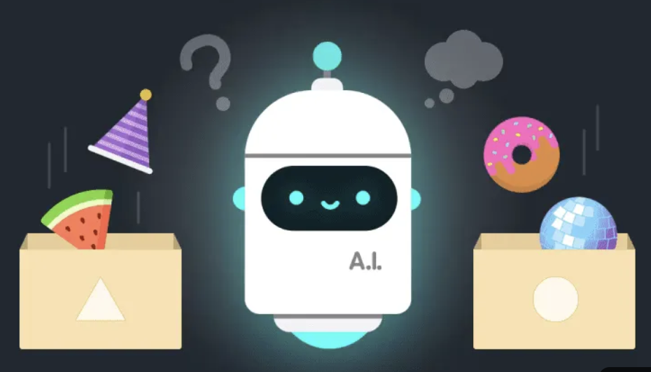
How AI Systems Work
AI Techniques Overview
Rule-Based | ML | Deep Learning
30 | 50 | 70
AI Mechanics - Page 2
Page 2 of 3
Generated by MatrixAI

Slide 4
AI Applications in Technology
AI Use Cases by Industry
Healthcare | Finance | Retail | Manufacturing
40 | 30 | 25 | 20
Real-World AI - Page 3
Page 3 of 3
Generated by MatrixAI

